Slide 1
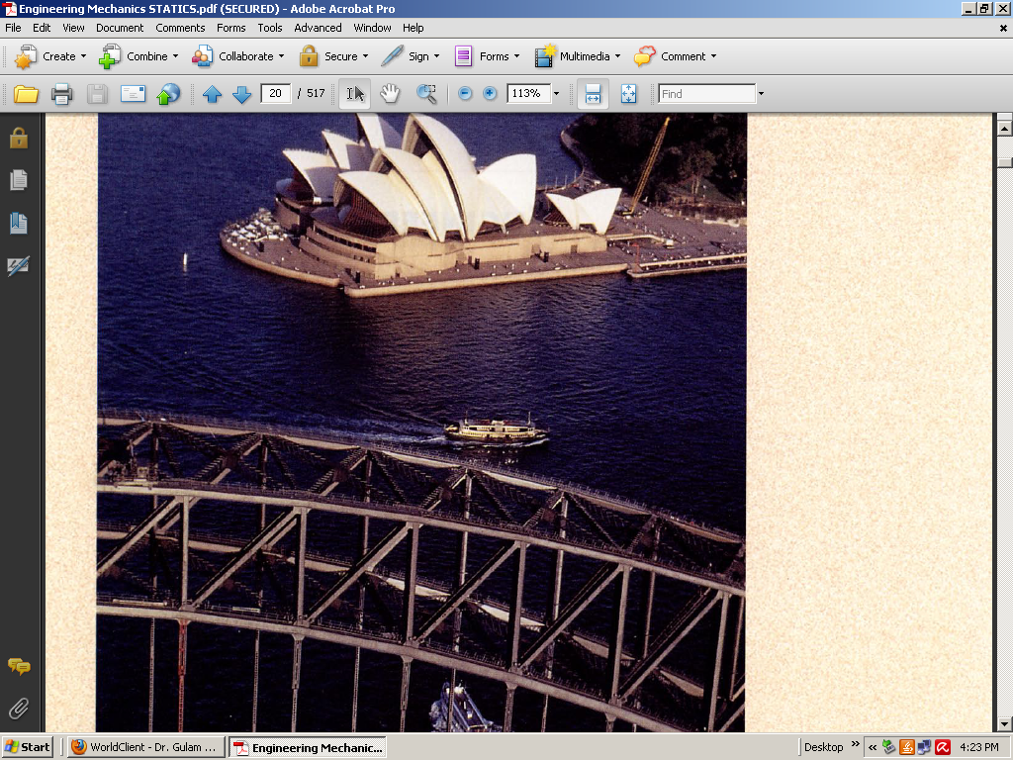

Slide 2
Chapter #1 Introduction to Statics

Slide 4
Engineering Mechanics
Physical science dealing with effects of forces
Plays greater role in engineering
Principles of mechanics are few but with wider application in engineering particularly for the research and development in the field of vibration, stability of structures and machines, robotics, rocket and spacecraft design, control, engine performance, fluid flow, electrical machines and nuclear engineering

Slide 5
We are concerned with the development and applications of principles of mechanics
These principles are based on mathematics
Mathematics required for the formulation and solution of mechanics problems
Mechanics is divided into two parts
Statics and Dynamics
Statics --- force only
Dynamics ---- force and effect -- motion

Slide 6
Basic Concepts
Space: Geometric region occupied by bodies whose positions are described by linear and angular measurements relative to a coordinate system.
Time: Measure of succession of events
Mass: Measure of inertia of body
Force: Action of a body on another one
Particle: A body of negligible dimensions
Rigid Body: A body is considered rigid when the change in distance between any two of its points is negligible for the purpose at hand.

Slide 7
Scalars and Vectors
Scalars
Scalar quantities are those with which only a magnitude is associated. Examples of scalar quantities are time, volume, density, speed, energy and mass.
Vectors
Vector quantities possess direction as well as magnitude, and must obey the parallelogram law of addition as described later in this article. Examples of vector quantities are displacement, velocity, acceleration, force, moment, and momentum.

Slide 8
Types of Vector
Free Vector
One whose action is not confined to or associated with a unique line in space.
Sliding Vector
One who has a unique line of action in space but not a unique point of application.
Fixed Vector
One for which a unique line of action and unique point of application are specified.

Slide 9
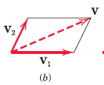
Working with Vectors
Vector sum
Law of Parallelogram
This law states that two vectors V1 and V2, treated as free vectors may be replaced by their equivalent vector V, which is the diagonal of the parallelogram formed by V1 and V2 as its two sides as shown in figure (V = V1 + V2)

Slide 10
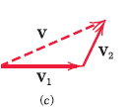
Working with Vectors
Triangular Law/ Head to tail rule
This law states that two vectors V1 and V2, treated as free vectors may also be added head-to-tail by the triangle law, as shown in figure to obtain the identical vector sum V.
V = V1 + V2

Slide 11
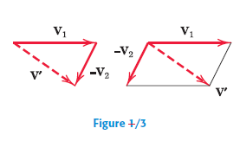
Working with Vectors
Vector difference
The difference between the two vectors V1 and V2 is easily obtained by adding V2 to V1 as shown in Figure where either the triangle or parallelogram procedure may be used.
V = V1 + (-V2)

Slide 12
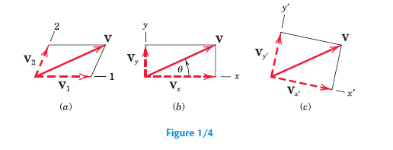
Components of Vector
Any two or more vectors whose sum equals a certain vector V are said to be the components of that vector. Thus, the vectors V1 and V2 as shown in figure are the components of V in the directions 1 and 2, respectively.
It is usually most convenient to deal with vector components which are mutually perpendicular; these are called rectangular components.

Slide 13
Unit Vector
A vector V may be expressed mathematically by multiplying its magnitude V by a vector n whose magnitude is one and whose direction coincides with that of V.
The vector n is called a unit vector
V = V n

Slide 14
Magnitude and Direction of a Vector
The direction of the vector with respect to, say, the x-axis is clearly specified by the angle , where

Slide 15
Newton’s Laws
Law I
A particle remains at rest or continues to move with uniform velocity (in a straight line with a constant speed) if there is no unbalanced force acting on it.
Law II
The acceleration of a particle is proportional to the vector sum of forces acting on it, and is in the direction of this vector sum. (F = ma)
Law III
The forces of action and reaction between interacting bodies are equal in magnitude, opposite in direction, and collinear (they lie on the same line).

Slide 16
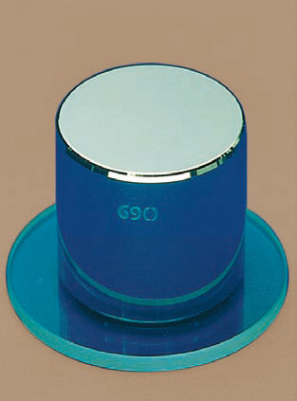
Units---- SI units, customary units
Units conversions
Primary Standards
Law of Gravitation

Slide 17
Units (SI and US Customary)

Slide 19
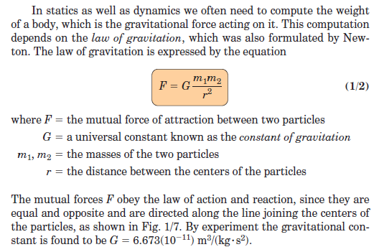
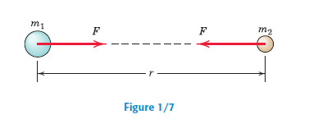
Law of Gravitation

Slide 20
Free Body Diagram
Isolate the body from all other bodies
Account all the forces acting on the body accurately
Isolation should exist mentally, presented on the paper
Diagram of such isolated body with all external forces shown acting on it, is called free body diagram
Isolation of a body is the tool for identifying cause and effect

Slide 22
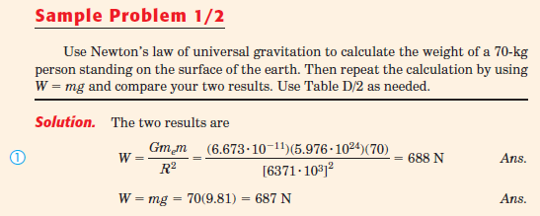
Notes:
Problem ½

Slide 23
Sample problem 1/3
Find the vector V1 and V2 shown in the figure
(a) Determine the magnitude S of their vector sum S = V1 + V2
(b) determine the angle α between S and the positive x-axis
(c) Write S as a vector in terms of the unit vectors i. and j and then write a unit vector n along the vector sum s
(d) Determine the vector difference D = V1 – V2

Slide 25
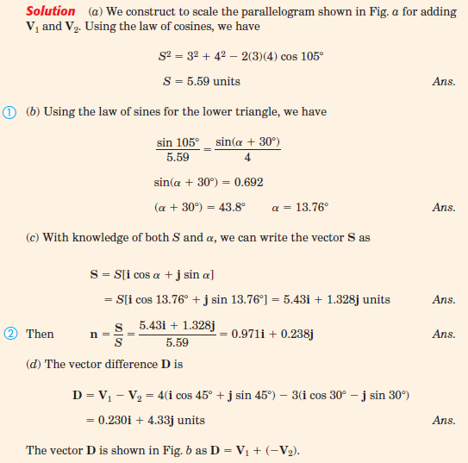

Slide 27
Assignment # 1
Problem 1/1 to Problem 1/7
Submission date: 22-03-2021

Slide 28
Thanks

