Slide 1
Introduction of Niacin
After isolation of thiamin and riboflavin from the vitamin B complex, niacin was the third B vitamin to be established.
Niacin exerts its major physiological effects through its role in the enzyme system for cell respiration.
Niacin was found to be a dietary essential for pigs, poultry, and other non ruminant animals.
The vitamin can also be considered a drug when administered at pharmacological levels.

Slide 2
History:
Niacin has been known to organic chemists since 1867.
The history of Niacin and the significance of its deficiency have been reported
Harris 1919;
McCollum 1957;
Darby et al 1975;
Hanks 1984;
Anonymous,1987;
Loosli 1991
1911 to 1913, Funk had isolated it from yeast and rice polishing in the course of an attempt to identify the water-soluble anti-beriberi vitamin.

Slide 3
Natural Resources/Occurance:
Niacin is widely distributed in foods of both plant and animal origin.
Large quantities of niacin are found in brewer’s yeast and meats.
Animal and fish by-products, distiller’s grains and yeast, various distillation and fermentation soluble,
and certain oil meals are good sources.
Leafy materials, especially pasture grass, are fair sources
Milk, dairy products, fruits, and eggs are poor sources.
Niacin is present in uncooked foods mainly as the pyridine nucleotides NAD and NADP, but some hydrolysis of these nucleotides to free forms may occur during food preparation.

Slide 5
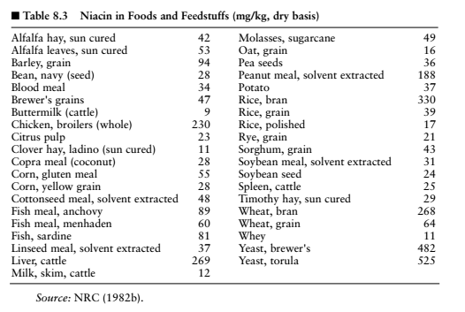

Slide 6
But interest in Niacin was lost when it was found ineffective in curing pigeons of beriberi. Cure were very effective when they were administrated with Thiamin vitamin(anti beriberi).

Slide 7
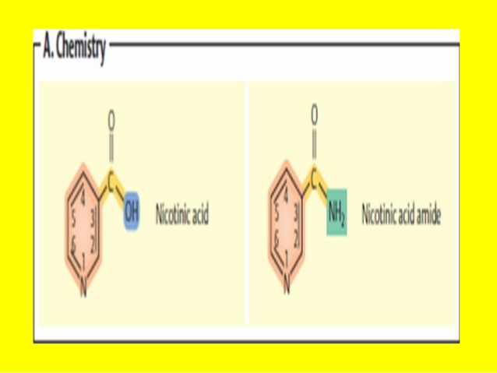
Chemical Properties:
Chemically, niacin (C6H5O2N) is one of the simplest vitamins. The two forms of niacin >Nicotinic acid and Nicotinamide correspond to 3-pyridine carboxylic acid and its amide.

Slide 8
These compounds have the basic pyridine structure, with two of the important antagonists of nicotinic acid being 3-acetyl pyridine and pyridine sulfonic acid.
Nicotinamide functions as a component of two coenzymes: Nicotinamide adenine Dinucleotide (NAD) and Nicotinamide adenine Dinucleotide phosphate (NADP).
Both Nicotinic acid and Nicotinamide are white, odorless, crystalline solids soluble in water and alcohol.
Also resistant to heat air light and are stable in food.
It is stable in usual oxidizing agent but sometime it undergo decorboxylation at high temperature in alkaline medium.

Slide 9
It forms salts when combine with metals Al, Ca, Cu, and Na.
In acidic solution it form quaternary ammonium compounds such as Nicotinic acid hydrochloride which is soluble in water.
When in a basic solution, Nicotinic acid readily forms carboxylic acid salts.

Slide 10
Chemical Structure

Slide 11
Metabolism of Niacin
Absorption, Transportation and storage:
Nicotinic acid and its amide are absorbed by diffusion at physiological or pharmacological doses.
At low concentration absorption occur as an Na+ depended facilitated diffusion.
Employing GIT tube technique it was observed that Niacin absorbed by both stomach and small intestine in human.
In cattle studies, Nicotinamide was more rapidly absorbed from the rumen than nicotinic acid (Erickson et al., 1991).
Niacin in food mostly occur in its co enzyme form which hydrolyzed during digestion and no need of further hydrolysis in GIT.

Slide 12
The intestinal mucosa is rich in niacin conversion enzymes such as NAD glycohydrolase.
Nicotinamide is released from NAD in the liver and intestines by glycohydrolase for transport to tissues that synthesize NAD as needed.
The tissue contents of Niacin and its analogs is vary according to Age,Sex, Specie and treatment of animals.
Niacin coenzymes are widely distributed in the body, no true storage occurs.
Liver contains the greatest niacin concentration, but the amount stored is not great.

Slide 13
Excretion:
Urine is the primary pathway of excretion of absorbed niacin and its metabolites.
The principal excretory product in humans, dogs, rats, and pigs is the methylated metabolite N′-methylnicotinamide.
In herbivores niacin doesn’t seem to metabolized by methylation. Large amount secreted unchanged.
In the chicken, however, nicotinic acid is conjugated with ornithine as either α- or δ- nicotinyl ornithine or dinicotinyl ornithine.
The kinds and relative amounts of these products vary with the species and level of niacin intake.

Slide 14
Function:
The major function of niacin is in the coenzyme forms of Nicotinamide, NAD and NADP which contains enzymes that are associated with several reaction with carbohydrates protein and lipids metabolism.
Essentially important in metabolic reaction gives energy to animals.
The coenzymes act as an intermediate in most of the H+ transfers in metabolism.

Slide 15
Important metabolic reactions catalyzed by NAD and NADP are summarized below:
Carbohydrate metabolism
(a) glycolysis (anaerobic oxidation of glucose) and (b) the Krebs cycle.
2. Lipid metabolism—
(a) glycerol synthesis and breakdown, (b) fatty acid oxidation and synthesis, and (c) steroid synthesis
3.Protein metabolism—
(a) degradation and synthesis of amino acids and (b) oxidation of carbon chains via the Krebs cycle.
4. Photosynthesis.
5. Rhodopsin synthesis

Slide 16
Requirements:

Slide 17
Factor affecting Niacin requirement in ruminants:
Niacin requirements of ruminants are unknown; the vitamin is normally synthesized in adequate quantities in the rumen.
Protein balance —excess of leucine, arginine, and glycine increases the requirement.
High tryptophan content of feeds —as tryptophan content increases, niacin requirements decrease.
Energy content —high-energy rations require more niacin per unit of feed.
Antibiotics —depending on the product, niacin requirements are increased.
Dietary rancidity —if fat is rancid, niacin requirements are increased.
Gastrointestinal synthesis —niacin is synthesized in the gastric and intestinal regions.
Availability of niacin and tryptophan in feedstuffs —cereal grains and other feedstuffs have varying degrees of niacin and tryptophan availability

Slide 18
Deficiency of Niacin:
Niacin deficiency is characterized by severe metabolic disorders in the skin and digestive organs.
The first signs to appear are loss of appetite, retarded growth, weakness, digestive disorders, and diarrhea.
we will study deficiency in only ruminants small ruminant and poultry.

Slide 19
In Ruminants:
Young ruminant were think that they can withstand with deficiency of niacin
Dietary requirement of niacin for young ruminants does not exist as long as the level of tryptophan is maintained near 0.2% of the diet. In calves, a diet free of niacin and low in tryptophan produced deficiency signs of sudden anorexia, severe diarrhea, inability to stand, and dehydration, followed by sudden death.
Supplementation with 2.6 mg of nicotinic acid per liter of milk offered adlibitum twice daily prevented the deficiency of niacin

Slide 20
In Beef Cattle:
The addition of niacin to beef cattle diets has been shown to significantly improve average daily gain and feed efficiency. Feeder calves responded positively in rate and efficiency of gain in the 29-day adaptation study by gaining an additional 8.3 kg with 70 ppm added niacin.
Studies indicate that 50 or 100 ppm of niacin is more effective than higher levels of 150, 250, or 500 ppm, with respect to gain.
Niacin appears to be effective in enhancing acclimation and adaptation to urea-supplemented diets and it stimulates the microbial protein production.

Slide 21
In Dairy cow:
Adequate amount in rumen to meet the dairy need of cow.
he effect of niacin on milk production and composition has been found to be variable, but it appears that niacin (5 to 6 g per cow per day) may have a beneficial effect on milk production early in the lactation period and when given to ketotic(An abnormal increase of ketone bodies in the blood as in diabetes mellitus) cows.
Daily Niacin supplementation of 3 to 6 g in early lactation dairy cows resulted in slight increases in milk production.

Slide 22
In Lambs:
Mizwicki et al. (1975) observed that 500 ppm of supplemental niacin improved feed efficiency of lambs fed a high-concentrate diet containing urea.
Studies shows that growing and finishing lambs performance was increases. These studies gives 4 points.
Increase Nitrogen utilization
Improved the percentage of absorbed nitrogen retained.
Reduced urinary nitrogen excretion
Reduced the percentage of nitrogen found as urea nitrogen.
All these positive changes point toward improved protein metabolism

Slide 23
In Poultry:
There is good evidence that poultry even chick and turkey embryos are able to synthesize niacin, but that rate of synthesis may be too slow for optimal growth.
It has been marked that before the deficiency of niacin deficiency of tryptophan has occur.
Niacin deficiency in the chick is characterized by appetite loss and growth failure. The deficiency results in black tongue, a condition characterized by inflammation of the tongue and mouth cavity.
Turkey poults, pheasant chicks, ducklings, and goslings all expressed perosis as the primary niacin deficiency signs.
Goslings fed purified rations develop perosis and hock deformities that are preventable with administration of nicotinic acid

Slide 24
Deficiency in Poultry:

Slide 25
Deficiency in Turkeys:

Slide 26
Deficiency in Rabbits:
Substantial synthesis of niacin occurs in the intestinal tract of rabbits fed niacin-deficient diets.
Niacin deficiency in rabbits has resulted in pronounced loss of appetite, followed by emaciation and diarrhea(NRC, 1977).

Slide 27
Toxicity
Harmful effects of niacin occur at levels far in excess of requirements.
Non ruminant animals can tolerate oral exposures of at least 10 to 20 times their normal requirements.
Limited research indicates that nicotinic acid and Nicotinamide are toxic at dietary intakes greater than about 350 mg/kg of body weight per day (NRC, 1987).
Short-term intravenous administration of niacin at a dose of 2.5 g/kg was needed before 50% of test mice died.
High levels of nicotinic acid, such as 3 g/day in humans, can cause vasodilation, itching, heat sensation, nausea, vomiting, headache, and skin lesions.
In dogs, oral administration of 2 g of nicotinic acid per day (133 to 145 mg/kg of body weight) produced bloody feces in a few dogs, followed by convulsions and death (NRC, 1987)

Slide 28
Bioavailability of Niacin
Nicotinamide:
NM is readily bioavailable and is effective in preventing the classical signs of niacin deficiency (pellagra).
Female college students were administered 51 mg of NM, of which 52% was excreted as urinary metabolites.26 NM is not sufficiently converted to NA to produce either the undesirable flushing effect or the beneficial changes in plasma lipid

Slide 29
Nicotinic acid:
Intestinal uptakes of NA are rapid and nearly stoichiometric,2 i.e., bolus doses of up to 3–4 g NA are almost completely absorbed by adults.10 Once absorbed in the intestine, 15–30% of the plasma NA is bound to protein.
Effect may occur when intakes exceed 50 mg/day.The beneficial effects on serum lipid profiles occur at much higher levels of intake (500–3,000 mg/day)

