Slide 1
Trigonometry BS Education-V Teaching Mathematics (EDU-511)
Department of Education University of Sargodha

Slide 2
UNIVERSITY OF SARGODHA
Presented by:-
Hina Gul( BEUF18M040)
BS- Education 5th

Slide 4
Trignometery
The word trignometry has been derived from a Greek word whose meaning is measurements of triangle It is a branch of mathematics which deals with the solution of triangle. Solution of a triangle means to find three sides and angles.
There are six functions of an angle commonly used in trrignometery . Their names and abbreviations are
Sin (Sine) , Cosine (Cos), Tangent( Tan), Cotangent (Cot), Secant(Sec) and Cosecant( Csc )
These six trigonometric functions in relation to a right triangle are displayed in the figure.

Slide 5
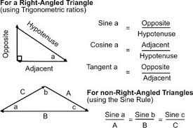
.
Right Angle Triangle:- A right triangle or right-angled triangle is a triangle in which one angle is a right angle . The relation between the sides and angles of a right triangle is the basis for trigonometry. The side opposite the right angle is called the hypotenuse, the side in front of the given angleθ will be called perpendicular and the side between given angle and 90 will be the adjacent of triangle

Slide 7
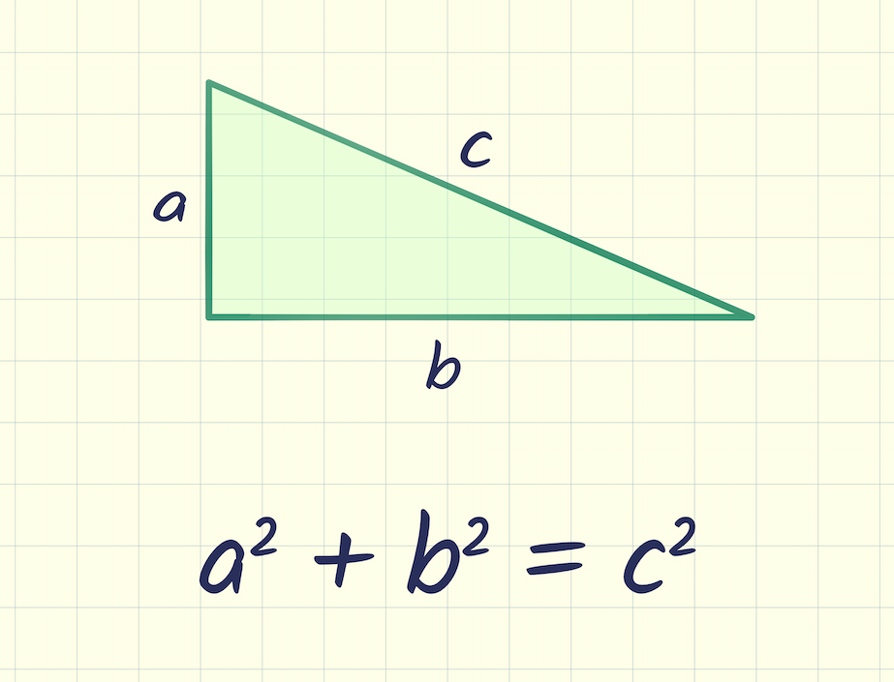
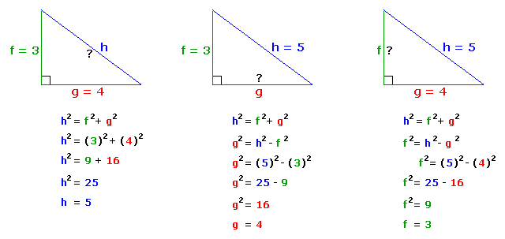
Pythagoras’ Theorem :
In the figure:- a² + b² = c²
In any right triangle, the area of the square whose side is the hypotenuse is equal to the sum of areas of the squares whose sides are the two legs.

Slide 13
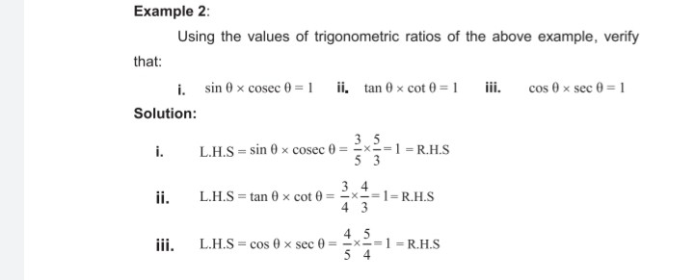

Slide 14
MCq’s
1. The value of cos 0°. cos 1°. cos 2°. cos 3°… cos 89° cos 90° is
(a) 1
(b) -1
(c) 0
(d) 12√
2. If x tan 45° sin 30° = cos 30° tan 30°, then x is equal to
(a) √3
(b) 12
(c) 12√
(d) 1
3. If x and y are complementary angles, then
(a) sin x = sin y
(b) tan x = tan y
(c) cos x = cos y
(d) sec x = cosec y

Slide 15
4. sin 2B = 2 sin B is true when B is equal to (a) 90° (b) 60° (c) 30° (d) 0°
5. In ∆ ABC, right-angled at B, AB = 24 cm, BC = 7 cm. The value of tan C is:
(a)12/7
(b)24/7
(c)20/7
(d)7/2
6. (Sin 30°+cos 60°)-(sin 60° + cos 30°) is equal to:
(a)0
(b)1+2√3
(c)1-√3
(d)1+√3
ANSWERS:-
1. C 2. d 3. d 4. d 5. b 6.c

Slide 16
REFRENCES:-
https://www.google.com/search?q=mcq+on+trigonometry+for+class+10&rlz=1C1CHBF_enPK839PK839&oq=&aqs=chrome.1.69i59l8.5707020j0j15&sourceid=chrome&ie=UTF-8#
https://www.learncbse.in/mcq-questions-for-class-10-maths-introduction-to-trigonometry-with-answers/
https://www.slideshare.net/201127223/trigonometry-presentation-32096288
https://www.slideshare.net/PrashantDwivedi14/introduction-of-trigonometry

Slide 17
THANK YOU

