Slide 1
Melon
Prof. Dr. Sarfraz Hussain

Slide 2
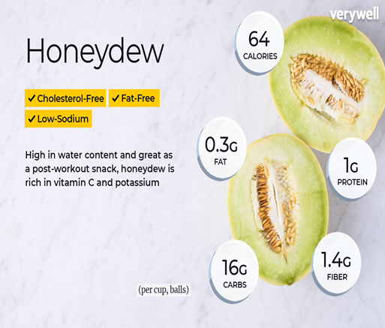
Melon
The scientific name of melon is cucumis melo
A melon is any of various plants of the family Cucurbitaceae with sweet edible, fleshy fruit. The word "melon" can refer to either the plant or specifically to the fruit

Slide 3
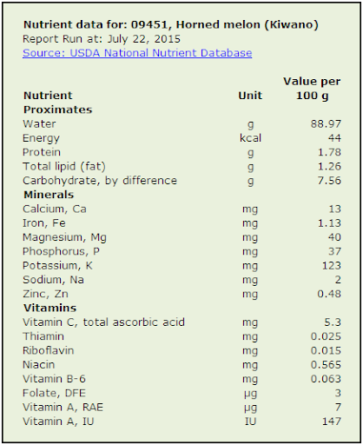

Slide 4
Quality Characteristics
Melons must have sufficient maturity to ensure completion of ripening, sufficient firmness (not soft or wilted),shape and netting characteristic for their type, a stem scar not wet and slippery (wet slip), no sunscald (solar injury), flesh and rind free of decay by fungi or bacteria, and absence of damage

Slide 5
Damage and decay
liquid in the seed cavity, hail injury, surface mold, aphid honeydew, scars, cracks, ground spot rind disorders, bruises, and mechanical damage.

Slide 6
Maturity indices
Stem separation and background rind color are used to indicate acceptable maturity for harvest. As netted melons begin to ripen, a separation layer, or abscission zone, develops at the point where the stem attaches to the fruit
commercially harvested when half of the stem has separated from the melon
If picked at proper maturity, netted melons will continue to soften and become more aromatic after harvest

Slide 7
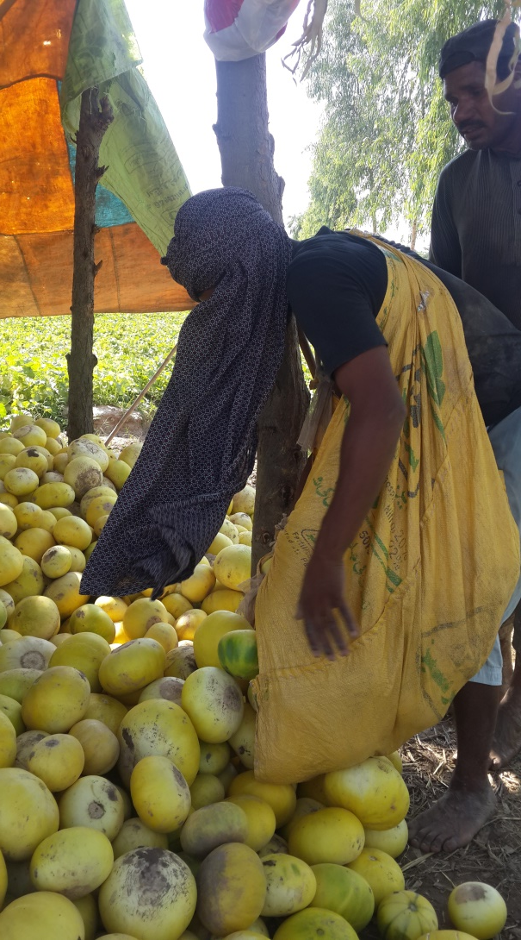
Field collection

Slide 8
Pre cooling
Precooling to a fruit center temperature of 10
to 15 °C (50 to 59 °F) soon after harvest is recommended to delay ripening and retain sugar content. Hydro cooling, forced-air cooling, and top-icing are acceptable, but hydro cooling is most efficient

Slide 9
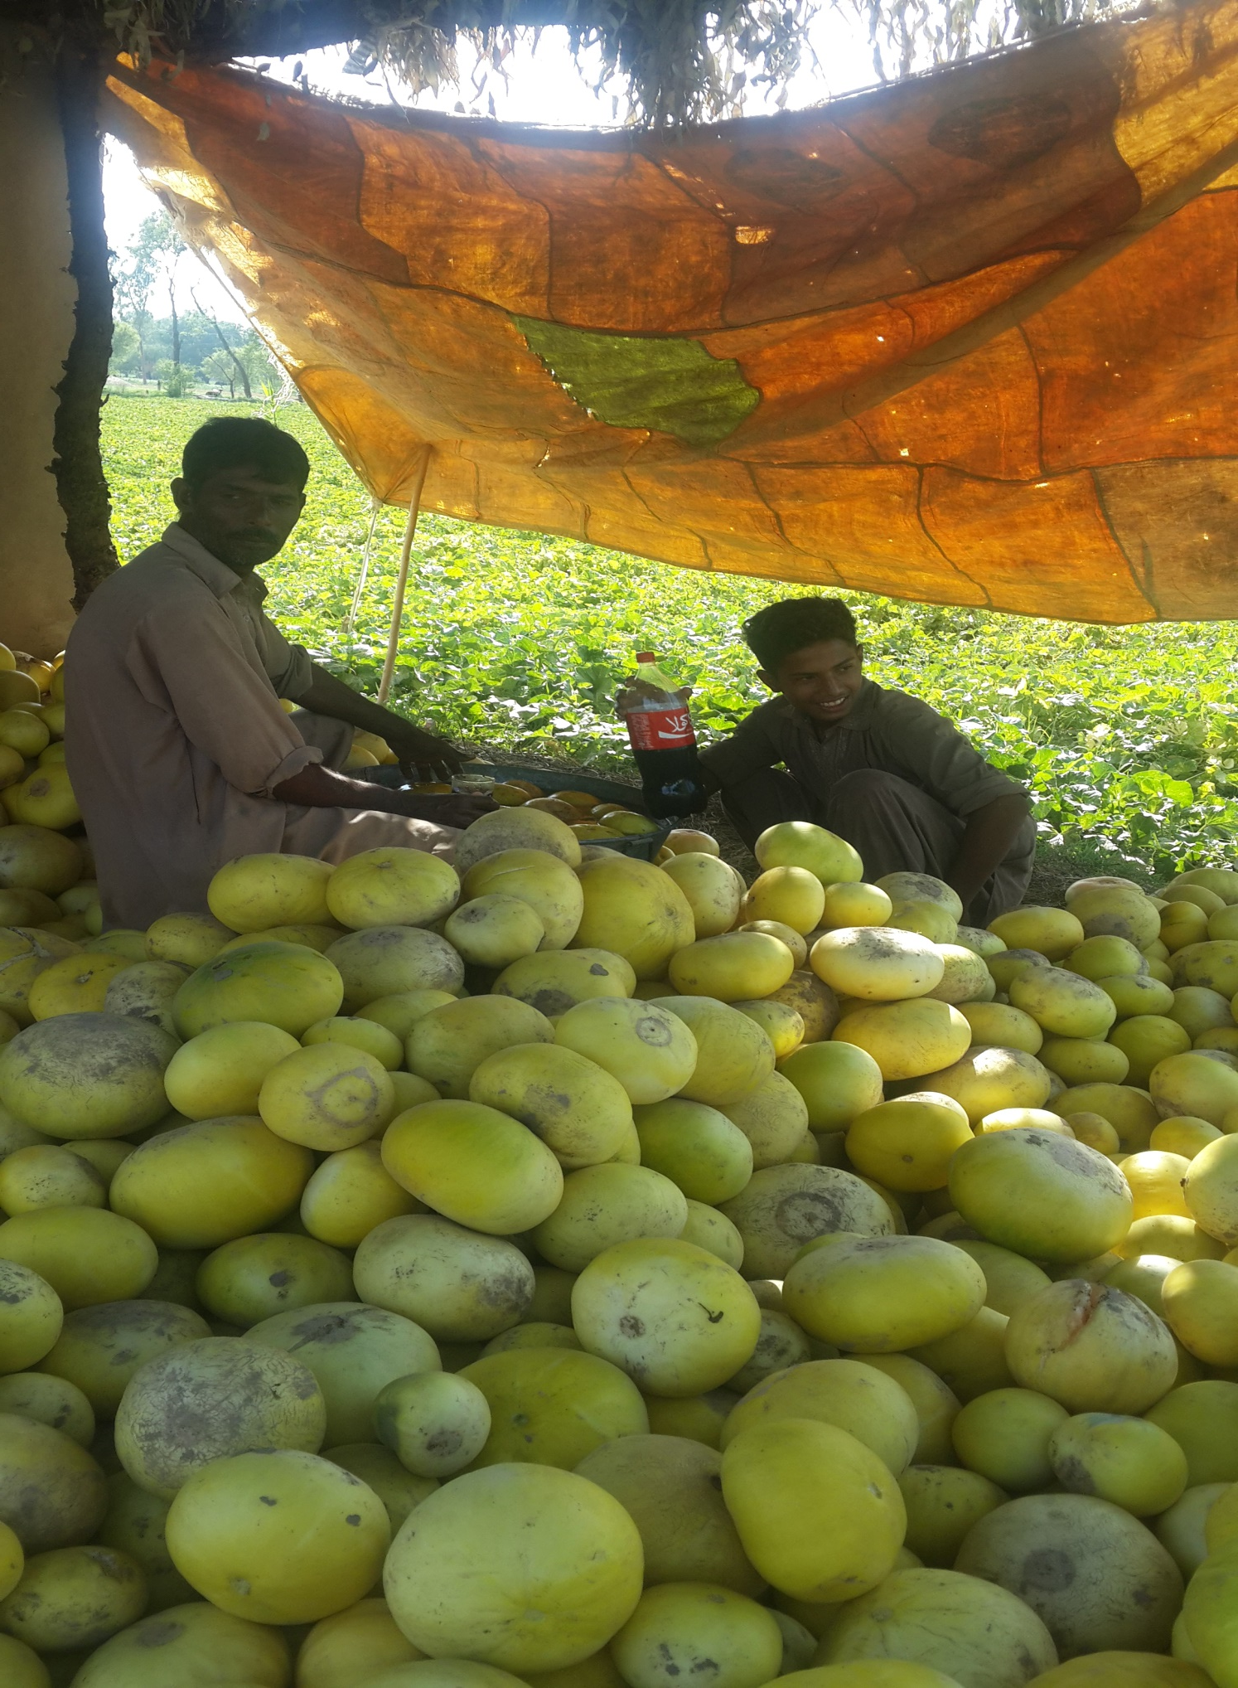
Field washing

Slide 10
Optimum Storage Conditions
Optimum is 2 to 7 °C (36 to 45 °F) with 95% RH
The expected shelf-life at these recommended conditions is 10 to 14 days.
Chilling Sensitivity
Sensitivity decreases as fruit mature. Full-slip, netted melons may be stored for 5 to 14 days at 0 to 2 °C (32 to 36 °F). Less mature melons may be damaged by storage at <2 °C (36 °F).
Injury symptoms include pitting, surface decay, and failure to ripen

Slide 11
Controlled Atmosphere Considerations
CA in transit or storage has some potential for extending shelf-life.
The recommended level of O₂ is 3 to 5% for reducing respiration and ethylene production
The recommended level of CO₂ is 10 to 20% for reducing loss of sugar and inhibiting surface mold
Storage in an atmosphere containing>10% CO₂ may result in a carbonated taste that is lost during subsequent storage in air. Off flavors, odors, and impaired ripening may develop if melons are stored in <1% O₂ or >20% CO₂

Slide 12
Ethylene Production and Sensitivity
Melons are climacteric fruit that produce 10 to 100 µL kg-1 h-1 ethylene from 4 days prior to stem separation to as late as 10 days after harvest
Postharvest exposure to ethylene reduces shelf-life and should be avoided
Exogenous ethylene application after harvest will not ripen melons harvested prematurely, nor will it prevent normal postharvest decline in SSC.
Retail Outlet Display Considerations
The shelf-life of netted melons can be maximized by storage under refrigeration and by avoiding postharvest exposure to ethylene

Slide 13
Physiological Disorders
Solar injury causes patchy ground color, or “bronzing,” and net discoloration. Severely injured tissue becomes sunken or wrinkled
Vein track browning, a darkening of the longitudinal tracts between netted areas, is caused by exposure to sun or high temperature at harvest
Netted melons are easily injured and should never be dropped more than 60 cm (2 ft)
Harvest and packing equipment should be padded to reduce scuffing of netting
Avoidance of wounding during handling (compression, bruising, or scuffing) and storage under recommended conditions provides protection against physical injury and decay.

Slide 14
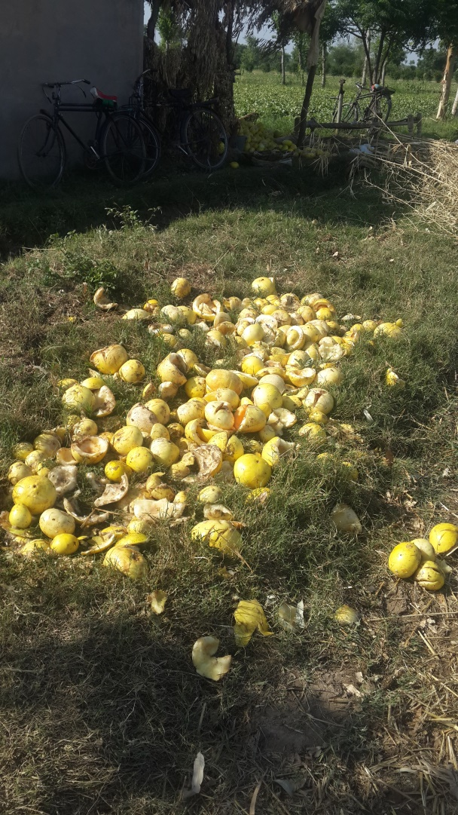
Wastage

Slide 15
Transportation
Melon transportation is done in the baskets of mulberry shoots
Avoid direct loading of the fruit as it becomes the higher risk of mechanical damage

