Slide 1
Lecture 4
Introduction of PM Tools, PMI‘s Knowledge Areas, Technical Fundamentals in SPM, Lifecycle Relationships, Classic Mistakes Product-Process-Peoples-Technology Mistakes PMI Framework, PMI Process Groups: Process Initiating Process Group, Planning Process Process Group, Executing Process, Process Monitoring and controlling, Closing Process Group, Project Charter, Statement of Work

Slide 2
PM Tools: Software
Low-end
– Basic features, tasks management, charting
– MS Excel
Mid-market
– Handle larger projects, multiple projects, analysis tools
– MS Project (approx. 50% of market)
High-end
– Very large projects, specialized needs, enterprise
– AMS Realtime (Adv Mngt Solution)

Slide 3
Project Management Institute
PMI stands for the Project Management Institute, and is a not-for-profit professional membership association for project managers and program managers. PMI was started in 1969, and now has a membership of more than 2.9 million professionals around the globe.
.The Project Management Institute is the organization that gives out the PMP (Project Management Professional) credential, a globally recognized certificate that assures employers that a person is trained and qualified to manage projects.

Slide 4
PMI’s 9 Knowledge Areas
• Project integration management
• Scope
• Time
• Cost
• Quality
• Human resource
• Communications
• Risk
• Procurement

Slide 5
Four Project Dimensions
People
Process
Product
Technology

Slide 6
Classic Mistakes
– People-Related
– Process-Related
– Product-Related
– Technology-Related

Slide 7
People-Related Mistakes Part 1
• Undermined motivation
• Weak personnel
• Uncontrolled problem employees
• Adding people to a late project

Slide 8
Noisy, crowded offices
Customer-Developer friction
(Customer friction is anything that impedes your customer from moving through the marketing and sales funnels to buy your goods or services, or pushes them away from wanting to buy from you again.)
Unrealistic expectations
Politics over substance (a particular kind of matter)
Wishful thinking
Lack of effective project sponsorship
Lack of stakeholder buy-in(agreement to do something, even though the person agreeing didn't have anything to do with the project beforehand.)

Slide 9
Process-Related Mistakes Part 1
Optimistic schedules
Insufficient risk management
Contractor failure
Insufficient planning
Abandonment of plan under pressure
Wasted time during fuzzy front end
Shortchanged upstream activities
Inadequate design
Shortchanged quality assurance

Slide 10
• Insufficient management controls
• Omitting necessary tasks from estimates
• Planning to catch-up later
• Code-like-hell programming

Slide 11
Product-Related Mistakes
• Requirements gold-plating (Gold plating refers to adding the extra features that were not part of the product scope)
Gilding the lily (to attempt to improve something that is already fine the way it is)
• Feature creep (is a tendency for product or project requirements to increase during development beyond those originally foreseen.)
• Developer gold-plating (after having met the requirements, the project manager or the developer works on further enhancing the product)
• Push-me, pull-me negotiation (Some managers approve a schedule slip on a project that is progressing more slowly than expected and then add in additional new tasks after the schedule change to make the schedule wrong again
• Research-oriented development

Slide 12
Technology-Related Mistakes
• Silver-bullet syndrome (is the belief that the next big change in tools, resources or procedures will miraculously or magically solve all of an organization's problems)
• Overestimated savings from new tools and methods
• Switching tools in mid-project
• Lack of automated source-code control

Slide 13
The Five Traditional Process Groups

Slide 14
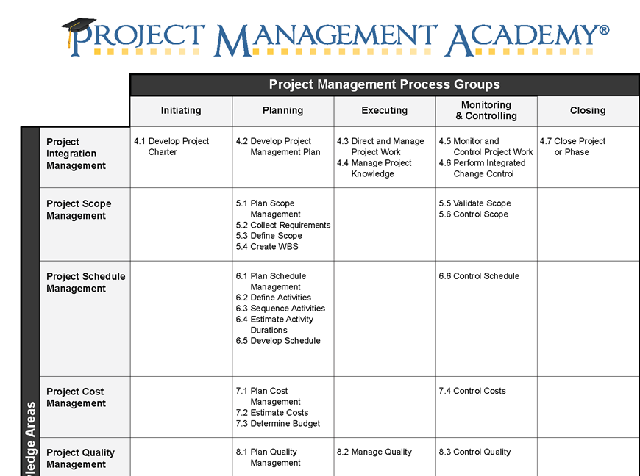

Slide 15
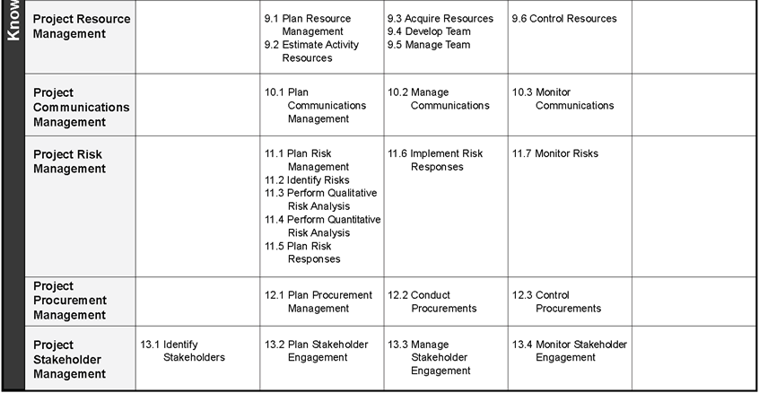

Slide 16
Project Pre-initiation
It is good practice to lay the groundwork for a project before it officially starts
Senior managers often perform several pre-initiation tasks, including the following:
Determine the scope, time, and cost constraints for the project
Identify the project sponsor
Select the project manager
Develop a business case for a project (see Table 3-2 for an example)
Meet with the project manager to review the process and expectations for managing the project
Determine if the project should be divided into two or more smaller projects

Slide 17
Project Planning
The main purpose of project planning is to guide execution
Every knowledge area includes planning information (see Table 3-7 on pages 98-99)
Key outputs included in the JWD project include:
A team contract
A project scope statement
A work breakdown structure (WBS)
A project schedule, in the form of a Gantt chart with all dependencies and resources entered
A list of prioritized risks (part of a risk register)
See sample documents starting on p. 101

Slide 18
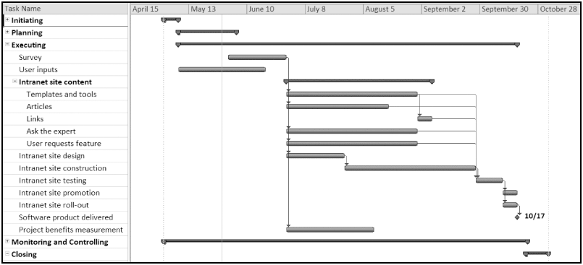
Figure 3-4. JWD Consulting Intranet Site Project Baseline Gantt Chart

Slide 19
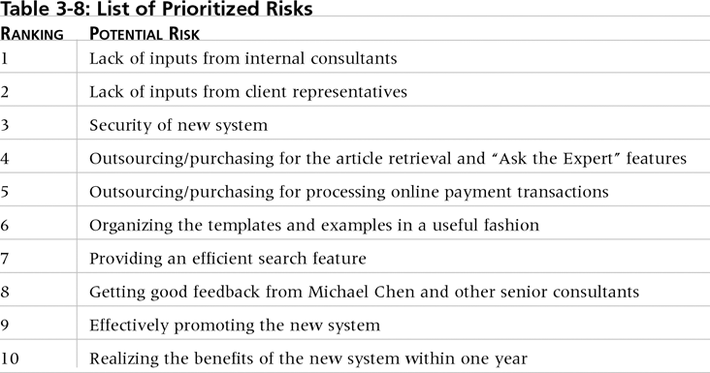
Table. 3-10. List of Prioritized Risks

Slide 20
Project Executing
Usually takes the most time and resources to perform project execution
Project managers must use their leadership skills to handle the many challenges that occur during project execution
Table 3-11 lists the executing processes and outputs. Many project sponsors and customers focus on deliverables related to providing the products, services, or results desired from the project
A milestone report can help focus on completing major milestones

Slide 21
Part of Milestone Report (Table 3-12, partial)

Slide 22
Project Monitoring and Controlling
Involves measuring progress toward project objectives, monitoring deviation from the plan, and taking correction actions
Affects all other process groups and occurs during all phases of the project life cycle
Outputs include performance reports, change requests, and updates to various plans
See Table 3-13

Slide 23
Project Closing
Involves gaining stakeholder and customer acceptance of the final products and services
Even if projects are not completed, they should be closed out to learn from the past
Outputs include project files and lessons-learned reports, part of organizational process assets
Most projects also include a final report and presentation to the sponsor/senior management

Slide 24
What is a Project Charter in Project Management?
What is a project charter in project management?
A project charter is a formal, typically short document that describes your project in its entirety — including what the objectives are, how it will be carried out, and who the stakeholders are. It is a crucial ingredient in planning out the project because it is used throughout the project lifecycle.

Slide 25
The project charter typically documents:
Reasons for the project
Objectives and constraints of the project
Who the main stakeholders are
Risks identified
Benefits of the project
General overview of the budget

Slide 26
How to Create a Project Charter
Understand project goals and objectives. Identify the project vision and determine the scope of the project
Define project organization. List all of the essential roles for the project, including customers, stakeholders, and day-to-day project team.
Create an implementation plan. Outline major milestones, dependencies and timeline for the entire team and stakeholders.
List potential problem areas. No one wants to be a downer, but adding potential risks and issues to the project charter helps everyone think ahead should the worst happen.

Slide 27
Statement of Work:
The SoW is the document that captures and defines all aspects of your project. You’ll note the activities, deliverables and the timetable for the project. It’s an extremely detailed document as it will lay the groundwork for the project plan.

