Slide 1
Week 7

Slide 2
Lecture Contents
Explain the bounded-buffer synchronization problem
Explain the readers-writers synchronization problem
Explain and dining-philosophers synchronization problems

Slide 3
Lecture Objectives
Demonstrate classical synchronization problems and their solutions using Semaphores

Slide 4
Producer Consumer Problem
• Bounded Buffer Problem
• Unbounded Buffer Problem

Slide 5
Producer – Consumer Bounded Buffer
init(mutex,1); init(full,0); init(empty, N);
in = 0; out = 0; buffer[N] ;
Producer
Consumer
while(TRUE)
{
x = produce();
while(TRUE)
{
append(x)
{
b[in] = x;
in = (in+1) mod N;
}
wait(full);
wait(empty);
wait(mutex);
wait(mutex);
y = take();
take()
{
y = b[out];
out = (out+1) mod N;
return y;
}
append(x);
signal(mutex);
signal(mutex);
signal(empty);
signal(full);
consume(y);
}
}
• Bounded buffer:
– Bufferlimited to N places, is managed as a circular buffer

Slide 6
Deadlock Situation
• The sequence of signal() call can be arbitrary
• The sequence of wait() calls is essential
while(TRUE)
{
x = new_data();
while(TRUE)
{
wait(mutex);
wait(empty);
WRONG !!
wait(full);
wait(mutex);
y = take();
append(x);
signal(mutex);
signal(mutex);
signal(empty);
signal(full);
consume(y);
}
}

Slide 7
Reader­WriterProblem
Readers have Priority
• Reader processes share the following controlling data
structures
– Mutex Semaphores: mutex,W
– rCount: counts readers
• Readers share mutex semaphore W with writers
– Acts as amutual exclusion semaphore for readers and
writers
– Manipulated by the first or last reader when they enter /
exit critical section
• Blocking by first Reader, unblocking by last Reader, all other
readers are not manipulating semaphore W
• Readers share semaphore mutex to allow exclusive
manipulation of rCount

Slide 8
Reader­WriterProblem
Shared Read Access, Reader­Priority
init(mutex,1); init(W,1);
Global Variables
Reader
rCount = 0; // counts the readers
Writer
while(TRUE)
{
while(TRUE)
{
wait(mutex);
wait(W);
rCount ++;
if(rCount == 1)
write();
wait(W);
signal(W);
signal(mutex);
}
read();
• Semaphore W checks whether the
wait(mutex);
writer is in critical section
• Semaphore ‘mutex’ protects
rCount --;
if(rCount == 0)
signal(W);
increment / decrement of rCount
signal(mutex);
• Readershave priority, writer has to
}
wait until there is no reader

Slide 9
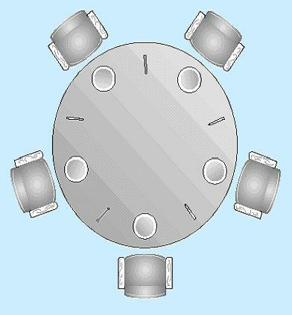
Dining Philosophers Problem
• Five philosophers sit arounda table for dinner
• There are only 5 forks on the table, two neighbouring
philosophers share one fork
Philosopher:
while(TRUE) {
Think();
Grab first fork;
Grab second fork;
Eat();
Put down first fork;
Put down second fork;
}
• Each philosopher needs two forks to eat
– How many of them can eat at the same time?

Slide 10
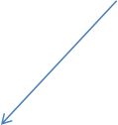
Dining Philosophers Problem
• First attempt
Semaphore fork[5] = {1,1,1,1,1};
–One process per
philosopher
Wait for left fork
Process i
Wait for right
fork
–One semaphore per
while(TRUE)
{
think();
fork
–Each semaphore
initialised to 1
wait(fork[i]);
• Leads to deadlock,if
wait(fork[(i+1) mod 5]);
all philosophers grab
their left fork
–Will wait forever for a
eat();
signal(fork[(i+1) mod 5]);
signal(fork[i]);
right fork to become
available!
}

Slide 11
Lecture Material
Slides of chapter 7 can be found from the given link
https://codex.cs.yale.edu/avi/os-book/OS10/slide-dir/index.html

