Slide 1
COLLEGE OF ENGINEERING AND TECHNOLOGY UNIVERSITY OF SARGODHA STEEL STRUCTURES (CT-313) (B.S TECHNOLOGY)
LECTURE- 7, 8 & 9
Design Philosophies
Engineer Aqeel Ahmed
Lecturer, CET, UOS, Sargodha
30-Oct-2020

Slide 2
DESIGN PHILOSOPHIES
As discussed earlier, the design of a structural member entails the selection of a cross-section that will safely and economically resist the applied loads.
Economy usually means minimum weight that is the minimum amount of steel, which corresponds to the cross section with the smallest weight per foot, which is the one with the smallest cross sectional area.
Although other considerations such as ease of construction may ultimately affect the choice of member size, the process begins with the selection of the lightest cross sectional shape that will do the job.
Having established this objective, the engineer must decide how to do it safely, which is where different to design come into play.

Slide 4
ALLOWABLE STRENGTH DESIGN (ASD)
In this method, a member is selected that has cross-sectional properties such as area and moment of inertia that are large enough to prevent the maximum applied axial force, shear or bending moment from exceeding an allowable or permissible value.
This allowable value is obtained by dividing the nominal or theoretical strength by a favor of safety. This can be expressed as
required strength < allowable strength ……………… (A)
Where,
allowable strength = $\frac{nominal strength}{safety factor}$
Strength can be an axial force strength (as in tension or compression members), flexural strength (moment strength) or a shear strength.
If stresses are used instead of forces or moments the relationship of equation ------ (A) becomes
maximum applied stress < allowable stress
This approach is called allowable stress design. The allowable stress will be in the elastic range of material (See Figure-1.3 in next slide). This approach to design also called elastic design or working stress design.
Working stresses are those resulting from the working loads, which are the applied loads. Working loads are also known as service loads.

Slide 5
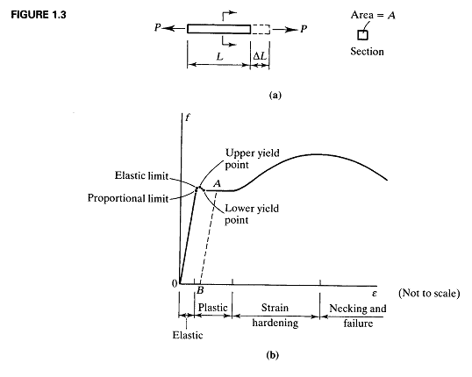

Slide 9
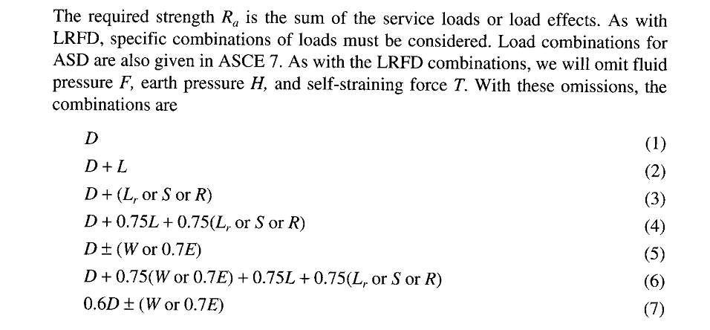

Slide 11
PLASTIC DESIGN
Plastic design is based on a consideration of failure conditions rather than working load conditions.
A member is selected by using the criterion that the structure will fail at a load substantially higher than the working loads. Failure in this context means either collapse or extremely large deformations.
The term plastic is used because at failure parts of the member will be subjected to very large strains – large enough to put the member into plastic range.
When the entire cross sections becomes plastic at enough locations, “Plastic Hinges” will form at those locations creating a collapse mechanism.
As the actual loads will be less than the failure loads by a factor of safety known as the load factor, members designed this way are safe designed being designed based on what happens at failure.

Slide 12
PLASTIC DESIGN-----------
This design procedure is roughly as follows:-
Multiply the working loads (service loads) by the load factor to obtain the failure loads.
Determine the cross sectional properties needed to resist failure under these loads. (A member with these is said to have sufficient strength and would be at the verge of failure when subjected to the factored loads).
Select the lightest cross section that has these properties.
Members designed by plastic theory would reach the point of failure under the factored loads but are safe under actual working loads.

Slide 14
LOAD AND RESISTANCE FACTOR DESIGN (LRFD)-------------
The factored load is a failure load greater than the total actual service load, so the load factors are usually greater than the unity.
However, the factored strength is reduced, useable strength and the resistance factor is usually less than unity.
The factored loads are the load that bring the structure or member to its limit.
In terms of safety, this limit state can be fracture, yielding, or buckling and the factored resistance is the useful strength of the member, reduced from the theoretical value by the resistance factor.
The limit state can also be one of the serviceability such as maximum acceptable deflection.

Slide 19
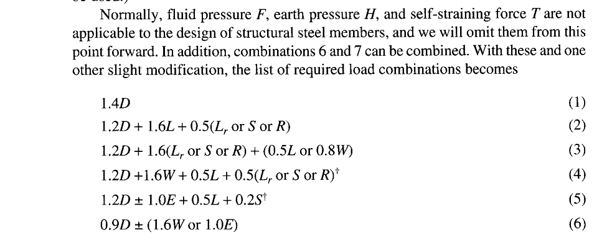

Slide 26
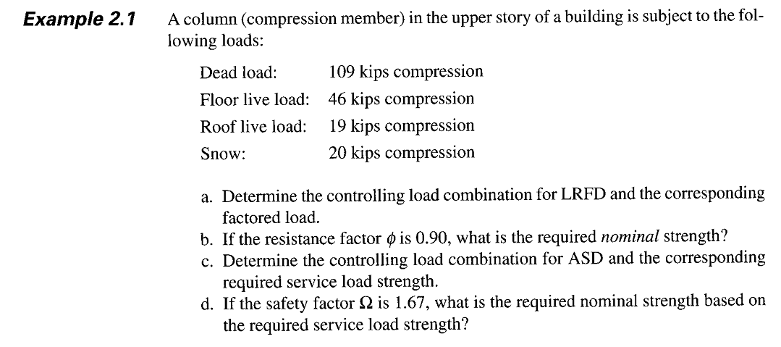

Slide 27
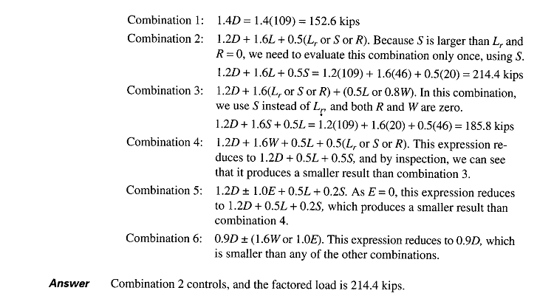

Slide 28
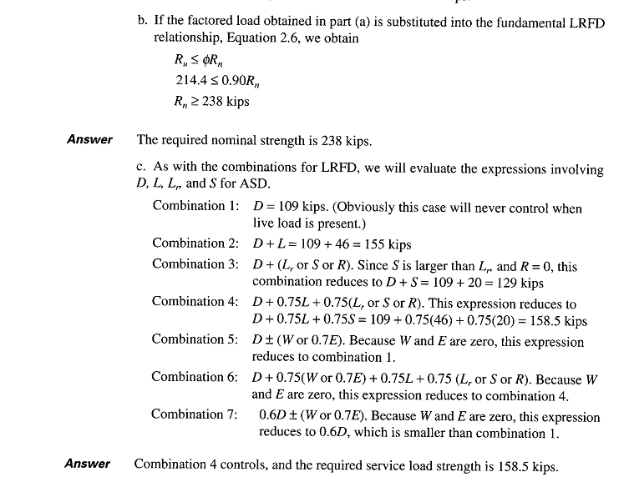

Slide 29
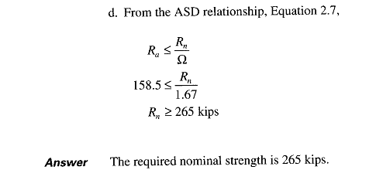
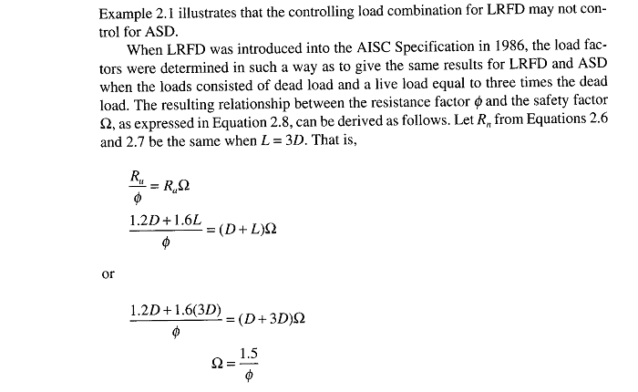

Slide 30
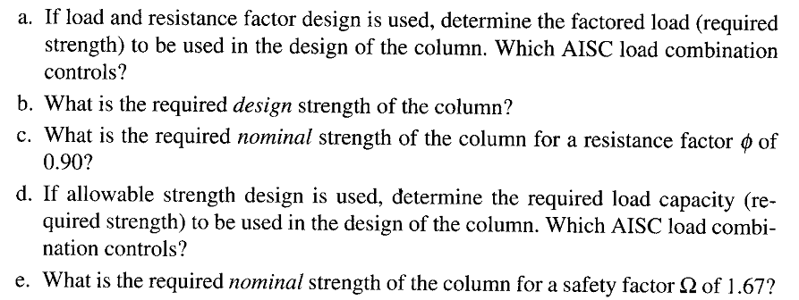
Practice Questions

Slide 31
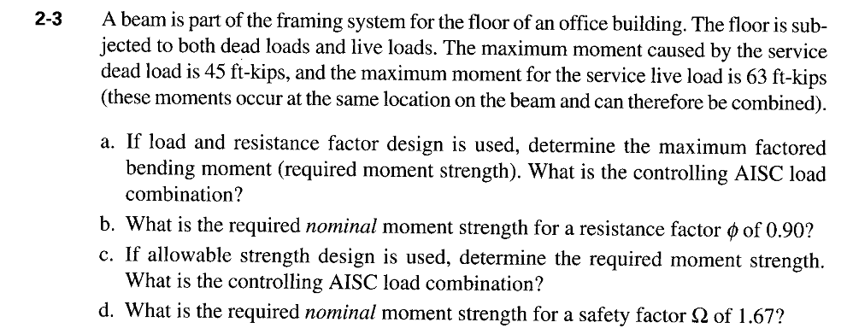
Practice Questions

