Slide 1
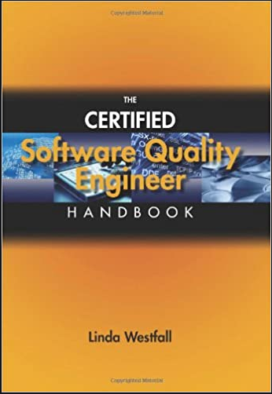
Software Testing & Quality Engineering
Chapter 3
Standards and Models
Linda Westfall Quality Press

Slide 2
Objectives
Standards and Models:
ISO 9000 standards
IEEE software engineering standards
SEI Compatibility Maturity Model Integration (CMMI)
Notes:
A decision might be made to use an outside contractor to produce the annual maintenance contracts subsystem. A natural concern would be the standard of the contractor’s deliverables.
Quality control would involve the rigorous testing of all the software produced by the subcontractor, insisting on rework where defects are found. This would be very time consuming. An alternative approach would focus on quality assurance i.e. to check that the contractors themselves were carrying out effective quality control. A key element therefore would be to ensure that the contractor had right quality management system.

Slide 3
ISO
Explanation of ISO.
What is ISO-9000?
Different family members of ISO-9000.
Which family member of ISO-9000 relates to Software Industry.
When to use ISO-9000.
ISO-9000 certification

Slide 4
What is ISO. . .?
ISO stands for the International Standardization organization. It is an organization which standardized the things on international level so things become easy to judge.
Examples of Standards:
Go any where in the world you will find an hour of 60 minutes this is standard thing.
Go any where in the world you will find 1Gb of memory equal to 1024Mb no one can violate this rule no one will create a USB drive of 512mb and say it is 1GB for me.
ISO 9000 is based on documentation and is based on the following:
Document what you do.
Do what your document.
Prove it and improve it.

Slide 5
What is ISO 9000
ISO 9000 describes the fundamental features of a Quality Management System (QMS) and its terminology. ISO 9000 describes how a QMS can be applied to the creation of products and provision of services. ISO 9004 applies to process improvement.
Standards such as ISO 9000 series try to ensure that a monitoring and control system to check quality is in place. They are concerned with the certification of the development process, not of the end-product.
ISO 9000 is a family of quality based standards by the International Standardization Organization (ISO).
This ISO 9000 family consist on 5 family members from 9000 to 9004.
All these family members are targeting the quality from different perspectives and they are applicable to different things and fields of life.
No one family member of ISO 9000 is specific to any particular product.

Slide 6
ISO 9000 Family members
ISO Standard Description of standards
ISO-9000 Tell details about 9001,2 and 3 which one is best for you.
ISO-9001 Deal with quality assuring in design, development, installation and maintenance.
ISO-9002 Assesse the production and installation process.
ISO-9003 Evaluation of final inspection and test phase.
ISO-9004 It defines 20 concepts about the quality which are used in the above three standards 9001,9002 and 9003
ISO 9000-3 | It is a standard for quality software systems.

Slide 7
What is ISO 9000
From the family of ISO 9000 the family member ISO-9001 relates the most to software industry.
ISO-9001
ISO-9001: It deals with the quality assurance in design, development, production, installation and servicing.
The all above mentions things of ISO9001 are related to Software industry so we chose it the most in software industry.

Slide 8
When to use ISO 9000
When organization want to regulate the quality system in the organization so they chose one of the family member of ISO 9000 which relates the most with their organization.
Example: In our example if we are a Software industry then to regulate the quality system in our industry we will chose the ISO 9001 as it relates the most to our software industry.
During a contract between two parties when an organization want to check the quality of the suppliers supply.

Slide 9
ISO 9000-3: Principal areas of quality focus
• management responsibility
• quality system requirements
• contract review requirements
• product design requirements
• document and data control
• purchasing requirements
• customer supplied products
• product identification and traceability
• process control requirements
• inspection and testing
• control of inspection, measuring, and test equipment
• inspection and test status
• control of nonconforming products
• corrective and preventive actions
• handling, storage, and delivery
• control of quality records
• internal quality audit requirements
• training requirements
• servicing requirements
• statistical techniques

Slide 10
ISO-9000 Certification
You have to get ISO-9000 certifications to prove you are delivering the quality
Certification also help to obtain more business because many customers require that organizations obtain certain standards.
Certification is granted by an external body. Third party certification bodies provide independent confirmation that organizations meet the requirements of a certain standard and hence a certificate is given to that organizations

Slide 11
An overview of ISO-9000 QMS requirements
The standard is built on foundation of the following principles.
1. Customer Focus
2. Leadership
3. Involvement of People
4. Process Approach
5. Systematic Approach to Management
6. Continual Improvement
7. Factual Approach to Decision-Making
8. Mutually Beneficial Supplier Relationships*

Slide 12
An overview of ISO-9000 QMS requirements - continued
Aforementioned principles are applied through cycles which involve the following activities.
Determining the needs and expectations of the customers.
Establishing a Quality policy i.e. a framework which allows the organization’s objectives in relation to quality to be defines.
Design of process which will create the products (or deliver the services) which will have the qualities implied in the organization’s quality objectives.
Allocation of the responsibilities for meeting these requirements for each element of each process.
Ensuring that resources are available to execute the process properly.
Design of methods for measuring the effectiveness and efficiency of each process.
Gathering measurements.
Identification of any discrepancies between actual and target values.
Analyze and elimination of causes of discrepancies.

Slide 13
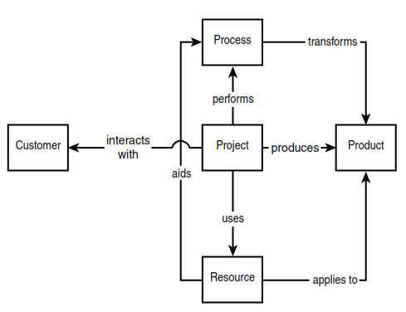
An Overview of the IEEE Software Engineering Standards
Customer Standards: Standards that describe the interaction between the customer and supplier of a software engineering project.
Process Standards: Standards that describe processes spanning the life cycle of a software product or service, including acquisition, supply, development, maintenance, operations, and measurements.
Product Standards: Standards that explain the requirements for classes of software products characteristics, measurements, evaluations, and specifications.
Resource Standards: Standards that recommend proper documentation, methods, models and tools for a well-managed software program and its related processes.
The SESC object model of software engineering

Slide 14
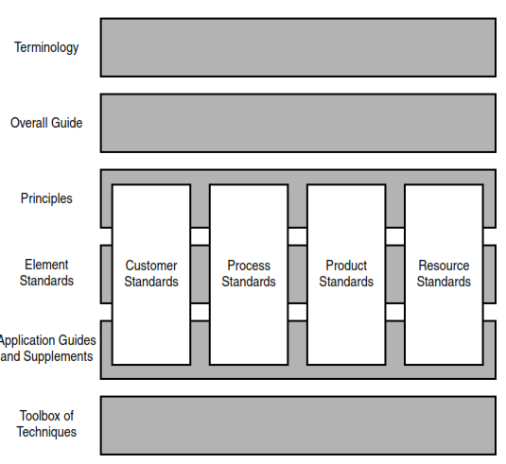
IEEE standards (SESC the IEEE Software Engineering Standards Committee)
The framework specifies six layers and—for the middle three layers—four stacks, as pictured in Figure
Terminology: Documents prescribing terms and vocabulary.
Overall Guide: One document providing overall guidance for the entire collection.
Principles: Documents that describe principles or objectives for use of the standards in the collection.
Element Standards: Standards that are the basis for conformity.
Application Guides and Supplements: Guides and supplements that give advice for using the standards in various situations.
Toolbox of Techniques: Descriptions of techniques that might be helpful in implementing the provisions of the higher-level documents.
The SESC framework model.

Slide 15
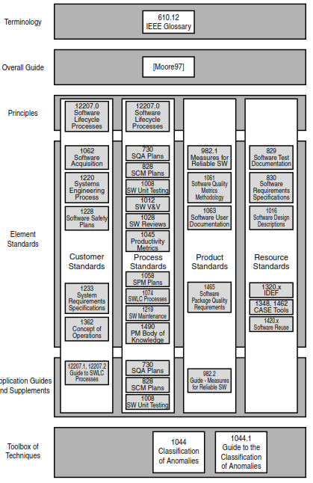
SESC Framework
Issues / Problems.
This is evidenced by numerous standards having secondary assignments. For example, IEEE Std. 829 (Software Test Documentation) has a primary classification as a Resource standard, and a secondary classification as a Process standard. Similarly, IEEE Std. 730 (Software Quality Assurance Plans) has a primary classification as a Process standard, and a secondary classification as a Product standard. In total, there are 15 such secondary classifications of standards and guides.
The SESC alternative model suffers the same classification ambiguity problem. For example, IEEE Std. 1058 (Software Project Management Plans), is assigned to the Project Management category, however, being a plan, can also be in the Plans category.
A more important short-coming is that it don’t tell you how to get started. The models don’t specify a phase-in strategy, and they don’t specify core standards for just getting started.

Slide 16
What is CMMI
CMMI (Capability Maturity Model Integration) is a proven industry framework to improve product quality and development efficiency for both hardware and software
Sponsored by US Department of Defence in cooperation with Carnegie Mellon University and the Software Engineering Institute (SEI)
Many companies have been involved in CMMI definition such as Motorola and Ericsson
CMMI has been established as a model to improve business results
CMMI, staged, uses 5 levels to describe the maturity of the organization, same as predecessor CMM
Vastly improved version of the CMM
Emphasis on business needs, integration and institutionalization

Slide 17
How can CMMI Help
CMMI provides a way to focus and manage hardware and software development from product inception through deployment and maintenance.
ISO/TL9000 are still required. CMMI interfaces well with them. CMMI and TL are complementary - both are needed since they address different aspects.
ISO/TL9000 is a process compliance standard
CMMI is a process improvement model
Behavioral changes are needed at both management and staff levels. Examples:
Increased personal accountability
Tighter links between Product Management, Development, SCN, etc.
Initially a lot of investment required – but, if properly managed, we will be more efficient and productive while turning out products with consistently higher quality.

Slide 18
Purpose of CMMI
The purpose of CMM Integration is to provide guidance for improving organization’s processes and your ability to manage the development, acquisition, and maintenance of products or services.”
Covers the development of software systems
Focus on:
Applying systematic, disciplined, and quantifiable approaches to development.
Operation.
Maintenance of software.
Models of software engineering:
Process management.
Project management.
Support.
Engineering process areas.

Slide 19
CMMI Staged Representation - 5 Maturity Levels
Level 5
Process performance continually improved through incremental and innovative technological improvements.
Optimizing
Level 4
Quantitatively
Managed
Processes are controlled using statistical and other quantitative techniques.
Process Maturity
Level 3
Defined
Processes are well characterized and understood. Processes, standards, procedures, tools, etc. are defined at the organizational (Organization X ) level. Proactive.
Level 2
Managed
Processes are planned, documented, performed, monitored, and controlled at the project level. Often reactive.
Level 1
Initial
Processes are unpredictable, poorly controlled, reactive.

Slide 20
Maturity Level 1 Initial
Maturity Level 1 deals with performed processes.
Processes are unpredictable, poorly controlled, reactive.
The process performance may not be stable and may not meet specific objectives such as quality, cost, and schedule, but useful work can be done.

Slide 21
Maturity Level 2 Managed at the Project Level
Maturity Level 2 deals with managed processes.
A managed process is a performed process that is also:
Planned and executed in accordance with policy
Employs skilled people
Adequate resources are available
Controlled outputs are produced
Stakeholders are involved
The process is reviewed and evaluated for adherence to requirements
Processes are planned, documented, performed, monitored, and controlled at the project level. Often reactive.
The managed process comes closer to achieving the specific objectives such as quality, cost, and schedule.

Slide 22
Maturity Level 3 Defined at the Organization Level
Maturity Level 3 deals with defined processes.
A defined process is a managed process that:
Well defined, understood, deployed and executed across the entire organization. Proactive.
Processes, standards, procedures, tools, etc. are defined at the organizational (Organization X ) level. Project or local tailoring is allowed, however it must be based on the organization’s set of standard processes and defined per the organization’s tailoring guidelines.
Major portions of the organization cannot “opt out.”

Slide 23
Maturity Level 4
Sub-processes are selected that significantly contribute to overall process performance
As criteria in managing process the quantitative objects for quality are established
Quantitative objectives are based on:
Needs of a customer
End users
Organization
Process implements
For these processes, detailed measures of process performance are collected and statistically analyzed

Slide 24
Maturity Level 5
Focuses on continually improving process performance through:
Incremental technological improvements
Innovative technological improvements
Both processes are the organization’s set of measurable improvement activities

Slide 25
Conclusion CMMI Benefits
CMMI product users can expect to:
Efficiently and effectively improve and assess multiple disciplines across their organization
Reduce costs (including training) associated with improving and assessing processes
Deploy a common, integrated vision of process improvement that can be used as a basis for enterprise-wide process improvement efforts.
Improved
Processes

