Slide 1
L-03 ENGINEERING MATERIALS DISLOCATION, SLIP SYSTEMS AND TWINING

Slide 2
A pure metal consisting of only one type of atom just isn’t possible; impurity or foreign atoms will always be present, and some will exist as crystalline point defects.
In fact, even with relatively sophisticated techniques, it is
difficult to refine metals to a purity in excess of 99.9999%.
At this level, on the order of 10^22 to 10^23 impurity atoms
will be present in one cubic meter of material.
• Most familiar metals are not highly pure; rather, they are alloys, in which impurity atoms have been added intentionally to impart specific characteristics to the material.

Slide 3
Crystal Defects
• A perfect crystal, with every atom of the same type in the correct position, does not exist.
• All crystals have some defects. Defects contribute to the mechanical properties of metals.
• these defects are commonly intentionally
used to manipulate the mechanical properties
of a material.
• Adding alloying elements to a metal is one way of introducing a crystal defect.

Slide 4
Crystal Defects
just keep in mind that crystalline defects are not always bad.
There are basic classes of crystal defects:
• point defects, which are places where an atom is missing or irregularly placed in the lattice structure. Point defects include lattice vacancies, self-interstitial atoms, substitution impurity atoms, and interstitial impurity atoms

Slide 5
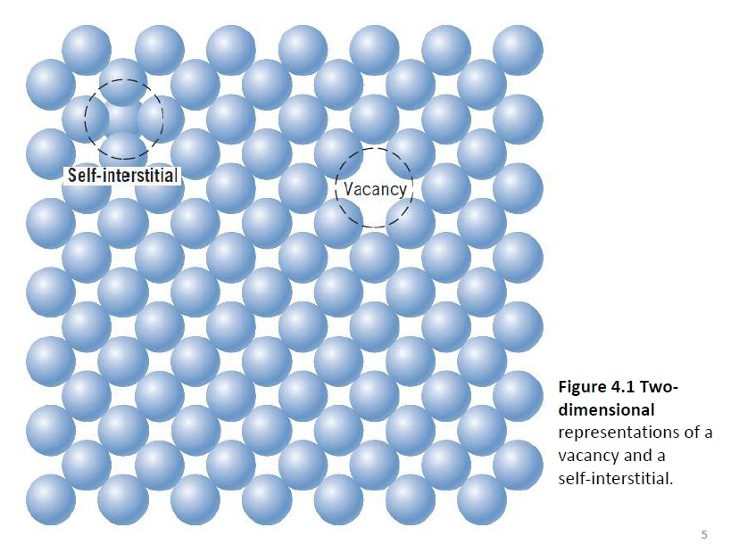

Slide 6
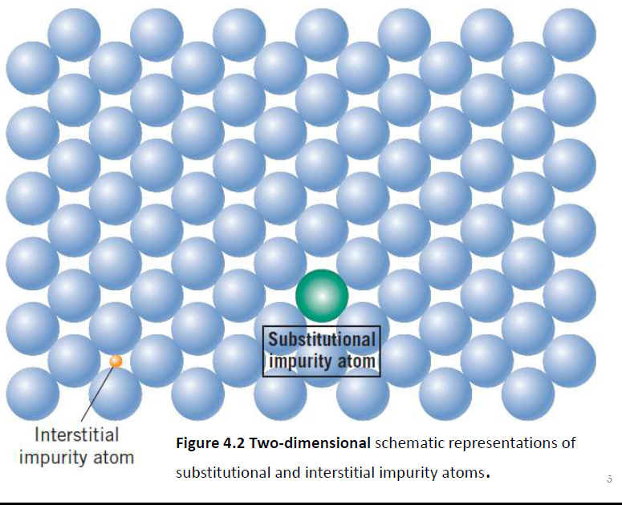

Slide 7
Crystal Defects
• linear defects, which are groups of atoms in
irregular positions. Linear defects are commonly called dislocations.
• planar defects, which are interfaces between
homogeneous regions of the material. Planar
defects include grain boundaries, stacking faults and external surfaces.
• It is important to note at this point that plastic
deformation in a material occurs due to the movement of dislocations (linear defects).

Slide 8
Crystal Defects
• Millions of dislocations result for plastic forming operations such as rolling and extruding.
It is also important to note that any defect in the regular lattice structure disrupts the motion of dislocation, which makes slip or plastic deformation more difficult.
• These defects not only include the point and planer defects mentioned above, and also other dislocations.

Slide 9
Dislocation movement produces additional dislocations, and when dislocations run into each other it often impedes movement of the dislocations.
• This drives up the force needed to move the dislocation or, in other words, strengthens the material.

Slide 18
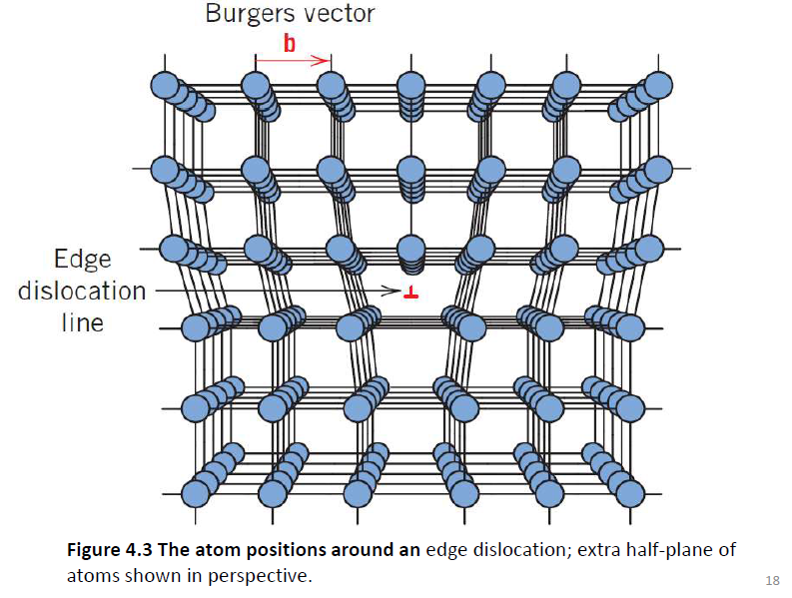

Slide 19
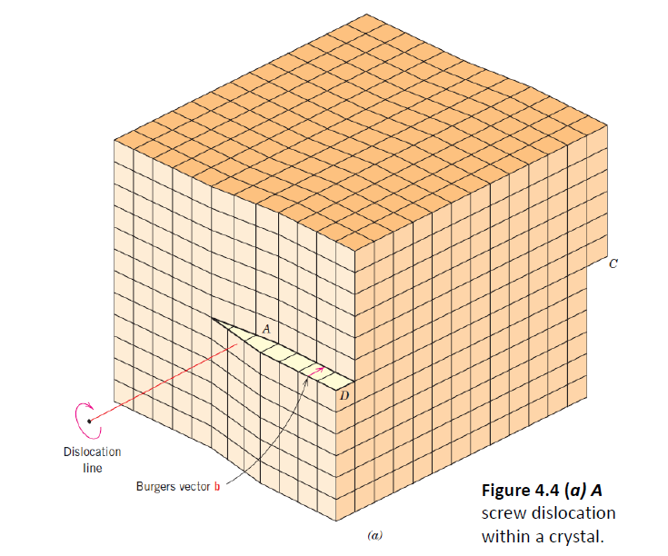

Slide 21
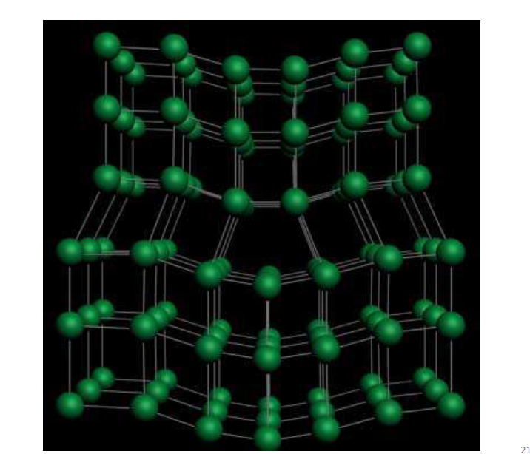

Slide 22
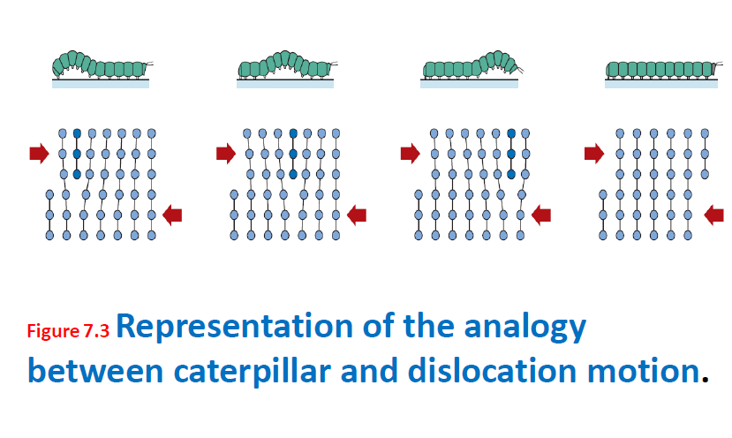

Slide 23
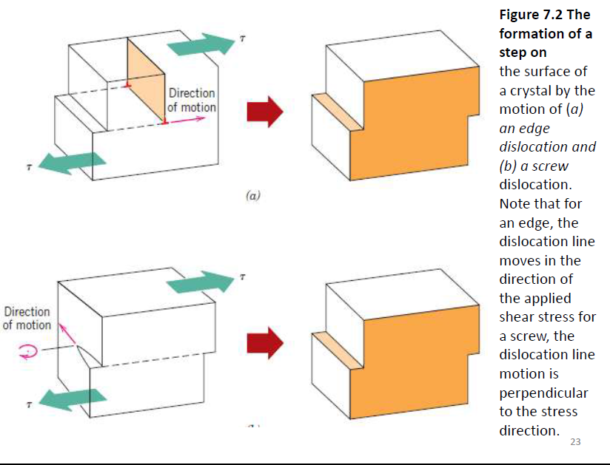

Slide 26
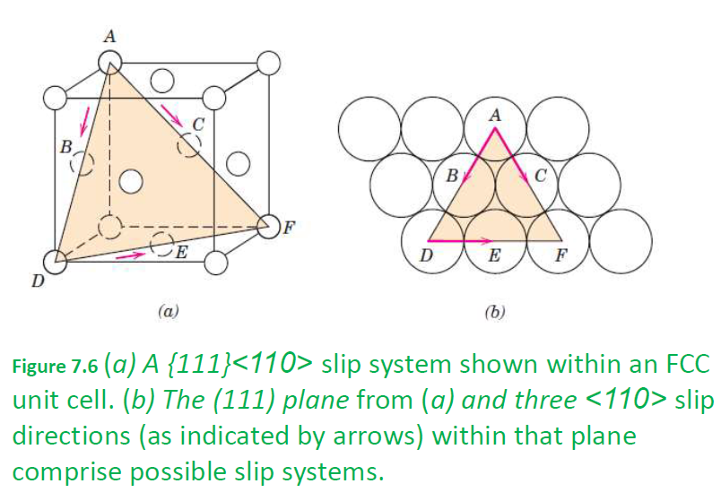

Slide 31
Bauschinger effect
The Bauschinger effect refers to a property of materials where the material's stress/strain characteristics change as a result of the microscopic stress distribution of the material. For example, an increase in tensile yield strength occurs at the expense of compressive yield strength. The effect is named after German engineer Johann Bauschinger.
While more tensile cold working increases the tensile yield strength, the local initial compressive yield strength after tensile cold working is actually reduced. The greater the tensile cold working, the lower the compressive yield strength.
The Bauschinger effect is normally associated with conditions where the yield strength of a metal decreases when the direction of strain is changed. It is a general phenomenon found in most polycrystalline metals. The basic mechanism for the Bauschinger effect is related to the dislocation structure in the cold worked metal. As deformation occurs, the dislocations will accumulate at barriers and produce dislocation pile-ups and tangles. Based on the cold work structure, two types of mechanisms are generally used to explain the Bauschinger effect.

Slide 32
