Slide 1
MYCOTOXINS IN POULTRY FEEDS: OCCURRENCE, EFFECTS AND CONTROL
Dr. Muhammad Arif
Deaprtment of Animal Sciences, UCA, U.O.S

Slide 2
MYCOTOXIN: DEFINITION & FEATURES
Mycotoxins are toxic compounds produced by fungi .They are secondary metabolites of fungi which are associated with certain disorders in animals and human beings.
toxic substances produced by fungi (molds) growing on crops/grains in the field or in storage.
Secondary metabolites (chemicals) of a fungus that produce toxic results in another organism.
Unlike bacterial toxins, fungal toxins (mycotoxins) are not proteins and therefore are not usually detectable by the immune systems of humans and animals
Lack of visible appearance of fungus does not negate presence of mycotoxins. Toxins can remain in the organism after fungus has been removed.
Can be heat stable, not destroyed by canning or other processes.

Slide 3
Most fungi do not produce Mycotoxins
Many fungi are edible
Mushrooms are fungi
Moldy feeds may be degraded without presence of mycotoxin, or may be unaffected in value.

Slide 4
How was the concept of Mycotoxins developed ?
An outbreak of an unknown disease killed poultry birds in 1960s
This was named Turkey X disease
After investigations it was finally traced to mycotoxins in groundnut meal feed imported from Brazil
The feed was shown to contain a compound that could cause cancer
Today we know this mycotoxin by the name of AFLATOXIN – A CLASS I CARCINOGEN

Slide 5
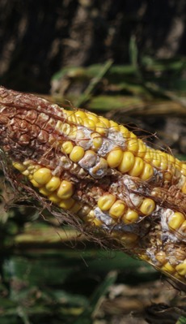
TYPES AND OCCURRENCE OF MYCOTOXINS
Today 300 - 400 mycotoxins are known
Mycotoxins of human concern based on toxicity:
Aflatoxin
Deoxyniva-lenol (DON) or Vomitoxin
T-2 toxin
Zearalenone
Fumonisin
Ochratoxin A

Slide 6
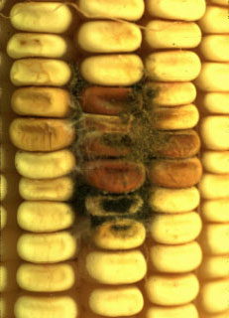
Aflatoxin
1. Sources : Corn, Groundnuts
2. Factor favoring production of Aflatoxins
a. Temperature : 25-30°C
b. Grain moisture
Naturally produced Aflatoxins –B₁, B₂, G₁, G₂
They undergo modifications during cellular metabolism and processing of foods to produce several derivatives such as
M₁, M₂, P₁, etc.

Slide 7
Aflatoxin (Aspergillus)
Highly toxic carcinogenic secondary metabolites produced by fungi namely:-
1. Aspergillus flavus
2. Aspergillus parasiticus
3. Aspergillus nomius
Aflatoxicosis: caused by high doses in short intervals or low doses in high intervals.
1961, caused the deaths of over 100,000 turkey poults: “Turkey X disease”.
Grows best between 80-90 degrees Fahrenheit.
Damage to grain increases likelihood of fungal growth.

Slide 8
Average total Aflatoxin level of feed ingredients in Nigeria
FEEDSTUFF | EDO | ENUGU | KADUNA | KANO | LAGOS | OGUN | OYO | RIVERS
GNC(ppb) | 371.2 | 1539.5 | 614.7 | 336.2 | 337.5 | 244.5 | 293.5 | 573.5
SBM(ppb) | 19.0 | 9.1 | 9.1 | 14.5 | 14.7 | 9.7 | 55.9 | 19.7
F/MEAL(ppb) | 30.7 | 7.7 | 10.7 | 10.0 | 16.6 | 49.4 | 9.9 | 28.2
MAIZE(ppb) | 5.8 | 16.2 | 576.1 | 157.3 | 248.7 | 166.5 | 83.4 | 20.1
BDG(ppb) | 15.0 | -- | 5.9 | 3.5 | 19.2 | 30.4 | -- | 10.9

Slide 9
Average Aflatoxin level of some feeds in Nigeria
TYPE OF FEED | EDO | ENUGU | KADUNA | KANO | LAGOS | OGUN | OYO | RIVERS
B/STARTER (ppb) | 43.9 | 26.4 | 121.7 | 57.3 | --- | 20.0 | 91.2 | 5.6
LAYERS (ppb) | 81.9 | 119.4 | 187.2 | 62.8 | 272.9 | 62.2 | 323.0 | 18.9
GROWERS (ppb) | 91.5 | 115.1 | 139.0 | 78.9 | 125.5 | -- | 23.1 | 162.7

Slide 10
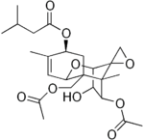
DON and T-2 Toxin
Tricothecenes of wheat, grain, and barley.
These are field toxins not storage toxins.
They target the circulatory, alimentary, skin, and nervous systems.
Fusarium graminearum produces DON and T-2 Toxin which causes scab damage to kernels and head blight.
Optimal temperature range is between 70 and 85 degrees Farenheit.
Advisory level of DON is 1 ppm.
T-2 toxin

Slide 11
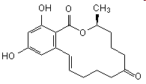
Zearalenone
Species : Fusarium roseum, F.graminearum, F. poae, F. culmorum
Food affected: corn, wheat, barley, oats
Interesting facts:
Zearalenone has estrogenic effects

Slide 12
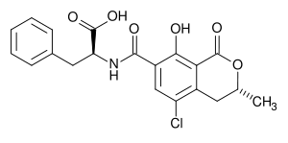
Ochratoxin A.
Species: P. Verrucosum and A. ochraceus
Food affected: Cereals, coffee beans, and grapes.
Interesting Facts: Ochratoxin can be transmitted from pork to humans by eating pork that is fed with contaminated food.
Ochratoxin sources are gnuts, pecans, beans, dried fruit and dried fish.

Slide 13
Favorable conditions for the growth of fungi
S/N | CONDITION | RANGE/SPECIFICATION
1 | Moisture content of feed/ingredient | 12-14% or higher.
2 | Relative humidity in the store | Above 70-75%
3 | Physical condition of grain | Damaged seed coat due to insects and improper harvesting.
4 | Ambient temperature | Moderate to high (25-30⁰C) for Aspergillus spp., low (15-20⁰C) for Fusarium spp.
5 | Storage | Leaky roof in the store.

Slide 14
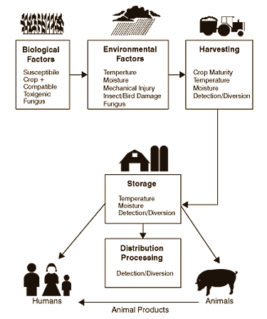
Mycotoxin Chain of Events

Slide 15
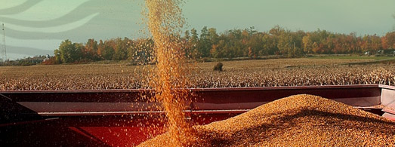
Modes of Spore Transmission
Airborne, wind or indoor ventilation systems.
Attachment to insects of birds, thus transmitted from plant to plant, or animal to animal, etc.
Via transportation mechanisms such as trucks, crop machinery, etc.

Slide 16
Route of infection
Ingestion/skin contact/ inhalation
Blood stream & lymphatic system
Inhibit protein synthesis
Damage macrophages system
Inhibit particle clearance of the lungs
Increase sensitivity to bacterial endotoxins

Slide 17
Tests for Mycotoxins
Quick Test (Qualitative)
Immunoassays (Elisa tests)
Thin Layer Chromatography (TLC)
Use: (Detect Specific Mycotoxin)
Confirmatory Tests (Quantitative)
High Pressure Liquid Chromatography(HPLC)
Use: Determine level of mycotoxins
Detect several mycotoxins

Slide 18
EFFECTS OF MYCOTOXINS
Mycotoxins are metabolized in the liver and kidney and also in the digestive tract. Fungal contamination affects both the organoleptic characteristics and the alimentary value of feeds and entails a risk of toxicities.
Effects on production
Effects on organs
Residual effects in humans (Food Safety Risk)

Slide 19
Effects on Production
Chickens, turkeys, and ducklings are affected by ochratoxicosis, causing poor weight gain, egg output, egg size/weight and poor shell quality.
In poultry, causes reduced egg production, beak and oral lesions, lower carcass value and abnormal feathering
Produces a thiaminase causing thiamine deficiency in Chicks
Mycotoxins are also known to interfere with the utilization of dietary vitamins D and this may result in deficiency symptoms of the vitamin
Increase in mortality of birds

Slide 20
Effects on Organs
Positive correlations in weight for liver, spleen and kidneys (organ’s enlargement)
negative correlation for bursa of Fabricius and thymus (organs' reduction)
change in texture and coloration of liver and bursa of Fabricius

Slide 21
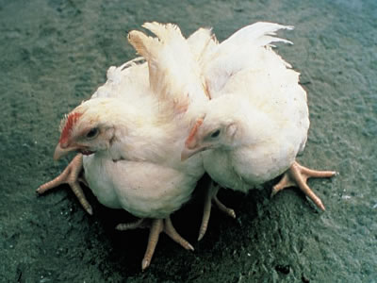
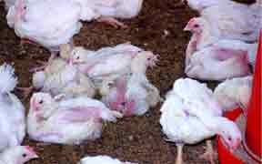
Effect of Mycotoxin on poultry
Nervous syndrome cause by aflatoxins

Slide 22
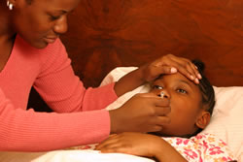
Residual effects in Humans (Food Safety Risk)
Physiological and pathological changes
Food poisoning
Inhibition of protein synthesis & Alteration of capacity of cells to proliferate
Increase of tryptophan in blood and brain (affects appetite, muscular co-ordination and sleep
Nausea ,Vomiting, Headache
Abdominal pain, Diarrhea, Giddiness, Convulsions
Reproductive and mammary changes
Role in hormonal imbalance and breast cancer
Precocious pubertal changes in children
Carcinogenic effects
Immunosuppressor

Slide 23
Types, sources and effects of mycotoxins
Mycotoxin | Fungi | Effect on animals
Aflatoxin | Aspergillus flavus, Aspergillus parasiticus | liver disease,carcinogenic and teratogenic effects
Trichothecene | Fusariumgraminearum, Fusariumsporotrichioides | immunologic effects, hematological changes, digestive diorders, edema
Zearalenone | Fusariumgraminearum | estrogenic effects, atrophy of ovaries and testicles, abortion
Ochratoxin | Aspergillus ochraceus, Penicilliumverrucosum | nephrotoxicity, mild liver damage, immune suppression
Ergot alkaloid | Clavicepspurpurea, Clavicepspaspaspali | nervous or gangrenous syndromes
Fumonisin | Fusariumverticillioides, Fusariumproliferatum | Pulmonary edema,leukoencephalomalacia, nephrotoxicity, hepatotoxicity

Slide 24
Factors causing variation in effects
Species, breed
Age
Sex
Nutritional status
Other diseases
Other mycotoxins
Extent of exposure

Slide 25
Symptoms of Mycotoxicosis
1. Drugs and antibiotics are not effective in treatment.
2. The symptoms can be traced to foodstuffs or feed.
3. Testing of said foodstuffs or feed reveals fungal contamination.
4. The symptoms are not transmissible person to person.
5. The degree of toxicity is subject to persons age (more often in very young and very old), sex ( more often in females than males)and nutritional status.
6. Outbreaks of symptoms appear seasonally.

Slide 26
PREVENTION AND CONTROL OF MYCOTOXINS
The presence of mycotoxins is unavoidable as they are environmentally induced. However, the economic importance and health implication of mycotoxins has made its control inevitable. Control is very important to the feed manufacturer and livestock producer

Slide 27
PREVENTIVE MEASURES
Application of Good Agricultural Practices (GAP), Good Manufacturing Practices (GMP), Good Hygienic Practices (GHP) and Hazard Analysis and Critical Control Points (HACCP).
Crop Rotation
Inhibit mold growth by appropriate drying and storage of grains/feeds.
Efficient detoxification strategies.

Slide 28
CONTROL MEASURES
Detoxification and Physical treatment
Chemical Agents
Dietary Manipulations
Use of Adsorbents/binders
Bio-control measure ( Use of AFLASAFE)
Regulations

Slide 29
Detoxification and Physical treatment
Exposure to sunlight for about 12-14 hours degrades aflatoxin up to 70-90%
Drying at 120°C for 2-3 hours resulting in reduction by 60-90%
Autoclaving, pelleting to inhibit mould growth.
Cleaning, mechanical sorting and separation
Density segregation (floatation).

Slide 30
Chemical Agents
Alkali
Calcium Hydroxide
Sodium Hydroxide
Ammonia
Acids
Benzoic acid
Copper Sulphate at 0.04 – 0.05%

Slide 31
Dietary Manipulations
Mycotoxins affects nutrient value of feed, increasing the dietary level can minimize this effect.
Aflatoxin negative effect is lower in birds consuming higher protein and higher methionine

Slide 32
Use of Adsorbents/binders
Inorganic toxin binders (Silica based)
Zeolites, Bentonites, Aluminosilicates
Activated charcoal, Clay and Yeast
Hydrated Sodium Calcium Aluminosilicate (HSCAS) at 1%
Organic toxin binders (Carbon based)
Oat hulls, Wheat bran, Alfalfa fiber, Extracts of yeast cell wall, Cellulose, Hemi-cellulose and Pectin

Slide 33
Bio-control measure ( Use of AFLASAFE)
This is a biological control strategy which employs the mechanism of “competitive exclusion.”
This method is used at agronomic level during planting. Aflasafe™ is tossed on field soil by hand 2-3 weeks prior to flowering of crop at 10-20 kg per hectare. Protection by Aflasafe carries over from field to store thus protecting maize/groundnut along the entire value chain (from field to fork).

Slide 34
Regulations
Regulation should be based on surveillance, evaluation of risk assessment, establishment of tolerance level (or LD₅₀) and enforcement of compliance with this level for raw materials and finished feed.
Thus the enforcement of the NIAS recommended minimum aflatoxin level in feed ingredients and finished feed is very essential

Slide 35
Future Fight Against Mycotoxins
Have farmers select strains resistant to contamination.
Scientists hope to genetically engineer plants resistant to fungal infection.
Use feed additives that sequester the toxins and prevent absorption from the gastrointestinal tract.

Slide 36
Considering the importance of mycotoxin in food safety, international trade, public health and the performance of poultry and livestock, the need to have a regulatory framework that addresses mycotoxin cannot not be over emphasized. Mycotoxin must be addressed at the policy level. This is not an option but a must.

Slide 37
THANK YOU

