Slide 2
Professional Practice
Contemporary Practice Issues

Slide 3
DPT
Clear Professional identity
Job specification
Public expectation
Means to cater those
expectations
Curriculum modifications
Elimination
Recognition
More attraction towards
field

Slide 4
Perspective of Practionaire
By 2020 conversion of licensed PTs with bachelor’s
and master’s degrees to PTs with DPT degrees.
WHAT WILL HAPPEN WHEN ALL PROFESSIONALS WILL BE WITH SAME DPT DEGREE ?
Reduce the public confusion that arises when the same professionals hold multiple degrees.
Notes:
Movement dysfunction

Slide 5
Homogeneous Element in PT

Slide 6
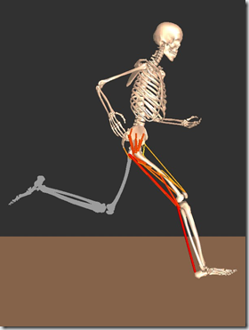
As PTs become more homogeneous,
they will be more easily identified
as the primary providers of care For
people with movement
dysfunction.

Slide 7
APTA
Preferred Curriculum Guide
PT Evaluation Tool (PTET)
assist academic institutions in developing transitional DPT (t-DPT) programs
aid PTs in preparing their credentials to apply for these programs

Slide 8
tDPT Preferred Curriculum Guide PT Evaluation Tool
Voluntary program
PTET is not mandatory for admission
Not under Commission on Accreditation of Physical Therapy Education (CAPTE),
Variation in quality of program.(due to loose check & Balance)
So must be monitored by higher education committees.

Slide 9
Cost & Benefits

Slide 10
PTs nearing retirement Vs more recent graduates of master’s degree entry-level programs.
tDPT entry-level “equivalency”degree.
(but those who are already eligible ?)
They will do what they are licensed to do…….
Professional development issue with t-DPT degree??
Not all entry level programs in PT are DPT

Slide 11
Employer’s related
Employer favor to Experience & skill Vs academic credentials
***Perception of self service for profession or urge to inflate salaries
Seeking DPT graduate for Marketing purpose

Slide 12
Perception at Patient’s end ??
Referral relationship & academics ??
T-DPT key to fulfill vision of all PTs with clinical doctorate degree.
Incentives like pay raise , license requirement are necessary to …….

Slide 13
Why tDPT degree ??
vision of having all PTs hold clinical doctoral degrees
License renewal
Salary on degree basics
Employed PTs & serving for professional development

Slide 15
tDPT
Preferred Curriculum Guide
PT Evaluation Tool
Cost & Benefits
Financial element
License requirement
Positive contribution to Field

Slide 16
American Board of Physical Therapy Specialties (ABPTS)
Promotes Specialization ,1 st specialization Cardio-pulmonary….
That developed criteria & examination for this specialty
Over the years other specialities like Geriatrics , Neurology , Orthopedics , Sports PT
Highest possible level of care
Development of science & art
Most physicians seek board certification as specialists
Concept of specialization 1976

Slide 17
Responsibilities of ABPTS
Policies & procedures for certifications & re…
Minimum requirement for specialty
Control Specialty Councils

Slide 18
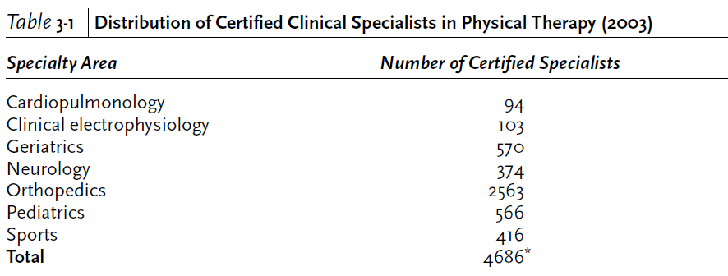

Slide 19
Direct access ,Perspective of profession
“Direct access is the ability of a physical therapist to provide evaluation and treatment to patients without the need for a physician referral.” (APTA)

Slide 20
Objections to direct access
Insufficient education
Serious medical problems might be missed beside MSK system
Increasing autonomy will shift PTs to private practice ,staffing issues in hospitals..

Slide 21
Perspective of the Practitioner
Specialization :
the process by which clinician build on their broad base of professional education and practice
to develop a greater depth of knowledge and skills
related to a particular area of practice

