Slide 1
ENTO-306
Agricultural pests and their management
Identification of important agricultural pests
Their mode of damages
Control measures
By: Dr. Muhammad Zeeshan Majeed

Slide 2
Some Recommended Insecticides Against Different Insect Pests

Slide 3
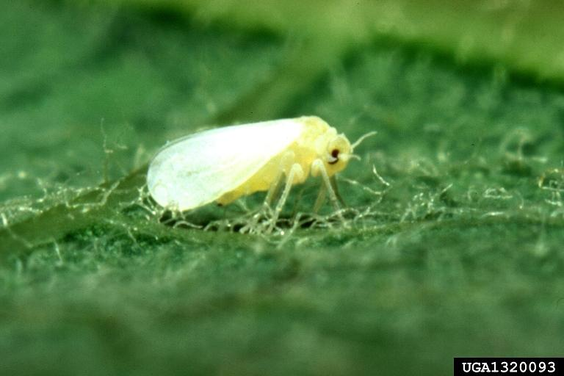
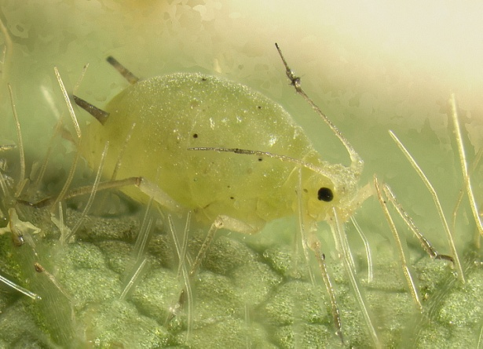
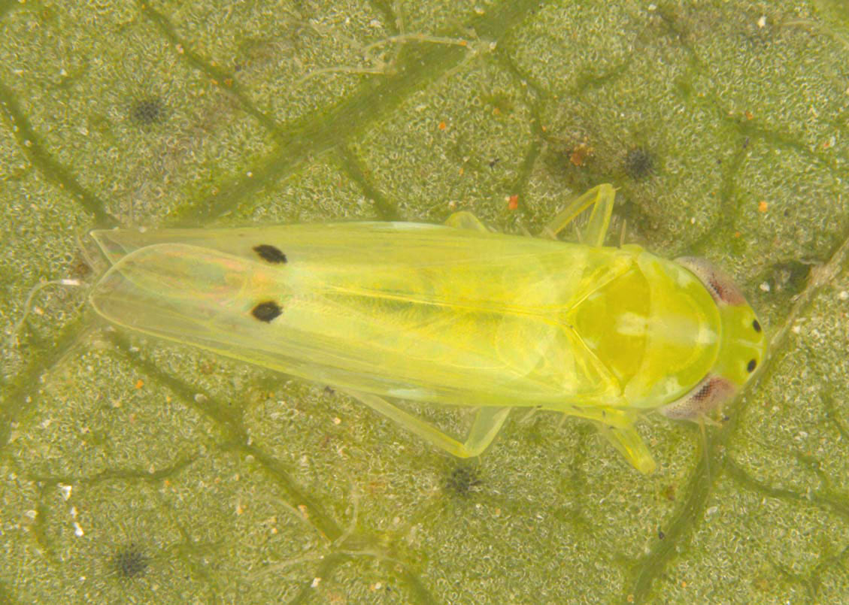
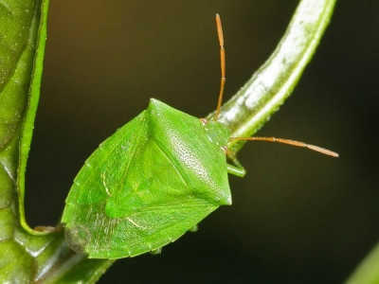
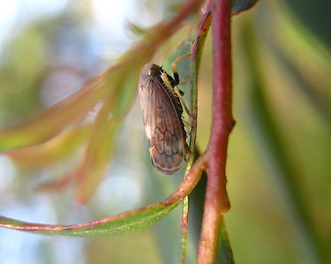
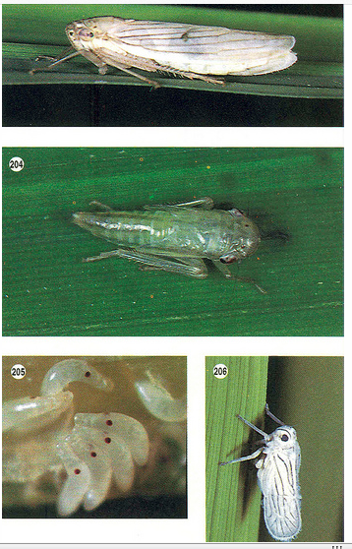
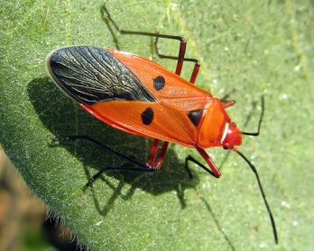
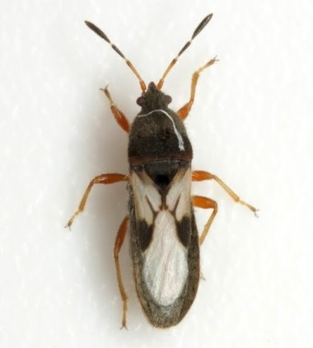
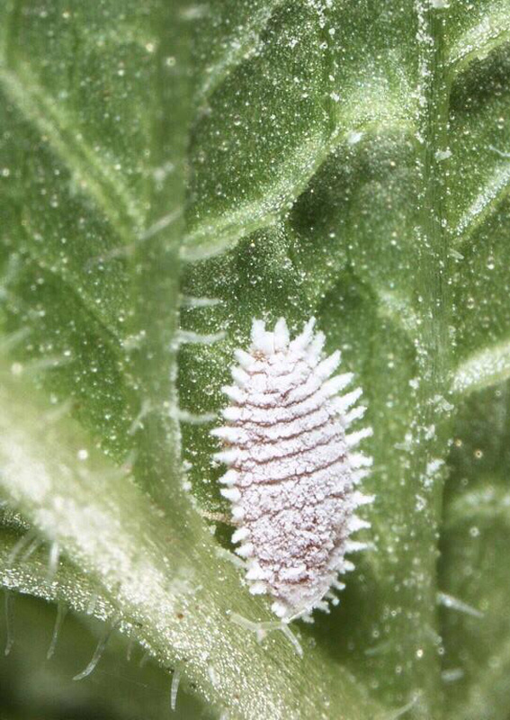
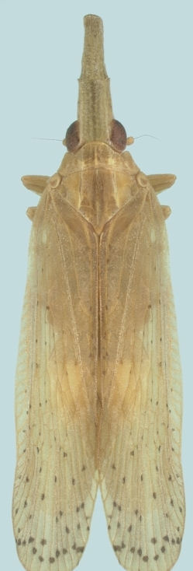
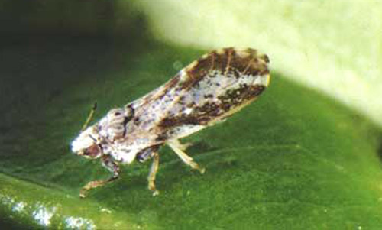
Recommended Insecticides for Sucking Insect Pests
Imidacloprid _Neonicotinoid
Thiamethoxam _Neonicotinoid
Acetamiprid _Neonicotinoid
Spirotetramat _Novel chemistry
Sulfoxaflor _Novel chemistry
Buprofezin _IGR
Bifenthrin _Pyrethroid
Chlorpyrifos _OP

Slide 4
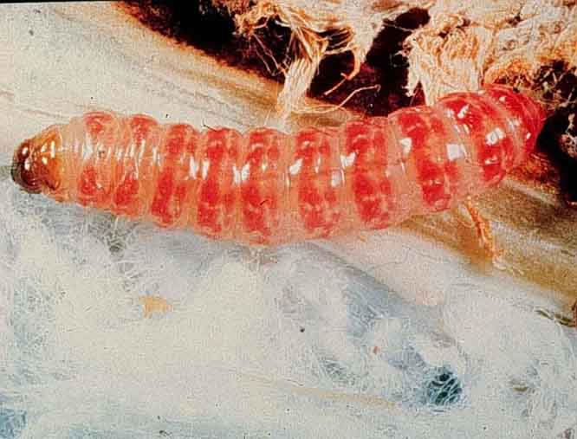
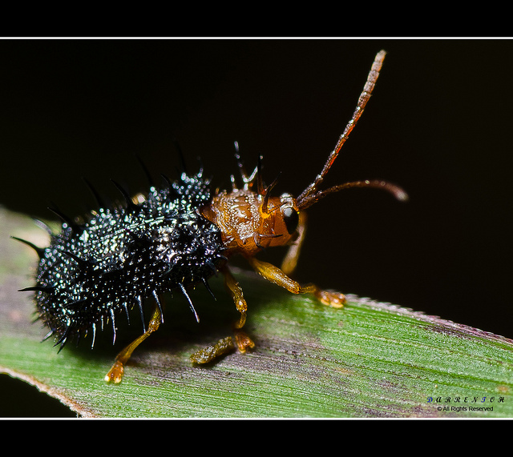
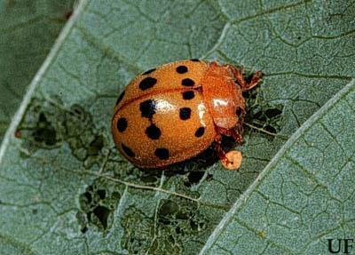
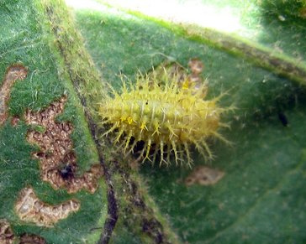
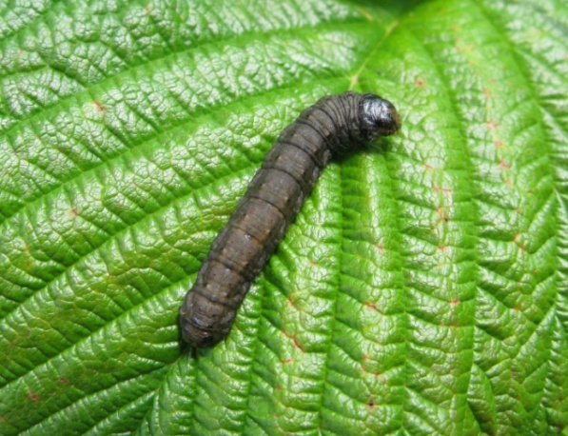
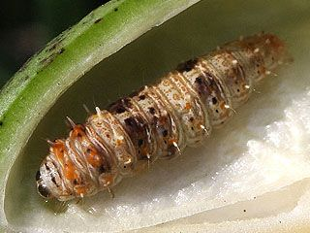
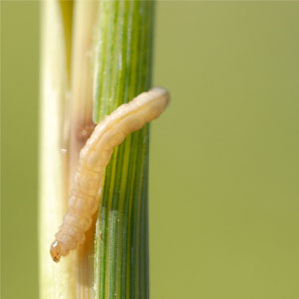
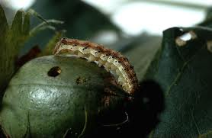
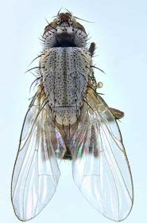
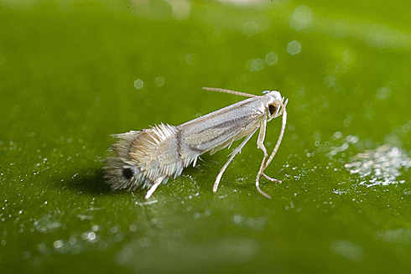
Recommended Insecticides for Chewing Insect Pests
Deltamethrin
Lambda-cyhalothrin
Chlorpyrifos
Profenofos
Carbofuran
Carbosulfan
Spinosad
Indoxacarb
Spinetoram

