Slide 1
Baltimore System of classification
The Baltimore Classification System is a scheme for classifying viruses based on the type of genome and its replication strategy. The system was developed by David Baltimore.

Slide 2
Baltimore System of classification;
Viruses do not contain a complete system for protein translation; therefore, every virus is dependent on host translational machinery. The Baltimore system is based on how viruses use that machinery. Using this classification system, messenger RNA (mRNA) is at the center, and different pathways to mRNA from DNA or RNA genomes denote the different classes.
The Baltimore Classification System initially included six classes of viruses. However, a seventh class was added to accommodate the gapped DNA genome of Hepadnaviridae (hepatitis B virus).
The seven classes of viruses in the Baltimore Classification System are as follows:

Slide 4
Class I: Double stranded DNA (dsDNA) viruses
A double stranded DNA virus enters the host nucleus before it begins to replicate. It makes use of the host polymerases to replicate its genome, and is therefore highly dependent on the host cell cycle. The cell must therefore be in replication for the virus to replicate.
Examples of Class I viruses include Herpesviridae, Adenoviridae, and Papoviridae.

Slide 5
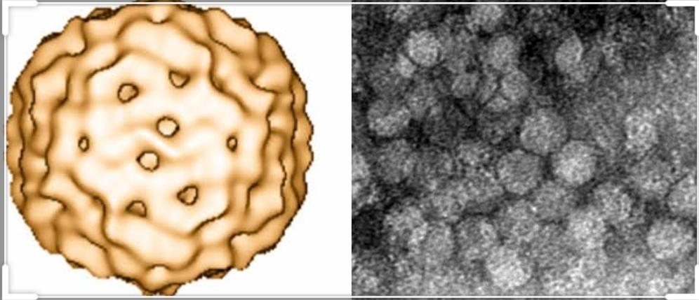
Class II: Single stranded DNA (ssDNA) viruses
Most ssDNA viruses have circular genomes and replicate mostly within the nucleus by a rolling circle mechanism. Some examples of Class II viruses are Anelloviridae, Circoviridae, and Parvoviridae.

Slide 6
Class III: Double stranded RNA (dsRNA) viruses Double stranded RNA viruses replicate in the core capsid in the host cell cytoplasm and do depend as heavily on host polymerases as DNA viruses. The genomes of Class III viruses may be segmented, and unlike viruses with more complex translation, each gene codes for only one protein. Examples of Class III viruses include Rheoviridae and Birnaviridae.

Slide 7
Rhioviradae Virus(Example of class 3;

Slide 8
Class IV: Single stranded RNA (ssRNA) viruses
Class IV ssRNA viruses have positive-sense RNA genomes, meaning they can be directly read by ribosomes to translate into proteins. They are further divided into viruses with polycistronic mRNA and those with complex transcription.
Polycistronic mRNA is translated into a polyprotein that is subsequently cleaved to form separate proteins. Viruses with complex transcription use ribosomal frameshifting and proteolytic processing to produce multiple proteins from the same gene sequences.
Examples of some Class IV viruses are Coronaviridae, Flaviviridae, Astroviridae, and Picornaviridae

Slide 9
Flaviviradae(example of class 4;

Slide 10
Class V: Single stranded RNA (ssRNA) viruses
Group VI viruses have a positive sense, single-stranded RNA genome, but replicate through a DNA intermediate. The RNA is converted to DNA by reverse transcriptase and then the DNA is spliced into the host genome for subsequent transcription and translation using the enzyme integrase.
Group VI includes retroviruses such as HIV, as well as Metaviridae and Pseudoviridae Class VII: Double stranded DNA (dsDNA) reverse transcriptase viruses
Class VII viruses have a double-stranded DNA genome, but unlike Class I viruses, they replicate via a ssRNA intermediate.

Slide 11
HIV VIRUS (example of class 6)

Slide 12
The dsDNA genome is gapped, and subsequently filled in to form a closed circle serving as a template for production of viral mRNA. To reproduce the genome, RNA is reverse transcribed back to DNA. Hepatitis B virus is a Class VII virus.
Sources:
Simplifying virus classification: the Baltimore system
Expression of animal virus genomes
Hepatitis B virus taxonomy and hepatitis B virus genotypes

Slide 13
Hepatitis B Virus (Example of class 7)

Slide 14
Baltimore System of classification;
Baltimore classification also closely corresponds to the manner of replicating the genome, so Baltimore classification is useful for grouping viruses together for both transcription and replication. Certain subjects pertaining to viruses are associated with multiple, specific Baltimore groups, such as specific forms of translation of mRNA and the host range of different types of viruses. Structural characteristics such as the shape of the viral capsid, which stores the viral genome, and the evolutionary history of viruses are not necessarily related to Baltimore groups.

Slide 15
Baltimore System of classification;
Baltimore classification was created in 1971 by virologist David Baltimore. Since then, it has become common among virologists to use Baltimore classification alongside standard virus taxonomy, which is based on evolutionary history. In 2018 and 2019, Baltimore classification was partially integrated into virus taxonomy based on evidence that certain groups were descended from common ancestors. Various realms, kingdoms, and phyla now correspond to specific Baltimore groups.

Slide 16
Advantages of Baltimore System of classification;
Baltimore classification is a system used to classify viruses based on their manner of messenger RNA (mRNA) synthesis. By organizing viruses based on their manner of mRNA production, it is possible to study viruses that behave similarly as a distinct group. Seven Baltimore groups are described that take into consideration whether the viral genome is made of deoxyribonucleic acid (DNA) or ribonucleic acid (RNA), whether the genome is single- or double-stranded, and whether the sense of a single-stranded RNA genome is positive or negative.

