Slide 2
CONSTRUCTING AN INSTRUMENT FOR DATA COLLECTION
CHAPTER 5

Slide 3
CONTENTS
Selecting a Method of Data Collection
Collecting Data Using Primary Sources
Collecting Data Using Secondary Sources

Slide 4
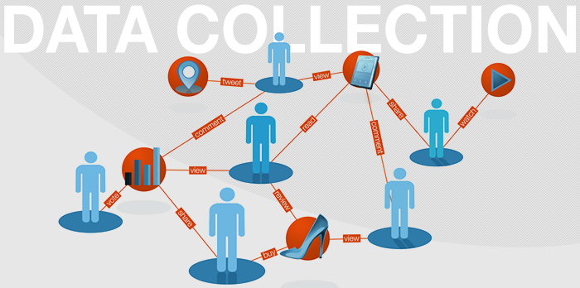

Slide 5
What is data Collection?
The process by which researcher collects information needed to answer the research problem.

Slide 6
S SOURCES OF INFORMATION
Primary Source
Data is collected by
researcher himself
Data is gathered
through questionnaire,
interviews,
observations etc.
Secondary Source
Data collected,
compiled or
written by other
researchers eg. books,
journals, newspapers
Any reference must
be acknowledged

Slide 7
Things to remember while data collection
What data to collect
How to collect
Who will collect
When to collect

Slide 9
The selection of data collection method should be based on the following
The identified hypothesis or research problem
The research design
The information gathered about the variables

Slide 10
The methods of data collection vary according to:
Degree of Structure
Degree of Quantifiability
Degree of Obtrusiveness
Degree of Objectivity

Slide 11
Research Instruments

Slide 12
Research Instruments
Research Instruments are measurement tools (for example, questionnaires or scales) designed to obtain data on a topic of interest from research subjects.

Slide 13
Research Instruments
They facilitate variable observation and measurement
The type of Instrument depends on the method of data collection .
The instrument development requires high degree of expertise as it must be valid and reliable .

Slide 14
Ways of searching for research Instruments
Read professional journals to learn what kind of instruments are being used for similar studies, their format, style, and how they are used by the writers.

Slide 15
Ways of searching for research Instruments
Read books that provide a description or an actual copy of various instruments for the reader.
Talk with other researchers who may know of certain tools they have developed for themselves, or may have used tools developed by others.

Slide 16
Ways of searching for research Instruments
Combine or adapt one or more tools used by other researchers.
Develop his/her own instrument to fulfill a specific need.

Slide 17
Guidelines for developing Instrument
It must be suitable for its function
It should be related to its purpose/ Objectives
It should be based on theoretical framework selected for the study

Slide 18
Guidelines for developing Instrument
It should be valid
Its contents should be according to the hypothesis and Research question .
It should provide comparable data every time it s used by the researcher

Slide 19
Guidelines for developing Instrument
It should be free of bias
It should be free of built in clues
Make sure that information is given by the targeted subjects

Slide 20
TYPES OF INSTRUMENTS

Slide 21
Types of Instruments
Questionnaires
Checklist
Interview
Observation
Records
Experimental approach
Survey approach

Slide 22
Questionnaire

Slide 23
Questionnaires
A series of questions designed to elicit information.
Can be filled by oral interview or by giving it directly to respondent.
The most common type of Instrument.

Slide 24
Advantages of questionnaire
Relatively simple method of data collection
Less Time consuming
Widely scattered population can be covered at one time.

Slide 25
Disadvantages of questionnaire
Responses to a question lack depth
Respondent may disobey or disregard the information asked
Respondent may loose interest
Printing cost for lengthy questionnaires
Some questions may be misunderstood
It can be used on literate population only

Slide 26
Criteria for good questionnaire
Clarity of language ( Level of respondents)
Should be according to the objectives
One to one correspondence
Correct grammar , spelling and construction

Slide 27
Characteristic of a good questionnaire
Well stated title
Has statement of the purpose
It assures the respondents privacy
It should have clear directions
There should be no double- negative responses
It should help in easy tabulation

Slide 28
Degree of Structured questions
Open ended
Close ended

Slide 29
Types of Close Ended Questions
Dichotomous questions
Choice between the two responses such as Yes/ No, Male/ female. Etc
2. Multiple choice questions: Gives more than one choice Such as :
- Low-income, Middle income, Upper middle, Rich

Slide 30
Types of Close ended questions
Rank order questions : The respondents are asked to choose a response from the “most” to the “least”
1--------2-------3---------4--------5--------6------

Slide 31
Types of Close ended questions
Rating questions : The respondents are asked to judge something from ordered dimensions.
Strongly Agree
Agree
Uncertain
Disagree
Strongly disagree

Slide 32
Techniques for developing Questionnaire
Literature review and expert’s view.
Open ended questions are preferable to gather the attitudes and behaviors.
Close ended questions may have some space for additional information.
Each question should relate to topic under study.

Slide 33
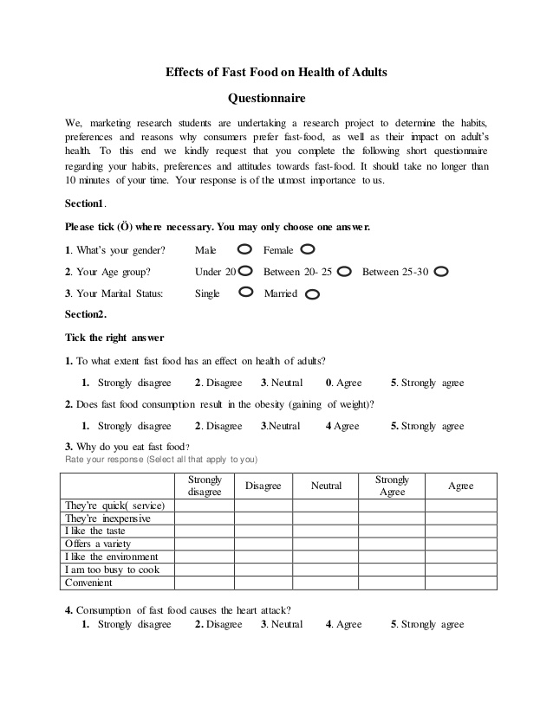
Sample Questionnaire

Slide 34
checklist

Slide 35
Checklist
The simplest of the devices, consists of a prepared list of items.
The presence or absence of the item may be indicated by inserting the appropriate word or number.

Slide 36
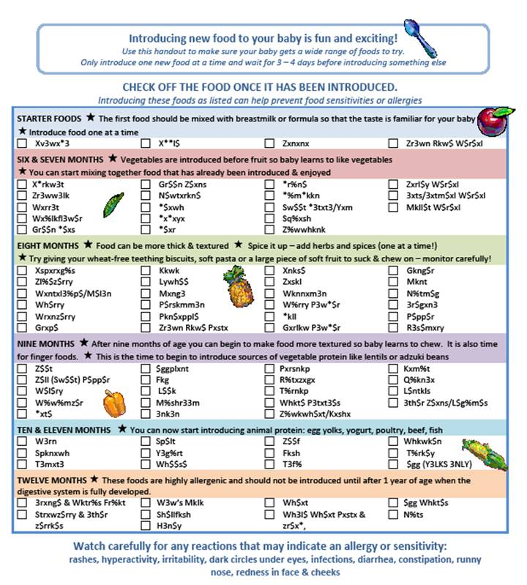

Slide 37
INTERVIEW

Slide 38
Interview
Structured or Unstructured verbal communication between the respondent and researcher .

Slide 39
Unstructured Interview
More conversational
Takes more time
Allows the researcher flexibility in questioning the subject

Slide 40
Structured Interview
It is operated according to Interview schedule
Questions are designed prior to interview
Questions are asked orderly either face to face or on Phone

Slide 41
Advantages of Interview
Data is reliable
Depth of response can be assured
Clarification is possible
No items are overlooked
Higher proportion of responses is obtained
Greater flexibility
In exploratory studies it can provide the basis for formulation of Interview

Slide 42
Disadvantages of Interview
Time taking
Costly
Bias element cannot be overlooked

Slide 43
Observation

Slide 44
Observation
Commonly used in Qualitative research
Types of Observation
Unstructured ( Both researcher and subjects are present at same time)
Structured ( record keeping forms, checklists, rating scales are used by the observer)

Slide 45
Advantages of Observation
Produces large quantity of reliable data
Relatively inexpensive
All subjects are available at one time
Observation can be stopped and restated as per convenience

Slide 46
Disadvantages of Observation
Accurate prediction of an event is unlikely
Observed events are subject to biases
Extensive training of the observers is required

Slide 47
Records

Slide 48
Records
A record refers to the statistics that Institutions/Organizations/people keep as record of their activities.
Census data
Educational Records
Hospital/Clinic records

Slide 49
Advantages:
Unbiased
Often cover a longer period of time
Inexpensive
Disadvantages
Incomplete records are difficult to complete
No assurance of accuracy of records
Background of the records is uncertain

Slide 50
Experimental approach

Slide 51
Experimental approach
A powerful design for testing hypothesis of causal relationships and variables
Researcher controls the independent variables to watch the effect of dependent variables.
Two groups of experimental approach
Treatment/experimental group
Control group

Slide 52
Disadvantages of Experimental approach
Difficult to minimize all variables in which cases and controls might differ.
Causal relationships are difficult to establish.
The time element may confound the results.
Difficult to convince subjects for lab experiments

Slide 53
Survey approach

Slide 54
Survey approach
It is best to investigate a Community or a group.
Also called formulative or Exploratory research

Slide 55
Survey approach
Advantages
Provides data about the present
Has high degree of representativeness
Convenience
It can provide information about the possibilities of undertaking different type of research methods.

Slide 56
Survey approach
Disadvantages
Has a low degree of control on extraneous variables.
Verbal behavior of people is unpredictable

Slide 57
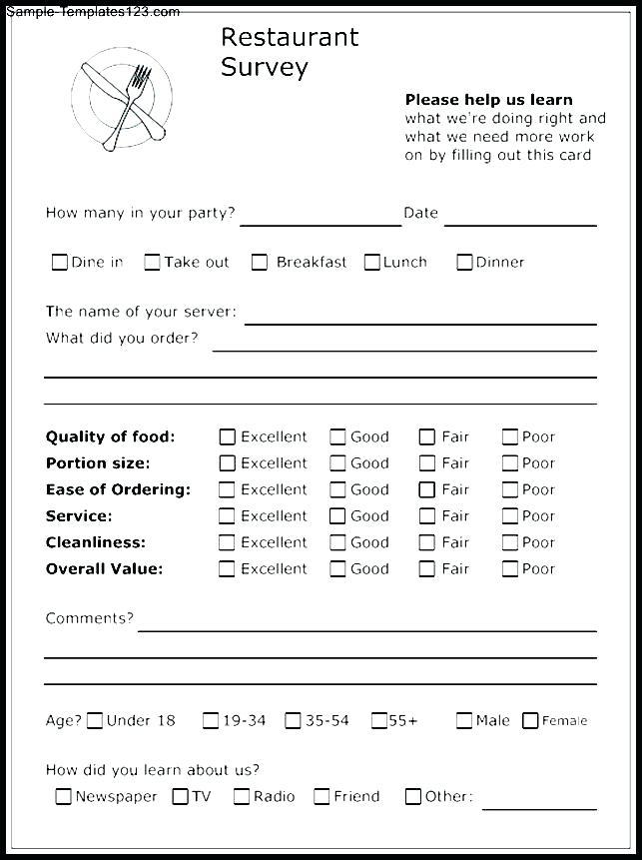
Sample Survey

Slide 58
Reliability and validity of measurement
Reliability: The degree of consistency and accuracy with which an instrument measures a variable.
Validity: The extent to which an instrument measures what it is designed to measure

Slide 59
Discussion…….

