Slide 1
EXPORT Marketing

Slide 2
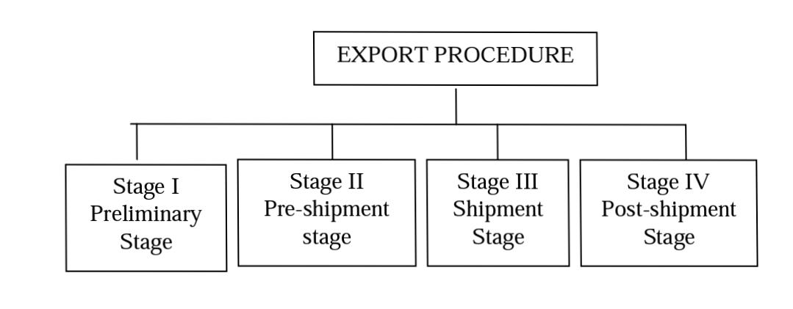
EXPORT PROCEDURE (Chp 12)
everything that the exporter is required to do right from the receipt of a confirmed order up to the realization
carried out under definite procedures
selling abroad requires specialized knowledge regarding certain matter
STAGES IN EXPORT PROCEDURE:

Slide 3
PRELIMINARY STAGE:
1) Organizing
2) Registering with various Authorities
a) Income Tax Authorities to obtain permanent Account Number (PAN).
b) Jt. DGFT – to obtain Importer‟s exporter‟s code Number (IEC No.)
c) EPC – to obtain Registration – cum –membership – certificate (RCMC)
d) Other authorities, such as FIEO, sales Tax authorities, chambers of commerce etc.
3) Appointing Agent / Distributors
4) Approaching Foreign Buyers

Slide 4
PRE-SHIPMENT STAGE:
1)Cofirmation of order act
2) Obtaining Letter of credit
3) Obtaining pre-shipment Finance
4) Obtaining Export License
5) Production and Procurement of goods
6) Packing and Marketing
7) Pre-shipment Inspection
8) Central Excise Clearance
a)Export Under Rebate and b) Export Under the bond.
9) ECGC cover
10) Marine Insurance policy
11) Appointment of clearing and Forwarding Agent

Slide 5
SHIPMENT STAGE :
1) Reservation of space in the ship .
2) Preparation and processing of shipping documents
3) Physical Examination of goods at the port
4) Loading of goods

Slide 6
POST-SHIPMENT STAGE:
1) Dispatch of Documents
2) Shipment font advice to importer
3) Presentation of Documents to the Bank
4) Realization of export proceeds
5) Follow-up of Export sales

Slide 7
EXCISE CLEARANCE PROCEDURE
Excise is a levy imposed by the Central Government on goods manufactured in India
Export under bond – The exporter need not pay any amount of duty but export the goods under a bond supported by a bank guarantee.
Export under Rebate – Under this system, the manufacturer / exporter initially pays the duty and then claims its refund after shipment of the goods.
PROCEDURE FOR EXCISE CLEARANCE:
The common procedure of excise clearance under „bond‟ and under „rebate‟ is as follows –
1) Preparing of Invoice
2) Filling up of ARE-1 Form
3) Application to Assistant collector
4) Instruction to Range Superintendent
5) Appointment of Inspector either at the factory or at the port.

Slide 8
6) Processing of ARE-1 Form
The fifth (blue) copy is returned to the exporter.
b) The fourth (green) copy is sent by Excise Authorities to the chief Accounts officer of central Excise.
c) The third (pink) copy is sent to maritime collector of central Excise at the part of shipment.
d) The original (white) and the duplicate (buff) copies are returned to the exporter.
e) The exporter hands over the original and the duplicate copies to the customs authorities
f) The customs preventive officer sends the original to the maritime collector (MCCF) and the duplicate copy is returned to the exporter or his agent.
7) Refund of Excise Duty

Slide 9
ROLE OF CUSTOM AGENTS
Custom Agents are the agents who look after the customs and forwarding formalities relating to export of goods.
The following are the most important services provided by CHA
1) Obtaining Shipping order
2) Arrangement for Internal Transport
3) Preparing of shipping Bill
4) Submission of Documents to customs
5) Obtaining carting order
6) Storing of goods
7) Obtaining "Let Export order"
8) Obtaining "Let Ship order"
9) Loading of goods
10) Obtaining Bill of Lading

Slide 10
Shipping and custoM Formalities
The custom procedure can be briefly explained as follows.
1) Submission of Document
2) Verification of documents
3) Carting order
4) Storing the goods in the sheds
5) Examination of goods
6) Obtaining "Let Ship order"
7) Loading of goods
8) Payment of port dues
9) Obtaining Bill of lading

Slide 11
Marine insurance
Marine Insurance is a contract under which the insurer undertakes to indemnity the insured against losses, caused due the perils of the sea.
Section 3 of the Marine Insurance Act, 1963 defines a contract of marine insurance as an insurance cover for marine cargo, air cargo and post parcels.
PROCEDURE FOR OBTAINING MARINE INSURANCE POLICY
1) Selection of Insurance Company
2) Type of policy
3) Proposal Form
4) Verification of proposal form
5) Payment of premium
6) Insurance Policy

Slide 12
Details
After making painsurf insurance, the insurance company
issues the insurance policy which contains the following –
a) The name and address of the insurance company.
b) The name and address of the insured.
c) A description of the risks covered.
d) A description of the goods insured.
e) The sum insured.
f) The date of issue, and the period of the policy.
g) The places where claims are payable together with details of the agent to whom claims may be directed.
h) Any other details, as applicable.
7) Filing of claim
8) Claim Amount

Slide 13
Negotiation of export documents
The submission of the full set of shipping documents to the bank for realization of payments is called negotiation of documents.
1) Negotiation of Documents
2) Letter of Indemnity
3) Dispatch of documents
4) Declaration of Export
5) Declaration Forms
Declaratio

Slide 14
Realization of export proceeds
Payment against exports should be realized only through an authorized dealer. No payment can be received even through bank drafts and cheques, unless exempted otherwise by RBI.
The following are the steps in realizing export proceeds.
1) Approaching a Bank
2) Submission of documents to the bank
3) Verification of documents
4) Letter of Indemnity
5) Discounting of Bills
6) Despatch of documents
7) Method of Realizationy
8) Processing of G R Form

Slide 15
Iso 9000 certification meaning
International organization for standardization (ISO) is an international body representing more than 120 countries . The objective of ISO is to facilitate the development of international standards in order to reduce the “barriers” effect of different national standards on international trade of goods and services. ISO is a non-governmental organization.
Meaning of ISO 9000
Quality standard recognized at the global level is called ISO 9000.
ISO 9000 provides common standards of products and services worldwide. ISO 9000 is essentially a mark of quality assurance. It is adopted by more than 120 countries. The developed nations prefer to import from the exporters who have obtained ISO 9000 certification for their products.
ISO 9000 is a series of five international standards an quality management. The series consists of ISO 9000, ISO 9001, ISO 9002, ISO 9003 and ISO 9004. These are as follows.
STANDARDS
ISO 9001- Consists of 20 elements covering design, development, production, installation and servicing. It is the most comprehensive standard.
ISO 9002 - Same as 9001 without design and service,
ISO 9003 - Consists of 12 elements covering final inspection and testing for laboratories, ware houses etc.

Slide 16
Importance/advantages of ISO 9000
INTERNAL BENEFITS
1) Improvement in Efficiency
2) Lower Reject
3) Better Relationship
4) Team work
5) Optimum Utilization of Resources
6) Motivate personnel
EXTERNAL BENEFITS
1) Customer Satisfaction
2) Corporate image
3) Improved competitiveness
4) Increase in sales
5) Better Brand Image

Slide 17
Procedure certification for obtaining ISO
The following is the procedure to obtain ISO 9000 certification
1) Assessment of existing quality procedure
2) Initiating corrective Action
3) Preparation of Quality assurance programme
4) Preparation of Quality Manual
5) Selection of certification agency
6) Pre-inspection meeting
7) Preliminary visit
8) Actual assessment visitg
9) Certification
10) Surveillance

Slide 18
Thankyou ☺

