Slide 1
Traditional Grammar
Presented by: Rogelyn A. Castaῇeto
MED - English

Slide 2
Traditional Grammar is applied to summarize the range of methods found in the pre-linguistic era of grammatical study. The whole approach of this method emphasizes on correctness, linguistic purism, literary excellence, the priority of the written mode of language and the use of Latin models.

Slide 3
Traditional grammarians considered Latin as their model because English is a part of the Indo-European family of languages, and to which Latin and Greek also belong. It did have similar grammatical elements. If you study the form of traditional grammar, the rules of classical languages were followed considering that English did not have grammar of its own. And English followed Latin grammar.
Besides the parts of speech, traditional grammatical analysis also makes use of numerous other categories, just like 'number', 'gender', 'person', 'tense' and 'voice'.

Slide 4
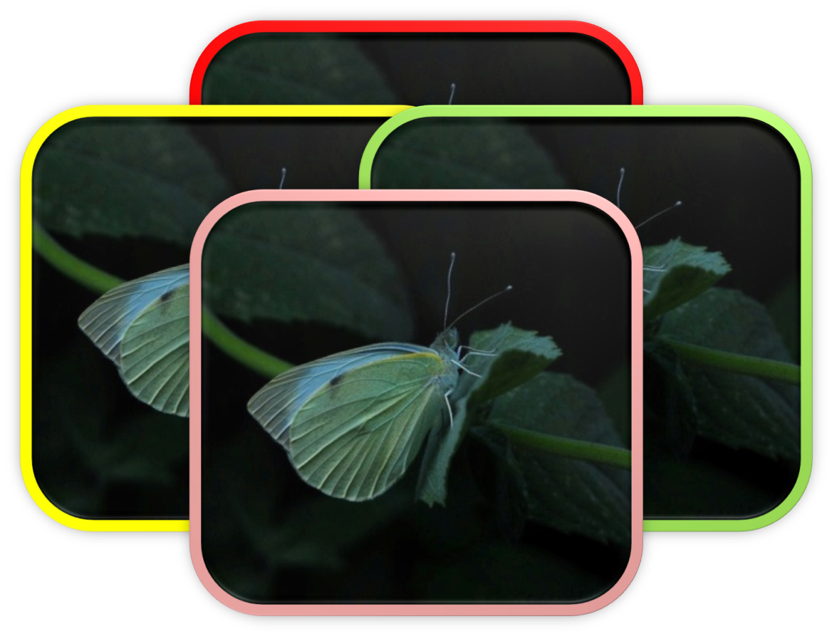
Traditional Grammar is the speculative work of the medieval and the prescriptive approach of the 18th Century grammarians basically it refer back to the Aristotelian orientations towards the nature of language as it is shown in the work of the ancient Greeks and Romans. There are ideas about sentence structure deriving form Aristotle and Plato ideas about the parts of speech deriving from the socio-grammarians.

Slide 5
The collection of prescriptive rules and concepts about the structure of language that is commonly taught in schools.
Traditional English grammar(also known as school grammar) is largely based on the principles of Latin grammar, not on current linguistic research in English.

Slide 6
"We say that traditional grammar is prescriptive because it focuses on the distinction between what some people do with language and what they ought to do with it, according to a pre-established standard. . . . The chief goal of traditional grammar, therefore, is perpetuating a historical model of what supposedly constitutes proper language." (James D. Williams, The Teacher's Grammar Book. Routledge, 2005)

Slide 7
"Why do the media cling to traditional grammar and its sometimes out-dated rules? Mainly because they like the prescriptive approach of traditional grammar rather than the descriptive approach of structural and transformational grammar. . . . "Why? Inconsistencies in the style of a newspaper, online news site, magazine or book draw attention to themselves when readers should instead be concentrating on the content. . . . "But the prescriptive rules have to be amended occasionally to reflect not only changes in the language but also research that proves traditional advice may have been inaccurate. The work of linguists is essential for making such calls on the best evidence available." (Brian Brooks, James Pinson, and Jean Gaddy Wilson, Working with Words. Macmillan, 2005)

Slide 8
Firstly, modern linguistic is descriptive(to describe the way people speak) , while traditional grammar is prescriptive(to prescribe the way people speak, or simply, to tell people how to speak and let people know the correct way of their speaking ) *Secondly, traditional grammar pays more attention to the written form of language, while linguistics attaches more importance to speaking than writing. *Thirdly, traditional grammar has been restricted mainly to SYNTAX, that is, the way of words making patterns to form sentences, while linguistics has a boarder scope for researching, ex. Pragmatics, psycholinguistics, sociolinguistics.
What is the difference between traditional grammar and modern linguistics?

Slide 9
Best Answer by WIKI
There is no difference. All grammar is traditional. There is a difference between formal or written grammar, which insists on certain distinctions, as between who and whom, the appropriate use of subjunctive and the indicative moods and agreement of subject and verb, and informal or colloquial grammar which does not. Modern English grammar, as the description of modern English usage characteristic of people under the age of forty, certainly suffers from the reduction of distinctions, the loss of refinement and the tongue-tied confusion of tenses and moods which is the inevitable result of having its standards set by the most careless speakers rather than by the most careful.
Traditional grammar doesn't let you write like you talk. It doesn't, among other things, let you end a sentence with a preposition or start a sentence with the word "and." Some English teachers still insist that people comply with each and every one of those archaic rules, but many writers have accepted and even recommended the use of modern grammar instead.

Slide 10
Traditional grammar is a framework for the description of the structure of language. Concepts treated in traditional grammars include:
Subject

Slide 11
The subject (abbreviated SUB or SU) is one of the two main constitutes of a clause, according to a tradition that can be tracked back to Aristotle and that is associated with phrase structure grammar; the other constituent is the predicate. According to another tradition, i.e. the one associated with predicate logic and dependency grammars, the subject is the most prominent overt argument of the predicate. Both traditions see the subject in English governing agreement on the verb or auxiliary verb that carries the main tense of the sentence, as exemplified by the difference in verb forms between he eats and they eat.

Slide 12
The predicate in traditional grammar is inspired by propositional logic of antiquity .A predicate is seen as a property that a subject has or is characterized by. A predicate is therefore an expression that can be true of something. Thus, the expression "is moving" is true of those things that are moving. This classical understanding of predicates was adopted more or less directly into Latin and Greek grammars and from there it made its way into English grammars, where it is applied directly to the analysis of sentence structure. The predicate is one of the two main parts of a sentence (the other being the subject, which the predicate modifies). The predicate must contain a verb, and the verb requires, permits, or precludes other sentence elements to complete the predicate.

Slide 13
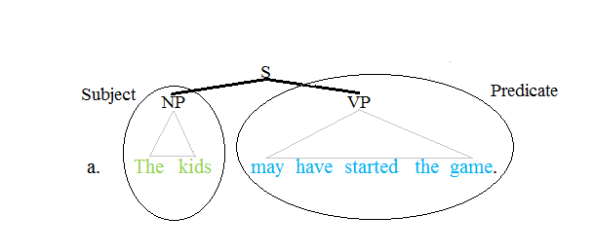

Slide 14
An object in grammar is part of a sentence, and often part of the predicate. It denotes somebody or something involved in the subject's "performance" of the verb. Basically, it is what or whom the verb is acting upon. As an example, the following sentence is given:
"Bobby scored a goal", "a goal" is the object.

Slide 15
A sentence is a grammatical unit consisting of one or more words that bear minimal syntactic relation to the words that precede or follow it. A sentence can include words grouped meaningfully to express a statement, question, exclamation, request, command, or suggestion.

Slide 16
In grammar an adverbial is a word (an adverd) or a group of words (an adverbisl phrase or an adverbial clause) that modifies or tells us something about the sentence or the verb. The word adverbial is also used as an adjective, meaning 'having the same function as an adverb'. Look at the examples below:
Danny speaks fluently. (telling us more about the verb)

Slide 17
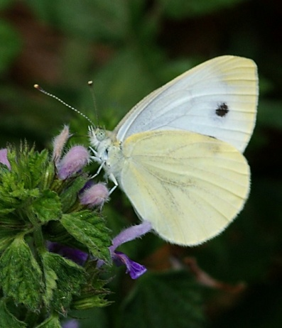
A clause typically contains at least a subject noun phrase and a finite verb. While the subject is usually a noun phrase, other kinds of phrases(such as gerund phrases) work as well, and some languages allow subjects to be omitted. There are two types of clauses: independent and subordinate (dependent). An independent clause demonstrates a complete thought; it is a complete sentence: for example, I am sad. A subordinate clause is not a complete sentence: for example, because I have no friends.

Slide 18
A noun is a part of speech typically denoting a person, thing, place or idea.
In linguistics, a noun is a member of a large, open lexical category whose members can occur as the main word in the subject of a clause, the object, of a verb, or the object of a preposition.
The syntactic rules for nouns differ from language to language.
An adjective is a 'describing' word; the main syntactic role of which is to qualify a noun or noun phrase, giving more information about the object signified.
Adjectives are one of the traditional eight English parts of speech, although linguists today distinguish adjectives from words such as determinerst hat formerly were considered to be adjectives

Slide 19
A verb, from the Latin verbum meaning word, is a word that in syntax conveys an action (bring, read, walk, run, learn), an occurrence (happen, become), or a state of being (be, exist, stand). In the usual description of English the basic form, with or without the participle to, is the infinitives. In many languages, verbs are inflected (modified in form) to encode tense, aspect, mood and voice. A verb may also agree with the person, gender and/or number of some of its arguments, such as its subject, or object. In many languages, verbs have a present tense, to indicate that an action is being carried out; a past tense, to indicate that an action has been done; and a future tense, to indicate that an action will be done.

Slide 20
A conjunction (abbreviated CONJ or CNJ) is a part of speech that connects two words, sentences, phrase, clauses together. A discourse connective is a conjunction joining sentences. The definition may also be extended to idiomatic phrases that behave as a unit with the same single-word conjunction (as well as, provided that, etc.).

Slide 21
Despite the fact that traditional grammar is informal, unscientific full of contradictions and inconsistencies, inexplicit, inadequate, and prescriptive uneconomical and unwholesome and it ignores spoken language, language change, contemporary usage and all the varieties of language. It is still crucial unit of English language. It is not in so much what traditional grammar actually tells us about language that is the real worrying factor as what it does not tell us. Thus there is no need for whole scale change, it surely needs to be mended rather than ended.

Slide 22
Salamat!!!

