Slide 1
Chapter 1 Semiconductor Diodes
Edit by Shaheen

Slide 2
Instructor
Dr. Ateeq-Ur-Rehman Shaheen,
E-mail: ateeq.shaheen@uos.edu.pk

Slide 3
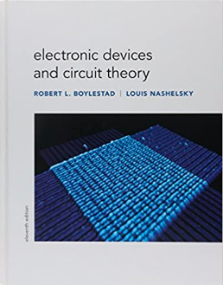
ELECTRONIC DEVICES AND CIRCUIT THEORY
Robert boylestad and Louis nashelsky, 11th edition

Slide 4
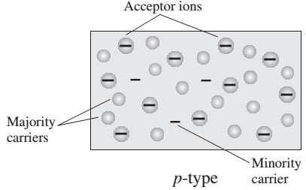
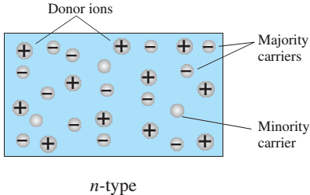
Semiconductor Diode
N-Type Material
The p-type material is formed by doping a pure germanium or silicon crystal with impurity atoms having three valence electrons (boron, gallium, and indium).
P-Type Material
An n-type material is created by introducing impurity elements that have five valence electrons (pentavalent), such as antimony, arsenic, and phosphorus.

Slide 5
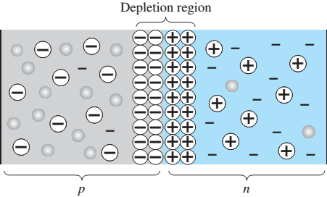
Semiconductor Diode
The semiconductor diode is created by simply joining an n-type and a p-type material together, nothing more, just the joining of one material with a majority carrier of electrons to one with a majority carrier of holes.
This region of uncovered positive and negative ions is called the depletion region due to the “depletion” of free carriers in the region.

Slide 6
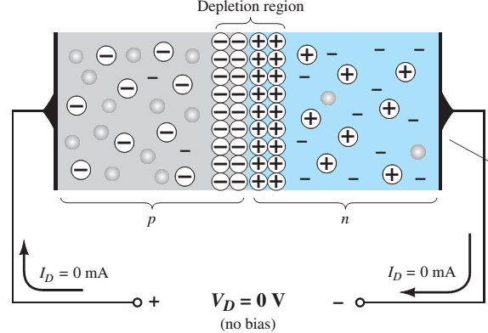
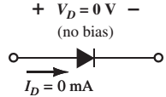
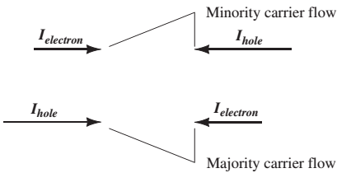
Semiconductor Diode
No Applied Bias (V = 0 V)
The majority carriers (electrons) of the n-type material must overcome the attractive forces of the layer of positive ions in the n-type material and the shield of negative ions in the p-type material to migrate into the area beyond the depletion region of the p-type material. However, the number of majority carriers is so large in the n-type material that there will invariably be a small number of majority carriers with sufficient kinetic energy to pass through the depletion region into the p-type material.
In the absence of an applied bias across a semiconductor diode, the net flow of charge in one direction is zero.

Slide 7
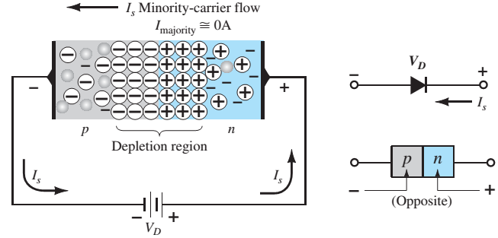
Semiconductor Diode
Reverse Bias (V < 0 V)
The number of uncovered positive ions in the depletion region of the n-type material will increase due to the large number of free electrons drawn to the positive potential of the applied voltage. For similar reasons, the number of uncovered negative ions will increase in the p-type material. The net effect, therefore, is a widening of the depletion region. This widening of the depletion region will establish too great a barrier for the majority carriers to overcome, effectively reducing the majority carrier flow to zero.
The current that exists under reverse-bias conditions is called the reverse saturation current and is represented by Is.

Slide 8
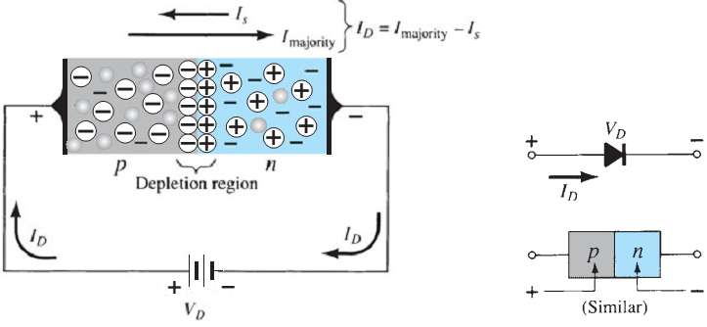
Semiconductor Diode
Forward Bias Bias (V > 0 V)
The application of a forward-bias potential V D will “pressure” electrons in the n-type material and holes in the p-type material to recombine with the ions near the boundary and reduce the width of the depletion region. The resulting minority-carrier flow of electrons from the p-type material to the n-type material (and of holes from the n-type material to the p-type material) has not changed in magnitude (since the conduction level is controlled primarily by the limited number of impurities in the material), but the reduction in the width of the depletion region has resulted in a heavy majority flow across the junction. An electron of the n-type material now “sees” a reduced barrier at the junction due to the reduced depletion region and a strong attraction for the positive potential applied to the p-type material. As the applied bias increases in magnitude, the depletion region will continue to decrease in width until a flood of electrons can pass through the junction.

Slide 9
Semiconductor Diode
V-I Characteristics
General characteristics of a semiconductor diode can be defined by the following equation, referred to as Shockley’s equation, for the forward- and reverse-bias regions:

Slide 10
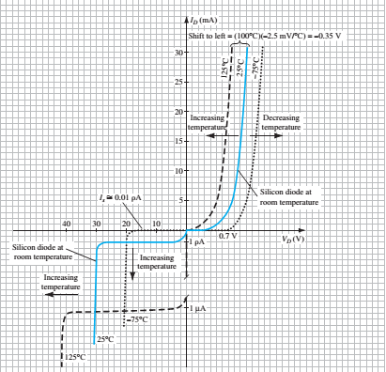
Semiconductor Diode
V-I Characteristics

Slide 11
Ideal Vs Practical Diode

Slide 12
Load Line of Diode

Slide 13
DC or Static Resistance

Slide 14
AC Resistance

