Slide 1
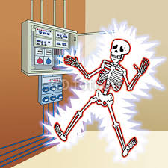
ELECTRIC SHOCK

Slide 2
A shock is a pain full stimulus of sensory nerves which is caused by a sudden flow, cessation or variation in the intensity of current passing through the body
Motor nerves may be stimulated causing muscle contraction

Slide 3
The severity of shock
The greater is the intensity of current, the more sever is the shock
According to Ohm’s law, The current intensity depends on
EMF
Resistance
High EMF, lager will be the intensity of the current
So apparatus used for patient are kept at low EMF i.e.
For d.c. It is not more than 75 volts
N for muscle stimulating currents __ 110 to 130 volts
High Resistance , reduces the intensity of current
Exposed part of circuit, touched with dry hands/ wet hands

Slide 4
Path taken by the current flow:
High intensity current through head, neck, heart or whole body prove fatal
A.C or D.C.
A.C. is more sever, as continuously changing polarity causes more sensory stimulation, titanic muscle contraction, impossible for the victim to let go of the conductor

Slide 5
Effects of shock
Following minor shock
Frightened
Distressed
Not loss consciousness
After more sever shock
Fall of blood pressure
Loss of consciousness
In extreme cases
Cessation of respiration___ lack of respiratory movements & cyanosis
Cardiac arrest___ absence/ abnormal resp. movt. Absence of carotid pulse, fully dilated pupils

Slide 6
Treatment of shock
First step:
Remove the victim from the source of supply
A.C. must be switch off at once
But D.C./unvarying disconnected slowly, as sudden cessation can cause a second shock
If no switch in the circuit, the victim must be removed from the contact, with great care
Contact with the affected person should be made only through a thick layer of insulating material

Slide 7
Following a minor shock:
Reassured the patient
Ask to rest
Give water to drink
Avoid hot drinks as they cause vasodilatation and further fall in blood pressure
Better to consult a medical officer

Slide 8
Following a more sever shock:
Lay the victim flat so that respiratory passages are clear
Tight clothing is loosened and plenty of air allowed
Undue warmth is avoided(vasodilatation _ fall in BP) also external heat increases metabolism, and increase the demand of oxygen
If patient is unconscious , nothing is given by mouth, a medical officer is called without delay
If respiration has ceased, air ways should be clear and artificial respiration is commenced
If cardiac arrest is occurred, external cardiac massage must be applied
The most important is to call the medical emergency

Slide 9
Causes of shock
A patient may receive a shock in the course of an electrical treatment is a result of a sudden increase in the intensity of current
Direct and LFC is switched on with the controls turns up
If insufficient time is allowed to warm up current come suddenly
Intensity control is turned up unduly during the interval of current flow
If there is a fault in the apparatus
Patient touches the exposed part of circuit
Sudden cessation of DC

Slide 10
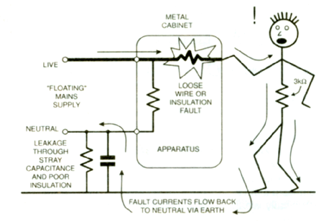

Slide 11
Precautions
All apparatus must be tested before used, connection checked
Check controls that they are at zero before switching on
Adequate warm up time and intensity increase accurately
Patient should not allow to touch the apparatus
Apparatus should be serviced regularly
Physiotherapist may receive a shock while handling the equipment, so be careful when ever connections are made or removed

Slide 12
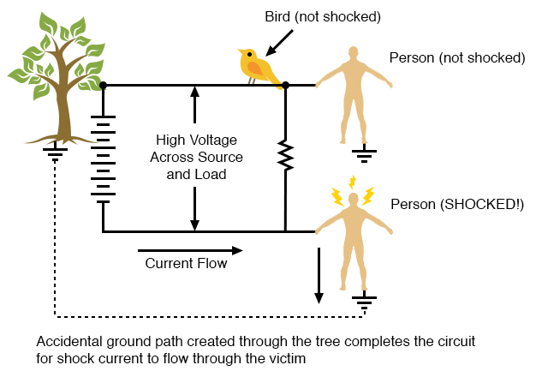
Earth shock
when a shock is due to a connection between the live wire of the main and earth, is known as earth shock

Slide 13
The earth circuit
Electric power is transmitted by one live cable and neutral cable which is connected to the earth.
The earth form the part of conducting pathway and any connection between the live wire of main and earth completes a circuit through which current passes.
If some person forms part of this circuit he receives an earth shock

Slide 15
Connection to the live cable
A patient who is receiving treatment with a current that is not earth free is connected to the cable
If patient touches exposed part of apparatus and if switch breaks only the neutral wire
Insulation of live wire is faulty and it come in contact with some metal part of apparatus, casing etc.

Slide 17
Connection to earth
Touching any conductor which is connected to earth
Like gas or water pipes, stone floors etc. particularly if they are damped
A metal bed on such a floor is also dangerous, if it make connection with exposed live wire too

Slide 18
Examples of earth shock
Simultaneous connections to the live wire and to the earth can occur in a variety of way, e.g,
A patient who is receiving treatment with earth free current rest her hand on water pipe
Physiotherapist holding an electrode which is connected to the live wire touches the earthed apparatus casing
Person standing on a damp stone floor, touching the apparatus which is in contact with live wire

Slide 19
Precautions
Physiotherapy department should be arranged so that there is minimal dangers of making an earth connection while in contact with apparatus
Water and gas pipes should be out of the reach of apparatus and patients
Floor should be of insulating material and kept dry
If floor is not of insulating material, rubber mat or rubber shoes should be used
Switches must break the live wire and fuses should be on live wire
Patient not touches the apparatus, especially when using water bath method, and bath tub should be of insulating material
Water should not be added during treatment
Current used must be earth free
Cells provide earth free currents
Ensure the quality of apparatus while purchasing

Slide 20
Thanks

