Slide 1
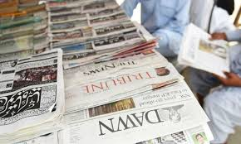
Newspaper Terminologies

Slide 2
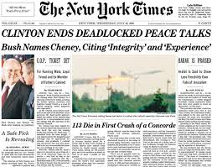
Beat: A reporter's regular routine for covering news sources.
Banner: A headline in large letters running across the entire width of the first page.

Slide 3
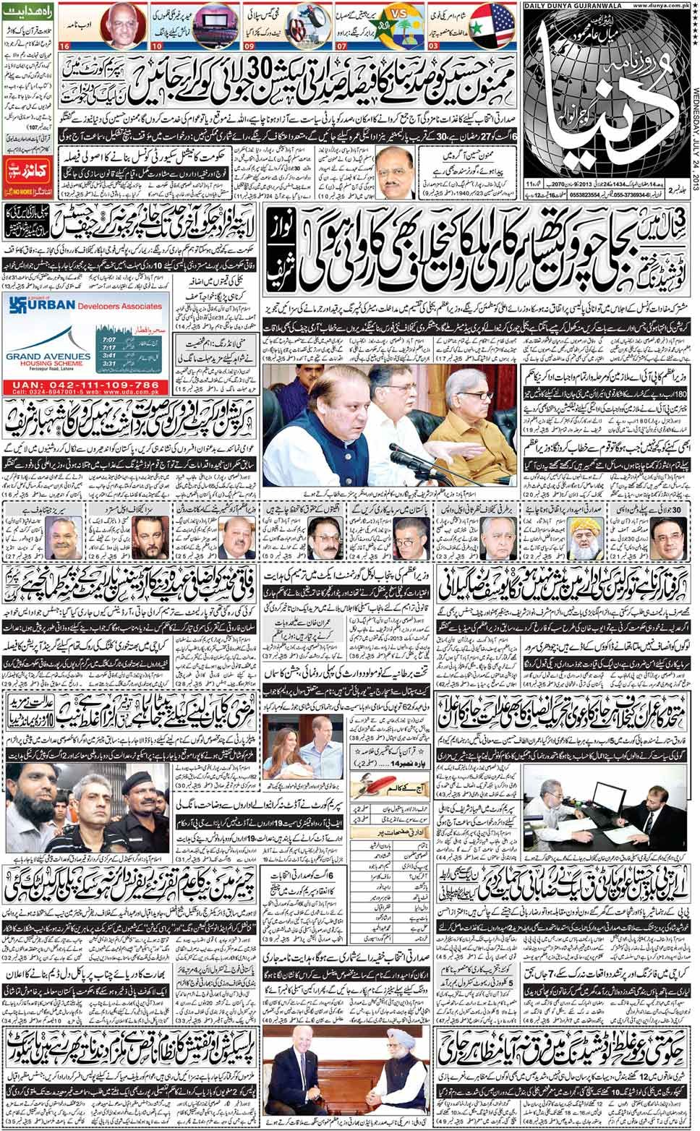
Broadsheet: A "standard" or large-sized newspaper. The measurements of broadsheet newspapers vary.

Slide 4
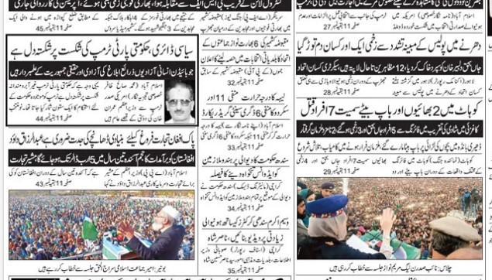
Box: Border around a story or photo.

Slide 5
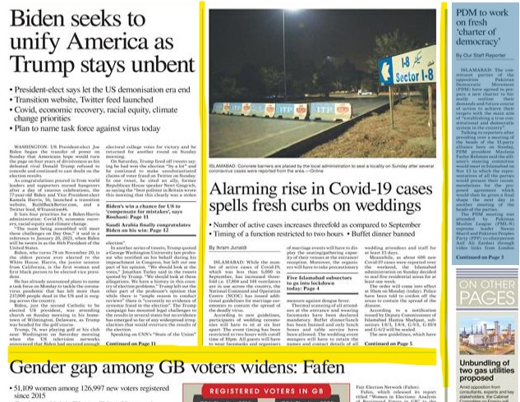
Rule: The line which separate the news stories.

Slide 6
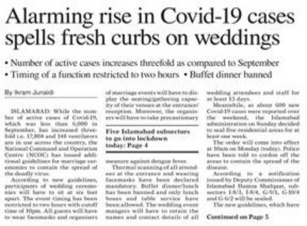
Byline: The name of the writer printed at the top of a story.

Slide 7
Caption: A title or explanatory phrase accompanying a picture. The larger type over a cutline.

