Slide 1
Exponential Smoothing Methods Muhammad Wasim Amir

Slide 2
Motivation of Exponential Smoothing
Simple moving average method assigns equal weights (1/k) to all k data points.
Arguably, recent observations provide more relevant information than do observations in the past.
So we want a weighting scheme that assigns decreasing weights to the more distant observations.

Slide 3
Exponential Smoothing
Exponential smoothing methods give larger weights to more recent observations, and the weights decrease exponentially as the observations become more distant.
These methods are most effective when the parameters describing the time series are changing Slowly over time.

Slide 4
Data vs Methods
No trend or
seasonal
pattern?
Linear trend
and no seasonal
pattern?
Both trend
and seasonal
pattern?
N
N
N
Y
Y
Y
Single
Exponential
Smoothing
Method
Holt’s Trend
Corrected
Exponential
Smoothing
Method
Holt-Winters
Methods
Use Other
Methods

Slide 5
Simple Exponential Smoothing
The Simple Exponential Smoothing method is used for forecasting a time series when there is no trend or seasonal pattern, but the mean (or level) of the time series y_{t} is slowly changing over time.
NO TREND model

Slide 6
Procedures of Simple Exponential Smoothing Method
Step 1: Compute the initial estimate of the mean (or level) of the series at time period t = 0
Step 2: Compute the updated estimate by using the smoothing equation
where α is a smoothing constant between 0 and 1.

Slide 7
Procedures of Simple Exponential Smoothing Method
Note that
The coefficients measuring the contributions of the observations decrease exponentially over time.

Slide 8
Simple Exponential Smoothing
Point forecast made at time T for y_{T+p}
SSE, MSE, and the standard errors at time T
Note: There is no theoretical justification for dividing SSE by (T – number of smoothing constants). However, we use this divisor because it agrees to the computation of s in Box-Jenkins models introduced later.

Slide 9
Example: Cod Catch
The Bay City Seafood Company recorded the monthly cod catch for the previous two years, as given below.
Cod Catch (In Tons)
Month | Year 1 | Year 2
January | 362 | 276
February | 381 | 334
March | 317 | 394
April | 297 | 334
May | 399 | 384
June | 402 | 314
July | 375 | 344
August | 349 | 337
September | 386 | 345
October | 328 | 362
November | 389 | 314
December | 343 | 365

Slide 10
Example: Cod Catch
The plot of these data suggests that there is no trend or seasonal pattern. Therefore, a NO TREND model is suggested:
It is also possible that the mean (or level) is slowly changing over time.

Slide 11
Example: Cod Catch
Step 1: Compute ℓ₀ by averaging the first twelve time series values.
Though there is no theoretical justification, it is a common practice to calculate initial estimates of exponential smoothing procedures by using HALF of the historical data.

Slide 12
Example: Cod Catch
Step 2: Begin with the initial estimate ℓ₀ = 360.6667 and update it by applying the smoothing equation to the 24 observed cod catches.
Set α = 0.1 arbitrarily and judge the appropriateness of this choice of α by the model’s in-sample fit.

Slide 13
One-period-ahead Forecasting

Slide 14
Example: Cod Catch
Results associated with different values of α
Smoothing Constant | Sum of Squared Errors
0.1 | 28735.11
0.2 | 30771.73
0.3 | 33155.54
0.4 | 35687.69
0.5 | 38364.24
0.6 | 41224.69
0.7 | 44324.09
0.8 | 47734.09

Slide 15
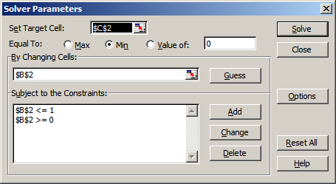
Example: Cod Catch
Step 3: Find a good value of α that provides the minimum value for MSE (or SSE).
Use Solver in Excel as an illustration
SSE
alpha

Slide 16
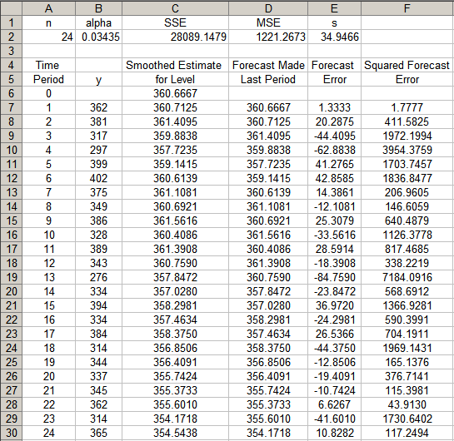
Example: Cod Catch

