Slide 1
Subbing and Editing

Slide 2
Subbing and Editing
Subbing or editing is a process of selecting, vetting, identifying the news stories to make them capable for writing, rewriting, designing, copy making and printing according to standard language, law and policy of news media organization.

Slide 3
Sub Editor
Sub editor is a person who edits the news stories, rewriting the news stories, check accuracy or authenticity, corrects language, chose appropriate words to make headline, decision about the space, makeup or design the page.

Slide 4
Subbing Process
Collection of News (Reports, Staff Reporters, Correspondents, News agencies)
Press Releases
Creed
Internet

Slide 5
Types of Sub Editor
Stringer
Sub Editor
Desk Incharge
Shift Incharge
Managing Editor
Executive Editor
Proof Reader

Slide 6
Professional Traits of Sub Editor
All rounder
Language Abilities
Sense of Grammar
Awareness of Media Organization Policy
Understanding of Journalism Jorgen
Professional Writer
Knowledge about Press Laws
Managerial Skills

Slide 7
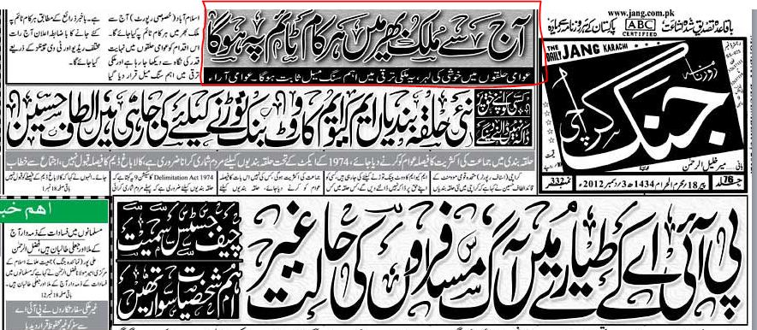
How to write Headlines
The summary of news in few words prominently before formal description of the details.

Slide 8
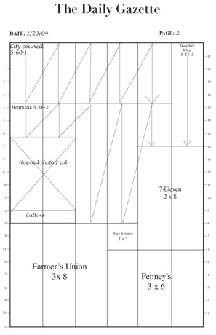
Deck
The space of the page reserved for headline while process of page making is called deck.

Slide 9
Standard of Words
One Column, 6 to 12
Two Column, 6 to 12
Dropper, 16 to 22
Hanger, 16 to 22

Slide 10
Streamer or Banner Headline
The stretches across the whole page is called Banner headline.

Slide 11
Main Headline
The most important news which is printing prominently on the first page is called main headline or lead story.

Slide 12
Super Lead
The second important story of the day is called super lead.

Slide 13
Inverted Pyramid
This type of headline reflects the inverted pyramid image.

Slide 14
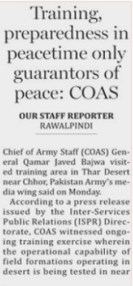
Hanging Indention
The headline which has same lines or in which lines are equal.

Slide 15
Step Headline
The headline which lines are in shape of stairs or steps.
c

Slide 16
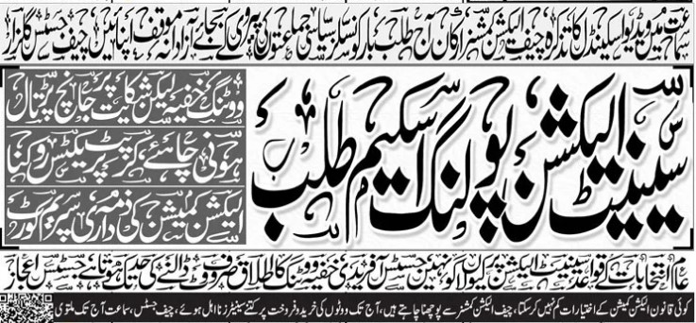
Kicker
The headline which is followed by same important words used as reference of the background of the news.

Slide 17
Reverse Headline
When the background is black and words are white is called reverse headline.

Slide 18
How to write Headline
Read and understand the story.
Choose specific precise words
Make each word count
Use active verbs
Show some creativity
Look for fresh angle and fresh words

Slide 19
How to write Headlines
Don’t repeat words

Slide 20
How to write Headlines
Use attribution and qualification.
For example:
Vitamin C prevents cold, study says

Slide 21
Fine Rules for Headline Writing
Commas can be used to replace the word “And”.

Slide 22
Fine Rules for Headline Writing
Dashes and Colons can replace the word said

Slide 23
Fine Rules for Headline Writing
Single quotation marks are used instead of double quotation marks because single marks take less space.

Slide 24
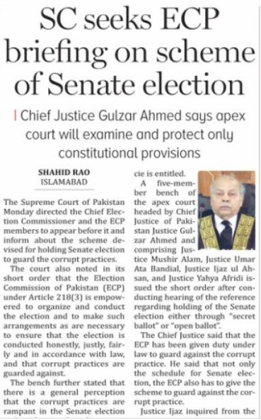
Fine Points for Headline Writing
Present Tens: Most headlines in present tens. Which shows urgency and freshness.

Slide 25
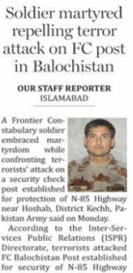
Fine Points for Headline Writing
Past Tens: About events that are not current.

Slide 26
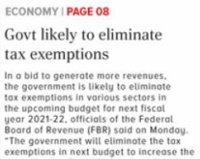
Fine Points for Headline Writing
Future Tens: In this tens will, shell replace by “to”.

Slide 27
Fine Points for Headline Writing
Abbreviations: Because space in headline is tight. Newspaper allows to use abbreviations.

Slide 28
Fine Points for Headline Writing
Capitalization:
Up Style: First letter of every word in headline capitalized.
Down Style: Capitalized only the first word of headline.

