Slide 1
EDUCATIONAL PSYCHOLOGY
Simply put Educational psychology is the study of the learner, learning and teaching.
The roles of Educational Psychology in the teaching/learning process
1. To understand how learning processes can be effectively guided by taking into account the special circumstances of the student’s setting.
2. To determine how teaching can be made more effective, how educational goals can be made more meaningful, and how desirable educational goals can be achieved.
3. To evaluate and influence the curriculum changes which may be needed to make learning more relevant to the cultural setting.
4. To help solve learning problems and select suitable materials that relate to the student’s background.
5. To guide or indicate how children can receive social learning and how they should be challenged to perform social services that may develop their community.

Slide 2
EDUCATIONAL PSYCHOLOGY
Simply put Educational psychology is the study of the learner, learning and teaching. In some more comprehensive way it is the study of the ways in which the learner can most effectively be brought into successful interaction with the material to be learnt, the learning situation and the teacher who provides the learning opportunity.
The roles of Educational Psychology in the teaching/learning process
1. To understand how learning processes can be effectively guided by taking into account the special circumstances of the student’s setting.
2. To determine how teaching can be made more effective, how educational goals can be made more meaningful, and how desirable educational goals can be achieved.
3. To evaluate and influence the curriculum changes which may be needed to make learning more relevant to the cultural setting.
4. To help solve learning problems and select suitable materials that relate to the student’s background.
5. To guide or indicate how children can receive social learning and how they should be challenged to perform social services that may develop their community.

Slide 17
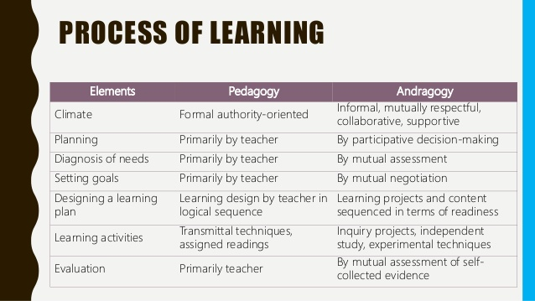

Slide 18
Focal areas of Educational Psychology
· The learner
· The learning process
· The learning situation
The learner
persons who individually or collectively comprise the class and on whose behalf educational programmes exist and operate

Slide 19
Factors considered when a teacher focuses on learners include:
· Family background
· Prior knowledge
· Motivation
· Developmental level
· Interests
· Attitude

Slide 20
The learning process
Is next in order of importance. It refers to the process by which people change their behaviour, improve performance, reorganize their thinking or become familiar with new concepts and information.
Important aspects of this element include:
· When people learn, the change in their behaviour may not be directly observed [perceiving, thinking, remembering and identifying] or it may be observed [writing, attending and talking].
· Learning is an on going process that begins at birth and continues in some form or another until one dies.

Slide 21
The learning situation
Refers to the environment where learners find themselves and where the learning process takes place.
Some parts of the environment may be immediate such as the classrooms and the library.
Other aspects may be remote but relevant, such as the relationship between the school/university committee and the head teacher.

Slide 22
Importance of Educational psychology to teachers
Educational psychology serves as a foundation discipline in education in the same way that physical science serves engineering [Gage, Berliner, 1999].
Educational psychology serves as a guideline to educational practice.
For example it offers important ideas about learning and about the influences that families, business, industry and the community have on learning.
In very specific ways Educational psychology may help a teacher to:

Slide 23
• Understand the nature of the learner and the learning process. This means taking into consideration growth and development patterns of learners to maximize learning opportunities.
• Understand the many variables that interact as learning takes place in the classroom.
This ensures greater understanding of the learning environment to help pupils achieve their best,
• Understand the role of the teacher in the classroom in view of the social interactions within the classroom and other psychological variables that affect social behaviour.
• Structure subject matter, learn how materials are transferred in teaching and evaluate what has been taught.
• Understand oneself as both a teacher and a person which is necessary so that a teacher controls role conflict.

