Slide 1
"The Art of the Book" contains FOUR areas:
Calligraphy
Illumination
Illustrations (miniature)
Binding and other technicality related to book making.
The art of illumination is not only limited to the Muslim world, previous religious texts like the Torah and the Bible were also illuminated/gilded with real gold. The styles of each religion, each geographical region and each time period are slightly different.
The 'Khamsah' of Niẓāmī 1539-1543 Source

Slide 2
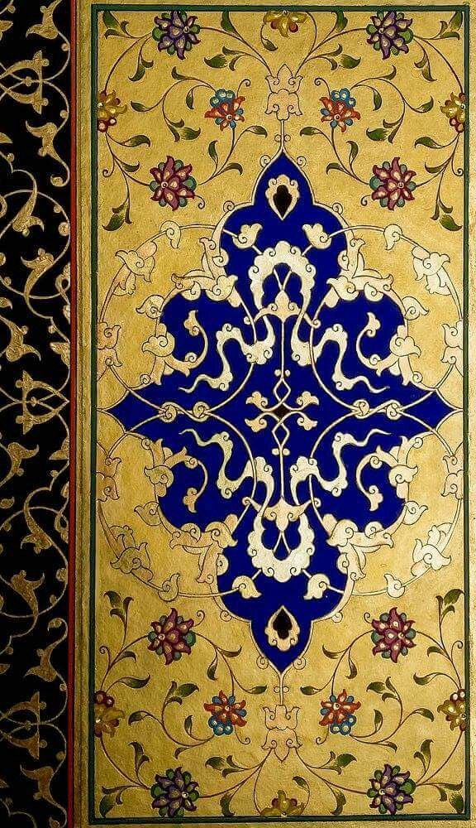
Traditional islamic illumination

Slide 3
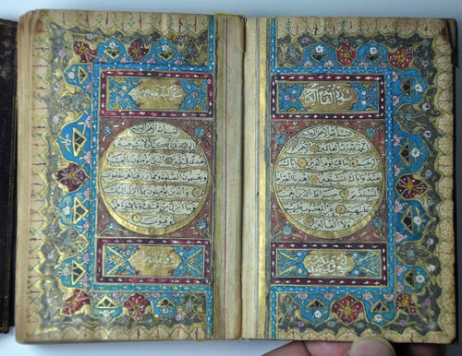
700 years old

Slide 4
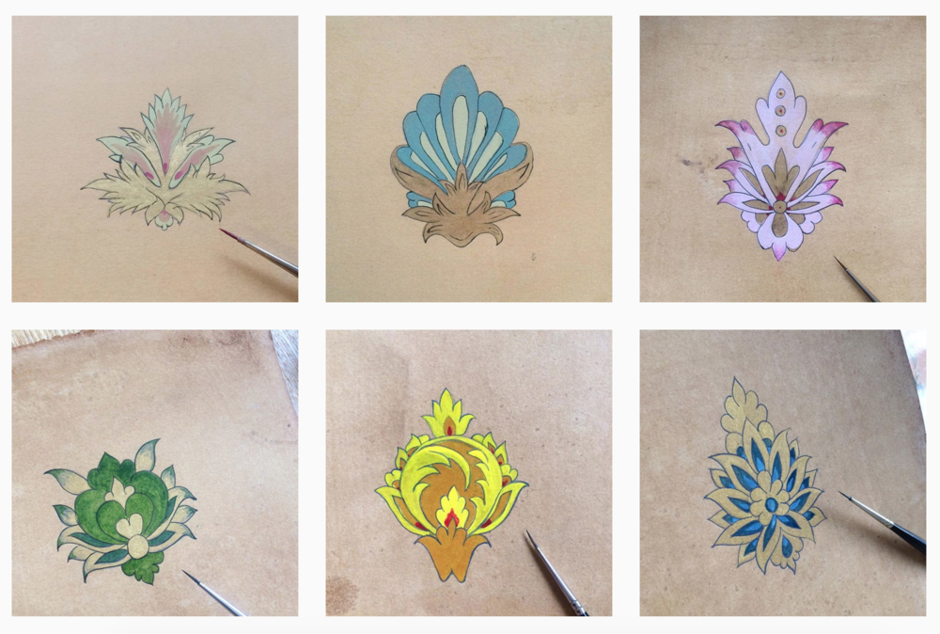
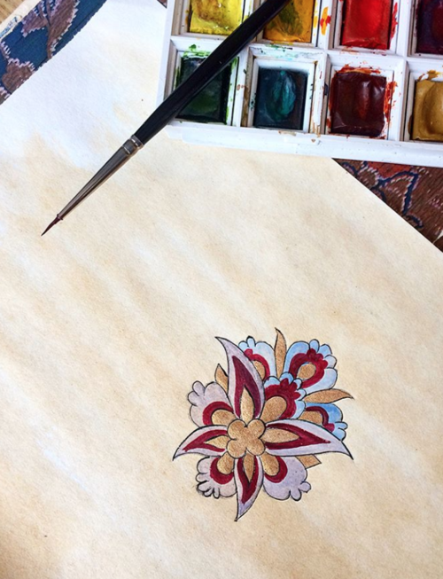
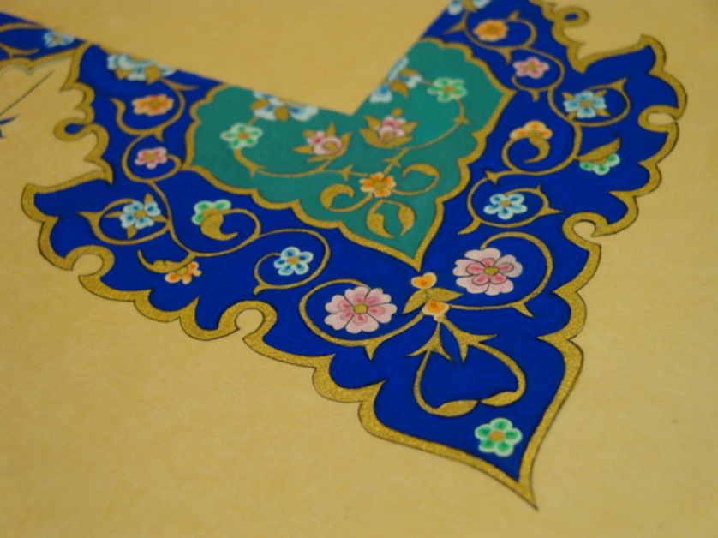

Slide 6
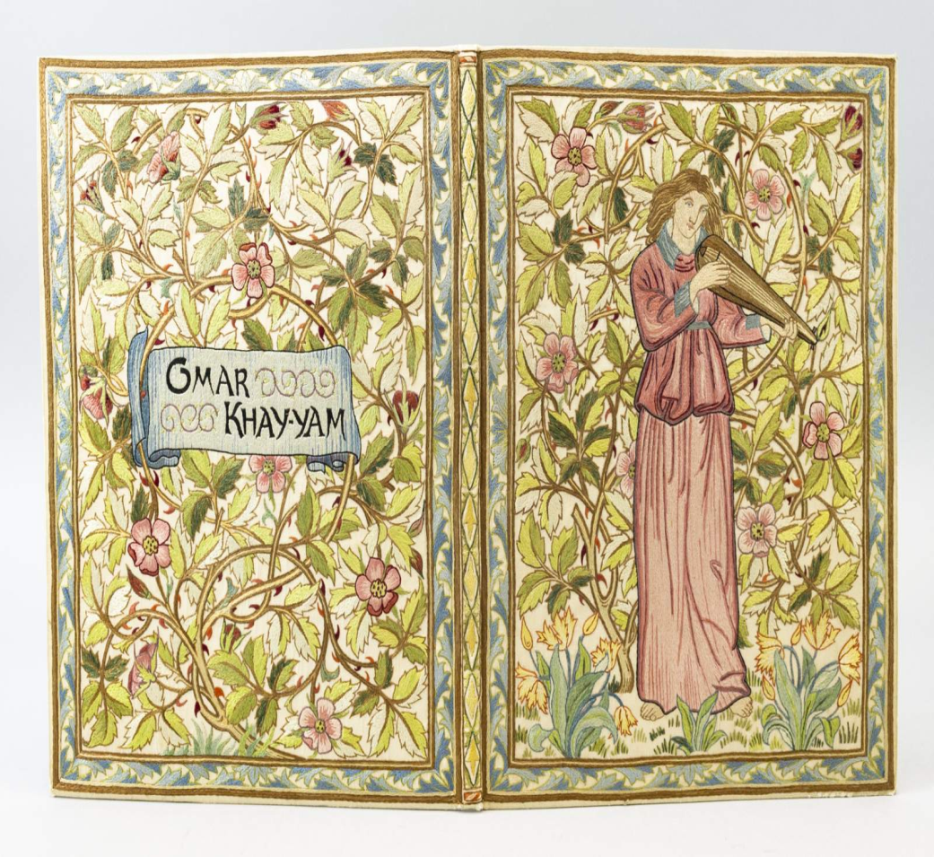
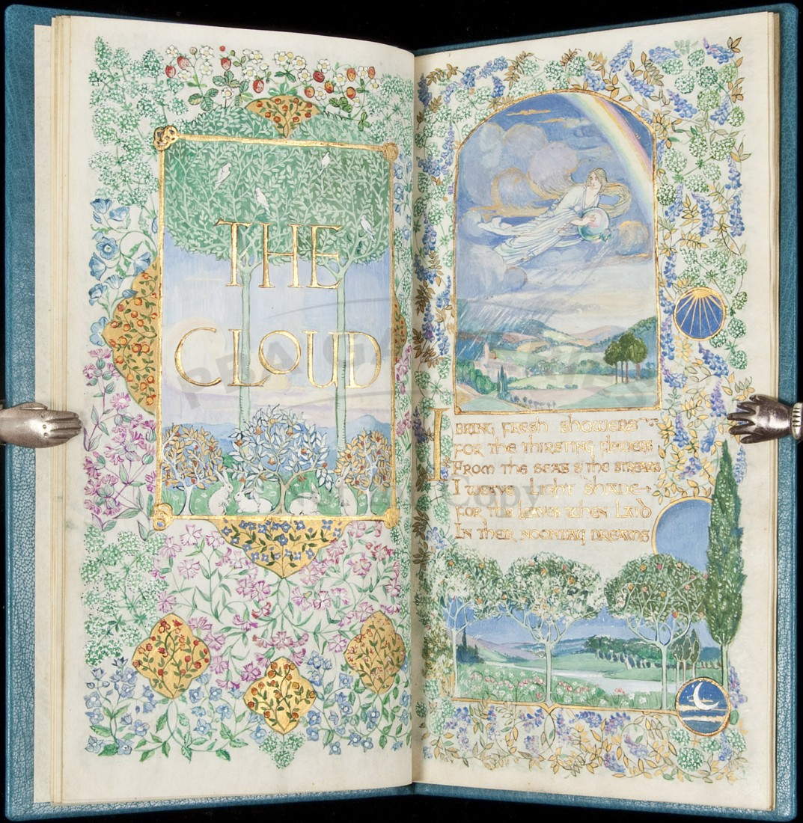
Modern Illuminated Manuscript on Vellum

Slide 7
