Slide 2
MIXER
A device that blends or mixes substances or ingredients, especially by mechanical agitation.
OR
A food mixer is a piece of electrical equipment that is used to mix food such as batter.

Slide 3
OBJECTIVES
2
Blending ingredients together to form a uniform mass.
To hydrate the ingredients.
Kneading for gluten development.

Slide 4
Why we need different types of mixers?
3
There is no single design of mixer that perform all of the functions with maximum efficiency.

Slide 5
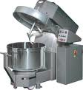
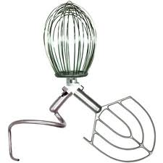
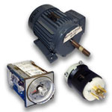
Components of a mixer
4
Bowl
Lid
Shaft
Beaters
Motor

Slide 6
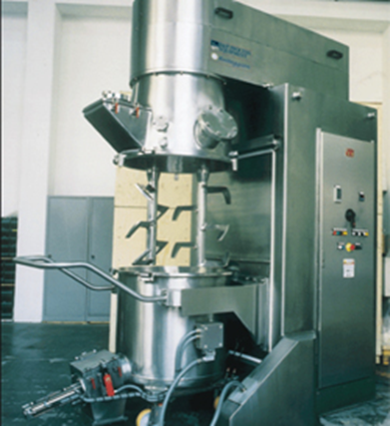
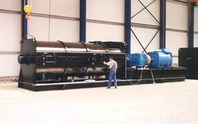
Types of mixers
5
Batch type mixers.
Continuous mixers.

Slide 7
Batch type mixers
6
Vertical mixers.
Planetary mixers
Spiral mixers
Horizontal high speed mixers
These could be further classified into
Single/ Double arm(beater) mixers
Detachable/ Non-detachable bowl mixers
Fixed/ Moveable bowl mixers
Slow/ High Speed mixers

Slide 8
Vertical mixers
7
Beaters are placed vertically.
Bowl may be fixed or moveable .
Shaft may b fixed or moveable.
Fixed shaft
Moveable shaft

Slide 9
Moveable shaft………. Single beater
9
Shaft is
moved in
Circular, planetary manner.

Slide 10
Spiral Mixers
10
The spiral mixer takes its name from the spiral-shaped hook
It uses to mix dough mostly and are not ideal for other functions like whipping or mixing ingredients.
The bowl for this mixer rotates while the spiral hook is stationary, making this ideal for kneading the dough for bread, delicate French dough and pizza.

Slide 11
Spiral Mixers
11

Slide 12
Planetary mixer
12
Consist of a bowl which remains static, while an agitator is rapidly moved around the bowl to mix its contents.
These are more versatile than their spiral mixers, and can be used to mix a wide variety of ingredients.
Also use to whip and blend, which cannot be done with a spiral mixer.
These are used for mixing soft dough like batter, cream preparation.

Slide 13
Planetary mixer
13

Slide 14
Advantages
14
Bowls and beaters are portable and changeable.
Without additional handling different operations can be performed e.g. resting, fermentation, remixing.
Visual monitoring of state of dough.

Slide 15
Disadvantages
15
Slow speed (not more than 20 rev/min
Long mixing time (45 minutes to develop dough)
Slow speed (not more than 20 rev/min)
Sometime non-uniformity.

Slide 16
Horizontal high speed mixers
16
Beater are placed horizontally.
Bowl is fixed & a door is used to discharge the dough.
Shafts may be single or multiple.
Single shaft beater
Multiple shaft beater

Slide 17
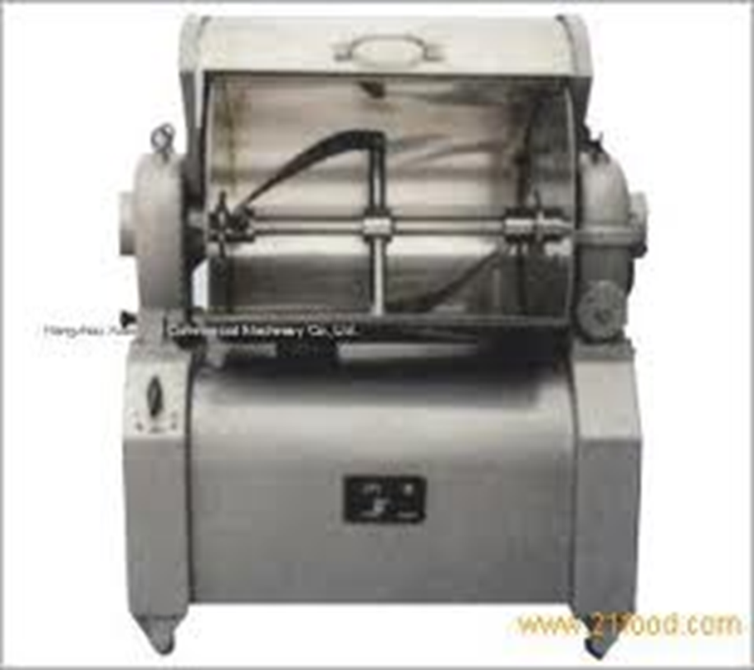
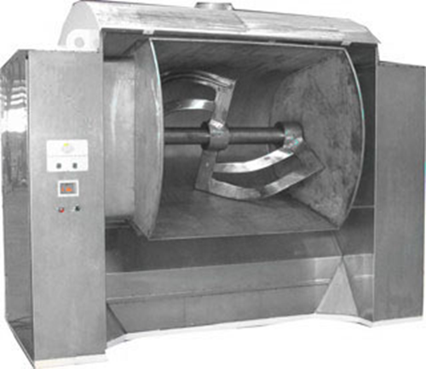
Single shaft beater
17
Beaters are usually inclined to through the dough upward & towards the sides during rotation.

Slide 18
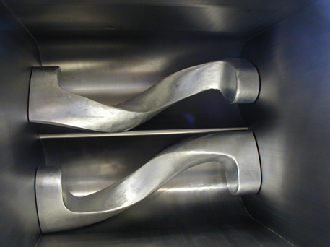
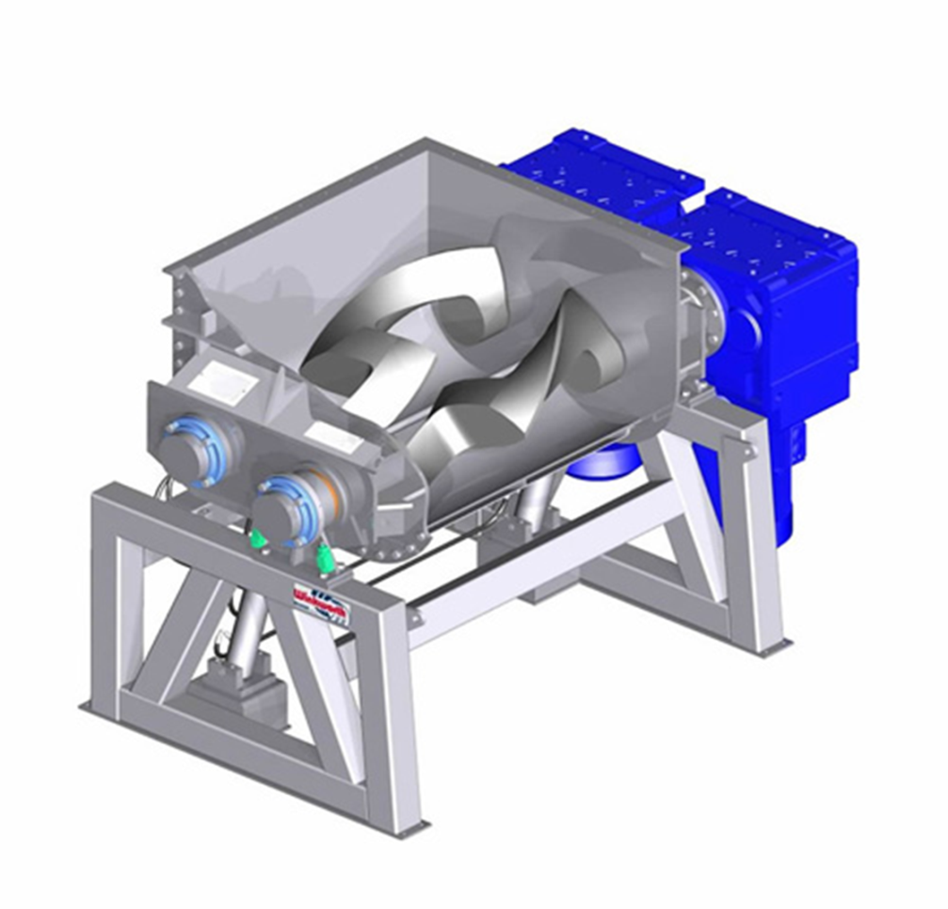
Multiple shaft beater
18
Two shafts are employed
Bottom of the bowl is W-Shaped
Shafts rotates in opposite direction
These are usually called Z- Blade mixers.

Slide 19
Advantages
19
Powerful mixer (handle tough & large quantity of dough)
Efficient discharging.
High speed(60 rev/min)
Less time consuming(15-20 minutes to develop dough)

Slide 20
Disadvantages
20
Less variety in design
Material wastage
No visual observation
Difficult cleaning

Slide 21
Continuous mixers
21
Barrel with a rotor
Different types of blades(arms) perform different mixing operations in barrel (blending, dispersing, aerating & kneading)
Ingredients may be added according to need
( at start, at specific interval).
Water jackets are used for temperature control
Barrel length controls the retention time & mixing time.

Slide 22
22

Slide 23
Advantages
23
Best & neatest dough making
Uniform dough production
Require minimum supervision

Slide 24
Disadvantages
24
Starting & stopping is difficult
Continuous measuring of ingredients are required
Best for single purpose plants

