Slide 1
Internal Scanning: Organizational Analysis
Chapter 5

Slide 2
Learning Objectives
Apply the resource-based view of the firm to determine core and distinctive competencies
Use the VRIO framework and the value chain to assess an organization’s competitive advantage and how it can be sustained
Understand a company’s business model and how it could be imitated
Notes:
After reading this chapter, you should be able to:
• Apply the resource-based view of the firm to determine core and distinctive competencies
• Use the VRIO framework and the value chain to assess an organization’s competitive advantage and how it can be sustained
• Understand a company’s business model and how it could be imitated

Slide 3
Learning Objectives
Assess a company’s corporate culture and how it might affect a proposed strategy
Scan functional resources to determine their fit with a firm’s strategy
Construct an IFAS Table that summarizes internal factors
Notes:
After reading this chapter, you should be able to:
• Assess a company’s corporate culture and how it might affect a proposed strategy
• Scan functional resources to determine their fit with a firm’s strategy
• Construct an IFAS Table that summarizes internal factors

Slide 4
A Resource-Based Approach to Organizational Analysis
Organizational analysis
concerned with identifying and developing an organization’s resources and competencies
Notes:
Organizational analysis is concerned with identifying, developing and taking advantage of an organization’s resources and competencies.

Slide 5
Core and Distinctive Competencies
Resources
an organization’s assets and are thus the basic building blocks of the organization
tangible, intangible
Capabilities
refer to a corporation’s ability to exploit its resources
consist of business processes and routines that manage the interaction among resources to turn inputs into outputs
Notes:
Resources are an organization’s assets and are thus the basic building blocks of the organization. They include tangible assets (such as its plant, equipment, finances and location), human assets (the number of employees, their skills and motivation), and intangible assets (such as its technology [patents and copyrights], culture and reputation).
Capabilities refer to a corporation’s ability to exploit its resources. They consist of business processes and routines that manage the interaction among resources to turn inputs into outputs.

Slide 6
Core and Distinctive Competencies
Core competency
a collection of competencies that cross divisional boundaries, is wide-spread throughout the corporation and is something the corporation does exceedingly well
Distinctive competency
core competencies that are superior to those of the competition
Notes:
A core competency is a collection of competencies that crosses divisional boundaries, is widespread within the corporation, and is something that the corporation can do exceedingly well. When core competencies are superior to those of the competition, they are called distinctive competencies.

Slide 7
VRIO Framework of Analysis
Value: Does it provide customer value and competitive advantage?
Rareness: Do no other competitors possess it?
Imitability: Is it costly for others to imitate?
Organization: Is the firm organized to exploit the resource?
Notes:
Barney, in his VRIO framework of analysis, proposes four questions to evaluate a firm’s competencies:
1. Value: Does it provide customer value and competitive advantage?
2. Rareness: Do no other competitors possess it?
3. Imitability: Is it costly for others to imitate?
4. Organization: Is the firm organized to exploit the resource?

Slide 8
Using Resources to Gain Competitive Advantage
Identify and classify resources in terms of strengths and weaknesses
Combine the firm’s strengths into specific capabilities and core competencies
Appraise profit potential—Are there any distinctive competencies?
Select the strategy that best exploits the firm’s capabilities and competencies relative to external opportunities
Identify resource gaps and invest in upgrading weaknesses
Notes:
Proposing that a company’s sustained competitive advantage is primarily determined by its resource endowments, Grant proposes a five-step, resource-based approach to strategy analysis.
1. Identify and classify the firm’s resources in terms of strengths and weaknesses
2. Combine the firm’s strengths into specific capabilities and core competencies
3. Appraise the profit potential of these capabilities and competencies in terms of their potential for sustainable competitive advantage and the ability to harvest the profits resulting from their use. Are there any distinctive competencies?
4. Select the strategy that best exploits the firm’s capabilities and competencies relative to external opportunities
5. Identify resource gaps and invest in upgrading weaknesses

Slide 9
Access to a Distinctive Competency
Asset endowment
Acquired from someone else
Shared with another business
Built and accumulated within the company
Notes:
A corporation can gain access to a distinctive competency in four ways:
• It may be an asset endowment, such as a key patent, coming from the founding of the company.
• It may be acquired from someone else.
• It may be shared with another business unit or alliance partner.
• It may be carefully built and accumulated over time within the company.

Slide 10
Access to a Distinctive Competency
Clusters
geographic concentrations of interconnected companies and industries
Access to:
Employees
Suppliers
Specialized information
Complementary products
Notes:
Clusters are geographic concentrations of interconnected companies and industries. According to Michael Porter, clusters provide access to employees, suppliers, specialized information and complementary products

Slide 11
Determining the Sustainability of an Advantage
Durability
the rate at which a firm’s underlying resources, capabilities or core competencies depreciate or become obsolete
Imitability
the rate at which a firm’s underlying resources, capabilities or core competencies can be duplicated by others
Notes:
Durability is the rate at which a firm’s underlying resources, capabilities or core competencies depreciate in value or become obsolete.
Imitability is the rate at which a firm’s underlying resources, capabilities or core competencies can be duplicated by others.

Slide 12
Determining the Sustainability of an Advantage
Transparency
the speed at which other firms under the relationship of resources and capabilities support a successful strategy
Transferability
the ability of competitors to gather the resources and capabilities necessary to support a competitive challenge
Replicability
the ability of competitors to use duplicated resources and capabilities to imitate the other firm’s success
Notes:
Transparency is the speed with which other firms can understand the relationship of resources and capabilities supporting a successful firm’s strategy.
Transferability is the ability of competitors to gather the resources and capabilities necessary to support a competitive challenge.
Replicability is the ability of competitors to use duplicated resources and capabilities to imitate the other firm’s success.

Slide 13
Determining the Sustainability of an Advantage
Explicit knowledge
knowledge that can be easily articulated and communicated
Tacit knowledge
knowledge that is not easily communicated because it is deeply rooted in employee experience or in the company’s culture
Notes:
It is relatively easy to learn and imitate another company’s core competency or capability if it comes from explicit knowledge—that is, knowledge that can be easily articulated and communicated.
Tacit knowledge, in contrast, is knowledge that is not easily communicated because it is deeply rooted in employee experience or in a corporation’s culture.

Slide 14
Business Models
Business model
a company’s method for making money in the current business environment
includes the key structural and operational characteristics of a firm—how it earns revenue and makes a profit
Notes:
A business model is a company’s method for making money in the current business environment. It includes the key structural and operational characteristics of a firm—how it earns revenue and makes a profit.

Slide 15
Business Models
A business model is usually composed of five elements:
Who it serves
What it provides
How it makes money
How it differentiates and sustains competitive advantage
How it provides its product/service
Notes:
A business model is usually composed of five elements:
■ Who it serves
■ What it provides
■ How it makes money
■ How it differentiates and sustains competitive advantage
■ How it provides its product/service

Slide 16
Business Models
Some of the many possible business models are:
Customer solutions model
Profit pyramid model
Multi-component system/installed model
Advertising model
Switchboard model
Notes:
Some of the many possible business models are:
• Customer solutions model
• Profit pyramid model
• Multi-component system/installed model
• Advertising model
• Switchboard model

Slide 17
Business Models
Some other possible business models are:
Efficiency model
Blockbuster model
Profit multiplier model
Entrepreneurial model
De Facto industry standard model
Notes:
Some other possible business models are:
• Efficiency model
• Blockbuster model
• Profit multiplier model
• Entrepreneurial model
• De Facto industry standard model

Slide 18
Value-Chain Analysis
Value chain
a linked set of value-creating activities that begin with basic raw materials coming from suppliers, moving on to a series of value-added activities involved in producing and marketing a product or service and ending with distributors getting the final goods into the hands of the ultimate consumer
Figure 5-1
Notes:
A value chain is a linked set of value-creating activities that begin with basic raw materials coming from suppliers, moving on to a series of value-added activities involved in producing and marketing a product or service and ending with distributors getting the final goods into the hands of the ultimate consumer. See Figure 5–1 for an example of a typical value chain for a manufactured product.

Slide 19
Industry Value Chain Analysis
Value chain segments include:
Upstream
Downstream
Center of gravity
the part of the chain that is most important to the company and the point where its core competencies lie
Notes:
The value chains of most industries can be split into two segments, upstream and downstream.
A company’s center of gravity is the part of the chain where the company’s greatest expertise and capabilities lie—its core competencies.

Slide 20
Corporate Value Chain Analysis
Primary activities
Support activities
Inbound logistics
Operations
Outbound logistics
Procurement
Technology development
Human resource management
Firm infrastructure
Notes:
Porter proposes that a manufacturing firm’s primary activities usually begin with inbound logistics (raw materials handling and warehousing), go through an operations process in which a product is manufactured, and continue on to outbound logistics (warehousing and distribution), to marketing and sales and finally to service (installation, repair and sale of parts). Several support activities, such as procurement (purchasing), technology development (R&D), human resource management and firm infrastructure (accounting, finance, strategic planning), ensure that the primary value-chain activities operate effectively and efficiently.

Slide 21
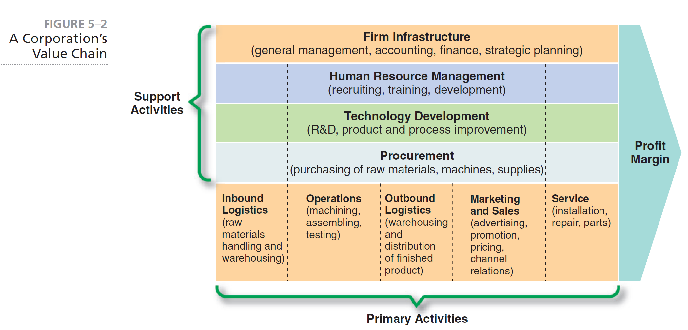
A Corporation’s Value Chain
Notes:
Each corporation has its own internal value chain of activities. See Figure 5–2 for an example of a corporate value chain.

Slide 22
Corporate Value Chain Analysis
Examine each product line’s value chain in terms of the various activities involved in producing the product or service
Examine the linkages within each product line’s value chain
Examine the potential synergies among the value chains of different product lines or business units
Notes:
Corporate value-chain analysis involves the following three steps:
Examine each product line’s value chain in terms of the various activities involved in producing the product or service
Examine the linkages within each product line’s value chain
Examine the potential synergies among the value chains of different product lines or business units

Slide 23
Basic Organizational Structures
Simple
Functional
Divisional
Strategic Business Units
Conglomerate
Notes:
Examples of basic organizational structures are simple, functional, divisional, strategic business units and conglomerate.

Slide 24
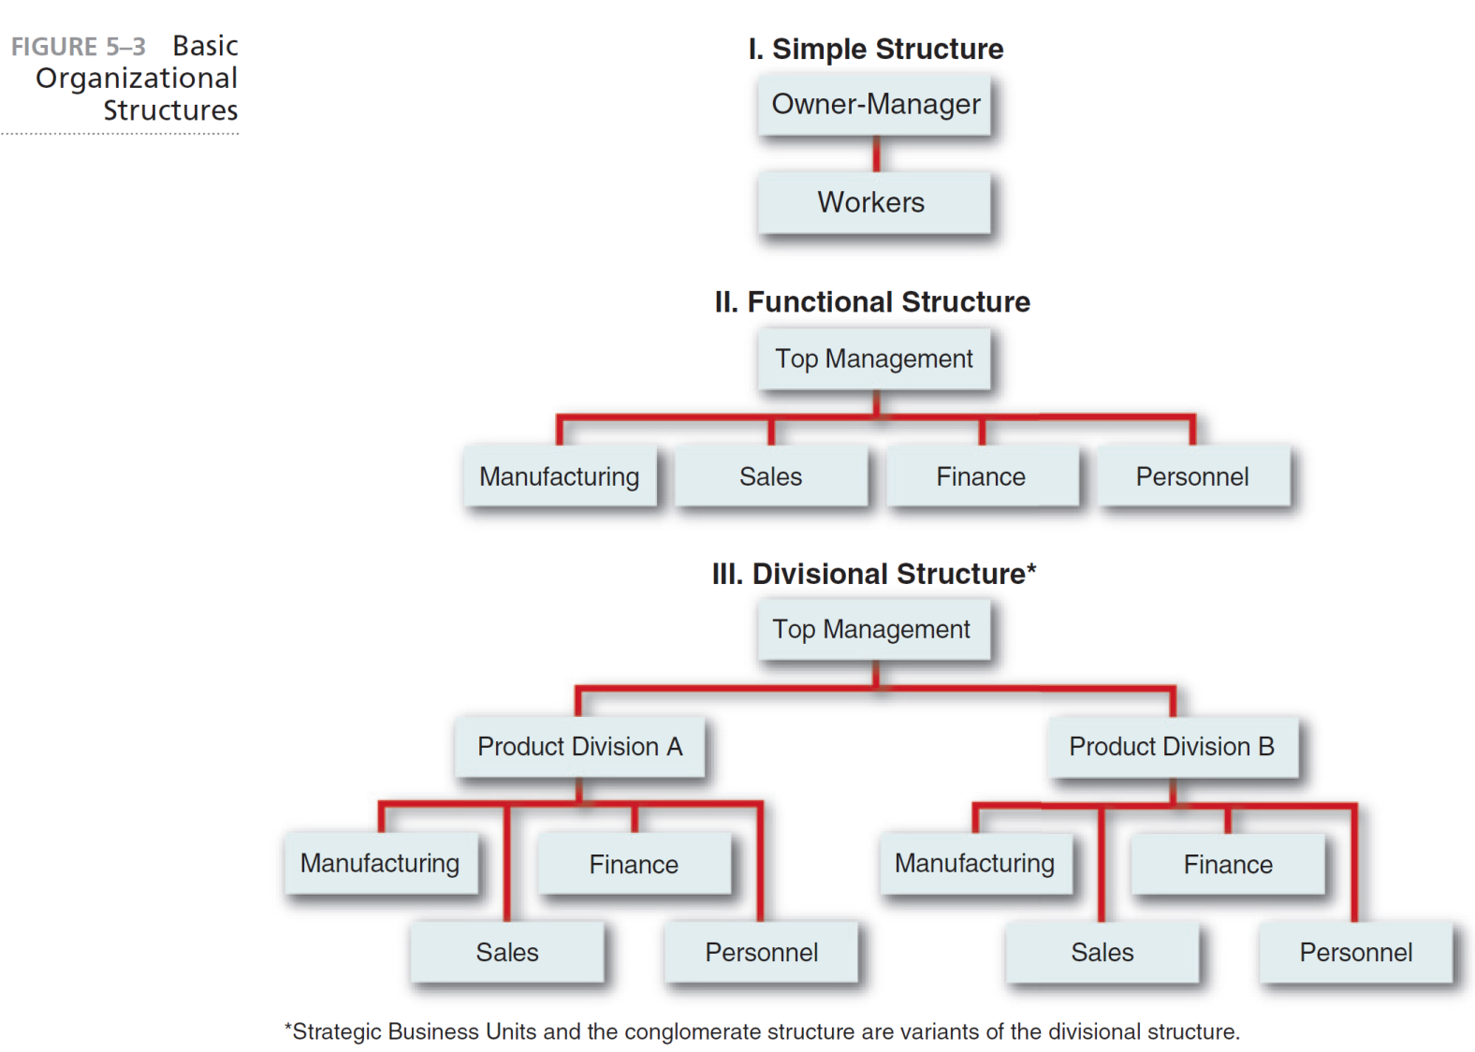
Basic Organizational Structures
Notes:
Figure 5–3 illustrates three basic organizational structures. The conglomerate structure is a variant of divisional structure and is thus not depicted as a fourth structure.

Slide 25
Corporate Culture: The Company Way
Corporate culture
the collection of beliefs, expectations and values learned and shared by a corporation’s members and transmitted from one generation of employees to another.
Notes:
Corporate culture is the collection of beliefs, expectations and values learned and shared by a corporation’s members and transmitted from one generation
of employees to another.

Slide 26
Functions of Corporate Culture
Conveys a sense of identity for employees
Generates employee commitment
Adds to the stability of the organization as a social system
Serves as a frame of reference for employees to understand organizational activities and as a guide for behavior
Notes:
Corporate culture fulfills several important functions in an organization:
1. Conveys a sense of identity for employees
2. Helps generate employee commitment to something greater than themselves
3. Adds to the stability of the organization as a social system
4. Serves as a frame of reference for employees to use to make sense of organizational activities and to use as a guide for appropriate behavior

Slide 27
Corporate Culture: The Company Way
Cultural intensity
the degree of which members of a unit accept the norms, values and other cultural content associated with the unit
shows the culture’s depth
Cultural integration
the extent of which units throughout the organization share a common culture
culture’s breadth
Notes:
Cultural intensity is the degree to which members of a unit accept the norms, values or other cultural content associated with the unit. This shows the culture’s depth.
Cultural integration is the extent to which units throughout an organization share a common culture. This is the culture’s breadth.

Slide 28
Strategic Marketing Issues
Market position
refers to the selection of specific areas for marketing concentration and can be expressed in terms of market, product and geographic locations
Marketing mix
the particular combination of key variables under a corporation’s control that can be used to affect demand and to gain competitive advantage
Notes:
Market position deals with the question, “Who are our customers?” It refers to the selection of specific areas for marketing concentration and can be expressed in terms of market, product and geographic locations.
Marketing mix refers to the particular combination of key variables under a corporation’s control that can be used to affect demand and to gain competitive advantage

Slide 29
Marketing Mix Variables
Notes:
Marketing mix variables are product, place, promotion and price. Within each of these four variables are several subvariables, listed in Table 5–1, that should be analyzed in terms of their effects on divisional and corporate performance.

Slide 30
Product Life Cycle
Product life cycle
a graph showing time plotted against the sales of a product as it moves from introduction through growth and maturity to decline
Notes:
As depicted in Figure 5–4, the product life cycle is a graph showing time plotted against the sales of a product as it moves from introduction through growth and maturity to decline.

Slide 31
Brand and Corporate Reputation
Brand
a name given to a company’s product which identifies that item in the mind of the consumer
Corporate brand
a type of brand in which the company’s name serves as the brand
Notes:
A brand is a name given to a company’s product which embodies all of the characteristics of that item in the mind of the consumer.
A corporate brand is a type of brand in which the company’s name serves as the brand.

Slide 32
Brand and Corporate Reputation
Corporate reputation
a widely held perception of a company by the general public
Consists of two attributes:
Stakeholders’ perceptions of quality
Corporation’s prominence in the minds of stakeholders
Notes:
A corporate reputation is a widely held perception of a company by the general public. It consists of two attributes: (1) stakeholders’ perceptions of a corporation’s ability to produce quality goods and (2) a corporation’s prominence in the minds of stakeholders.

Slide 33
Strategic Financial Issues
Financial leverage
ratio of total debt to total assets
describes how debt is used to increase earnings available to common shareholders
Capital budgeting
the analyzing and ranking of possible investments in fixed assets in terms of additional outlays and receipts that will result from each investment
Hurdle point
Notes:
The concept of financial leverage (the ratio of total debt to total assets) is helpful in describing how debt is used to increase the earnings available to common
shareholders.
Capital budgeting is the analyzing and ranking of possible investments in fixed assets such as land, buildings and equipment in terms of the additional outlays and additional receipts that will result from each investment. A good finance department will be able to prepare such capital budgets and to rank them on the basis of some accepted criteria or hurdle rate (for example, years to pay back investment, rate of return or time to break-even point) for the purpose of strategic decision making.

Slide 34
Strategic Research and Development Issues
R&D intensity
spending on R&D as a percentage of sales revenue
principal means of gaining market share in global competition
Technology transfer
the process of taking new technology from the laboratory to the marketplace
Notes:
A company’s R&D intensity (its spending on R&D as a percentage of sales revenue) is a principal means of gaining market share in global competition. A company should also be proficient;
Technology transfer is the process of taking a new technology from the laboratory to the marketplace.

Slide 35
R&D Mix
Basic R&D
focuses on theoretical problems
Product R&D
concentrates on marketing and is concerned with product or product packaging improvements
Engineering R&D
concerned with engineering, concentrating on quality control and the development of design specifications and improved production equipment
Notes:
Basic R&D is conducted by scientists in well-equipped laboratories where the focus is on theoretical problem areas. Product R&D concentrates on marketing and is concerned with product or product-packaging improvements.
Engineering (or process) R&D is concerned with engineering, concentrating on quality control, and the development of design specifications and improved production equipment.

Slide 36
Impact of Technological Discontinuity on Strategy
Technology discontinuity
when a new technology cannot be used to enhance current technology, but substitutes for the technology to yield better performance
Notes:
The displacement of one technology by another (technological discontinuity) is a frequent and strategically important phenomenon. Such a discontinuity occurs when a new technology cannot simply be used to enhance the current technology, but actually substitutes for that technology to yield better performance.

Slide 37
Strategic Operations Issues
Intermittent systems
item is normally processed sequentially, but the work and sequence of the process vary
Continuous systems
work is laid out in lines on which products can be continuously assembled or processed
Operating leverage
impact of a specific change in sales volume on net operation income
Notes:
In intermittent systems (job shops), the item is normally processed sequentially, but the work and sequence of the process vary. In contrast, continuous systems are those laid out as lines on which products can be continuously assembled or processed. Operating leverage is the impact of a specific change in sales volume on net operation income

Slide 38
Experience Curve
Experience curve
unit production costs decline by some fixed percentage each time the total accumulated volume of production units doubles
Notes:
The experience curve suggests that unit production costs decline by some fixed percentage (commonly 20%–30%) each time the total accumulated volume of production in units doubles.

Slide 39
Increasing Use of Teams
Autonomous (self-managed)
a group of people work together without a supervisor to plan, coordinate and evaluate their work
Cross-functional work teams
various disciplines are involved in a project from the beginning
Concurrent engineering
specialists work side-by-side and compare notes constantly to design cost-effective products with features customers want
Notes:
More than two-thirds of large U.S. companies are successfully using autonomous (self-managing) work teams in which a group of people work together without a supervisor to plan, coordinate and evaluate their own work.
With cross-functional work teams, various disciplines are involved in a project from the beginning. In a process called concurrent engineering, the once isolated specialists now work side by side and compare notes constantly in an effort to design cost-effective products with features customers want.

Slide 40
Increasing Use of Teams
Virtual teams
groups of geographically and/or organizationally dispersed co-workers that are assembled using a combination of telecommunications and information technologies to accomplish an organizational task
Notes:
Virtual teams are groups of geographically and/or organizationally dispersed co-workers that are assembled using a combination of telecommunications and information technologies to accomplish an organizational task

Slide 41
Trends Driving Virtual Teams
Flatter organizational structures
Turbulent environments
Increased employee autonomy
Higher knowledge requirements
Increased globalization
Notes:
The use of virtual teams to replace traditional face-to-face work groups is being driven by five trends:
1. Flatter organizational structures with increasing cross-functional coordination need
2. Turbulent environments requiring more interorganizational cooperation
3. Increasing employee autonomy and participation in decision making
4. Higher knowledge requirements derived from a greater emphasis on service
5. Increasing globalization of trade and corporate activity

Slide 42
Quality of Work Life and Human Diversity
Quality of work life includes improvements in:
Introducing participative problem solving
Restructuring work
Introducing innovative reward systems
Improving the work environment
Notes:
The knowledgeable human resource manager should be able to improve the corporation’s quality of work life by (1) introducing participative problem solving, (2) restructuring work, (3) introducing innovative reward systems, and (4) improving the work environment.

Slide 43
Quality of Work Life and Human Diversity
Human diversity
the mix in the workplace of people from different races, cultures and backgrounds
provides a competitive advantage
Notes:
Human diversity refers to the mix in the workplace of people from different races, cultures and backgrounds.

Slide 44
Strategic Information Systems/Technology Issues
Information systems/technology contributions to performance:
Automation of back office processes
Automation of individual tasks
Enhancement of key business functions
Development of a competitive advantage
Notes:
Information systems/technology offers four main contributions to corporate performance:
• Automation of back office processes
• Automation of individual tasks
• Enhancement of key business functions
• Development of a competitive advantage

Slide 45
Strategic Information Systems/Technology Issues
Web 2.0
the use of wikis, blogs, RSS (Really Simple Syndication), social networks (e.g., LinkedIn and Facebook), podcasts and mash-ups through company Web sites to forge tighter links with customers and suppliers and to engage employees more successfully
Notes:
A recent development in information systems/technology is Web 2.0. Web 2.0 refers to the use of wikis, blogs, RSS (Really Simple Syndication), social networks (e.g., LinkedIn and Facebook), podcasts and mash-ups through company Web sites to forge tighter links with customers and suppliers and to engage employees more successfully.

Slide 46
Strategic Information Systems/Technology Issues
Supply chain management
the forming of networks for sourcing raw materials, manufacturing products or creating services, storing and distributing the goods and delivering them to customers and consumers
Notes:
Supply chain management is the forming of networks for sourcing raw materials, manufacturing products or creating services, storing and distributing the goods and delivering them to customers and consumers.

Slide 47
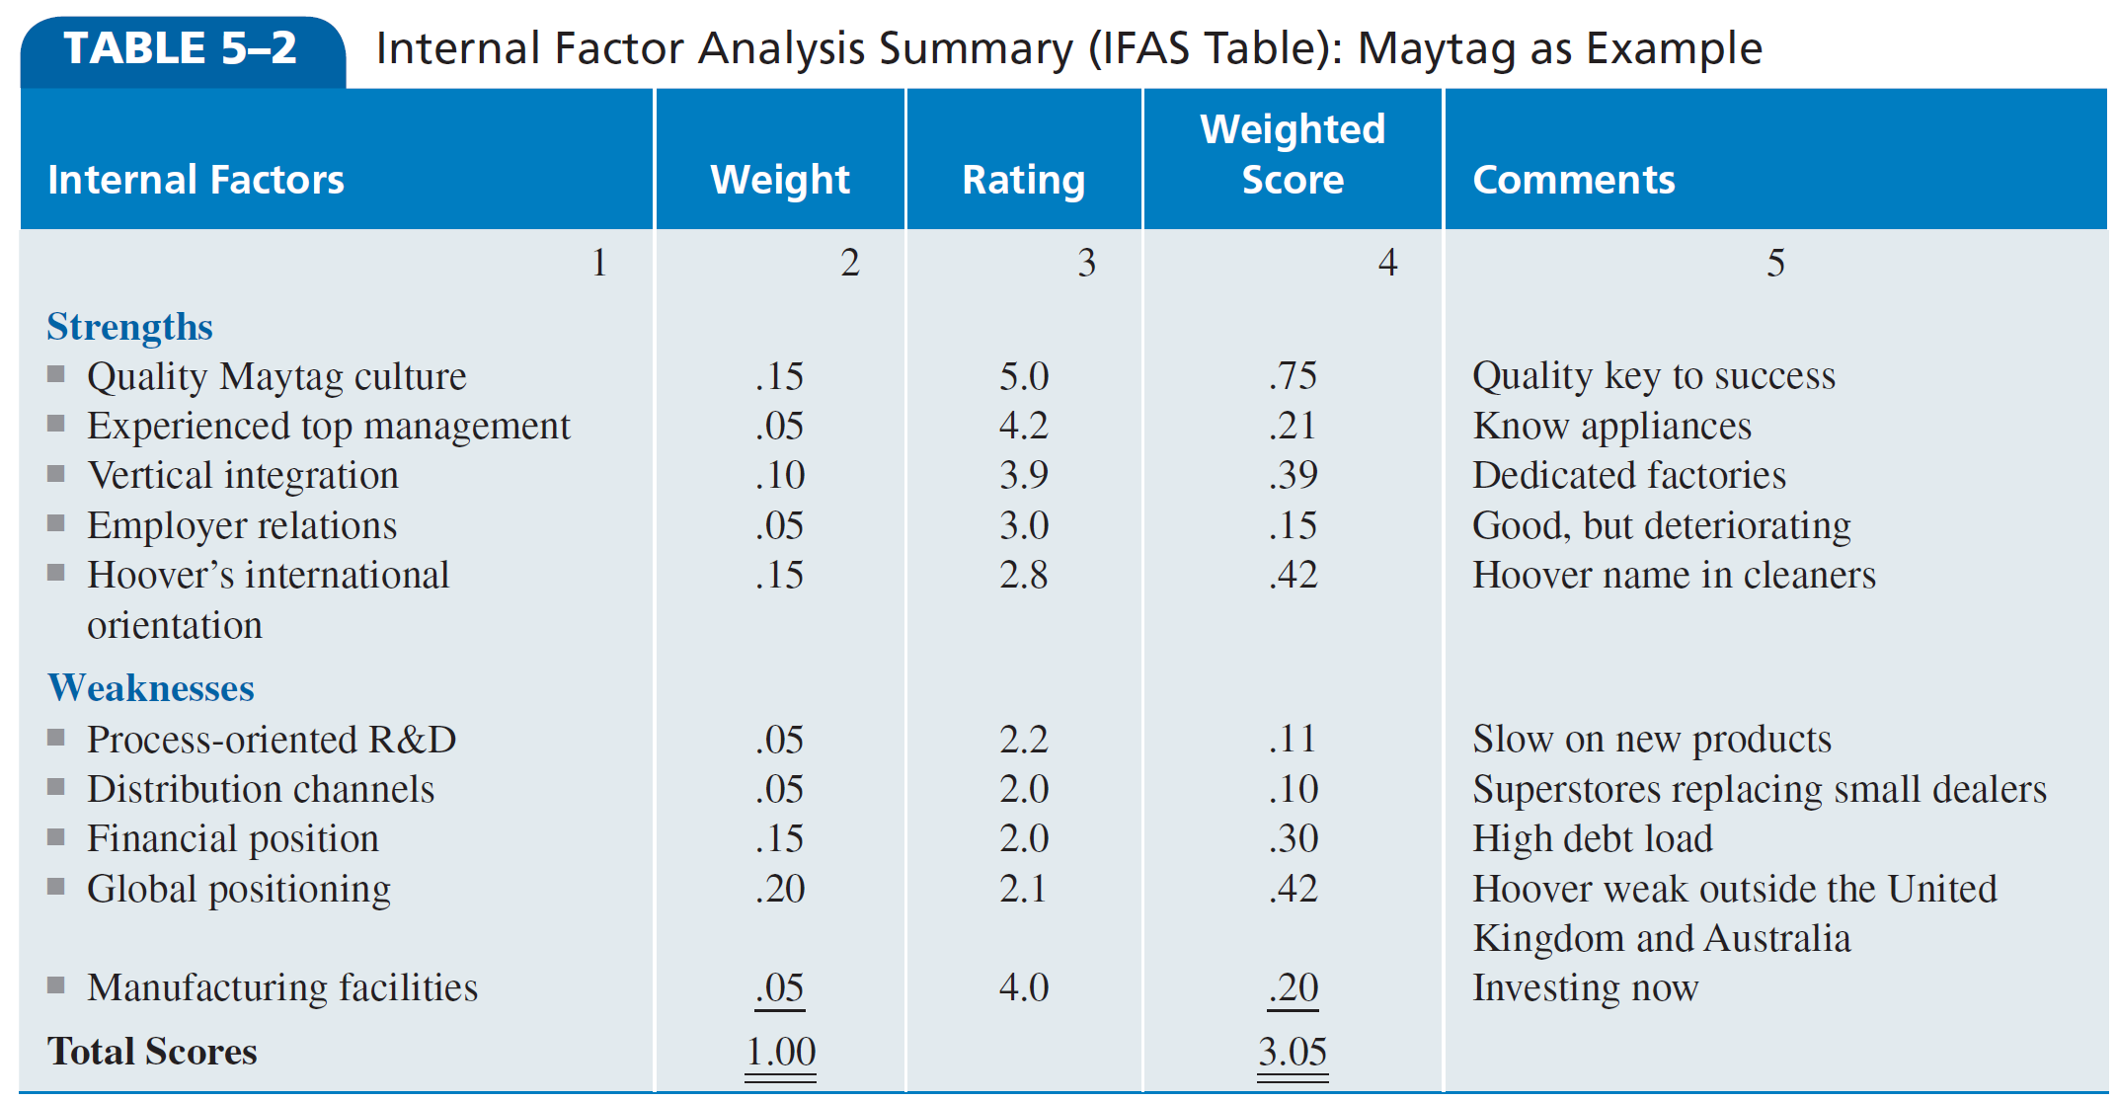
Internal Factor Analysis Summary
Notes:
This IFAS (Internal Factor Analysis Summary) Table is one way to organize the internal factors into the generally accepted categories of strengths and weaknesses as well as to analyze how well a particular company’s management is responding to these specific factors in light of the perceived importance of these factors to the company.

