Slide 1
Computer Output Devices

Slide 2
Output Devices
Output device (electronic equipment) connected to a computer and used to transfer data out of the computer in the form of text, images, sounds, or other media.
Few are the important output devices, which are used in Computer Systems:
Monitors
Graphic Plotter
Printer etc.

Slide 3
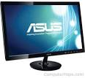
Types of Output device
Categorized by color output
Monochrome
One color with black background
Color
Display 4 to 16 million colors
Two types
Cathode Ray Tube (CRT)
Flat-Panel
Monitor is most common output device
Connects to the video card or controller
CRT
Flat Panel

Slide 4
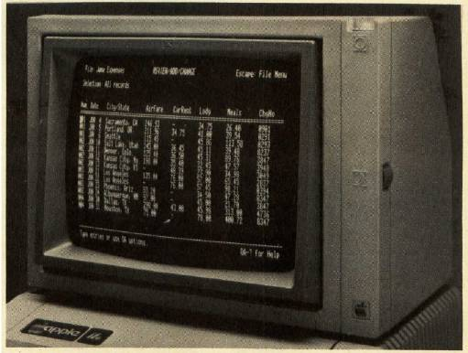
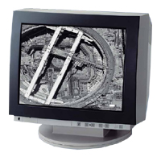
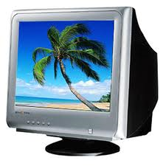
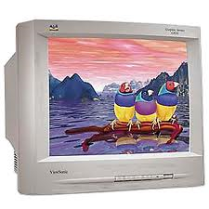
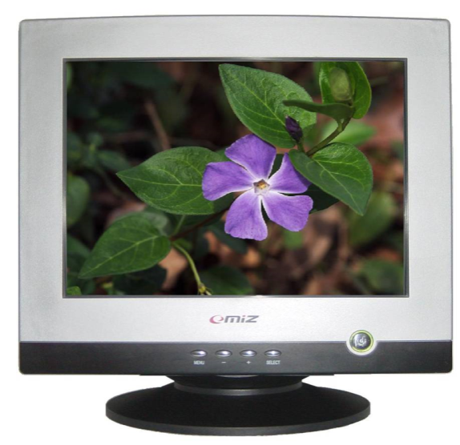
Cathode Ray Tube (CRT)
Most common type of monitor

Slide 5
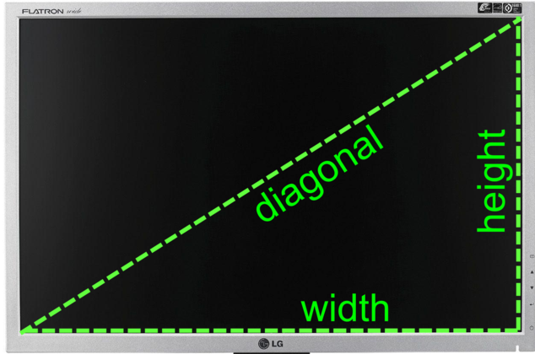
Monitors…
Size of monitor
Measured in inches
Measured diagonally
Actual size
Distance from corner to corner
Notes:
Teaching tip
It is helpful to draw the relationship between viewable and actual size.

Slide 6
Monitors…
Resolution
Number of pixels on the screen
The size of each pixel on the screen is determined by the screen's resolution setting. e.g. a monitor may have
low-resolution 640 x 480,
medium resolution of 800 x 600,
high-resolution of 1024 x 768 or more.
The first number in the pair is the number of pixels across the screen.
Higher number creates sharper images
.
Pixel
Notes:
Insider information
Many CRT’s are capable of supporting several resolutions. LCD monitors in contrast often can only support one or two resolutions. The reason are the transistors on the LCD cannot move, while the electron gun on the CRT can simply aim for a smaller pixel.
If you are in a computer class, stop and have students adjust their resolution on the screen. The simplest method is to right click the desktop and select properties. Click the settings tab, and adjust the slider. As the students are experimenting, have a student answer why larger resolution numbers make smaller images. The answer is higher resolutions draw with smaller pixels.

Slide 7
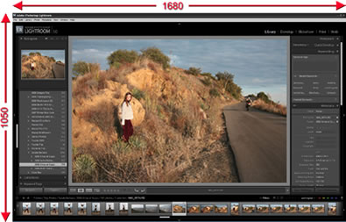
Resolution…
…

Slide 8
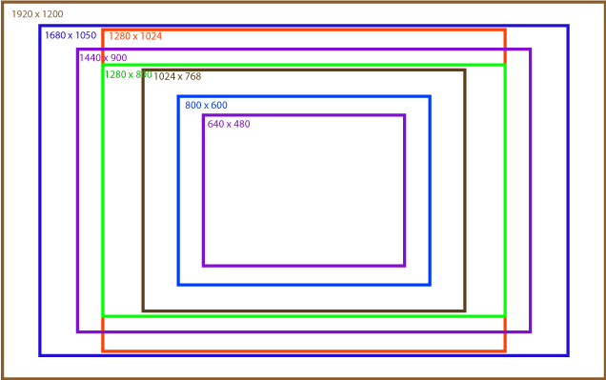
Resolution
Refers to sharpness of image
Number of pixels on the screen
Higher number creates sharper images
Higher number creates smaller images
Notes:
Insider information
Many CRT’s are capable of supporting several resolutions. LCD monitors in contrast often can only support one or two resolutions. The reason are the transistors on the LCD cannot move, while the electron gun on the CRT can simply aim for a smaller pixel.
If you are in a computer class, stop and have students adjust their resolution on the screen. The simplest method is to right click the desktop and select properties. Click the settings tab, and adjust the slider. As the students are experimenting, have a student answer why larger resolution numbers make smaller images. The answer is higher resolutions draw with smaller pixels.

Slide 9
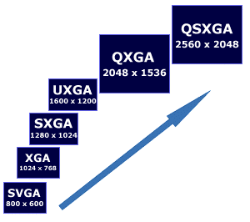
Various Screen Resolution
Color Graphics Adapter (CGA)
300 X 200
Enhanced Graphic Adapter (EGA)
640 X 350
Video Graphic Array (VGA)
640 x 480

Slide 10
Refresh Rate
Number of time the screen is redrawn
Measured in Hertz (Hz)
Modern equipment sets this automatically
Improper settings can cause eyestrain
Notes:
Insider information
Whenever a TV camera films a computer monitor, the monitor seems to have a line moving up the screen. This is the monitor refreshing the pixels. The camera films faster than the eye can see, which is why the refresh is noticeable.

Slide 11
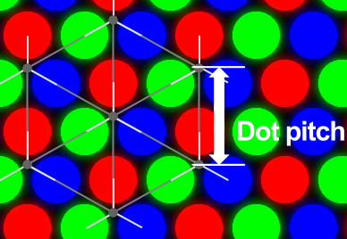
Monitors
Dot pitch: is a measurement that defines the sharpness of monitor's
display
Distance between the same color dots
Ranges between .15 mm and .40 mm
Smaller creates a finer picture

Slide 12
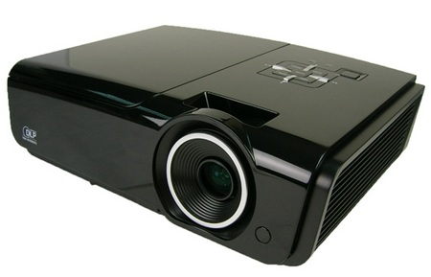
Data projector
Replaced overhead and slide projectors
Project image onto wall or screen
LCD projectors
Most common type of projector
Small LCD screen
Very bright light
Require a darkened room

Slide 13
Sound Cards
Device between the CPU and speakers
Can be connected to several devices
Modern cards support echo Sound
Notes:
Insider Information
Sound Blaster is the primary manufacturer of sound cards. Exceptional models start at around $30.00.

Slide 14
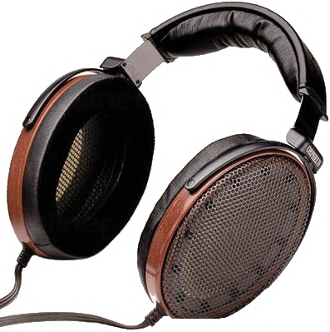
Sound Systems
Headphones and headsets
Replacement for speakers & microphones
Offer privacy
Does not annoy other people
Outside noise is not a factor
Headsets have speakers and a microphone
Notes:
Insider information
The PS2 game SOCOM II Navy Seals includes a USB headset to allow verbal communication with other team members.

Slide 15
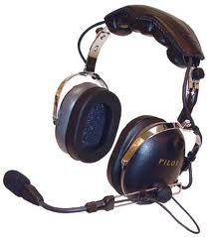
Headphones and Headsets
Replacement for speakers and microphones
Offer privacy
Does not annoy other people
Outside noise is not a factor
Headsets have speakers and a microphone
Notes:
Insider information
The PS2 game SOCOM II Navy Seals includes a USB headset to allow verbal communication with other team members.

Slide 16
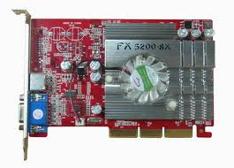
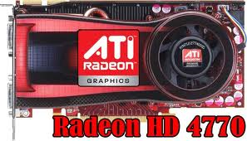
Video Cards
Device between the CPU and monitor
Better cards result in better output
Removes burden of drawing from CPU
Have their own processor and RAM
Modern cards have up to 8GB VRAM
Capable of rendering 3D images
Notes:
Insider information
The two leading video card families are ATI’s Radeon and NVIDIA’s GeForce line. Both offer exceptional graphics cards ranging from $50 to $600.

Slide 17
Today End Note
The road to success is always under construction.

Slide 18
?

