Slide 1
Cesarean Childbirth

Slide 2
Cesarean Childbirth
A cesarean section is the delivery of a baby through an incision in the abdominal wall and uterus rather than through the pelvis and vagina.
General, spinal, or epidural anesthesia may be used.

Slide 3
INDICATIONS
usually performed when a vaginal delivery is a risk for mother or baby,
complications of labor and factors impeding vaginal delivery :small pelvis,dystocia

Slide 4
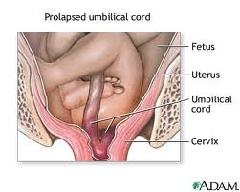
cord prolapse
hypertension

Slide 5
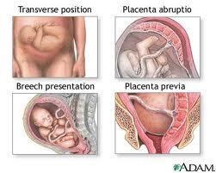
placental problems

Slide 6
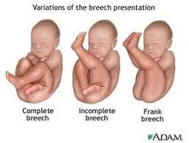
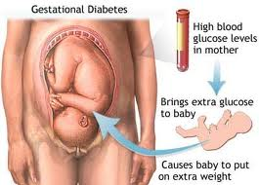
abnormal presentation
macrosomia

Slide 7
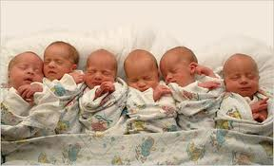
other complications of pregnancy, preexisting conditions and concomittant disease
pre-eclampsia
multiple births

Slide 8
sexually transmitted infections such as genital herpes

Slide 9
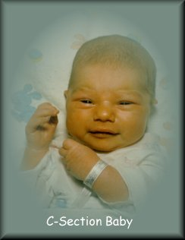
Risk
RISK FOR MOTHER
associated with risks of post-operative adhesions
incisional hernias
wound infections
severe blood loss
post spinal headaches
RISK FOR THE CHILD
neonatal depression
fetal injury
breathing problems

Slide 10
Cesarean section (C-section) delivery is now at an all-time high and is the most commonly performed surgical procedure in the United States.
In 2007, the total number of C-sections was almost 1.5 million, for a record high rate of 31.8% .This statistic has fluctuated in the past three to four decades

Slide 11
INTERVENTIONS

Slide 14
Thank you

