Slide 1
A-sexual or vegetative propagation
Reproduction of plants from their vegetative parts.

Slide 2
Advantages
True to type
Some plants produce little or no viable seed (banana, pineapple)
Early bearing
offsprings are genetically identical
Only one parent is required

Slide 3
Disadvantages
plants gradually lose their vigour
Short lived
No new variety can evolved
Require technical skills
Some time expensive

Slide 4
Methods of asexual propagation
Cutting
Grafting
Layering
Clonal propagation
Micro propagation

Slide 5
A- Cutting
Piece of plant that produce roots and develop into full plant
Cutting may be
Stem
Root
Leaf
Bud
shoot

Slide 6
Merits of cutting
Easy
Cheaper
Stock-scion relation avoided
Large no. can produce in short time

Slide 7
Types of Cutting
Stem cutting
Root cutting
Leaf cutting
Leaf bed cutting

Slide 8
a) Stem Cutting
Different types of stem cutting are used
Hardwood cutting
Semi-hardwood cutting
Softwood cutting

Slide 9
i- Hardwood cutting
Cutting from
Past season’s growth
Matured and lignified
Generally one yea old
Simplest method
Easily handled and transported
Length of cutting 10-45 cm
Pencil thickness
Have at least two buds

Slide 10
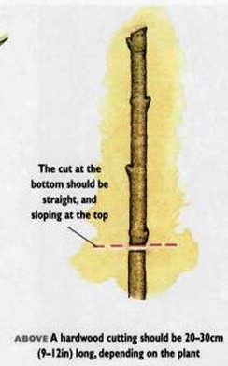
Procedure
Straight cut at the
base of shoot below
the node

Slide 11
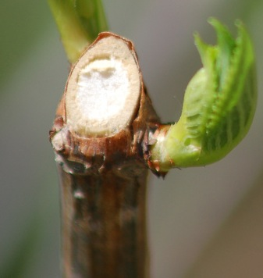
Slanting cut 1-2 cm above the bud
Water not accumulate at top
Save from fungal disease
Eg. Grapes, fig, pomegranate

Slide 12
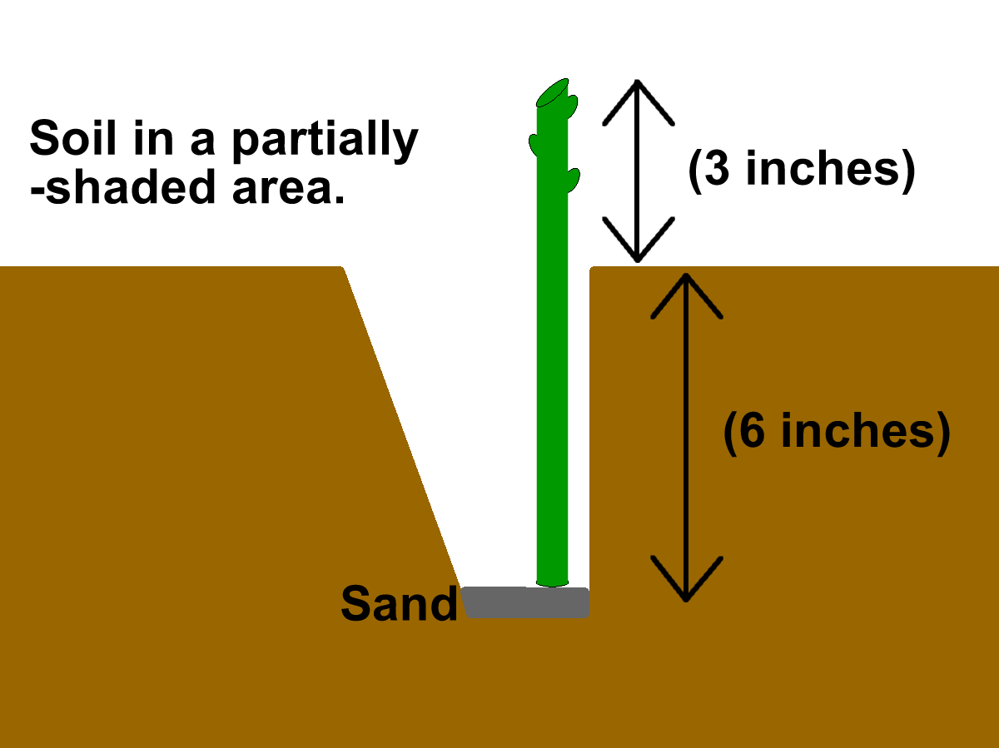

Slide 13
ii- semi-hardwood cutting
Take from partially matured woody shoot
Length 7-20cm, 2-4 leaves on top
Used in mango, guava, lemon

Slide 14
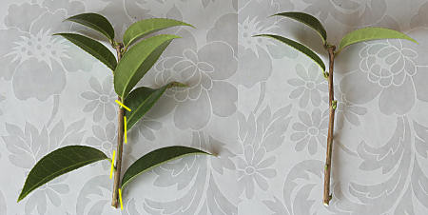
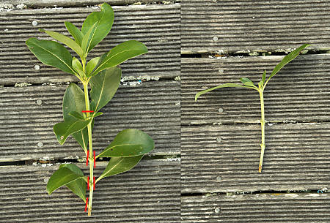

Slide 15
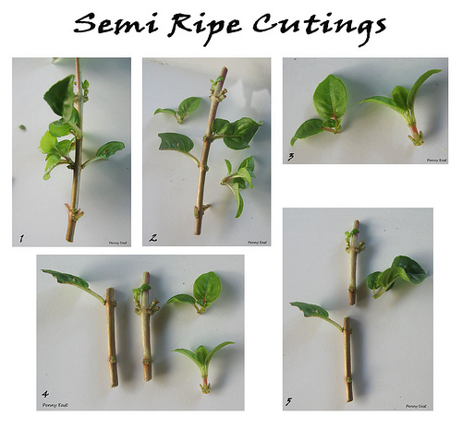

Slide 16
iii- softwood cutting
Cutting from
Soft
Succulent
Non lignified
Length 10-15 cm
Some leaves should be retained
Mostly used for shrubs

Slide 17
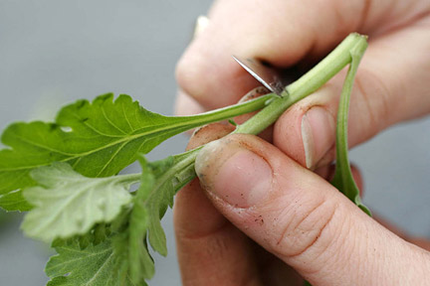
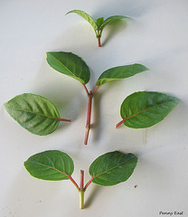

Slide 18
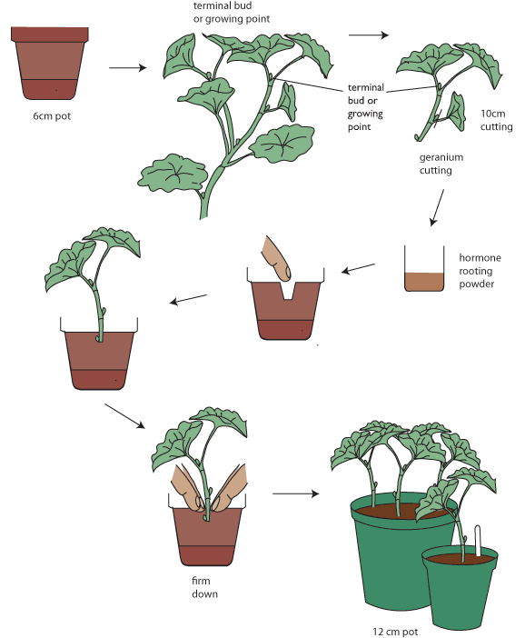

Slide 19
b) Root cutting
Plants which produce suckers can easily propagated
Roots
1 cm thickness
10-20 cm length
Planted horizontally in well prepared beds

Slide 20
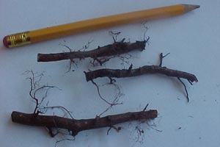
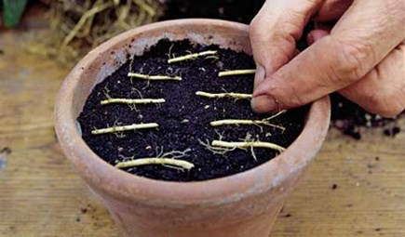

Slide 21
c) Leaf cutting
Thick and fleshy leaves
Leaf blade and section are used
Roots developed on Leaf blade or section
Some flowering plants propagate
Eg. Sansevieria, begonia

Slide 22
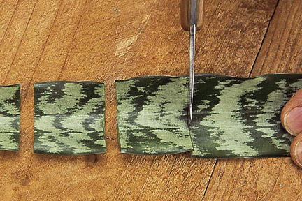
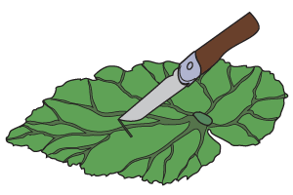
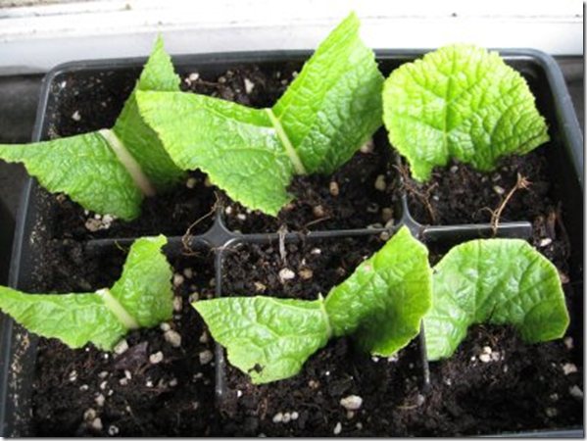

Slide 23
d) Leaf bud cutting
Consist of leaf blade, petiole, short piece of stem with axillary bud
10-15cm portion
Eg. Blackberry, raspberry

Slide 24
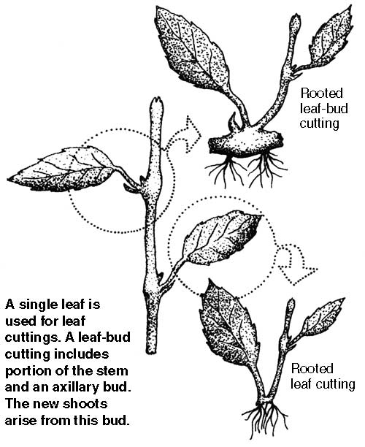

Slide 25
