Slide 1
Lecture 11 Nutrition during Pregnancy(2)
By dr. umer farooq

Slide 2
Nutrition during pregnancy
A woman’s body changes dramatically during pregnancy. Her uterus and its supporting muscles increase in size and strength; her blood volume increases by half to carry the additional nutrients and other materials; her joints become more flexible in preparation for childbirth; her feet swell in response to high concentrations of the hormone estrogen, which promotes water retention and helps to ready the uterus for delivery; and her breasts enlarge in preparation for lactation. The hormones that mediate all these changes may influence her mood. She can best prepare to handle these changes given a nutritious diet, regular physical activity, plenty of rest, and caring companions

Slide 3
Energy and Nutrient Needs during Pregnancy
From conception to birth, all parts of the infant—bones, muscles, organs, blood cells, skin, and other tissues—are made from nutrients in the foods the mother eats. For most women, nutrient needs during pregnancy and lactation are higher than at any other time (see Figure). To meet the high nutrient demands of pregnancy, a woman will need to make careful food choices, but her body will also help by maximizing absorption and minimizing losses

Slide 5
Energy
The enhanced work of pregnancy raises the basal metabolic rate dramatically and demands extra energy.
Energy needs of pregnant women are greater than those of nonpregnant women—an additional 340 kcalories per day during the second trimester and an extra 450 kcalories per day during the third.
A woman can easily get these added kcalories with nutrient dense selections from the five food groups. See Table (2.3) for suggested dietary patterns for several kcalorie levels and Figure (14.11)for a sample menu for pregnant and lactating women.
For a 2000-kcalorie daily intake, these added kcalories represent about 15 to 20 percent more food energy than before pregnancy.

Slide 6
The increase in nutrient needs is often greater than this, so nutrient-dense foods should be chosen to supply the extra kcalories: foods such as whole-grain breads and cereals, legumes, dark green vegetables, citrus fruits, low-fat milk and milk products, and lean meats, fish, poultry, and eggs.
Ample carbohydrate (ideally, 175 grams or more per day and certainly no less than 135 grams) is necessary to fuel the fetal brain. Sufficient carbohydrate ensures that the protein needed for growth will not be broken down and used to make glucose.

Slide 7
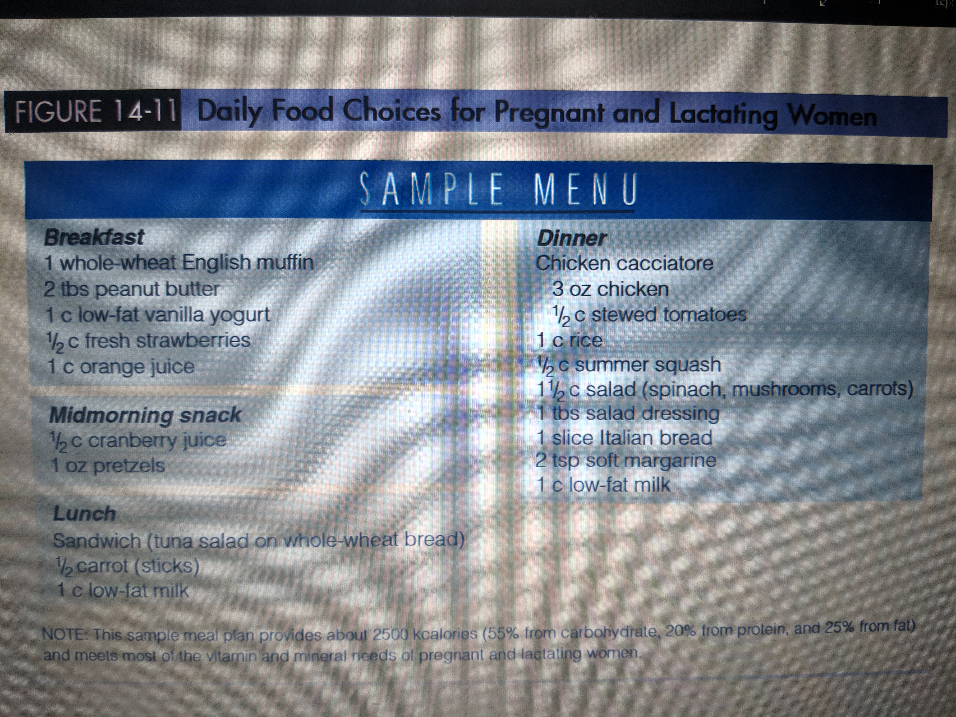

Slide 8
Protein
The protein RDA for pregnancy is an additional 25 grams per day higher than for nonpregnant women. Pregnant women can easily meet their protein needs by selecting meats, milk products, and protein-containing plant foods such as legumes, whole grains, nuts, and seeds.
Because use of high-protein supplements during pregnancy may be harmful to the infant’s development, it is discouraged
Essential Fatty Acids
The high nutrient requirements of pregnancy leave little room in the diet for excess fat, but the essential long-chain polyunsaturated fatty acids are particularly important to the growth and development of the fetus.
The brain is largely made of lipid material, and it depends heavily on the long-chain omega-3 and omega-6 fatty acids for its growth, function, and structure (See Table 5-2 on for a list of good food sources of the omega fatty acids.)

Slide 10
Nutrients for Blood Production and Cell Growth
New cells are laid down at a tremendous pace as the fetus grows and develops. At the same time, the mother’s red blood cell mass expands.
All nutrients are important in these processes, but for folate, vitamin B12, iron, and zinc, the needs are especially great due to their key roles in the synthesis of DNA and new cells.
The requirement for folate increases dramatically during pregnancy. It is best to obtain sufficient folate from a combination of supplements, fortified foods, and a diet that includes fruits, juices, green vegetables, and whole grains. The “How to” feature in the figure described how folate from each of these sources contributes to a day’s intake.
The pregnant woman also has a slightly greater need for the B vitamin that activates the folate enzyme—vitamin B12.

Slide 11
Generally, even modest amounts of meat, fish, eggs, or milk products together with body stores easily meet the need for vitamin B12.
Vegans who exclude all foods of animal origin, however, need daily supplements of vitamin B12 or vitamin B12–fortified foods to prevent the neurological complications of a deficiency.

Slide 12
Pregnant women need iron to support their enlarged blood volume and to provide for placental and fetal needs.
The developing fetus draws on maternal iron stores to create sufficient stores of its own to last through the first four to six months after birth.
Even women with inadequate iron stores transfer significant amounts of iron to the fetus, suggesting that the iron needs of the fetus have priority over those of the mother.
In addition, blood losses are inevitable at birth, especially during a cesarean section, and can further drain the mother’s supply.
During pregnancy, the body makes several adaptations to help meet the exceptionally high need for iron. Menstruation, the major route of iron loss in women, ceases, and iron absorption improves thanks to an increase in blood transferrin, the body’s iron-absorbing and iron-carrying protein. Without sufficient intake, though, iron stores would quickly dwindle.

Slide 13
Few women enter pregnancy with adequate iron stores, so a daily iron supplement is recommended during the second and third trimesters for all pregnant women.
For this reason, most prenatal supplements provide 30 to 60 milligrams of iron a day.
To enhance iron absorption, the supplement should be taken between meals or at bedtime and with liquids other than milk, coffee, or tea, which inhibit iron absorption.
Drinking orange juice does not enhance iron absorption from supplements as it does from foods; vitamin C enhances iron absorption by converting iron from ferric to ferrous, but supplemental iron is already in the ferrous form. Vitamin C is helpful, however, in preventing the premature rupture of amniotic membranes.

Slide 14
Zinc is required for DNA and RNA synthesis and thus for protein synthesis and cell development.
Typical zinc intakes for pregnant women are lower than recommendations, but fortunately, zinc absorption increases when zinc intakes are low.
Routine supplementation is not advised. Women taking iron supplements (more than 30 milligrams per day), however, may need zinc supplementation because large doses of iron can interfere with the body’s absorption and use of zinc.

