Slide 2
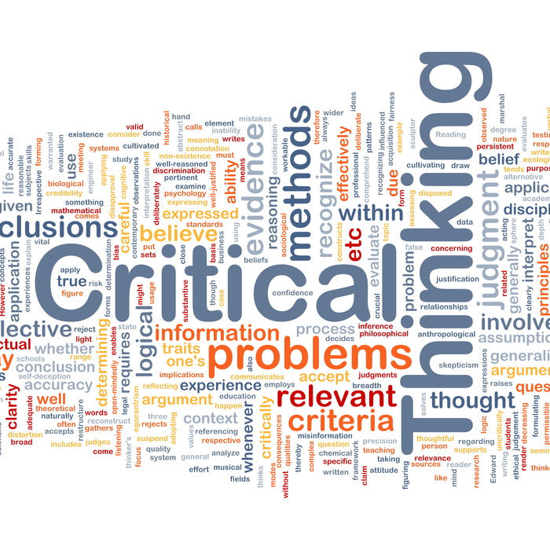

Slide 3
Group members:
Aman nasir 65
Arooj Fatima 81
Sana kainat 76
Sumayya mumtaz 119
Laraib shafqat 83
Hafsa naseer 118

Slide 4
Outline:
Introduction
Steps
Example
Importance

Slide 5
Definition
The process of actively and skillfully applying, analyzing, synthesizing, and evaluating information to reach an answer or conclusion.

Slide 6
Etymology of critical thinking
It is derived from two Greek words “kriticos” (discerning judgment) and “kriterion” (standards).

Slide 7
Combination
Critical thinking is the combination of several skills and habits such as:
Curiosity
Skepticism
Humility
Creativity
Emathy

Slide 8
Curiosity
The desire for knowledge and understanding

Slide 9
Skepticism:
Demand evidence

Slide 10
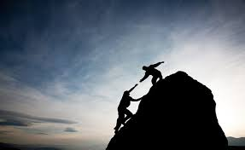
Humility
The recognition that your own understanding is limited.

Slide 11
Empathy
it is the ability to see things from another person’s perspective.

Slide 12
History
The earliest documentation of critical thinking are the teachings of Socrates.
His method of questioning is now known as "Socratic Questioning" and is the best known critical thinking teaching strategy.
In his mode of questioning, Socrates highlighted the need for thinking for clarity and logical consistency.

Slide 13
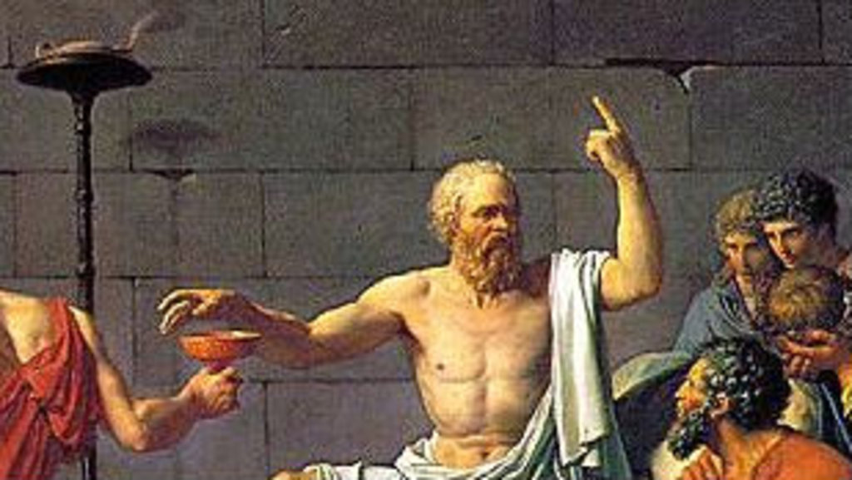
Socrates’ practice was followed by the critical thinking of Plato, Aristotle, and the Greek skeptics:
“All of whom emphasized that things are often very different from what they appear to be and that only the trained mind is prepared to see through the way things look to us on the surface (delusive appearances) to the way they really are beneath the surface (the deeper realities of life)”

Slide 14
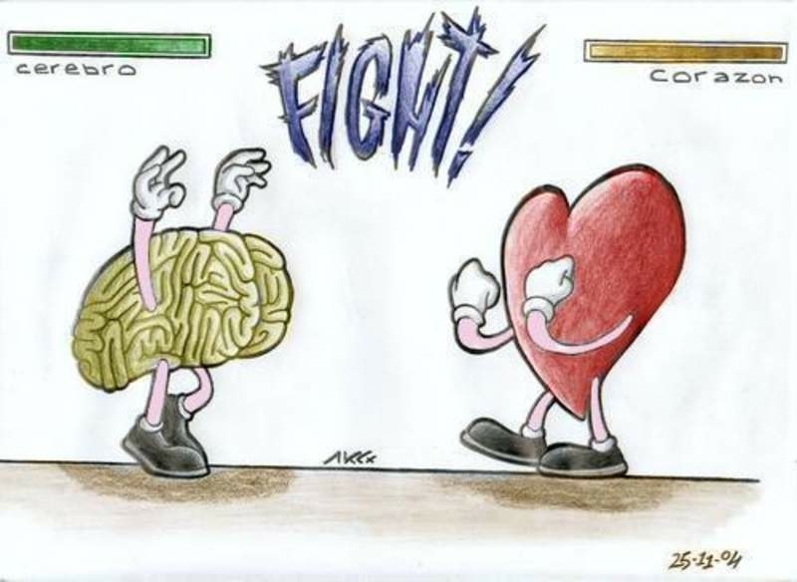
Rely on reasons other than emotions

Slide 15
2.Evaluate a broad range of view points

Slide 16
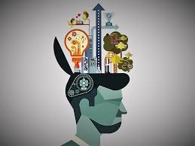
3.Accept new evidence, explanation and findings

Slide 17
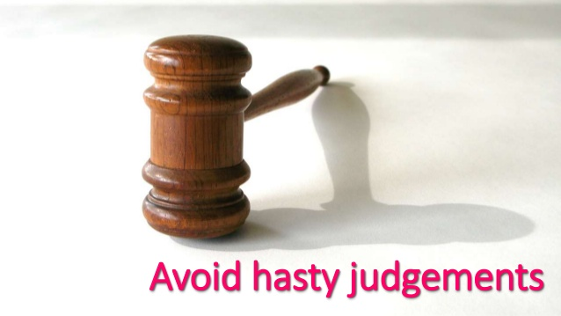
4.Take your time in making any decision

Slide 18
Steps of critical thinking
1. Identify the problem

Slide 19
2. Analyze the problem

Slide 20
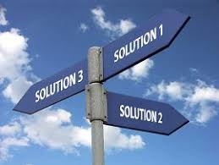
3. Come up with several possible solutions

Slide 21
4. Decide which solutions fits the situation best

Slide 22
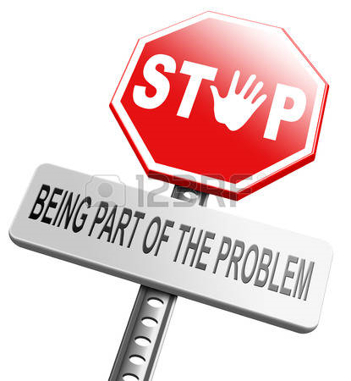
5. Take action

Slide 23
PURPOSE:

Slide 24
PROBLEM:
No preparation of
exams

Slide 25
Possible solution
As to take help of friend

Slide 26
Time management:

Slide 27
One night study

Slide 28
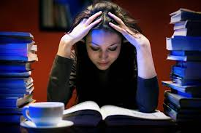
Don’t take stress

Slide 29
Selective study

Slide 30
Sitting plan

Slide 31
Information:

Slide 32
Assumption:
My friend said that time is too short her own
Slybus is not complete yet.

Slide 33
Sitting plan is
not accomplished
due to strictness
Of examiner.

Slide 34
Time is too short it can not be managed.

Slide 35
Selective study
has to be done.

Slide 36
Inferences:
I’ll do selective
Study.

Slide 37
Hypothesis:
Practical implementation of selective
Study has to be done.
Scientific hypothesis is that in which equipme-
nts, energy and time is required.
In critical hypothesis only thinking is required.

Slide 38
Consequences:
I am passed.

Slide 39
Importance of critical thinking
Critical thinking in language
Enhance Language Skill.
Thinking Clearly And Systematically.
Enhance Presentation Skill.
Improve The Way Of Ideas Delivery.

Slide 40
CRITICAL THINKING
Critical thinking as creativity
Role in evaluating new ideas .
Logical connection between ideas
Generate new ideas.
Selection and modifying new ideas.

Slide 41
Critical thinking
Communication
Sending and receiving information.
Face to face and oral communication.
Planning.
Organizing.
leading.
Controlling.

Slide 42
Critical thinking
Decision making
Analyze the problem in detail.
Best idea selection.
Role in making decision.
Draw conclusions.

Slide 43
Critical thinking
Critical thinking at university
. Critical thinking is a cognitive skill.
Critical thinking as evidence.
Critical thinking as arguments.
Improve the way of ideas delivery

Slide 44
DECISION MAKING
It's easy to let your emotions take over when making an important decision or arguing for your opinion.
Especially if you are personally invested in it. However, "Why Critical Thinking?",
A report from York University, asserts that critical thinking can help you effectively use emotional appeal, letting your feelings influence, but not control your reasoning..

Slide 45
IN JOBS
Many of the highest paying jobs require critical thinking skills
such as generating effective ideas and making important decisions.
Job interviewers often ask applicants questions that test their ability to think critically

Slide 46
SELF AWARENESS
critical thinker has the self-awareness.

Slide 47
WORK SMARTER
Critical thinkers embody the phrase "work smarter, not harder..

Slide 48
SKILSS
The critical thinker usually has the comprehensive skills to consider all possible options and solve a problem.
Rational critical thinkers are generally the voices of reason in times of mass hysteria or panic. As Franklin D. Roosevelt said, "We have nothing to fear but fear itself.

Slide 49
In the workplace..
to take on an amount of information
to sum information up
to pick out the theories and arguments
to be able to communicate and justify the point of view that you have taken.

Slide 50
Critical Thinking is crucial for self-reflection.
In order to live a meaningful life and to structure our lives accordingly,
we need to justify and reflect on our values and decisions
Critical thinking provides the tools for this process of self-evaluation.

