Slide 1
RESPIRATORY PHYSIOLOGY BY DR MADIHA NAZIR

Slide 2
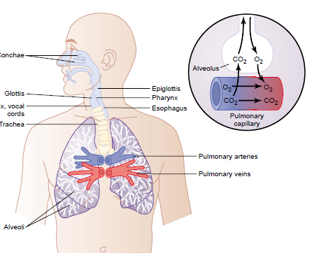

Slide 3
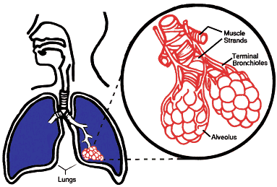

Slide 4
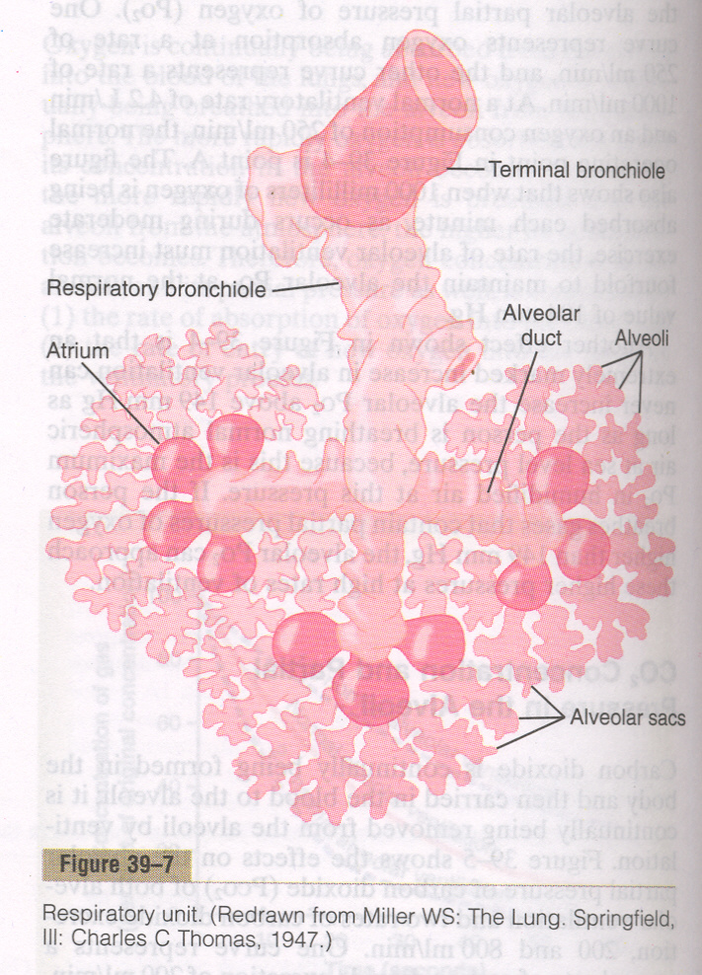

Slide 5
RESPIRATION
Respiration is defined as an act of breathing resulting in exchange of oxygen and carbondioxide between body tissues and atmosphere.

Slide 6
DIVISIONS OF RESPIRATION
Respiration can be divided into 04 main divisions:
1. Pulmonary Ventilation
2. Diffusion
3. Transport
4. Regulation

Slide 7
1. PULMONARY VENTILATION
It means the inflow and outflow of air between the atmosphere and the lung alveoli.

Slide 8
2. DIFFUSION
Diffusion of oxygen and carbondioxide between the alveoli and the blood.

Slide 9
3. TRANSPORT
Transport of oxygen and carbondioxide in blood and body fluids to and from the cells.

Slide 10
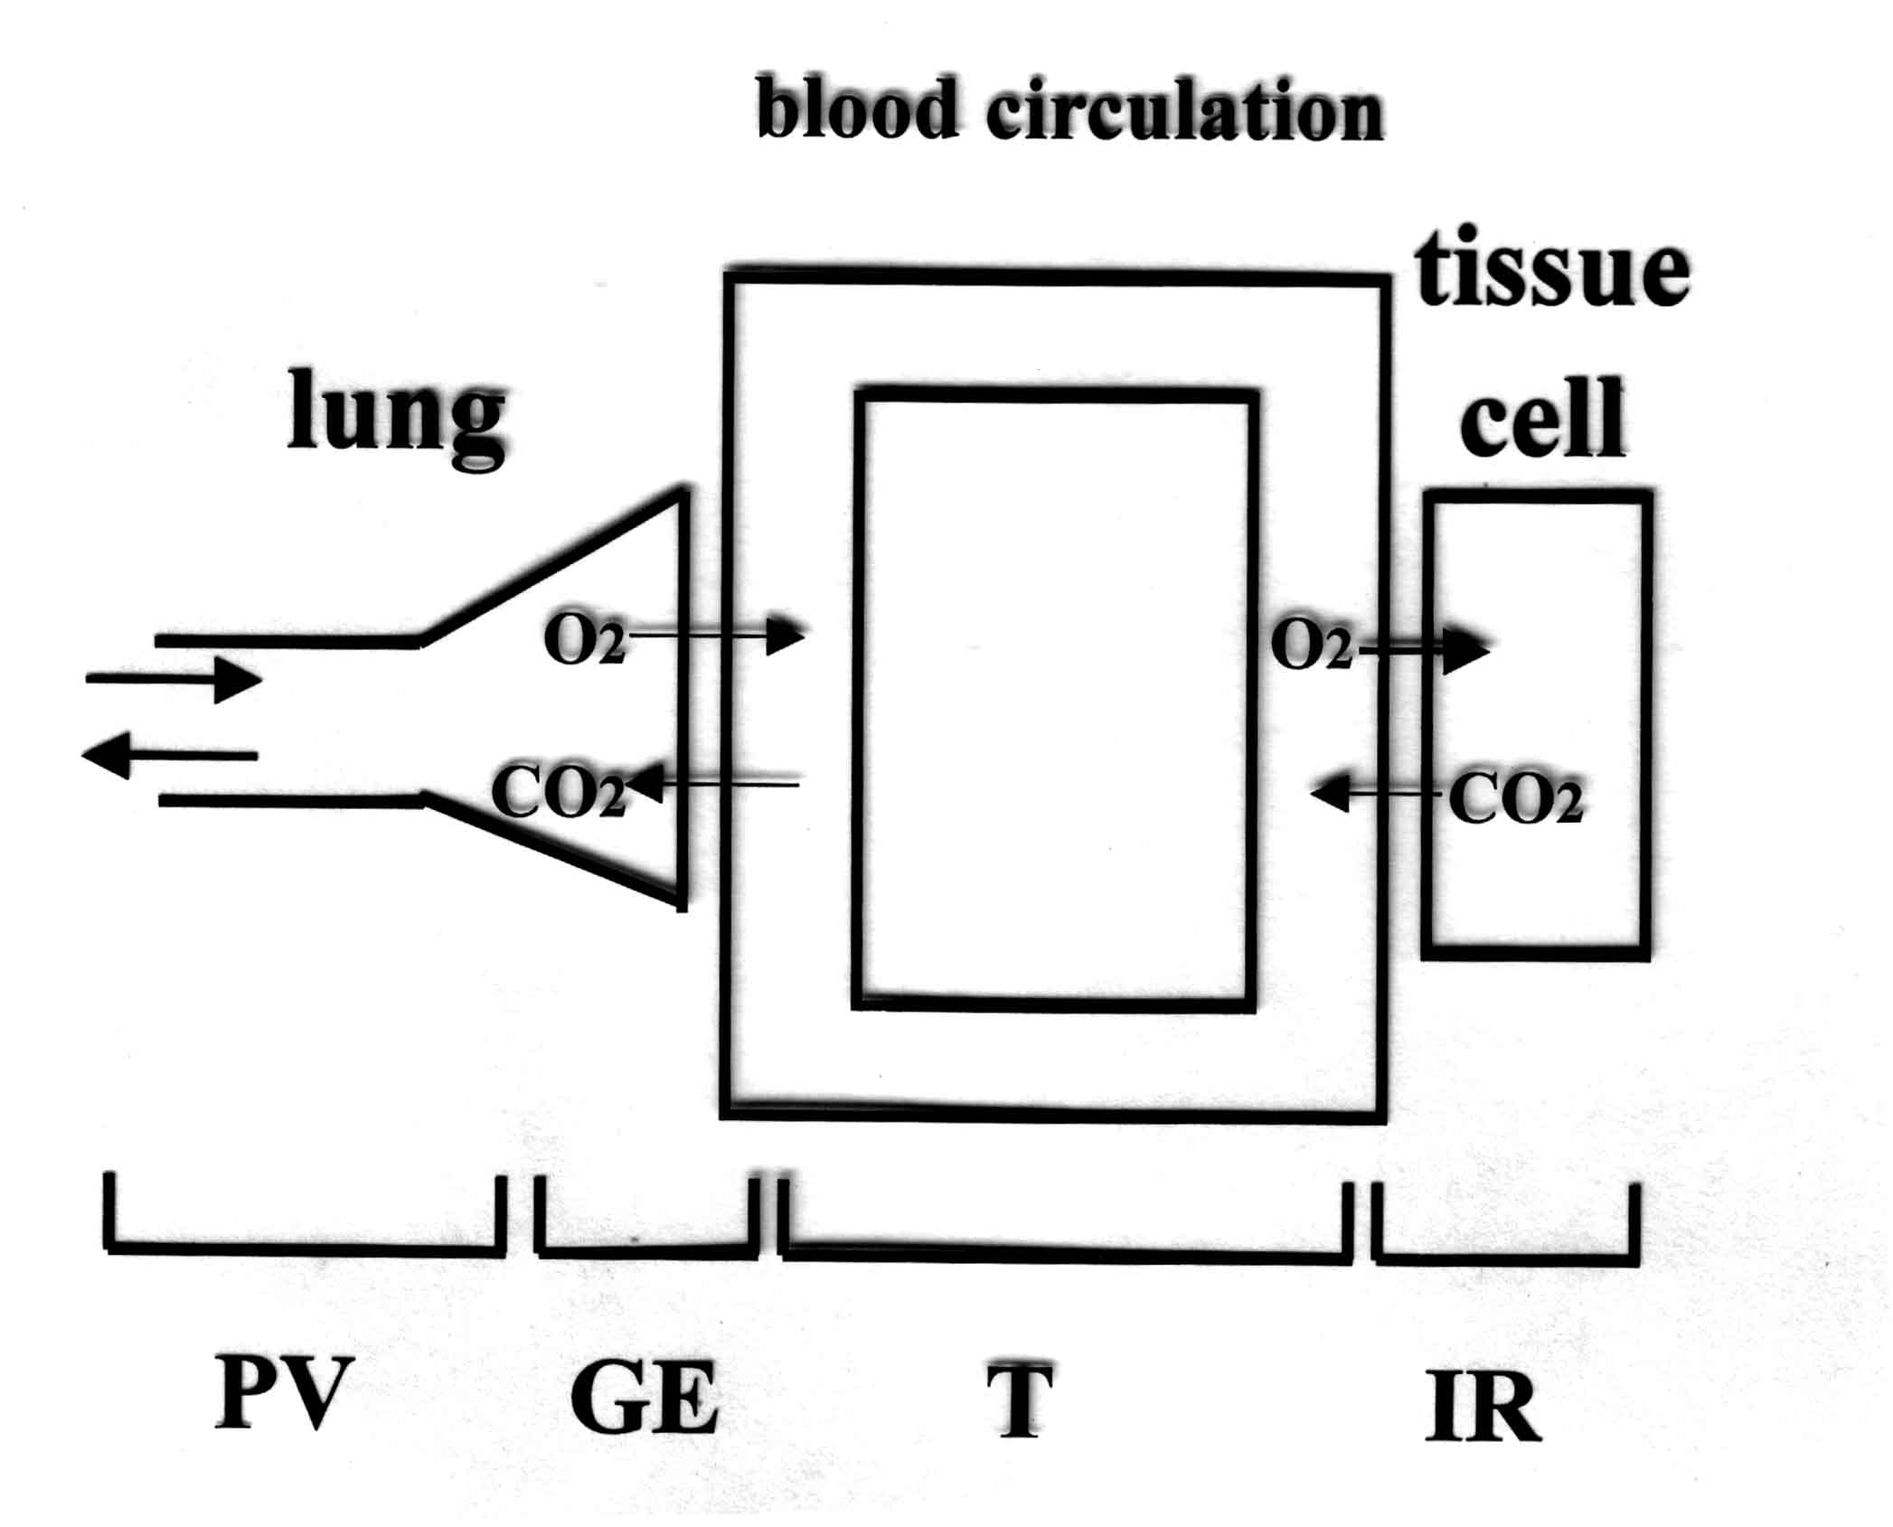

Slide 11
4. REGULATION
Regulation of ventilation and other acts of respiration.

Slide 12
FUNCTIONS OF RESPIRATION
1. Supply of oxygen to the tissues & removal of CO2 from the blood.
2. Helps in regulating the acid base balance by adjusting CO2 elimination from body.
3. Helps in keeping a constant condition of water in body through elimination of excess water vapours.
4. Eliminates certain harmful volatile substances from the body, e.g.,ammonia, alcohol etc.

Slide 13
MECHANICS OF RESPIRATION

Slide 14
The lungs can be expanded & contracted in 02 ways:
1. By downward & upward movement of the diaphragm to lengthen or shorter the chest cavity.
2. By elevation and depression of the ribs to increase and decrease the anteroposterior diameter of chest cavity.

Slide 15
INSPIRATION AND MUSCLES OF INSPIRATION

Slide 16
During inspiration the main role is played by the contraction of diaphragm, that pulls the lower surfaces of lungs downwards. Other muscles helping in inspiration are:
1. External intercostals
2. Sternocleidomastoid
3. Anterior serrati
4. Scaleni

Slide 17
EXPIRATION & MUSCLES OF EXPIRATION

Slide 18
During expiration diaphragm relaxes & the elastic recoil of lungs, chest wall 7 abdominal structures compresses lungs. Muscles helping in expiration are:
1. Abdominal recti
2. Internal intercostals

Slide 19
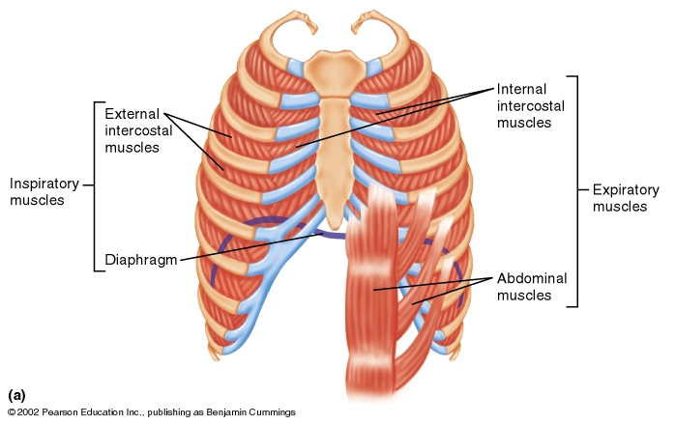

Slide 20
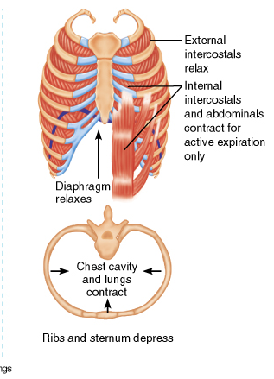
EXPIRATION

Slide 21
MOVEMENT OF AIR IN LUNGS & PRESSURES CAUSING IT

Slide 22
PLEURAL PRESSURE
PLEURAL PRESSURE is the pressure in the narrow space between the lung pleura & the chest wall pleura . It is that negative pressure which prevents the collapse of lungs and is also called LUNG RECOIL PRESSURE.
Value: 05 cm of H2O

Slide 23
ALVEOLAR PRESSURE
It is the pressure inside the lung alveoli.

Slide 24
ALVEOLAR PRESSURE is different during expiration & INSPIRATION.
1. During INSPIRATION alveolar pressure becomes -1cm of H2O which causes air to move into lungs.
2. During EXPIRATION alveolar pressure rises to about +1cm of H2O & this forces the inspired air out of the lungs.

Slide 25
TRANSPULMONARY PRESSURE
The difference between the alveolar pressure & the pleural pressure is called TRANSPULMONARY PRESSURE.
It is the difference between the alveoli & the outer surface of lungs.
It is the measure of recoil pressure.

Slide 26
RECOIL PRESSURE
The elastic forces in the lungs that tend to collapse the lungs at each point of expansion is called RECOIL PRESSURE.

Slide 27
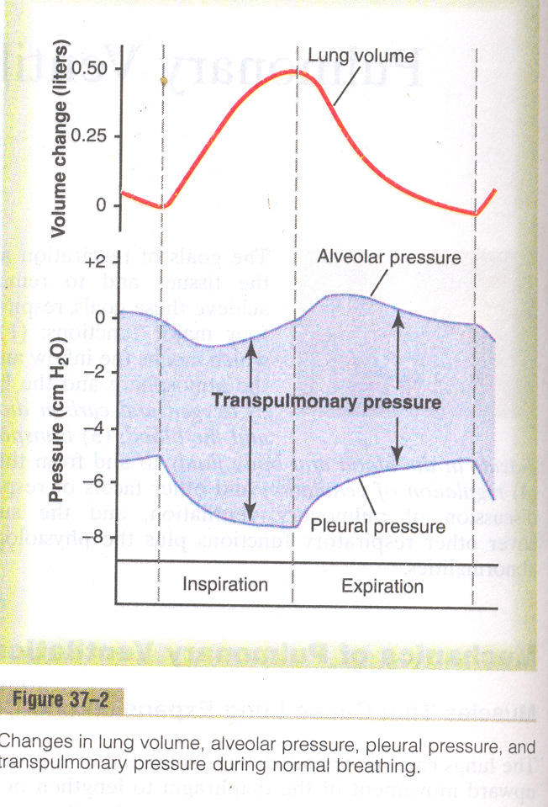

Slide 28
COMPLIANCE OF LUNGS

Slide 29
The extent to which the lungs expand for each unit increase in transpulmonary pressure is called their COMPLIANCE.
VALUE:
Approximately 200ml/cm of H2O pressure for both lungs.

Slide 31
FACTORS EFFECTING COMPLIANCE
1. The elastic forces caused by surface tension of the fluid that lines the inside walls of the alveoli.
2. The elastic forces of the lung tissue itself.

Slide 33
FACTORS DECREASING COMPLIANCE
Destruction of lung tissues
Pulmonary edema
Scoliosis

Slide 34
SURFACTANT

Slide 35
SURFACE TENSION
When water forms a surface with air, the water molecules on the surface of the water have an especially strong attraction for one another. As a result, the water surface is always attempting to contract. This is what holds raindrops together: that is, there is a tight contractile membrane of water molecules around the entire surface of the raindrop.

Slide 36
On the inner surface of alveoli the water surface is also attempting to contract.This results in an attempt to force the air out of the alveoli through the bronchi and, in doing so, causes the alveoli to try to collapse.
The net effect is to cause an elastic contractile force of the entire lungs, which is called the surface tension elastic force

Slide 37
DEFINITION
Surfactant is a surface active agent, which when spreads over the surface of a fluid greatly reduces the surface tension.

Slide 38
COMPOSITION
Surfactant is a complex mixture of phospholipids, proteins and ions.

Slide 39
SECRETED BY:
It is secreted by special surfactant secreting cells of alveolar epithelium called Type 2 granular pneumocytes.

Slide 40
FUNCTIONS OF SURFACTANT
It decreases the surface tension of fluids in alveoli & helps in inflation of lungs.
It prevents pulmonary edema.

Slide 41
Surface tension of different fluids
Pure water, 72 dynes/cm; normal fluids lining the alveoli but without surfactant, 50 dynes/cm; normal fluids lining the alveoli and with normal amounts of surfactant included, between 5 and 30 dynes/cm.

Slide 42
COMPLIANCE OF THORAX & LUNGS

Slide 43
DEFINITION
The compliance of entire pulmonary system is measured while expanding the lungs of a totally relaxed or paralysed person.

Slide 44
To inflate this total pulmonary system, almost twice as much pressure is needed as to inflate the same lungs after removal from the chest cage.
Therefore, the compliance of the combined lung-thorax system is almost exactly one half that of the lungs alone—110 milliliters of volume per centimeter of water pressure for the combined system .

Slide 45
VALUE
110 milimeter of volume per cm. of water

Slide 46
The work of breathing
During normal quite respiration, muscle contraction occurs only during INSPIRATION while no muscle contraction occurs during EXPIRATION.
This work performed by respiratory muscles during inspiration is termed as WORK OF BREATHING.

Slide 47
DIVISIONS OF WORK
1. Compliance work or elastic work.
2. Tissue resistance work.
3. Airway resistance work.

Slide 48
1. Compliance work
It is required to expand the lungs against its elastic force.
It is calculated by multiplying the volume of expansion times the average pressure required to cause the expansion.

Slide 49
2. Tissue resistance work
It is required to over come the viscocity of the lungs and chest wall structure.

Slide 50
3. Airway resistance work
It is required to overcome airway resistance during the movement of air into the lungs.

Slide 51
Energy Required for Respiration
During normal quiet respiration, only 3 to 5 per cent of the total energy expended by the body is required for pulmonary ventilation.

Slide 52
Energy Required for Respiration
During heavy exercise, the amount of energy required can increase as much as 50-fold, especially if the person has any degree of increased airway resistance or decreased pulmonary compliance.

Slide 53
PULMONARY VOLUMES

Slide 55
TIDAL VOLUME
Volume of air inspired or expired with each normal breath.
VALUE: 500mililiters

Slide 56
INSPIRATORY RESERVE VOLUME
It is the extra volume of air that can be inspired in after normal tidal volume.
VALUE: 3000mililiters or 03 liters.

Slide 57
EXPIRATORY RESERVE VOLUME
It is the extra amount of air that can be expired by forceful respiration after the end of a normal tidal expiration.
VALUE: 1100 mililiters or 1.1 liter.

Slide 58
RESIDUAL VOLUME
It is the volume of air still remaining in the lungs after the most forceful expiration.
VALUE: 1200 mililiters or 1.2 liter.

Slide 59
PULMONARY CAPACITIES

Slide 60
PULMONARY CAPACITIES is the combination of two or more pulmonary volumes.

Slide 61
INSPIRATORY CAPACITY
It is the combination of the tidal volume and inspiratory reserve volume.
FORMULA: I.C.= T.V + IRV

Slide 62
SIGNIFICANCE OF INSPIRATORY CAPACITY
This is the amount of air that a person can breath beginning at normal expiratory level and ending at maximum lung distension.
VALUE: 3500 mililiters or 3.5 liter.

Slide 63
FUNCTIONAL RESIDUAL CAPACITY
It is the combination of expiratory reserve volume & residual volume.
FORMULA:
FRV = ERV + RV

Slide 64
SIGNIFICANCE OF FRC
This is the amount of air remaining in the lungs at the end of normal expiration.
VALUE: 2300 mililiters or 2.3 liters.

Slide 65
VITAL CAPACITY
It is the combination of inspiratory reserve volume, tidal volume & expiratory reserve volume.
FORMULA: VC = IRV + TV + ERV

Slide 66
SIGNIFICANCE OF VITAL CAPACITY
This is the maximum amount of air that a person can expel from the lungs after first filling the lungs to their maximum extent and then expiring to the maximum limit.

Slide 67
TOTAL LUNG CAPACITY
It is combination of vital capacity and residual volume.
FORMULA: TLC = VC + RV

Slide 68
SIGNIFICANE OF TLC
This is the maximum volume to which the lungs can be expanded with the greatest possible inspiratory effort.
VALUE: 5800mililiters or 5.8 liters.

Slide 70
MINUTE RESPIRATORY VOLUME
It is the total amount of new air moved into the respiratory passages each minute.
VALUE: 06 liters per minute.

Slide 71
This is equal to the tidal volume times the respiratory rate per minute. The normal tidal volume is about 500 milliliters, and the normal respiratory rate is about 12 breaths per minute. Therefore, the minute respiratory volume averages about 6 L/min.

Slide 72
A person can live for a short period with a minute respiratory volume as low as 1.5 L/min and a respiratory rate of only 2 to 4 breaths per minute.

Slide 73
Minute respiratory volume may be greater than 200 L/min, or more than 30 times normal.Most people cannot sustain more than one half to two thirds these values for longer than 1 minute.

Slide 74
ALVEOLAR VENTILATION
It is the continual supply of new air to the gaseous exchange areas of the lungs where the air is in close proximity to pulmonary blood;alveoli,alveolar ducts,alveolar sacs.

Slide 75
DEAD SPACE AIR
The air present in the dead space ;nose,pharynx,trachea ;is called DEAD AIR because it is not useful for the gas exchange purposes.

Slide 76
SIGNIFICANCE OF DEAD SPACE AIR
Normal physiological dead space helps to fill the upper respiratory passages.

Slide 77
DEAD SPACE
Dead space comprises of those areas of respiratory tract where gases are present BUT do not take part in gas exchange.

Slide 78
TYPES OF DEAD SPACES
1. Anatomical dead space
2. Physiological dead space

Slide 79
1. ANATOMICAL DEAD SPACE
It is the volume of all spaces of respiratory system other than the alveoli and other gas exchange areas.

Slide 80
2. PHYSIOLOGICAL DEAD SPACE
Sometimes some of the alveoli are non-functional.
When alveolar dead space is included in the total measurement of dead space. This is then called PHYSIOLOGICAL DEAD SPACE.

Slide 81
NORMAL DEAD SPACE
It is the about 150 mililiters in a young adult.
It increases with age.

Slide 82
RATE OF ALVEOLAR VENTILATION
It is the total volume of new air entering the alveoli each minute.

Slide 83
VA = Freq • (VT – VD)
Where VA is the volume of alveolar ventilation per
minute, Freq is the frequency of respiration per
minute, VT is the tidal volume, and VD is the physiologic dead space volume.
Thus, with a normal tidal volume of 500 milliliters, a
normal dead space of 150 milliliters, and a respiratory
rate of 12 breaths per minute, alveolar ventilation
equals 12 x (500 – 150), or 4200 ml/min.

Slide 84
NERVOUS & LOCAL CONTROL OF BRONCHIOLES
SYMPATHETIC CONTROL
PARASYMPATHETIC CONTROL

Slide 85
SYMPATHETIC CONTROL
Direct control of the bronchioles by sympathetic nerve fibers is relatively weak because few of these fibers penetrate to the central portions of the lung.

Slide 86
LOCAL CONTROL BY SYMPATHETIC HORMONES
The bronchial tree is very much exposed to norepinephrine and epinephrine released into the blood by sympathetic stimulation of the adrenal gland medullae.
Both these hormones—especially epinephrine, because of its greater stimulation of beta-adrenergic receptors—cause dilation of the bronchial tree.

Slide 87
PARASYMPATHETIC CONTROL
A few parasympathetic nerve fibers derived from the vagus nerves penetrate the lung parenchyma. These nerves secrete acetylcholine and, when activated, cause mild to moderate constriction of the bronchioles.
When a disease process such as asthma has already caused some bronchiolar constriction, superimposed parasympathetic nervous stimulation often worsens the condition.

Slide 88
LOCAL FACTORS CAUSING CONSTRICTION
HISTAMINE
SLOW REACTIVE SUBSTANCE OF ANAPHYLAXIS

Slide 89
Both of these are released in the lung tissues by mast cells during allergic reactions, especially those caused by pollen in the air.Therefore, they play key roles in causing the airway obstruction that occurs in allergic asthma.

Slide 90
The same irritants that cause parasympathetic constrictor reflexes of the airways—smoke, dust, sulfur dioxide, and some of the acidic elements in smog—often act directly on the lung tissues to initiate local, non-nervous reactions that cause obstructive constriction of the airways.

Slide 91
COUGH REFLEX
It is a protective mechanism to clear the respiratory passages from irritating foreign substances.

Slide 92
PATHWAY OF COUGH REFLEX
Afferent impulses from the respiratory passages pass mainly through the VAGUS NERVE to medulla.
Then neuronal circuits of medulla sets an automatic sequence of events for the cough reflex.

Slide 93
MECHANISM OF COUGH REFLEX
1. First 2.5 liters of air is inspired.
2. The epiglottis closes & the vocal cords shut tightly to entrap the air within lungs.
3. The abdominal & respiratory muscles contract forcefully to raise the lung pressure to as high as 100 mm Hg or more.
4. Vocal cords & epiglotis open widely so that air under pressure in the lungs explodes outwards in form of COUGH REFLEX.

Slide 94
SNEEZE REFLEX

Slide 95
DEFINITION
Sneeze reflex is a protective mechanism characterized by passage of large amounts of air rapidly through the nose, thus helping clear the nasal passages of foreign matter.

Slide 96
STIMULUS
The initiating stimulus for sneeze reflex is irritation of the nasal passage.

Slide 97
PATHWAY
The afferent impulses pass through fifth cranial nerve to the medulla, where the sneeze reflex is triggered.

Slide 98
MECHANISM
A series of reactions similar to those for cough reflex takes place. Then UVULA is depressed so that large amount of air pass out rapidly through nose in form of sneeze.

Slide 99
RESPIRATORY FUNCTIONS OF NOSE
1. Warming of air.
2. Humidification of air.
3. Filtration of air.
4. Storage of some amount of air.
5. Eliciting sneeze reflex via its mucosa.
6. Formation of mucus.
8. Protective function—traps many germs.

Slide 100
Filtration Function of the Nose.
The hairs at the entrance to the nostrils are important for filtering out large particles.
Much more important, though, is the removal of particles by turbulent precipitation. That is, the air passing through the nasal passageways hits many obstructing vanes: the conchae , the septum and the pharyngeal wall.

Slide 101
Each time air hits one of these obstructions, it must change its direction of movement.
The particles suspended in the air, having far more mass and momentum than air, cannot change their direction of travel as rapidly as the air can
Therefore, they continue forward, striking the surfaces of the obstructions and are entrapped in the mucous coating and transported by the cilia to the pharynx to be swallowed.

Slide 102
SIZE OF PARTICLES
Turbulent precipitation removes larger particles of size 6 micrometer in diameter
Of the remaining particles, many that are between 1 and 5 micrometers settle in the smaller bronchioles as a result of gravitational precipitation.
Some of the still smaller particles (smaller than 1 micrometer in diameter) diffuse against the walls of the alveoli and adhere to the alveolar fluid.

Slide 103
But many particles smaller than 0.5 micrometer in diameter remain suspended in the alveolar air and are expelled by expiration.
Many of the particles that become entrapped in the alveoli are removed by alveolar macrophages, and others are carried away by the lung lymphatics.
An excess of particles can cause growth of fibrous tissue in the alveolar septa, leading to permanent debility.

Slide 104
VOCALIZATION

Slide 105
DEFINITION
Vocalization means production of voice.

Slide 106
Mechanism
Speech involves not only the respiratory system but also
(1) specific speech nervous control centers in the
cerebral cortex,
(2) respiratory control centers of the brain;
(3) the articulation and resonance structures of the mouth and nasal cavities.

Slide 107
COMPOSITION
1. PHONATION: It is achieved by larynx through vibration of vocal cords.
2. ARTICULATION: It is achieved by mouth, lips & tongue.
3. RESONANCE: It is achieved by nose, mouth, pharynx & nasal sinuses.

Slide 108
PHONATION
The larynx is especially adapted to act as a vibrator.The vibrating element is the vocal folds, commonly called the vocal cords.
The vocal cords protrude from the lateral walls of the larynx toward the center of the glottis; they are stretched and positioned by several specific muscles of the larynx itself.

Slide 109
During normal breathing, the cords are wide open to allow easy passage of air.
During phonation, the cords move together so that passage of air between them will cause vibration.
The pitch of the vibration is determined mainly by the degree of stretch of the cords, but also by how tightly the cords are approximated to one another and by the mass of their edges.

Slide 111
Immediately inside each cord is a strong elastic ligament called the vocal ligament. This is attached anteriorly to the large thyroid cartilage, which is the cartilage that projects forward from the anterior surface of the neck and is called the “Adam’s apple.”

Slide 112
Posteriorly, the vocal ligament is attached to the vocal processes of two arytenoid cartilages.
The vocal cords can be stretched by either forward rotation of the thyroid cartilage or posterior rotation of the arytenoid cartilages, activated by muscles stretching from the thyroid cartilage and arytenoid cartilages

Slide 114
Articulation and Resonance.
The resonators include the mouth, the nose and associated nasal sinuses, the pharynx, and even the chest cavity.
The function of the nasal resonators is demonstrated by the change in voice quality when a person has a severe cold that blocks the air passages to these resonators.

