Slide 2
Adverse effect of heavy metals on plants

Slide 3
Heavy metals
Heavy metals are metallic element that have relatively high density usually greater than 5 g/cm³, or their density is greater than the density of water.
Examples include:
Cadmium (Cd), Arsenic (As), Chromium (Cr) and lead (Pb)

Slide 4
Sources of heavy metals
There are different sources of heavy metals in the environment such as: industrial, domestic effluent, atmospheric sources and other sources.
Activities such as mining and agriculture have contaminated extensive areas of world mostly by heavy metals such as Cd, Cu and Zn.

Slide 6
Mechanism of metal uptake in plants
Because of their charge, metal ions cannot move freely across the cellular membranes, which are lipophilic structures.
Therefore, ion transport into cells must be mediated by membrane proteins with transport functions, generically known as transporters.

Slide 7
These transporters possess an extracellular binding domain to which the ions attach just before the transport, and a trans-membrane structure which connects extracellular and intracellular media.
The binding domain is receptive only to specific ions and is responsible for transporter specificity.

Slide 8
The trans-membrane structure facilitates the transfer of bound ions from extracellular space through the hydrophobic environment of the membrane into the cell.
It is important to note that of the total amount of ions associated with the root; only a part is absorbed into cells.
A significant ion fraction is physically adsorbed at the extracellular negatively charged sites (COO⁻) of the root cell walls.
The cell wall-bound fraction cannot be translocated to the shoots.

Slide 10
Toxicity
The term “heavy metal” is linked in many people’s minds to metals (or their compounds) that are toxic. However, this is a feeling rather than a conclusion based on scientific evidence.
Two facts should be kept in mind.

Slide 11
(1) The effect of any substance on a living system is always dependent on the concentration of it available to cells. Thus, there are no substances that are always toxic.
(2) Several metal ions are crucial to the metabolism of cells at low concentration but are toxic at high concentrations.

Slide 12
Mode of Action of Toxic heavy metals in Plant
The toxicity of heavy metals is manifested in many ways when plant cells accumulate them at high levels. Heavy metals can be divided into two groups:
redox active (Fe, Cu, Cr, Co)
redox inactive (Cd, Zn, Ni, Al)

Slide 13
Redox active heavy metals
The redox active heavy metals are directly involved in the redox reaction in cells and result in the formation of O⁻² and subsequently OH⁻ production.

Slide 14
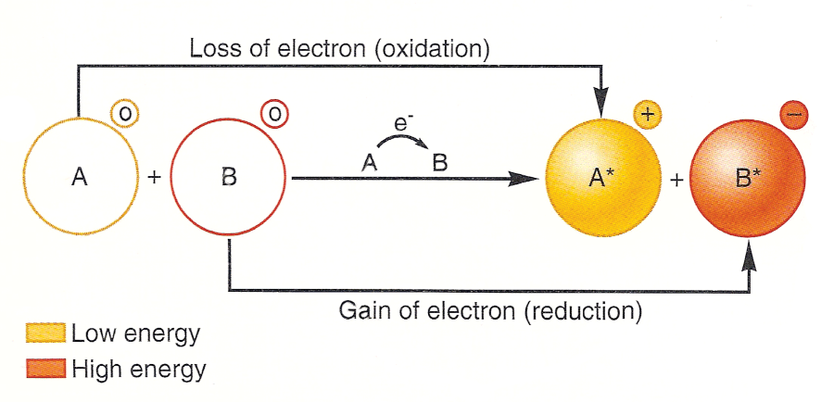

Slide 15
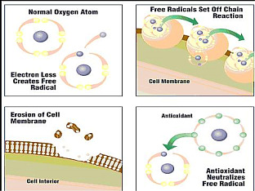

Slide 16
Redox inactive heavy metals
Exposure of plants to redox inactive heavy metals also results in oxidative stress through indirect mechanisms such as interaction with the antioxidant defense system, disruption of the electron transport chain, or induction of lipid peroxidation.

Slide 19
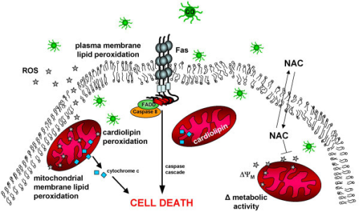

Slide 20
Effect on activity of enzymes
Another important mechanism of heavy metal toxicity is the ability of heavy metals to bind strongly to oxygen, nitrogen, and sulfur atoms. Because of these features, heavy metals can inactivate enzymes.
For example, Cd binding to sulfhydryl groups of structural proteins and enzymes leads to misfolding and inhibition of their activity.

Slide 21
The displacement of one heavy metal ion by another leads to the inhibition or loss of enzyme activities.
Divalent cations such as Co^{+2,} Ni⁺², and Zn⁺² displace Mg⁺² in ribulose 1,5- bisphosphate carboxylase/oxygenase (Rubisco) and result in a loss of activity.

Slide 22
Membrane damage
Additionally, heavy metals cause membrane damage through various mechanisms, including the oxidation of and cross-linking with protein and cause changes in the composition of membrane.

Slide 24
General Effects
Plant growth is commonly used as a general parameter to study the influence of stressors, with growth rate inhibition often being the most obvious plant reaction.
This is especially true of the root system, which is the first plant system to come into direct contact with toxic ions.

Slide 25
Fodor Model
Fodor (2002) suggested an interesting stepwise model for the action of heavy metals in plants.
Stage 1
At this stage metal ions enter in to the plants and cause the formation of reactive oxygen species (ROS) and effect the membranes.

Slide 26
Stage 2
At stage 2, the metal ion reacts with all possible interaction partners within the cytoplasm, including proteins, other macromolecules.
Stage 3
Stage 3 is mainly related to the factors that influence homeostatic events, including water uptake, transport and transpiration. At this stage, symptoms start to develop

Slide 27
Stage 4
At this stage symptoms become visible.
Stage 5
The death of the plant occur at stage 5.
This model has the advantage that visible effects are linked to metabolic events that are influenced by the metal ion of interest.

Slide 28
Formation of Reactive Oxygen Species
Heavy metals caused the formation of reactive oxygen species. The main important ROS (O⁻²) and the hydroxyl radical (OH⁻), because both are highly reactive, carrying out oxidation reactions with many organic molecules.
The generation of ROS is a general phenomenon; higher plants developed a highly sophisticated antioxidant system during the course of evolution.

Slide 29
This consists of several enzymes (catalase, oxidase, peroxidases and reductase) and antioxidant substrates (ascorbate and a-tocopherol).
The main sources of ROS under control conditions (an absence of toxic concentrations of heavy metals) are photosynthetic and respiratory electron transport processes.

Slide 30
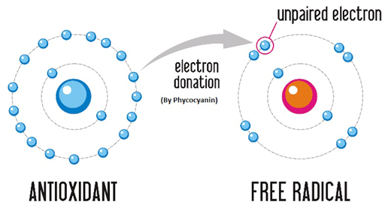

Slide 31
Heavy metals play many roles in this respect. They directly disturb electron transport, causing electrons to be transferred to O• oxygen instead of the natural electron acceptors in chloroplasts and mitochondria.
It has been shown on several occasions that lipid peroxidation is just a consequence of oxidative stress.

Slide 33
Photosynthesis
As already mentioned above, inhibition of photosynthesis is one effect that most of the heavy metals have in common when present at toxic concentrations.
It is a very sensitive response. Measuring the photosynthetic activity is a good screening method for detecting possible stress situations, perhaps including those involving heavy metals.

Slide 34
Direct effects of heavy metals on light and dark reactions and indirect effects caused by them decreasing the photosynthetic pigment content are involved.
Several enzymes involved in the Calvin cycle are also inhibited, especially Rubisco and PEP carboxylase.

Slide 35
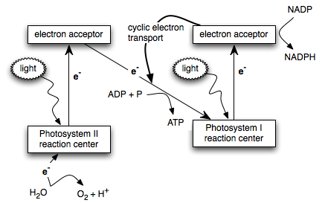

Slide 36
Defense mechanism in plants against metal toxicity
The most important mechanisms to avoid toxicity include:
Synthesis of callose
Limitation the metal assimilation by the root
The removal of excess metals
Binding metal in the cell wall.
Mycorrhizae

Slide 37
Synthesis of callose
In the plant cell, the earliest defence reaction in the case of heavy metal presence is a synthesis of callose (β-1,3 glucan).
This polysaccharide is deposited on the outside of the cell membrane, thereby reducing the diffusion of metal ions into the cell.
The enzyme, which is involved in the synthesis of callose, is β-1, 3-glucan synthetase.

Slide 38
Limitation of metal assimilation by the roots
Another defense mechanism is to limit the metal assimilation from the environment by the roots. Indicate that in an environment contaminated with heavy metals plant roots secrete a number of substances that can bind ions and limit their assimilation by plants.

Slide 39
Among such compounds are organic acids, and substances present in root extracellular matrix composed mainly of e.g. simple sugars, phenols, amino acids and polysaccharide gels.
Another way to reduce the toxicity of metals is the ability of roots to change the rhizosphere PH. The increased pH causes a decrease in the availability of metals.

Slide 41
The removal of excess metals
Another strategy is the ability of plants to remove excess metals in the form of crystals by salt glands of the leaf epidermis.
For example, copper, nickel, zinc, iron and manganese can be removed in such a way.
Metals may also be transported to the ageing leaves and removed along with them.

Slide 42
Binding metal in the cell wall
Another plant defence mechanism against the toxic effects of heavy metals is its binding in the cell wall. For some species, 80–95% of the metal taken up by the cells can be ﬁxed (this particularly applies to ions of lead, copper and zinc).
The cell walls are composed of pectins, which contain many of the methylated (COOCH₃) carboxyl groups, hemicelluloses and cellulose.

Slide 43
Their dissociation leads to the appearance of negatively charged groups, which are typically saturated with calcium.
In the presence of heavy metals (Cd⁺², Pb⁺², Cu⁺²) calcium ions may be competitively replaced by metals cations. In this way, toxic metal ions are immobilized in the cell wall.

Slide 45
Mycorrhizae
Another mechanism, known as mycorrhizae, enables symbiotic relationships between non-pathogenic fungi and roots of higher plant.
Research studies have shown that mycorrhizae fungi are able to alleviate the stress of heavy metals.

Slide 46
REFERENCES
www. Springer.com
Pinho, S., and B. Laderoi. 2012. Phytotoxicity by lead as heavy metal focus on oxidative stress. Journal of Botany, 20(12): 1-10.

