Slide 1
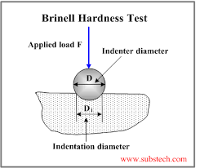
METHOD OF TESTING
Lecture-3

Slide 2
Why are metals tested ?
Ensure quality
Test properties
Prevent failure in use
Make informed choices in using materials
Factor of Safety is the ratio comparing the actual stress on a material and the safe useable stress.

Slide 3
Two forms of testing
Mechanical tests – the material may be physically tested to destruction. Will normally specify a value for properties such as strength, hardness, toughness, etc.
Non-destructive tests (NDT) – samples or finished articles are tested before being used

Slide 4
STRESS
stress – internal force in a material which tends to resist deformation when subjected to external forces
intensity of a stress unit depends on the value of the force acting on a unit area of the material
applied force
stress = ---------------------
c.s.a. of a material

Slide 5
Types of stresses
Compressive stress
Tensile stress
Shear stress
Torsion
Bending

Slide 6
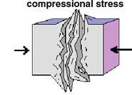
Compressive stress
Compressive stress is the stress applied to materials resulting in their compaction (decrease of volume).
Usually compressive stress is applied to columns, etc.

Slide 7
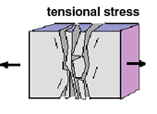
TENSILE STRESS
Tensile stress is the stress state leading to expansion (volume and/or length of a material tends to increase). In the uniaxial manner of tension, tensile stress is induced by pulling forces across a bar, specimen, etc.

Slide 8
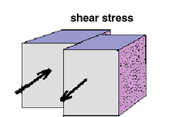
SHEAR STRESS
Shear stress is a stress state where the shape of a material tends to change without particular volume change.

Slide 9
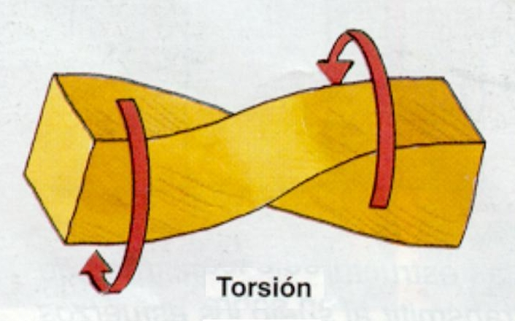
TORSION
the stress which resists a force tending to twist the material (e.g. axle, screw, etc.)

Slide 10
Bending
Bending occurs when the force applied tends to pull a horizontal bar out of its straight line.

Slide 11
Method of testing of Fatigue test
Method of testing of Hardness test
Method of testing of Tensile test
Method of testing of Impact test

Slide 12
TENSILE TEST
The following MATERIAL PROPERTIES can be evaluated / determined by TENSILE TESTING:
STRENGTH
DUCTILITY
ELASTICITY
STIFFNESS

Slide 13
TENSILE TEST
STRENGTH - the greatest stress that the material can withstand prior to failure.
DUCTILITY - a material property that allows it to undergo considerable plastic deformation under a load before failure.
ELASTICITY - a material property that allows it to regain its original dimensions after removal of a deforming load.
STIFFNESS - a material property that allows a material to withstand high stress without great strain.

Slide 14
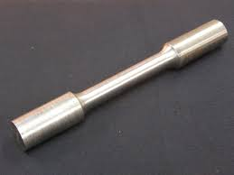
TENSILE MACHINE & SPECIMEN.

Slide 15
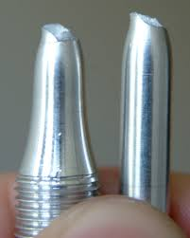
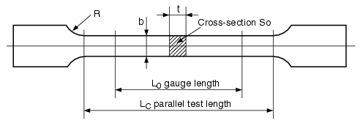
SPECIMEN DIMENSIONS

Slide 16
TENSILE TESTING
A machine which applies a tensile force (a force applied in opposite directions) to the specimen, and then measures that force and also the elongation:
This machine usually uses a hydraulic cylinder to create the force. The applied force is determined by system pressure, which can be accurately measured.

Slide 17
PROCESS
The test process involves placing the test specimen in the testing machine and slowly extending it until it fractures. During this process, the elongation of the gauge section is recorded against the applied force. The data is manipulated so that it is not specific to the geometry of the test sample. The elongation measurement is used to calculate the engineering strain , ε, using the following equation:

Slide 18
PROCESS
where ΔL is the change in gauge length, L₀ is the initial gauge length, and L is the final length. The force measurement is used to calculate the engineering stress, σ, using the following equation
where F is the tensile force and A is the nominal cross-section of the specimen. The machine does these calculations as the force increases, so that the data points can be graphed into a stress–strain curve.

Slide 19
STRESS STRAIN DIAGRAM

Slide 20
Modulus of elasticity
the modulus of elasticity (elastic modulus) of an object is defined as the slope of its stress-strain curve in the elastic deformation region

Slide 21
Yield point
the stress at which a material begins to deform plastically
prior to the yield point the material will deform elastically and will return to its original shape when the applied stress is removed
once the yield point is passed, some fraction of the deformation will be permanent and non-reversible

Slide 22
HARDNESS TEST APPRATUS

Slide 23
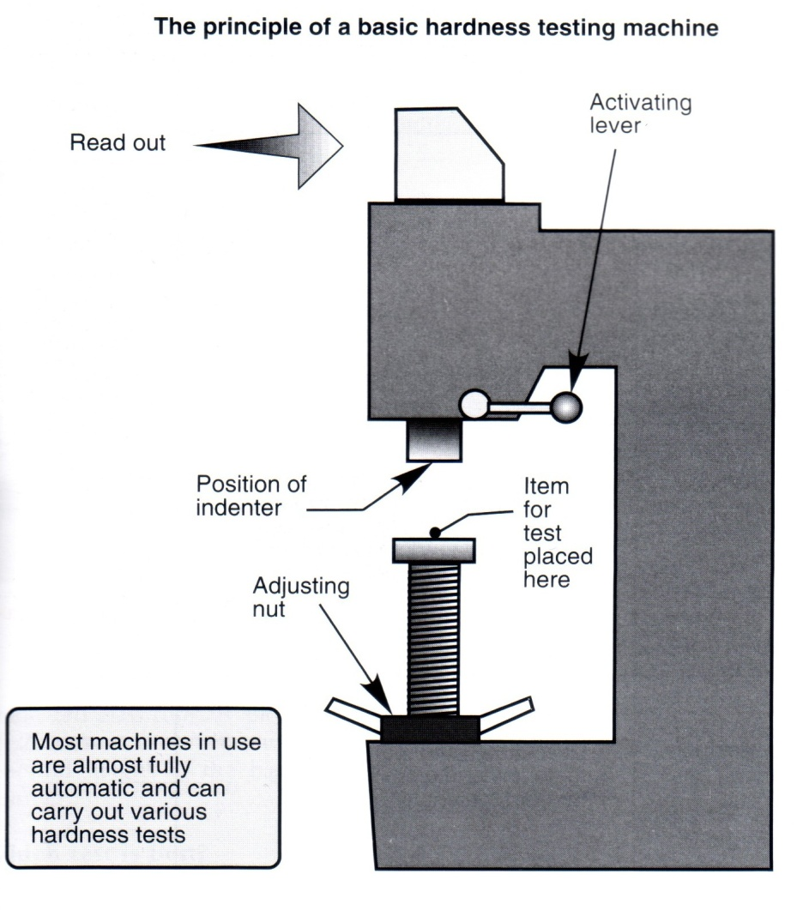
HARDNESS TESTING
Hardness is the ability to
withstand indentation or scratches

Slide 24
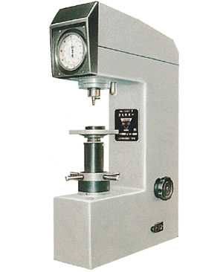
HARDNESS TESTING
The indenter is pressed into the metal
Softer materials leave a deeper indentation

Slide 25
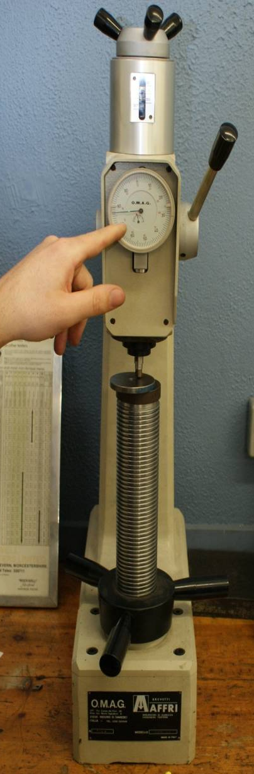

Slide 26
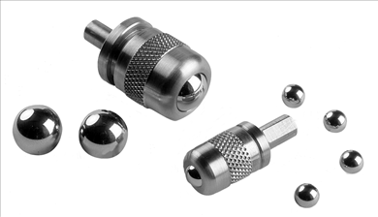
BRINELL HARDNESS TEST
Uses ball shaped indenter.
Cannot be used for thin materials.
Ball may deform on very hard materials
Surface area of indentation is measured.

Slide 27
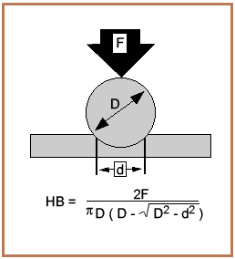
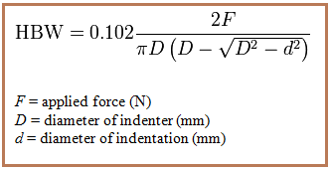
HARDNESS TESTING

Slide 28
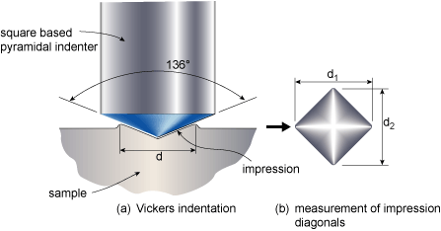
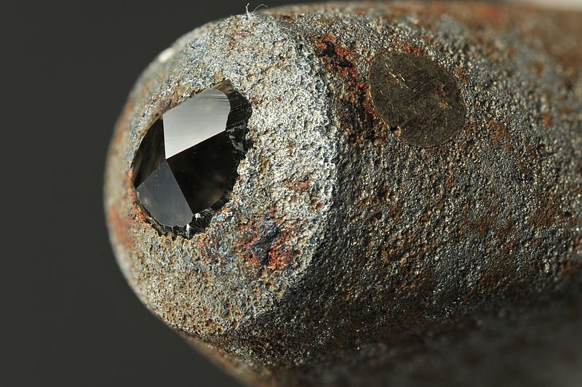
VICKERS HARDNESS TEST
Uses square shaped pyramid indenter.
Accurate results.
Measures length of diagonal on indentation.
Usually used on very hard materials

