Slide 1
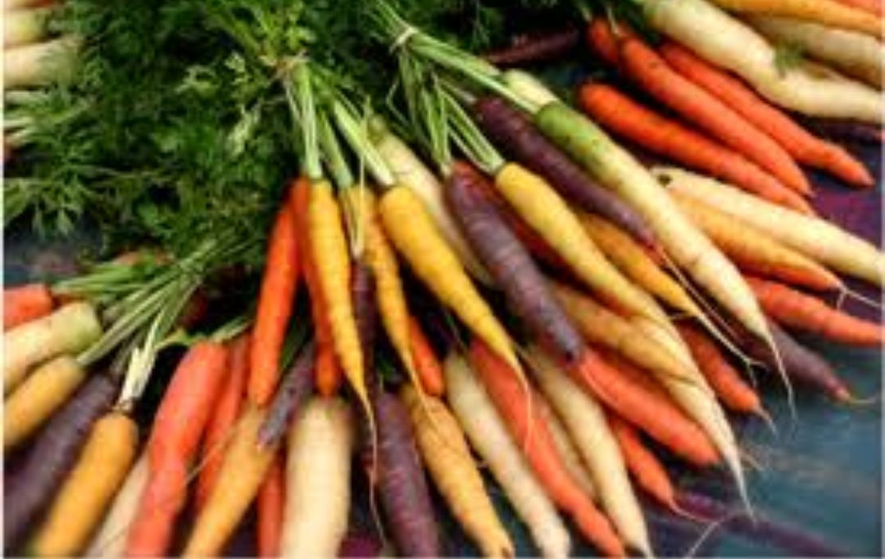
topic
Origin and distribution of crop species, center of origin and genetic diversity

Slide 2
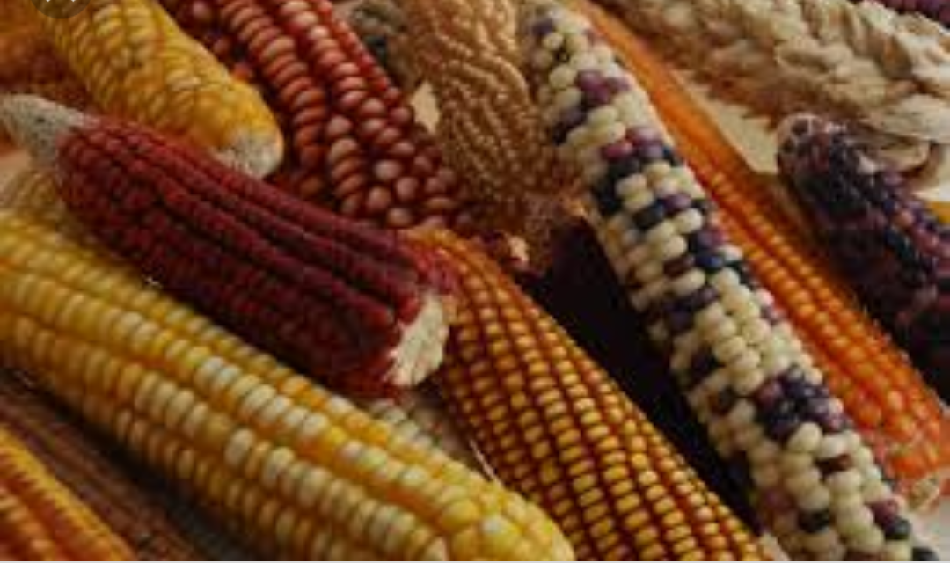
Genetic diversity
“It is the total number of genetic characteristics in the genetic makeup of species”
e.g. assorted colors of kernel in different varieties of corn are the result of genetic diversity

Slide 3
Genetic diversity is the basic ingredient for crops to respond to environmental threats ranging from pests to climate change.
It serves as the way for populations to adapt to changing environments.
It is different from variability which describes the tendency of genetic characteristics to vary.

Slide 4
Center of origion
“Center of origin is a geographical area where group of organisms, either domesticated or wild, first develop its distinctive properties.”
It is also termed as center of diversity.
The origin of crop plant is basic to plant breeding in order to locate wild relatives, related species and new genes ( especially dominant genes and source of disease resistance.

Slide 5
Origin of crop plants is vitally important in order to avoid
Genetic erosion
loss of germplasm (due to loss of ecotypes and landraces)
Loss of habitat (rain forests)
Increase urbanization

Slide 6
Types of center of diversity
Primary center of diversity
it is the region vast genetics diversity of crop plants and original homes of crop plants which are generally uncultivated areas like mountain, rivers, valleys and forests
Features
Wide genetic diversity
Large number of dominant genes
Wild characters

Slide 7
Exhibit less crossing over
Natural selection operates
Secondary center of diversity
vavilov suggested that values forms of crop plants are found for away from their primary area of origin called S.C.D

Slide 8
Features
Lesser genetic diversity
Large number of recessive gene
Desirable characters
Exhibit more crossing over
Natural and artificial selection

Slide 9
3. Micro centers
small area within the center of diversity exhibit tremendous genetic diversity of crop plants termed as micro centers
Features
Represent small areas within the center of diversity
Exhibit tremendous genetic diversity
Rate of natural evolution id faster than larger areas
Site for the study of crop evolution

Slide 10
vavilov Eight centers
vavilov centers are region where a high diversity of crop wild relatives can be found
Old world
Chinese center
Indian center
Central Asiatic center
Near eastern center
Mediterranean center
Abyssinian cater

Slide 11
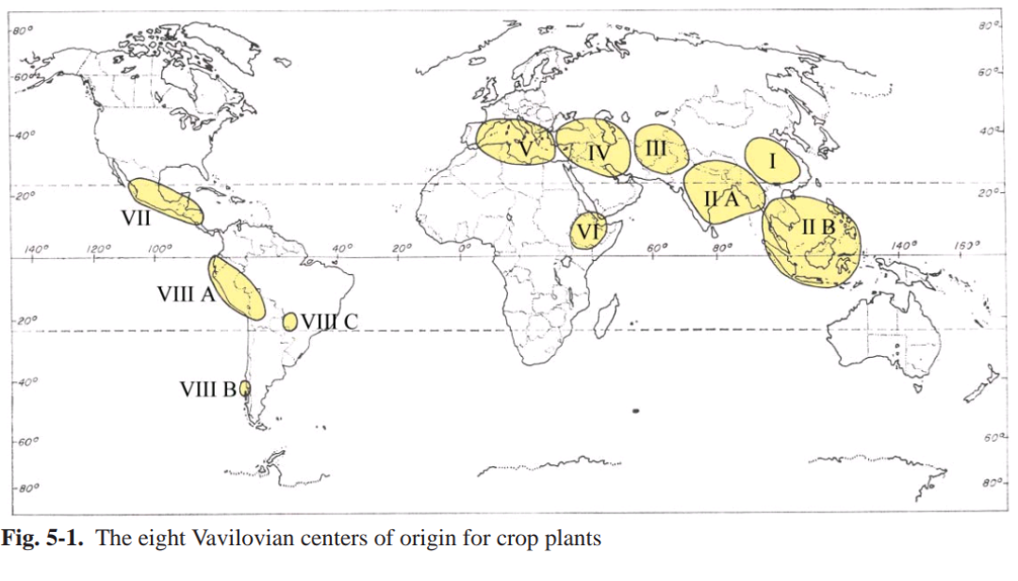
New world
South Mexican and central American center
South American center

Slide 12
Chinese center
largest independent center which includes the mountainous region of central and western china
(A total of 136 endemic plants are listed)

Slide 13
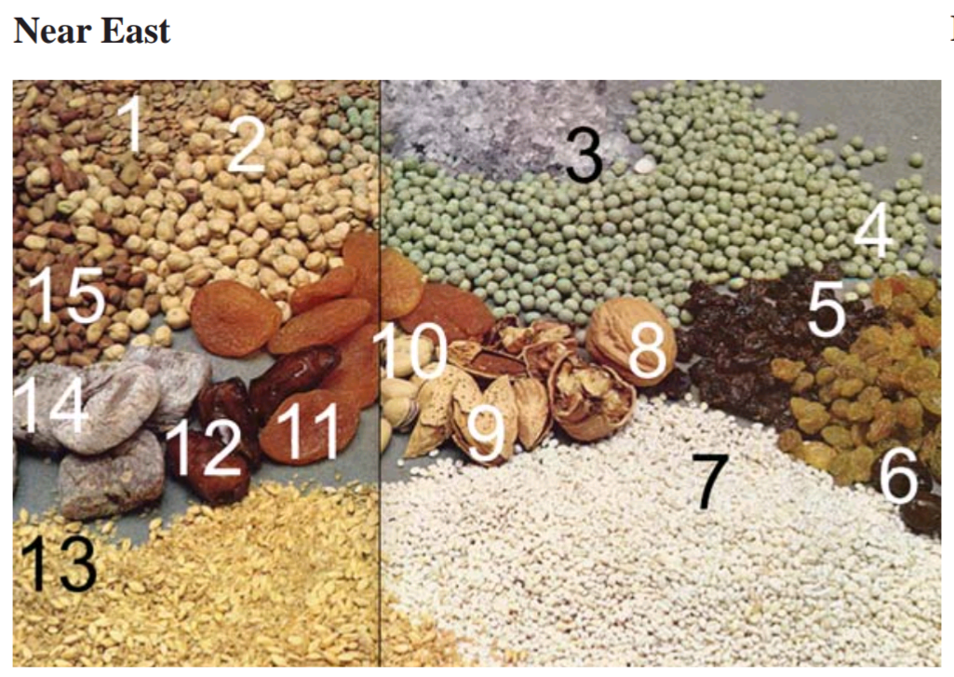
Origin of basic crops
Near East
Lentil
Chickpea
Salt
Pea
Olive
Barley
walnut
apricot

Slide 14
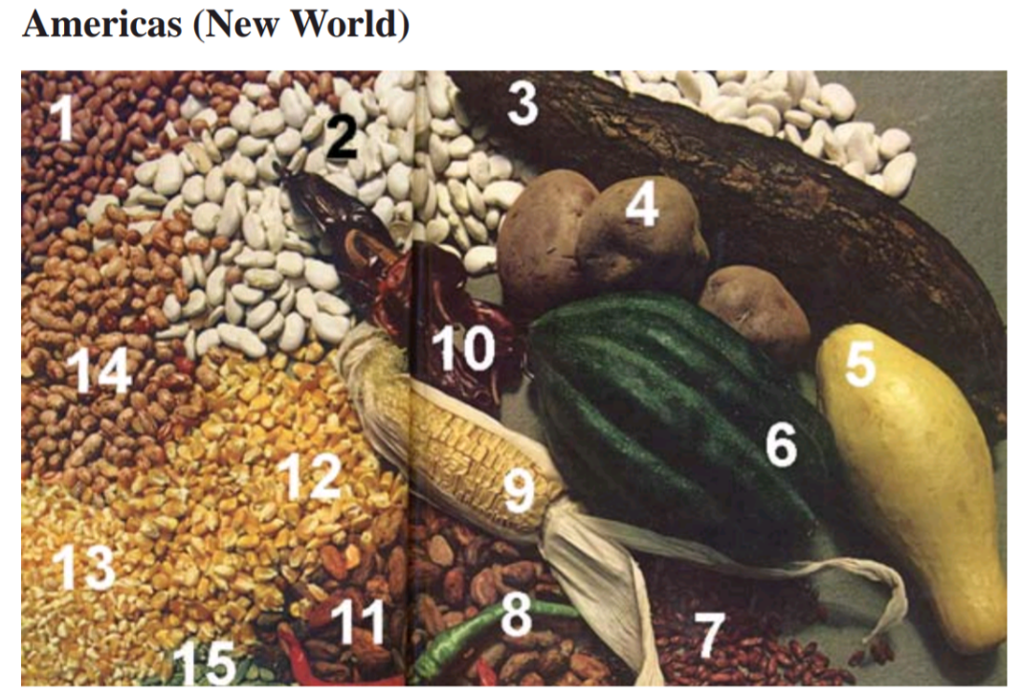
Americas
Pink bean
Lima bean
Chili pepper
Corn
Coca bean
Shelled pumpkin seeds
potato

Slide 15
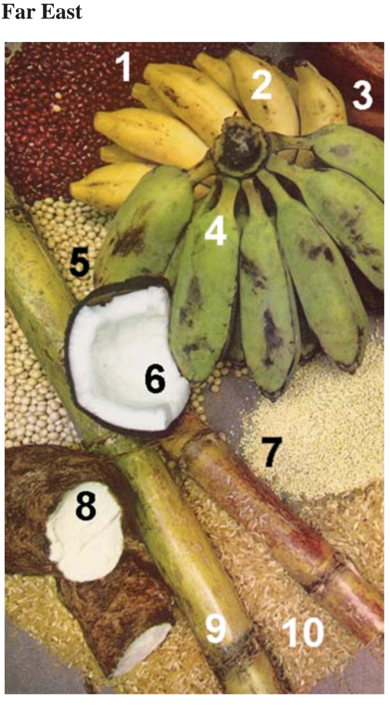
Far East
Yellow banana
Red banana
Green banana
Soybean
Coconut
Sugarcane
Rice
yam

Slide 16
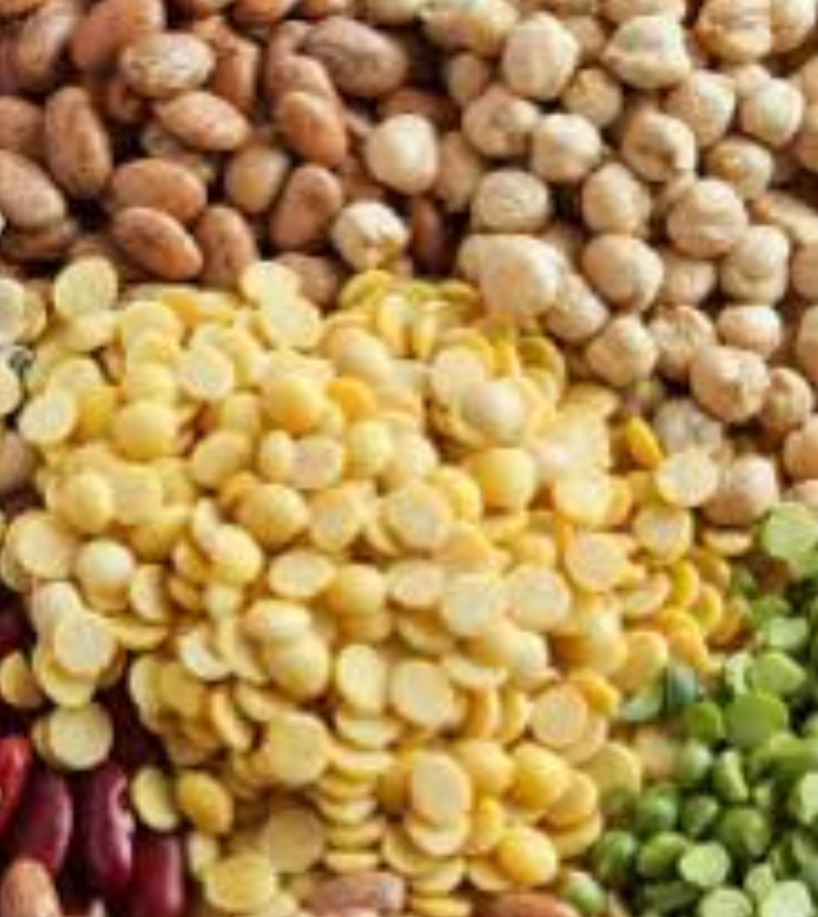
Cereals and legumes
Broomcorn millet
Italian millet
Japanese barnyard millet
Buckwheat
Hull-less barley
Soybean, glycine max
Velvet bean

Slide 17
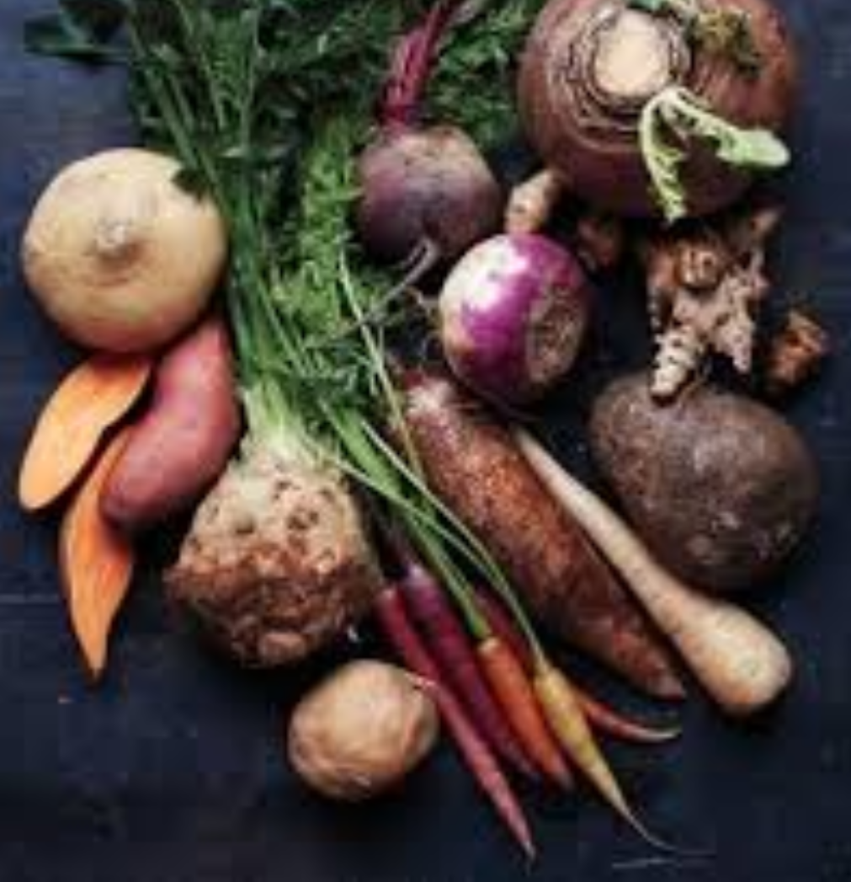
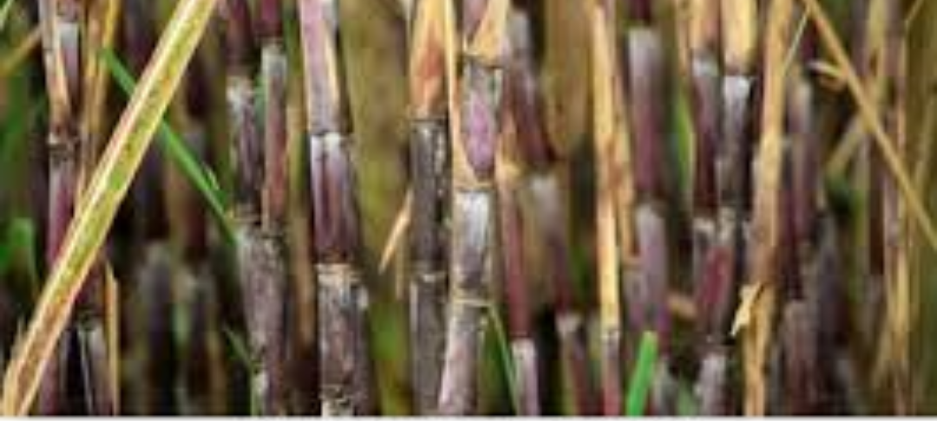
Roots, tubers and vegetables
Chinese yam
Reddish
chines cabbage
Onion
Cucumber
Sugar and drug
Sugarcane
Hemp
camphor

Slide 18
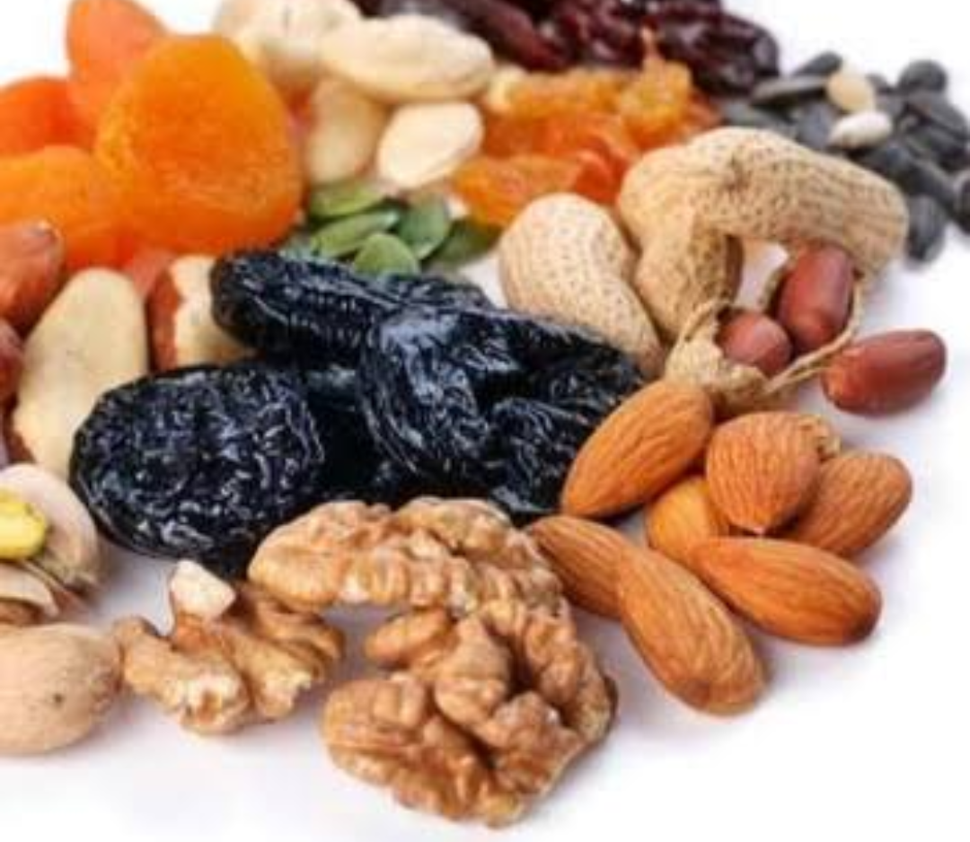
Fruits and nuts
Pear
Chines apple
Peach
Apricot
Walnut
Cherry leachy

Slide 19
Indian center
It has 2 sub centers
Main center (Hindustan center): Includes Assam and Burma
117 plants were considered were endemic
Indo-Malayan center: Includes indo china and Malay
55 plants were listed

Slide 20
Cereals and legumes
Rice
Chick pea
Pigeon pea
Mung bean
Cow pea
Velvet bean
Vegetables and tubers
Cucumber
Reddish
Yam
taro
Eggplant

Slide 21
Fruits
mango
orange
Citrus
Banana
Bread fruit
Mangos teen
Oil ,sugar , spice , fiber
Sugarcane
Safflower
Tree cotton
Peppers
Hemp
Clove
Coconut palm

Slide 22
Central Asiatic center
It includes North West India (Punjab and Kashmir),Afghanistan and Uzbekistan.
43 plants are listed as endemic
Cereals and legumes
Wheat
Club wheat
Short wheat
Pea
lentil

Slide 23
Fibers and vegetables
Hemp
Cotton
Onion
Garlic
Spinach
carrot
Fruits
Pear
Almond
Grapes
Apples

Slide 24
Near-eastern center
Includes Asia minor Iran, highland of Turkmenistan
83 species are listed
Cereals and legumes
Durum wheat
Common wheat
Rye
Oat
lentil

Slide 25
Forage plants
Alfalfa
Persian clover
Vetch
Hairy vetch
Fruits
Fig
Apples
Pear
Cherry
pomegranate

Slide 26
Mediterranean center
Include the borders of Mediterranean sea.
84 plants are listed as endemic plants
Cereals and legumes
Durum wheat
Polish wheat
Oats
Pea
Grass pea

Slide 27
Forage plants
Egyptian clover
White clover
Crimson clover
Oil and fiber plants
Flax
Rape
Black mustard
olive

Slide 28
Vegetables
Garden beet
Cabbage
Turnip
Asparagus
Oil and spice
Thyme
Peppermint
Hop
caraway

