Slide 1
House hold pests
Dr. M. Asam Riaz
Assistant Professor
Entomology, College of Agriculture, University of Sargodha, Sargodha, Pakistan

Slide 2
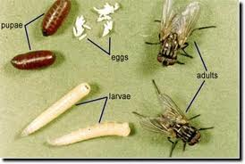
House fly (Musca domestica; Muscidae: Diptera)
Mechanical transmission of organisms on its hairs, mouthparts, vomitus and feces:
Parasitic diseases: cysts of protozoa e.g. Entamoeba histolytica (dysentry), Giardia lamblia (diarrhea)
Eggs of helminths, e.g., Ascaris lumbricoides ,Trichuris trichiura, Hymenolepis nana, Enterobius vermicularis. (all causes stomach diseases),
Bacterial diseases: typhoid, cholera, dysentery, pyogenic cocci, etc. House flies have been demonstrated to be vectors of E. Coli
Viruses: enteroviruses: poliomyelitis, viral hepatitis (A & E)..etc.
Management:
Dispose of manures, garbage, sewage, food waste, human exrement and dead animals
Use Sticky papers
Use Fly-flappers
Use of electric trap
Use Poison baits (coding with dichlorvos etc)
Spray insecticides inside homes (Trichlorphon 0.5%)

Slide 3
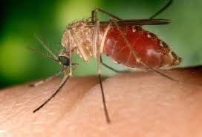
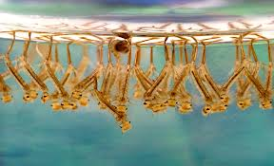
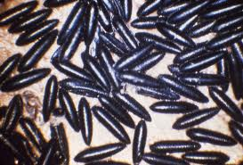
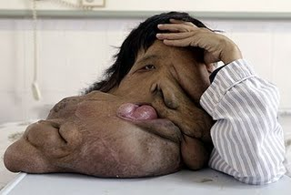
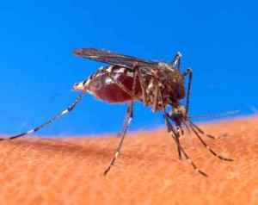
Mosquito (Aedes spp., Culex spp., Anopheles spp.; Culicidae: Diptera)
Disease transmission: malaria, dengue fever virus, yellow fever virus, japanese encephalitis virus, filariasis (disease due to Nematodes)
Management:
Destroy the mosquito breeding places (e.g., old tyres, water storage tank, room coller, flower vase etc to avoid dengue fever)
Remove the stagnant water (to avoid malaria)
Use of insecticide treated nets (ITN)
Screening of doors and windows
Vaccinate the children against malaria
Use of mosquito repellent (e.g., mospal, mos free etc)
Grasses around the house should be cut and sprayed with permethrin (0.25 %)
Spray on Vegetation around house against mosquito permethrin (0.25 %)
Use temephos to kill the larvae of mosquito
Filariasis

Slide 4
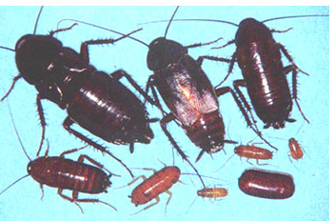
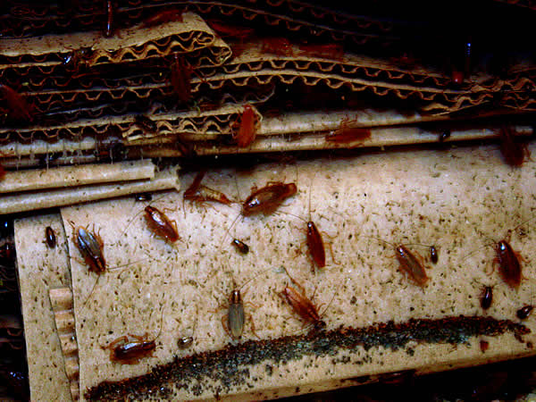
Cockroaches(Periplaneta americana; Blattidae: Dictyoptera)
vectors and/or reservoirs of antibiotic resistant microbes (enterococci)
Move freely from building to building or from drains, gardens, sewers and latrines to human habitations.
feed on old damp books and leather articles, human faeces as well as human food they can spread germs that cause disease
They are proven or suspected carriers of the organisms causing:
— diarrhoea
— dysentery
— cholera
— leprosy
— plague
— typhoid fever
— viral diseases such as poliomyelitis.
May cause allergic reactions, including dermatitis, itching, swelling of the eyelids and more serious respiratory conditions (asthma)
Sugary and starchy substances in the houses are destroyed by their excreta and produce offensive smell
Common in unclean kitchens, restaurants and old musty buildings and other filthy places

Slide 5
Management:
Close all cracks and crevices to control the entry of cockroaches
Keep the kitchen clean
Keep the drains sealed
Use of sticky traps
Spray rooms with chlorpyriphos (0.5 %)
Spray dichlorvos ( 0.5 %)
Fipronils in poison baits
Flufenoxuron (0.001 %) as IGR in baits

