Slide 1
TENS
TRANSCUTANEOUS ELECTRICAL NERVE STIMULATION

Slide 2
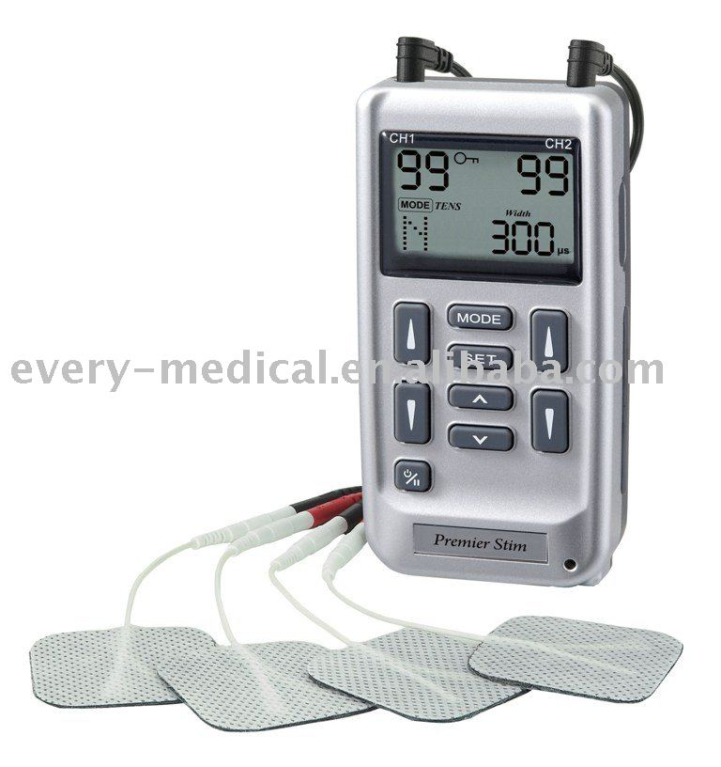

Slide 3
Transcutaneous electrical nerve stimulation is the application of low frequency current in the form of pulsed rectangular currents through surface electrodes on the patient’s skin to reduce pain.
A small battery operated machine is used to generate current, which have specific stimulatory effect.
The effect and use of TENS depends upon gait control theory and pain modulation.

Slide 4
Pain
Pain is an unpleasant disturbed sensation. Which accompanies the activation of nociceptors.
Pain is a subjective phenomenon with multiple dimensions.

Slide 5
Nociceptors
Nocicepters are the sensory receptors, which caries pain stimulus.
Any physical, chemical, thermal or mechanical stimulus like heat, cold or pressure activates these nociceptors.
These are free nerve endings found in all body tissues.
They carry pain stimulus to the higher centers.
Once a nociceptors is stimulated, it release a neuropeptide, which initiates the electrical impulse along the afferent fibers towards the spinal cord.

Slide 6
These afferent fibers are of two types.
A Delta fibers:
Fast conducting small diameter myelinated fibers, which conducts with a velocity of 5-30 m/s.
C fibers:
Slow conducting small diameter non-myelinated fibers, which conducts with a velocity of 2-5 m/s.
First order or primary afferent fibers:
Transmit impulses from the sensory receptors to the dorsal horn of the spinal cord.
Second order afferent fibers:
Carry sensory impulses from the dorsal horn of spinal cord to the brain

Slide 7
First order neurons:
A- alpha
A- beta
(large diameter)
A- delta
C- fibers
(small diameter)
Second order neurons:
Second order afferents are nociceptive specific.
A nociceptive neurons transmits pain signals.
Its cell body lies in the dorsal root ganglion.
A-delta and C-fibers transmits the sensation of pain.

Slide 8
Fast pain is transmitted over the larger, faster-conducting A-delta afferent neurons and originates from receptors located in the skin
Slow pain is transmitted by the C afferent neurons originates from both superficial(skin) and deeper(ligaments and muscle) tissue.
Most nociceptive second-order neurons ascend to higher centers along one of three tracts;
Lateral spinothalamic tract
Spinoreticular tract
Spinoencephalic tract
Approximately 90% of the wide dynamic range second- order afferent terminate in the thalamus

Slide 9
Pain Gate Control
Pain gate theory was first postulated by Melzack and Wall in 1965.
Later modified in 1982.
Afferent input is mainly through posterior root of the spinal cord and all afferent information must pass through synapses in substantia gelatinosa and nuscleus proprius of posterior horn.
It is at this level that pain gate operates and pre-synaptic inhibition by TENS works

Slide 10
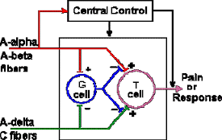

Slide 11
Mechanism of Pain Gate Control
Nociceptive afferent enters the spinal cord via dorsal root and make synapses either with interneurons or with second order neuron(called as transmission cells or T cells) in the substansia Gelatinosa in the dorsal horn of spinal cord.
The second order neuron crosses the midline of the spinal cord and transmit information to the higher centers via lateral spinothalmic tract.
These second order ascending neurons synapse with third order neurons in the nuclei of thalamus.
The third order neuron carries the noxious stimulus to the cerebral cortex.

Slide 12
Modulation of transmission of pain can be achieved by altering the excitability of this pain pathway.
The excitability of this pathway can be altered by other neurons(substansia Gelatinosa) in the dorsal horn.
The SG has inhibitory influence on the T cells.
This mechanism is called Presynaptic Inhibition.
Also the nociceptive afferent sends collaterals to the SG which inhibits the SG cells when these nociceptive afferents are activated.
These causes inhibition of SG cell activity which will the further inhibit the mechanism of pressynaptic inhibition.
Thus allowing the nociceptive stimuli to reach the higher centers.

Slide 13
Also low threshold large diameter mechano-sensitive afferent have excitatory influence on SG cells.
Their activation causes excitation of SG activity which in result causes increased presynaptic inhibition blocking the transmission at T cells thus closes the gate for nociceptive stimuli to travel upto the higher center.
This is the site where pain gate operates

Slide 14
In addition to these input to SG cells from peripheral afferent there are descending influences on Transmission cells(T cells) which came principally from higher centers such as
Preaquaduct gray matter PAG( mid brain)
Raphe Nucleus(Medulla)
Both have excitatory influence on SG cells activity thus have ability to reduce pain transmission.
These pathways are thought to exert their effect on SG cells by release of neurotransmitters such as noradrenaline and 5HT
under normal condition PAG and Raphe Nucleus are inhibited by neurons of other area of brain.
During pain inhibition on PAG and RN is removed by LIMBIC system thus allowing PAG and RN to exert its effect at SG of dorsal horn of spinal cord

Slide 15
Thus TENS stimulates the large diameter myelinated fibers as these are highly sensitive to electrical stimulation and quickly conduct the electrical impulse to the spinal cord.
The A-delta and C fibers are unable to pass the painful stimulus to spinal cord earlier than the large fibers.
PRE-SYNAPTIC INHIBITION
The mechanism by which the nociceptor fibers are prevented from passing on their message to the spinal cord is called as PRE-SYNAPTIC INHIBITION

Slide 16
TYPES OF TENS
High TENS
Low TENSE
Burst TENS

Slide 17
HIGH TENS
In this high frequency and low intensity electrical stimulation is applied. The stimulation will cause impulse to be carried along with the large diameter afferent fibers and produces pre-synaptic inhibition of the transmission of nociceptive A-delta and C fibers at SG of the pain gate.
Frequency 100-150 Hz
Pulse width 100 and 500 ms
Intensity 12-30 mA

Slide 18
LOW TENS
In this low frequency high intensity electrical pulses are applied, it gives a sharp stimulus and like a muscle twitch. As the nociceptive stimulus is carried towards the cerebrum, its passages through the mid-brain will cause the PAG and RN to interact to cause the opiate like substances at cord levels. The encephalins and endorphins released have effect of blocking forward transmission in the pain circuit.
Frequency 1-5Hz
Pulse Width 100 and 500ms
Intensity 30 mA or more

Slide 19
BURST TENS
High frequency, short pulse, high intensity electrical current is used
BURST TENS is a series of impulse repeated for 1-5 times/sec.
Each(train) burst last for about 70 ms.
The benefits for the Burst TENS are that it combines both the conventional and acupuncture like TENS and thus provide pain relief by the both routes.

Slide 20
METHODS OF TREATMENT
ELECTRODE PLACEMENT:
Area of greater intensity of pain.
Superficial nerve proximal to the site of pain.
To the appropriate dermatome.
To the nerve trunk trigger point.
A number of treatment methods may be used depending upon the severity of the problem.
TENS can be used for a single daily treatment of 40min. Duration.
Portable TENS can be used continuously for 24 hours.
TENS can be used in night, e.g., for the treatment of phantom limb pain.

Slide 21
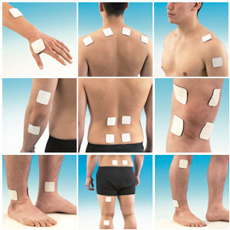

Slide 22
INDICATIONS FOR USE
TENS can be used for treatment of:
Chronic pain syndrome.
Phantom limb pain.
Reflex sympathetic dystrophy.
Post operative pain.
Obstetric pain.

Slide 23
DANGERS AND CONTRAINDICATIONS
Continuous application of high TENS may result in some electrolytic reaction below the skin surface.
TENS is contraindicated in patients having cardiac pacemaker may be because of possible interference with the frequency of pacemaker.
TENS should be avoided in first three months of pregnancy.
TENS should be avoided in hemorrhagic conditions.
TENS should be avoided over open wounds, carotid sinus, over the mouth, near eyes, etc.

Slide 24
THANK YOU

