Slide 1
Physical Structure
Memory and Process

Slide 2
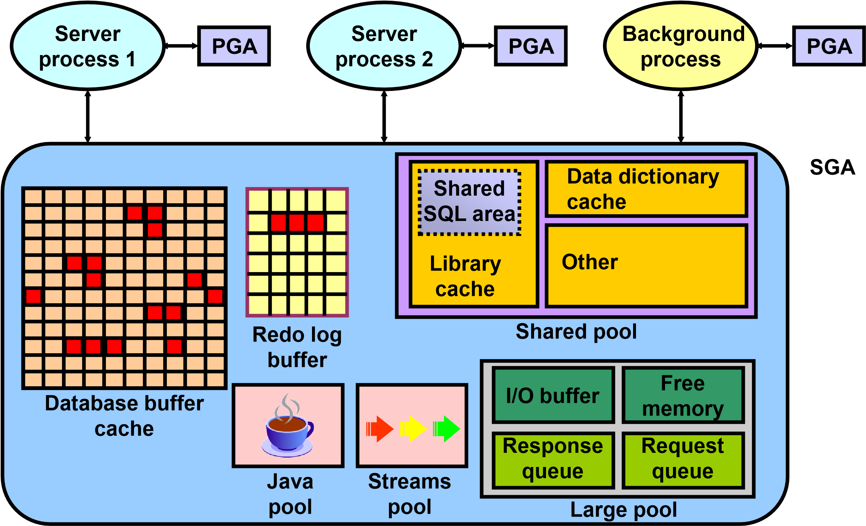
Oracle Database Memory Structures
DB structures
→Memory
- Process
- Storage
Notes:
Oracle Database Memory Structures
Oracle Database creates and uses memory structures for various purposes. For example, memory stores program code being run, data that is shared among users, and private data areas for each connected user. Two basic memory structures are associated with an instance:
System Global Area (SGA): Group of shared memory structures, known as SGA components, that contain data and control information for one Oracle Database instance. The SGA is shared by all server and background processes. Examples of data stored in the SGA include cached data blocks and shared SQL areas.
Program Global Areas (PGA): Memory regions that contain data and control information for a server or background process. A PGA is nonshared memory created by Oracle Database when a server or background process is started. Access to the PGA is exclusive to the server process. Each server process and background process has its own PGA.

Slide 3
Database Buffer Cache
Is part of the SGA
Holds copies of data blocks that are read from data files
Is shared by all concurrent users
Instance
SGA
Shared pool
Database buffer cache
Redo log buffer
Library
cache
Data dictionary cache
DBWn
CKPT
LGWR
SMON
PMON
ARCn
RECO
Others
Notes:
Database Buffer Cache
The first time an Oracle Database user process requires a particular piece of data, it searches for the data in the database buffer cache. If the process finds the data already in the cache (a cache hit), it can read the data directly from memory. If the process cannot find the data in the cache (a cache miss), it must copy the data block from a data file on disk into a buffer in the cache before accessing the data. Accessing data through a cache hit is faster than data access through a cache miss.
The buffers in the cache are managed by a complex algorithm that uses a combination of least recently used (LRU) lists and touch count.

Slide 4
Redo Log Buffer
Is a circular buffer in the SGA
Holds information about changes made to the database
Contains redo entries that have the information to redo changes made by operations such as DML and DDL
Instance
SGA
Shared pool
Database buffer cache
Redo log buffer
Library
cache
Data dictionary cache
DBWn
CKPT
LGWR
SMON
PMON
ARCn
RECO
Others
Notes:
Redo Log Buffer
Redo entries are used for database recovery if necessary.
Redo entries are copied by Oracle Database processes from the user’s memory space to the redo log buffer in the SGA. The redo entries take up continuous, sequential space in the buffer. The LGWR background process writes the redo log buffer to the active redo log file (or group of files) on disk.

Slide 5
Shared Pool
Is a portion of the SGA
Contains:
Library cache
Shared SQL area
Data dictionary cache
Control structures
Instance
SGA
Shared pool
Shared SQL area
Data dictionary cache
Database buffer cache
Redo log buffer
Library
cache
Data dictionary cache
Library cache
Other
DBWn
CKPT
LGWR
SMON
PMON
ARCn
RECO
Others
Notes:
Shared Pool
The shared pool portion of the SGA contains the library cache, the data dictionary cache, the SQL query result cache, the PL/SQL function result cache, buffers for parallel execution messages, and control structures.
The data dictionary is a collection of database tables and views containing reference information about the database, its structures, and its users. Oracle Database accesses the data dictionary frequently during SQL statement parsing. This access is essential to the continuing operation of Oracle Database.
The data dictionary is accessed so often by Oracle Database that two special locations in memory are designated to hold dictionary data. One area is called the data dictionary cache, also known as the row cache because it holds data as rows instead of buffers (which hold entire blocks of data). The other area in memory to hold dictionary data is the library cache. All Oracle Database user processes share these two caches for access to data dictionary information.
Oracle Database represents each SQL statement that it runs with a shared SQL area (as well as a private SQL area kept in the PGA). Oracle Database recognizes when two users are executing the same SQL statement and reuses the shared SQL area for those users.

Slide 6
Large Pool
Provides large memory allocations for:
Session memory for the shared server and the Oracle XA interface
I/O server processes
Oracle Database backup and restore operations
Database buffer cache
Redo log buffer
Shared pool
I/O buffer
Free memory
Response queue
Request queue
Java pool
Streams pool
Large pool
Large pool
Notes:
Large Pool
The database administrator can configure an optional memory area called the large pool to provide large memory allocations for:
Session memory for the shared server and the Oracle XA interface (used where transactions interact with more than one database):
I/O server processes
Oracle Database backup and restore operations
By allocating session memory from the large pool for shared server, Oracle XA, or parallel query buffers, Oracle Database can use the shared pool primarily for caching shared SQL and avoid the performance overhead that is caused by shrinking the shared SQL cache.
In addition, the memory for Oracle Database backup and restore operations, for I/O server processes, and for parallel buffers is allocated in buffers of a few hundred kilobytes. The large pool is better able to satisfy such large memory requests than the shared pool.
The large pool does not have an LRU list. It is different from reserved space in the shared pool, which uses the same LRU list as other memory allocated from the shared pool.

Slide 7
Java Pool and Streams Pool
Java pool memory is used in server memory for all session-specific Java code and data in the JVM.
Streams pool memory is used exclusively by Oracle Streams to:
Store buffered queue messages
Provide memory for Oracle Streams processes
Java pool
Streams pool
Notes:
Java Pool and Streams Pool
Java pool memory is used in different ways, depending on the mode in which Oracle Database is running.
The Java Pool Advisor statistics provide information about library cache memory used for Java and predict how changes in the size of the Java pool can affect the parse rate. The Java Pool Advisor is internally turned on when statistics level is set to TYPICAL or higher. These statistics reset when the advisor is turned off.
The Streams pool is used exclusively by Oracle Streams. The Streams pool stores buffered queue messages, and it provides memory for Oracle Streams capture processes and apply processes.
Unless you specifically configure it, the size of the Streams pool starts at zero. The pool size grows dynamically as needed when Oracle Streams is used.

Slide 8
Process Architecture
DB structures
- Memory
→ Process
- Storage
User process
Is started when a database user or a batch process connects to Oracle Database
Database processes
Server process: Connects to the Oracle instance and is started when a user establishes a session
Background processes: Are started when an Oracle instance is started
Instance
SGA
Shared pool
Database buffer cache
Redo log buffer
Library
cache
PGA
Data dictionary cache
User process
Server process
Background processes
DBWn
CKPT
LGWR
SMON
PMON
ARCn
RECO
Others
Notes:
Process Architecture
The processes in an Oracle Database system can be divided into two major groups:
User processes that run the application or Oracle tool code
Oracle Database processes that run the Oracle database server code (including server processes and background processes)
When a user runs an application program or an Oracle tool such as SQL*Plus, Oracle Database creates a user process to run the user’s application. Oracle Database also creates a server process to execute the commands issued by the user process. In addition, the Oracle server also has a set of background processes for an instance that interact with each other and with the operating system to manage the memory structures, asynchronously perform I/O to write data to disk, and perform other required tasks.
The process structure varies for different Oracle Database configurations, depending on the operating system and the choice of Oracle Database options. The code for connected users can be configured as a dedicated server or a shared server.
Dedicated server: For each user, the database application is run by a user process that is served by a dedicated server process that executes Oracle database server code.
Shared server: Eliminates the need for a dedicated server process for each connection. A dispatcher directs multiple incoming network session requests to a pool of shared server processes. A shared server process serves any client request.

Slide 9
Process Structures
Server
Server
Server
Server
Server
Server n processes
SGA
Shared pool
Database buffer cache
Redo log buffer
Library
cache
SGA
Data dictionary cache
CKPT
RECO
PMON
SMON
DBWn
LGWR
ARCn
Others
Oracle background processes
Notes:
Process Structures
Server Processes
Oracle Database creates server processes to handle the requests of user processes connected to the instance. In some situations, when the application and Oracle Database operate on the same computer, it is possible to combine the user process and corresponding server process into a single process to reduce system overhead. However, when the application and Oracle Database operate on different computers, a user process always communicates with Oracle Database through a separate server process.
Server processes created on behalf of each user’s application can perform one or more of the following:
Parse and run SQL statements issued through the application
Read necessary data blocks from data files on disk into the shared database buffers of the SGA (if the blocks are not already present in the SGA)
Return results in such a way that the application can process the information
Background Processes
To maximize performance and accommodate many users, a multiprocess Oracle Database system uses some additional Oracle Database processes called background processes. An Oracle Database instance can have many background processes.

Slide 10
Process Structures (continued)
The background processes commonly include the following:
Database writer process (DBWn)
Log writer process (LGWR)
Checkpoint process (CKPT)
System Monitor process (SMON)
Process monitor process (PMON)
Recoverer process (RECO)
Job queue processes
Archiver processes (ARCn)
Queue monitor processes (QMNn)
Other background processes may be found in more advanced configurations.
On many operating systems, background processes are created automatically when an instance is started.

Slide 11
Database Writer Process (DBWn)
Writes modified (dirty) buffers in the database buffer cache to disk:
Asynchronously while performing other processing
Periodically to advance the checkpoint
DBWn
Database buffer cache
Database writer process
Data files
Notes:
Database Writer Process (DBWn)
The Database Writer process (DBWn) writes the contents of buffers to data files. The DBWn processes are responsible for writing modified (dirty) buffers in the database buffer cache to disk. Although one Database Writer process (DBW0) is adequate for most systems, you can configure additional processes (DBW1 through DBW9 and DBWa through DBWj) to improve write performance if your system modifies data heavily. These additional DBWn processes are not useful on uniprocessor systems.
When a buffer in the database buffer cache is modified, it is marked dirty and is added to the LRUW (LRU write) list of dirty buffers that is kept in SCN order. This order therefore matches the order of redo that is written to the redo logs for these changed buffers. When the number of available buffers in the buffer cache falls below an internal threshold (to the extent that server processes find it difficult to obtain available buffers), DBWn writes dirty buffers to the data files in the order that they were modified by following the order of the LRUW list.

Slide 12
LogWriter Process (LGWR)
Writes the redo log buffer to a redo log file on disk
Writes:
When a user process commits a transaction
When the redo log buffer is one-third full
Before a DBWn process writes modified buffers to disk
LGWR
Redo log buffer
LogWriter process
Redo log files
Notes:
LogWriter Process (LGWR)
The LogWriter process (LGWR) is responsible for redo log buffer management by writing the redo log buffer entries to a redo log file on disk. LGWR writes all redo entries that have been copied into the buffer since the last time it wrote.
The redo log buffer is a circular buffer. When LGWR writes redo entries from the redo log buffer to a redo log file, server processes can then copy new entries over the entries in the redo log buffer that have been written to disk. LGWR normally writes fast enough to ensure that space is always available in the buffer for new entries, even when access to the redo log is heavy. LGWR writes one contiguous portion of the buffer to disk.

Slide 13
Checkpoint Process (CKPT)
Records checkpoint information in
Control file
Each data file header
CKPT
Control file
Checkpoint process
Data files
Notes:
Checkpoint Process (CKPT)
A checkpoint is a data structure that defines a system change number (SCN) in the redo thread of a database. Checkpoints are recorded in the control file and in each data file header. They are a crucial element of recovery.
When a checkpoint occurs, Oracle Database must update the headers of all data files to record the details of the checkpoint. This is done by the CKPT process. The CKPT process does not write blocks to disk; DBWn always performs that work. The SCNs recorded in the file headers guarantee that all changes made to database blocks prior to that SCN have been written to disk.
The statistic DBWR checkpoints displayed by the SYSTEM_STATISTICS monitor in Oracle Enterprise Manager indicate the number of checkpoint requests that have completed.

Slide 14
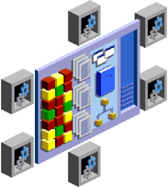
System Monitor Process (SMON)
Performs recovery at instance startup
Cleans up unused temporary segments
SMON
Instance
System Monitor process
Temporary segment
Notes:
System Monitor Process (SMON)
The System Monitor process (SMON) performs recovery at instance startup if necessary. SMON is also responsible for cleaning up temporary segments that are no longer in use. If any terminated transactions were skipped during instance recovery because of file-read or offline errors, SMON recovers them when the tablespace or file is brought back online.
SMON checks regularly to see whether the process is needed. Other processes can call SMON if they detect a need for it.

Slide 15
Process Monitor Process (PMON)
Performs process recovery when a user process fails
Cleans up the database buffer cache
Frees resources that are used by the user process
Monitors sessions for idle session timeout
Dynamically registers database services with listeners
PMON
User
Failed user process
Process Monitor process
Database buffer cache
Notes:
Process Monitor Process (PMON)
The Process Monitor process (PMON) performs process recovery when a user process fails. PMON is responsible for cleaning up the database buffer cache and freeing resources that the user process was using. For example, it resets the status of the active transaction table, releases locks, and removes the process ID from the list of active processes.
PMON periodically checks the status of dispatcher and server processes, and restarts any that have stopped running (but not any that Oracle Database has terminated intentionally). PMON also registers information about the instance and dispatcher processes with the network listener.
Like SMON, PMON checks regularly to see whether it is needed; it can be called if another process detects the need for it.

Slide 16
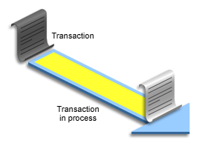
Recoverer Process
Used with the distributed database configuration
Automatically connects to other databases involved in in-doubt distributed transactions
Automatically resolves all in-doubt transactions
Removes any rows that correspond to in-doubt transactions
RECO
Recoverer process in database A
In-doubt transaction in database B
Notes:
Recoverer Process (RECO)
The Recoverer process (RECO) is a background process that is used with the distributed database configuration that automatically resolves failures involving distributed transactions. The RECO process of an instance automatically connects to other databases involved in an in-doubt distributed transaction. When the RECO process reestablishes a connection between involved database servers, it automatically resolves all in-doubt transactions, removing from each database’s pending transaction table any rows that correspond to the resolved in-doubt transactions.
If the RECO process fails to connect with a remote server, RECO automatically tries to connect again after a timed interval. However, RECO waits an increasing amount of time (growing exponentially) before it attempts another connection.

Slide 17
Archiver Processes (ARCn)
Copy redo log files to a designated storage device after a log switch has occurred
Can collect transaction redo data and transmit that data to standby destinations
ARCn
Archiver process
Copies of redo log files
Archive destination
Notes:
Archiver Processes (ARCn)
The archiver processes (ARCn) copy redo log files to a designated storage device after a log switch has occurred. ARCn processes are present only when the database is in ARCHIVELOG mode and automatic archiving is enabled.
If you anticipate a heavy workload for archiving (such as during bulk loading of data), you can increase the maximum number of archiver processes with the LOG_ARCHIVE_MAX_PROCESSES initialization parameter. The ALTER SYSTEM statement can change the value of this parameter dynamically to increase or decrease the number of ARCn processes.

Slide 18
Other Processes
MMON: Performs manageability-related background tasks
MMNL: Performs frequent and lightweight manageability-related tasks
MMAN: Performs automatic memory management tasks
CJQ0: Runs user jobs used in batch processing
QMNx: Monitors the Streams Advanced Queuing message queues
Notes:
Other Processes
There are several other background processes that might be running. These can include the following:
The Manageability Monitor process (MMON) performs various manageability-related background tasks, for example:
Issuing alerts whenever a given metrics violates its threshold value
Taking snapshots by spawning additional process (MMON slaves)
Capturing statistics value for SQL objects that have been recently modified
The Lightweight Manageability Monitor process (MMNL) performs frequent tasks related to lightweight manageability, such as session history capture and metrics computation.
The Memory Manager process (MMAN) is used for internal database tasks. It manages automatic memory management processing to help allocate memory where it is needed dynamically in an effort to avoid out-of-memory conditions or poor buffer cache performance.
Job queue processes are used for batch processing. They run user jobs and can be viewed as scheduler services that are used to schedule jobs as PL/SQL statements or procedures on an Oracle Database instance. The coordinator process, named CJQ0, periodically selects jobs that need to be run from the system JOB$ table. The CJQ0 process dynamically spawns job queue slave processes (J000 through J999) to run the jobs. The job queue process runs one of the jobs that was selected by the CJQ0 process for execution. The processes run one job at a time.
The Queue Monitor process (QMNx) is an optional background process for Oracle Streams Advanced Queuing, which monitors the message queues. You can configure up to 10 queue monitor processes.

