Slide 1
Petroleum Geology – Petroleum System

Slide 2
Outline
Introduction
Petroleum System
Hydrocarbon Generation and Maturation
Migration
Reservoir Rocks
Environment of Deposition
Traps And Seals
Conclusion

Slide 3
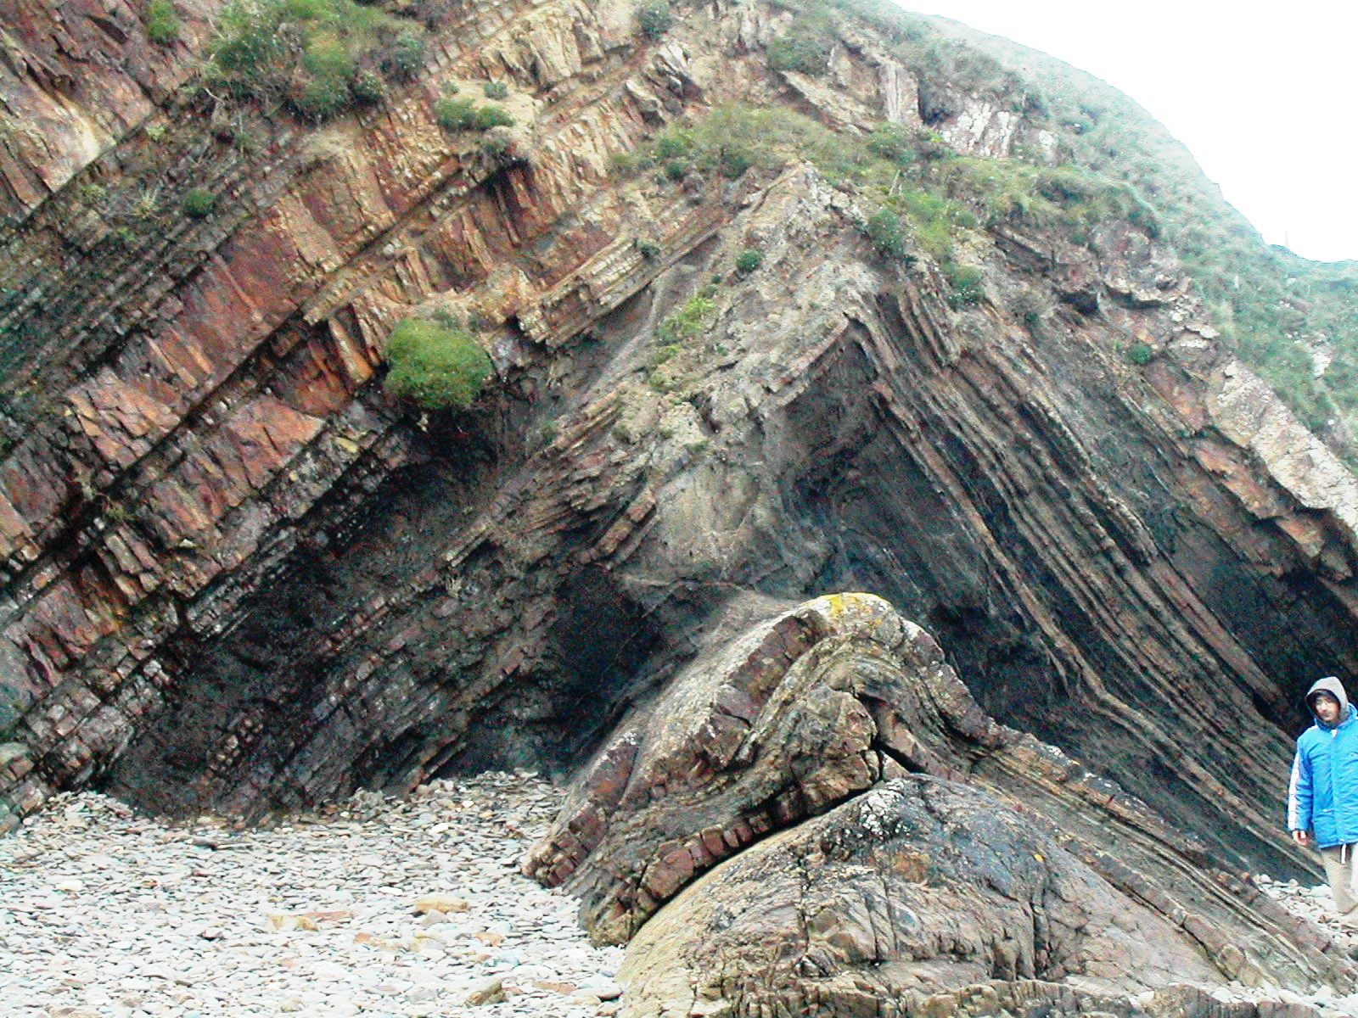
Introduction
What is Petroleum Geology?
This the aspect of geology that study the origin, occurrence, movement, accumulation, and exploration of Oil and Gas.
It refers to the specific set of geological disciplines that are applied to the search for hydrocarbons (oil exploration).

Slide 4
Introduction
To discover hydrocarbon, you must explore the earth geology.
This is a long history lasting for more than 500 million years
From Paleozoic period ...until present day
Where do we find hydrocarbon in the earth subsurface?

Slide 5
Introduction o/` `3 ` 4
Hydrocarbon fields are located in sedimentary basins.

Slide 6
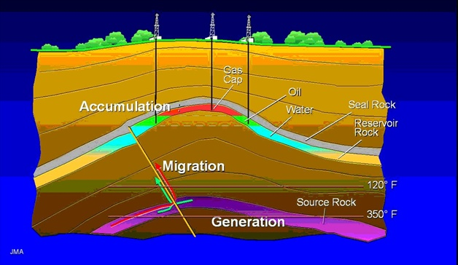
Petroleum System
Petroleum system is a concept that encompasses all of the disparate elements and processes of petroleum geology.
Elements
Source rock (shale)
Carrier bed
Reservoir rock
Trap/Seal
Processes
Maturation
Migration
Timing

Slide 7
Petroleum System
Source rock
Carrier bed
Reservoir rock
Trap/seal
Elements
Maturation
Migration
Timing
Processes

Slide 8
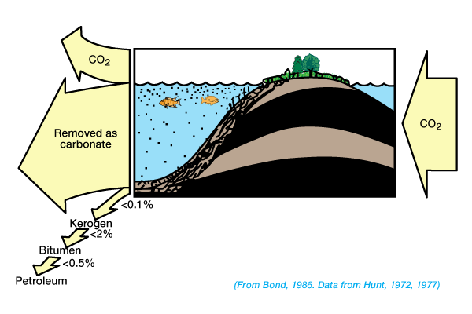
Hydrocarbon Generation and Maturation
In order to become a source rock and generate hydrocarbon, organic matter must be preserved during burial.
The deposition and preservation of organic matter are influenced by depositional events and by basin type and tectonic setting.
0.1% of buried organic matter are usually being converted to hydrocarbon.

Slide 9
Hydrocarbon Generation and Maturation
TEMPERATURE
TEMPERATURE
TEMPERATURE
TEMPERATURE

Slide 10
Migration

Slide 11
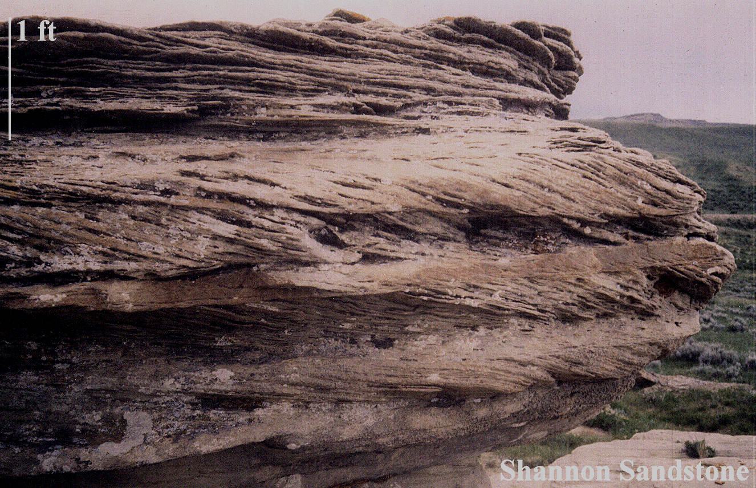
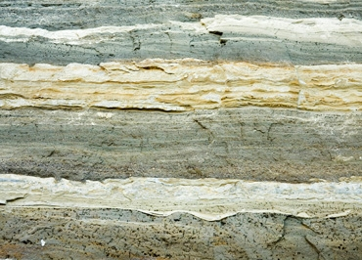
Reservoir Rocks
Reservoir Rocks
Sandstone Reservoir Rocks
Carbonate Reservoir Rocks
Reservoir Rock Properties
Porosity
Permeability
Sandstone
Carbonate

Slide 12
Environment of Deposition
Environments of Deposition (EOD)
Continental: Deposited on land or in fresh water.
Transitional: Deposited in an environment showing influence of both fresh water or air and marine water.
Marine: Only influenced by sea water.
Fluvial, alluvial, glacial, eolian, lacustrine, paludal.
Deltaic, esturine, lagoonal, beach
Shallow marine clastic, carbonate shelf, continental slope, deep marine.

Slide 13
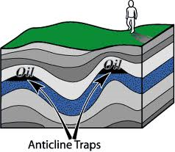
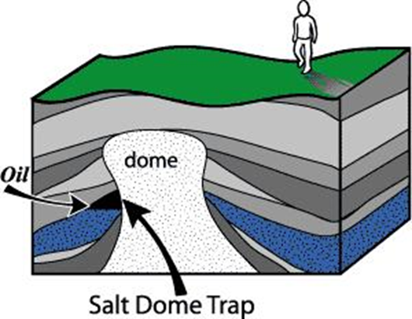
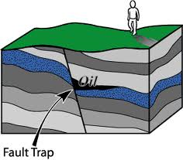
Traps and Seals
Structural Traps
Stratigraphy Traps
Combination Traps
lenses
Unconformity
Reef
Pinch-out

Slide 14
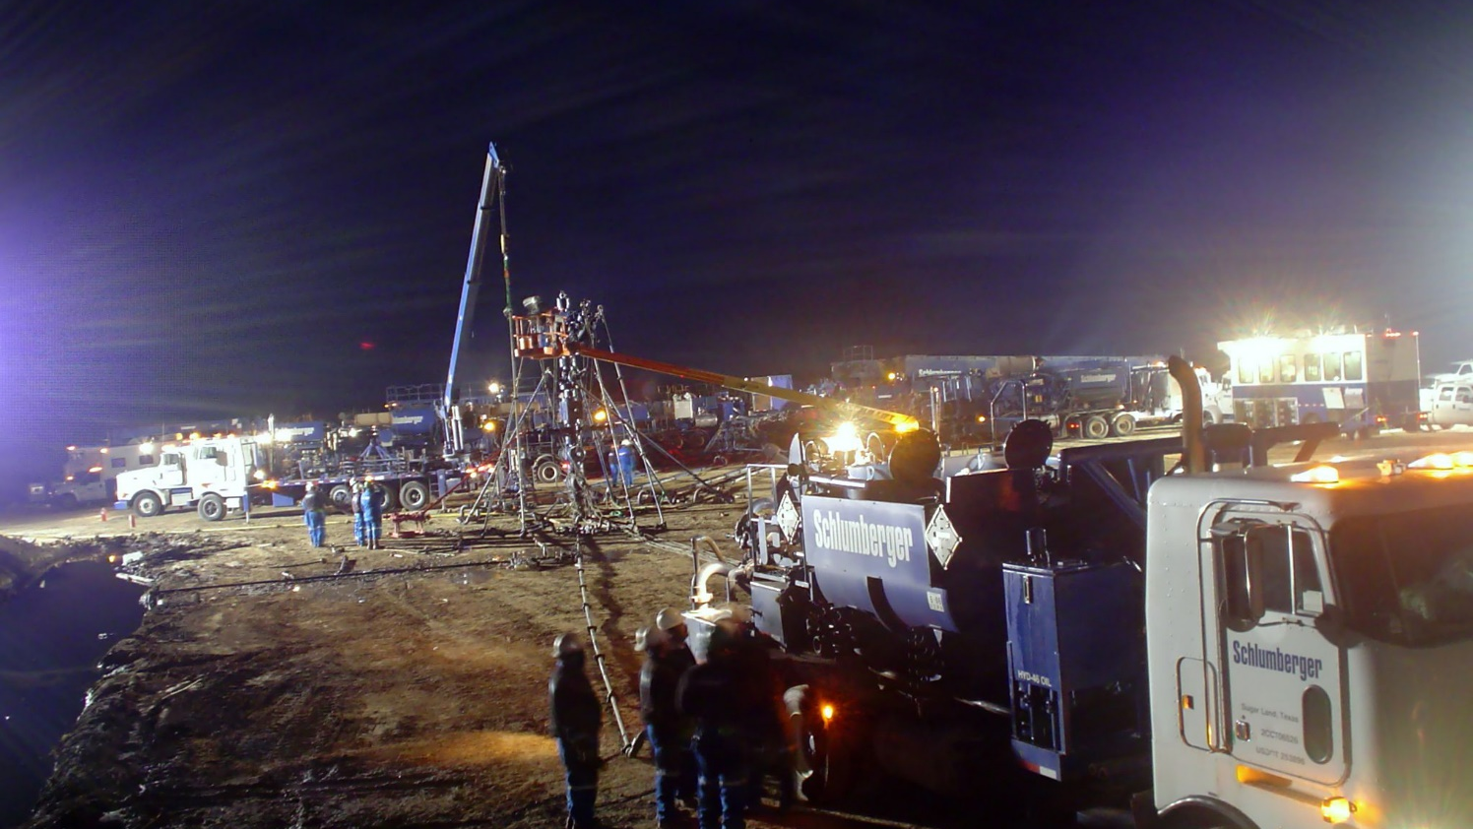
Conclusion
Petroleum geology is principally concerned with the evaluation of seven key elements in sedimentary basins: Source, reservoir, seal, trap, timing, maturation and migration.
4 Elements and 3 Processes of Petroleum System.
Only 0.1% of organic matter deposited in the source rock are usually converted to hydrocarbon.

Slide 15
THANK YOU

