Slide 1
CHEMICAL SENSES

Slide 2
Chemical Senses
Chemical senses – gustation (taste) and olfaction (smell)
Their chemoreceptors respond to chemicals in aqueous solution
Taste – to substances dissolved in saliva
Smell – to substances dissolved in fluids of the nasal membranes

Slide 3
Sense of Smell
Olfactory epithelium
Superior nasal concha
Olfactory receptors
Bipolar neurons
Olfactory cilia
Supporting cells
Basal cells
Olfactory glands

Slide 4
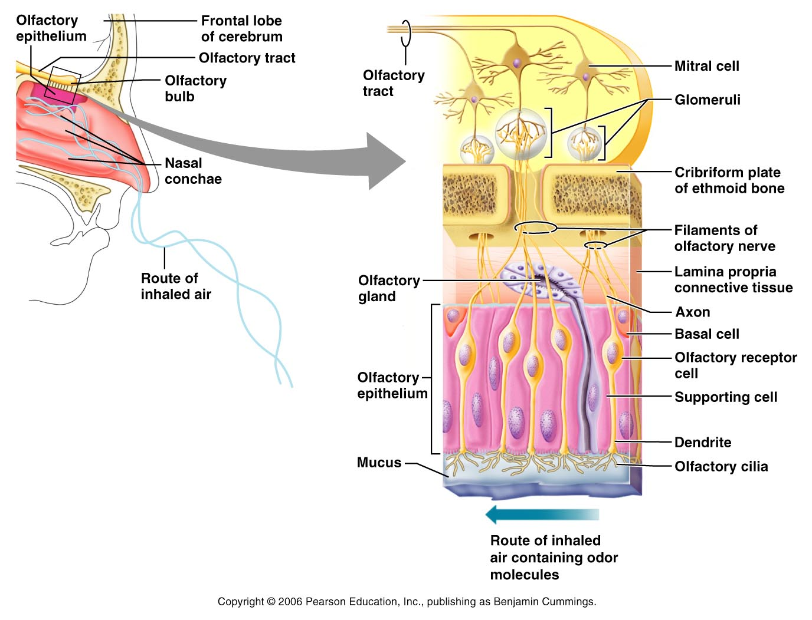
Olfactory Receptors

Slide 5
Physiology of Smell
Odorants dissolved in secretion bind to the receptor
G protein is activated
Adenylate cyclase is activated
cAMP is synthesized from ATP
Na and Ca channels open
Depolarization
Action potential

Slide 6
Olfactory Pathway
Olfactory receptor
Olfactory nerves
Synapse with mitral cells
Cells that process odor signals
Olfactory tract
The olfactory cortex
The hypothalamus, amygdala, and limbic system
No synapse on the thalamus

Slide 7
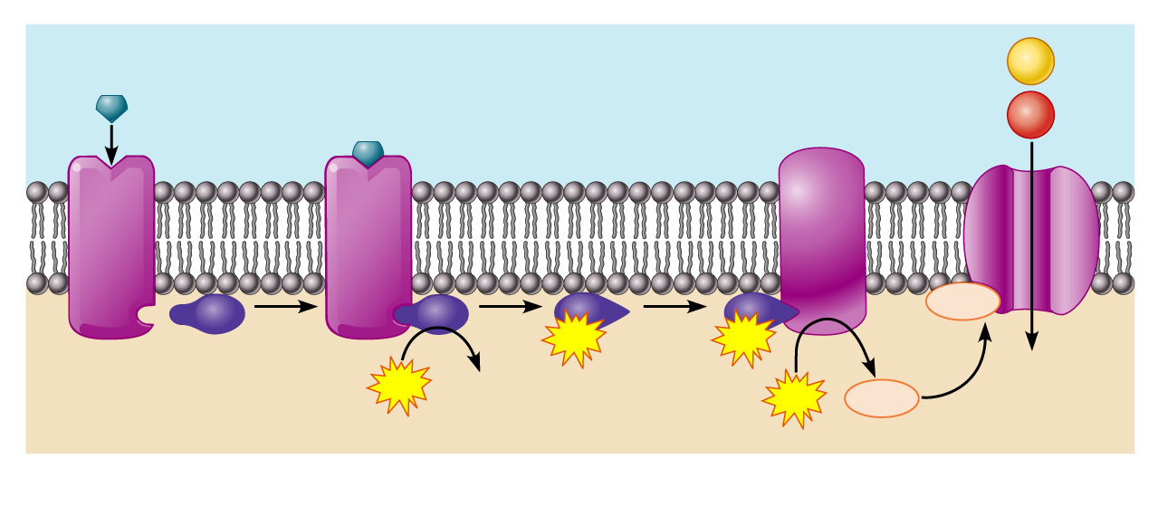
Olfactory Transduction Process
Extracellular fluid
Na⁺
Odorant
Adenylate cyclase
Ca²⁺
1
cAMP
2
GTP
3
GTP
4
Receptor
G_{olf}
GTP
GDP
cAMP
5
ATP
Cytoplasm

Slide 8
Taste Buds
Most of the 10,000 or so taste buds are found on the tongue
Taste buds are found in papillae of the tongue mucosa
Papillae come in three types: filiform, fungiform, and circumvallate
Fungiform and circumvallate papillae contain taste buds

Slide 9
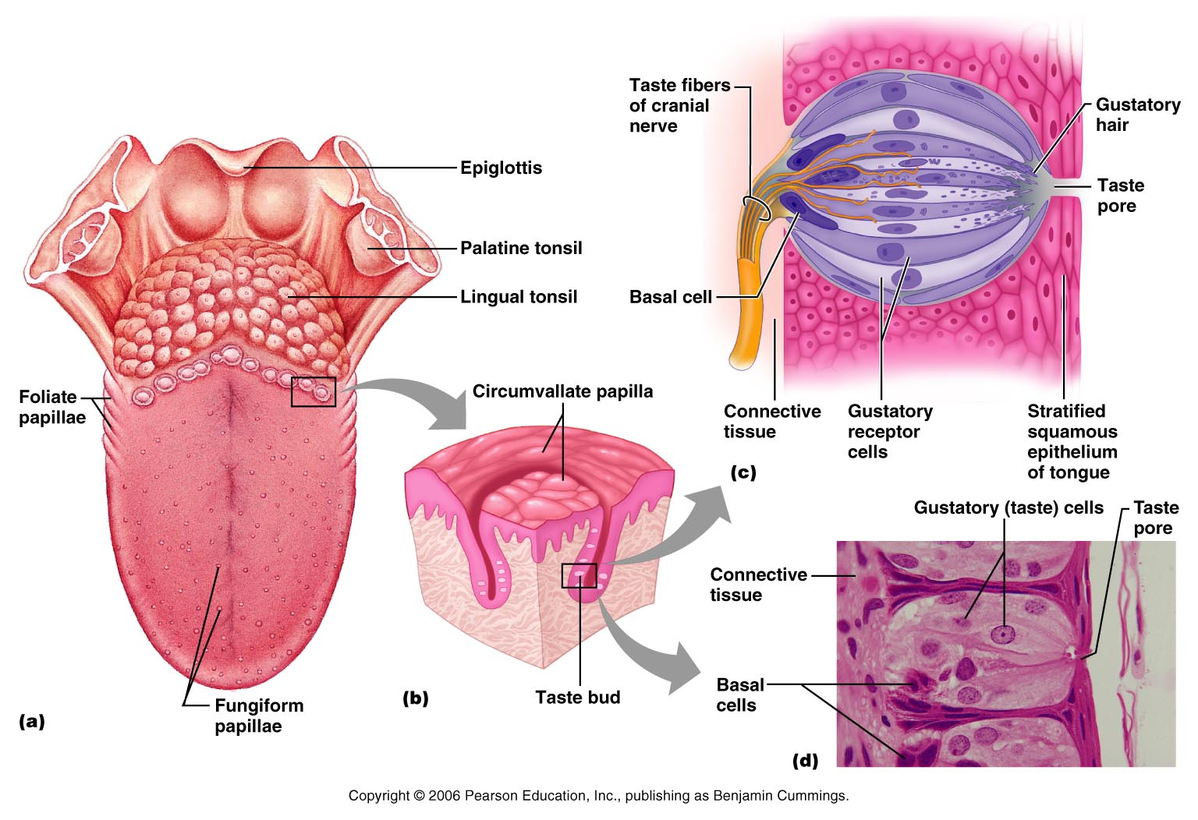
Taste Buds

Slide 10
Structure of a Taste Bud
Taste bud consists of three major cell types
Supporting cells – insulate the receptor
Basal cells – dynamic stem cells
Gustatory cells (taste cells) – special epithelial cells
Gustatory hair
Taste pores

Slide 11
Taste Sensations
There are five basic taste sensations
Sweet – sugars, saccharin, alcohol, and some amino acids
Salt – metal ions
Sour – hydrogen ions
Bitter – alkaloids such as quinine and nicotine
Umami – elicited by the amino acid glutamate

Slide 12
Physiology of Taste
In order to be tasted, a tastant:
Must be dissolved in saliva
Must contact gustatory hairs
Binding of the food chemical:
Depolarizes the taste cell membrane, releasing neurotransmitter
Initiates a generator potential that elicits an action potential

Slide 13
Taste Transduction
The stimulus energy of taste is converted into a nerve impulse by:
Na⁺ influx in salty tastes
H⁺ in sour tastes
The G protein (gustducin) in sweet and bitter tastes

Slide 14
Gustatory Pathway
Facial nerve
Anterior 2/3 of the tongue
Glossopharyngeal
Posterior 1/3 of the tongue
Vagus
Pharynx
To the solitary nucleus of the medulla

Slide 15
Gustatory Pathway
These impulses then travel to the thalamus, and from there fibers branch to the:
Gustatory cortex (taste)
Hypothalamus and limbic system (appreciation of taste)
Trigeminal nerve provide other information about the food

Slide 16
