Slide 1
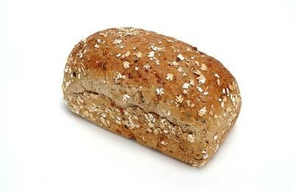
Bread Proofing

Slide 2
What is proofing:
Proofing is a method of leavening
Proofing means to allow the bread dough to rise at elevated humidity and temperature

Slide 3
Types of Proofing
Intermediate Proofing
Final Proofing

Slide 4
Types of Proofing
Intermediate Proofing
It compensate the loss of co2
At 37c°
Relative humidity 75%
for 10-20 minutes

Slide 5
Final Proofing
Final Proofing at Temp 35c° to 37c°
Relative Humidity 85%
for 60 minute

Slide 6
Objective of proofing
Increase the volume
Improve Flavor
Relax the dough
Proper shape and Texture
Redistribution of moisture

Slide 7
What Happen in Proofing
In Proofing starch converted sugar and dextrin
Yeast produce the co2 and alcohol
Co2 Diffuse into the dough
Dough Rise its volume (60-70%)

Slide 8
Proofing Equipment
Dough Proofer

Slide 9
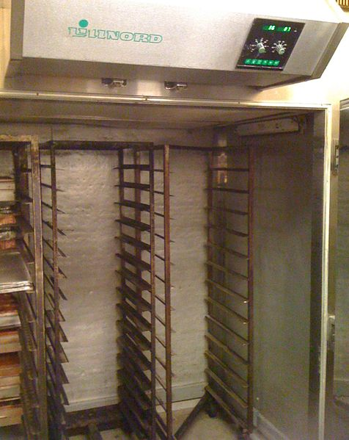
Proofing Equipment
Proofer Chamber

Slide 10
Critical Points for Proofing
Over Proofing
Under Proofing

Slide 11
Over Proofing
Bread are over from the pan
Bread are not proper shape
Cracks are present on the bread
Poor flavor

Slide 12
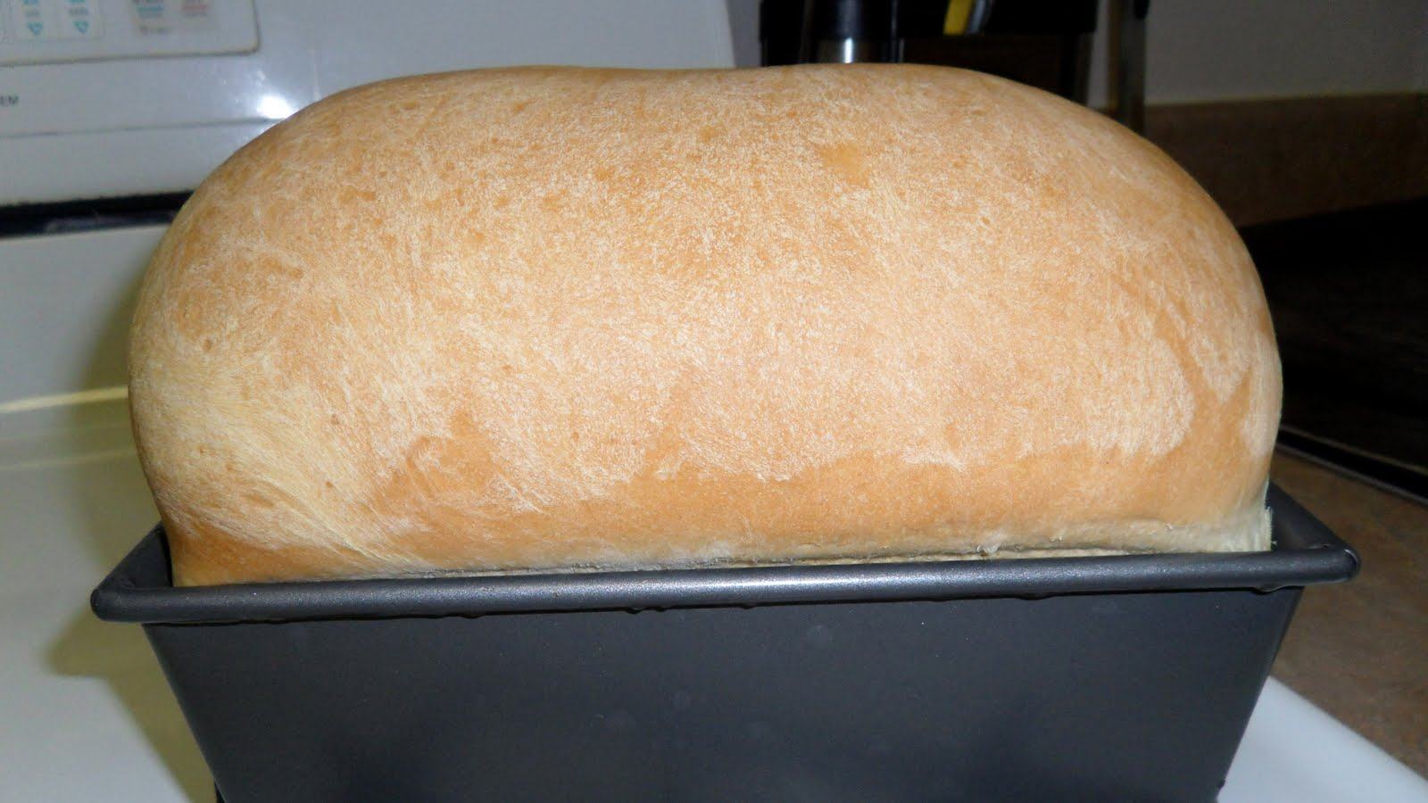
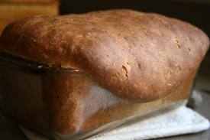
Over Proofing

Slide 13
Under Proofing
Bread are crumby
Bread loose the texture
Bread are de shapped
Crust broken
Poor flavor
Bread are not proper volume

Slide 14
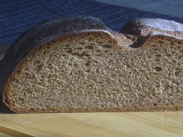
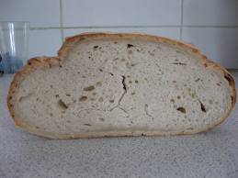
Under Proofing

Slide 15
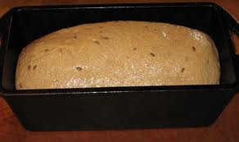
Proper Proofing

Slide 16
Proofing Test
Test Is done by Thumb Impression

