Slide 1
Print Media

Slide 2
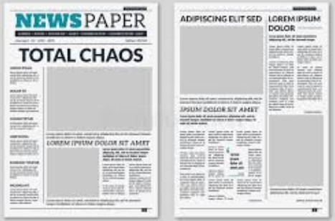
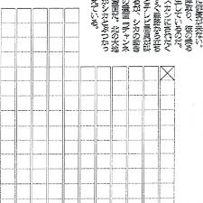
Column: Space measurement - one column wide by one inch deep

Slide 3
Circulation: The total number of copies of the newspaper distributed in one day.
Classified Advertising: Advertising space usually purchased in small amounts by the public and published, by categories, in its own section of the newspaper.

Slide 4
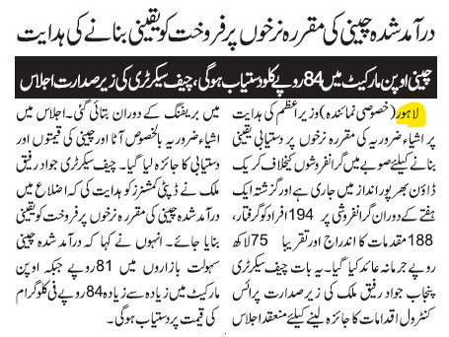
Date Line: The name of city from where the news is published.

Slide 5
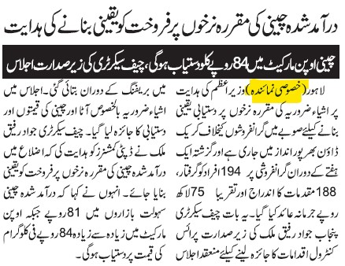
Credit Line; A line giving the source of a picture or art.

Slide 6
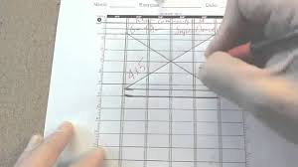
Deadline: A time at which all copy for an edition must be submitted.
Dummy : A diagram or layout of a newspaper page, showing the placement of stories, headlines, pictures and advertisements

Slide 7
Ears: Corners at the top of the front page of Newspaper.

