Slide 1
Structure Of Chromosome

Slide 2
INTRODUCTION:
Described by Strasburger ( 1815)
Named by Waldeyer (1888)
Chrom – soma
Rod shaped
Seen during metaphase stage of mitosis
Chromonemata

Slide 3
CHROMOSOME NUMBER:
Constant for a specie
Namatode, Ascaris megalocephalus univalens
PLANTS:
Haplopappus gracilis- pteridophyte
Importance

Slide 4
ANIMALS & PLANTS | NUMBER OF CHROMOSOMES
Paramecium aurelia | 30-40
Hydra vulgaris | 32
Ascaris lumbriocoides | 24
Musca domestica | 12
Homo sapiens | 46
Mucor heimalis | 2
Allium cepa Aspergillus nidulans | 16 16

Slide 5
Autosome and Sex chromosomes:
Nettie Steven and Edmund Beecher (1905).
Autosomes = 22 pairs.
The number indicate their size.
Sex chromosome = 1 pair.
Male= heteromorphic.
Female= homomorphic.

Slide 6
HUMAN CHROMOSOMES:
This Photo by Unknown Author is licensed under CC BY-SA

Slide 7
Hafsa Saeed
Roll no 48

Slide 8
Morphology of chromosome
PELLICLE
OUTER ENVELOPE
THIN, ACHROMATIC SUBSTANCES
MATRIX
JELLY-LIKE SUBSTANCE,CHROMONEMATA EMBEDDED
ENCLOSED BY PELLICLE
NON-GENETIC MATERIAL

Slide 10
CHROMONEMA
THREAD LIKE COILED STRUCTURES
THICKNESS: 800A
CONSIST OF 8 MICROFIBRILS
CHROMOMERES
SMALL DENSE MASSES
MORE DISTINCT: PROPHASE,LEPTOTENE AND ZYGOTENE STAGES
REGION OF TIGHTLY FOLDED DNA

Slide 12
CHROMATID
METAPHASE; SYMMETRICAL STRUCTURES
SINGLE DNA MOLECULE
ATTACHED BY CENTROMERE
SEPARATED IN ANAPHASE
CENTROMERE
STRUCTURE IN CHROMONEMA
CONSTRICTION POINT:TWO CHROMONEMATA JOINED
SPINDLE FIBRES ATTACHED
POSITION OF CENTROMERE

Slide 13
Nayha Munir
Roll no :BBTF17M020

Slide 14
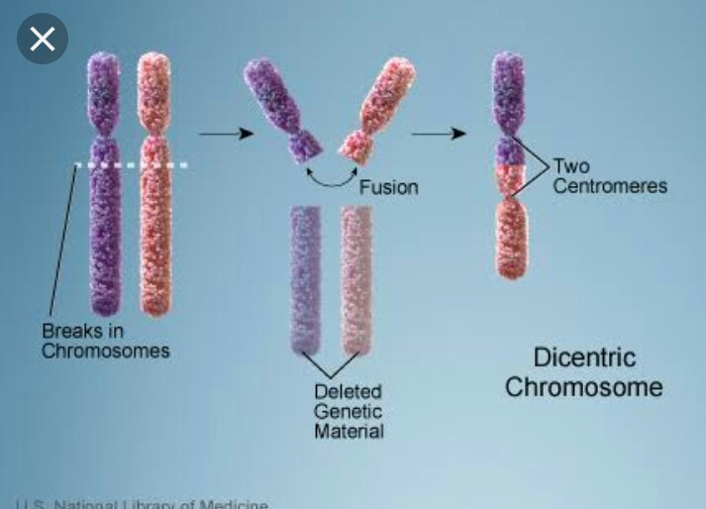
Depending upon the number of centromeres, Chromosomes may be :
Monocentric with one centromere.
Dicentric with two centromeres .
Polycentric with more than two.
Acentric without centromeres.
Diffused or non located centromere.

Slide 15
Depending upon the location of centromere the Chromosomes are categorized into :
Telocentric , rod shaped chromosomes, with centromere occupying the terminal position
Acrocentric ,rod shaped chromosomes ,centromere occupying the subterminal position .
Submetacentric ,centromere slightly away from the mid point .
Metacentric ,V- shaped chromosomes ,centromere lies in the middle of chromosomes
Centromere controls the orientation and movement of the chromosomes .

Slide 17
Secondary constriction and primary constriction :
The chromosomes besides having primary constriction or centromere possesses secondary constriction at any point of chromosomes .
Secondary constriction can be distinguished from primary constriction because chromosomes bends only at the position of centromere during anaphase .
The region between the secondary constriction and nearest telomere is known as satellite.
Sat-chromosomes
secondary constriction also called (NOR) .

Slide 19
Telomeres :
These are specialized ends of chromosomes which exhibits polarity .
Chromosomes due to polarity prevents other chromosomal segments to be fused with it .
If chromosomes breaks, broken ends fuse together ,due to lack of telomeres.

Slide 20
Material of chromosome:
Chromatin:
Combination of DNA and protein
Protein is the Histone protein
Histone is a DNA binding protein
Condensed form of chromatin is ‘Chromosome’.
Piece of DNA wound around a protein core

Slide 21
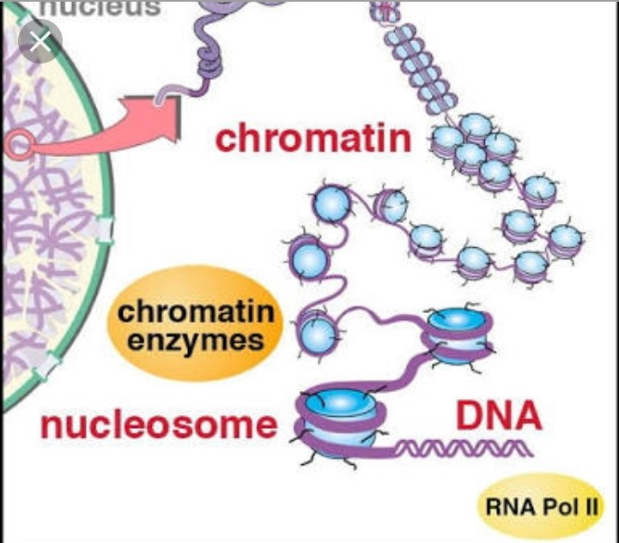

Slide 22
In Eukaryotes chromosome ,chromatin and the stuff is present.
In prokaryotes , only DNA is present.

Slide 23
Types of Chromatin:
Euchromatin
Heterochromatin
Euchromatin:
Portions of chromosome with ;
Lightly packed DNA
Partially condensed and lightly stained
Packed in 3 to 8 nm fibers

Slide 24
Genes in this portion are structural genes
Undergo replication and participates in transcription
Chromatin disperse after completion of mitosis
It comprises most active portion of genome
Play role in phenotypic expression of genes

Slide 25
Heterochromatin:
Portions of chromosome with:
Tightly packed DNA
Condensed and stained darkly
DNA is tightly packed in 30nm fibers

Slide 26
Definition by HEITZ :
regions of chromosomes remains condensed during interphase and early prophase.
Late replication
Limited transcription
Contains very few structural genes

Slide 27
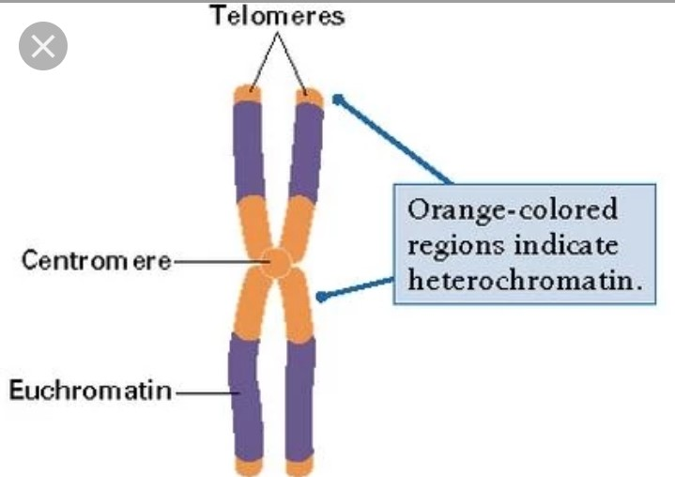

Slide 28
Types of Heterochromatin:
Constitutive
Facultative
Constitutive:
DNA is permanently inactive.
Is usually repetitive and forms structural functions such as centromere and telomere.

Slide 29
Facultative:
It is actively transcribed.
It is the result of genes that are silenced through a mechanism such as Methylation.

Slide 30
Chemical Composition of Chromatin:
Chromatin is composed of :
DNA
RNA
Proteins
Purified chromatin isolated from interphase nuclei consists of:
30-40% DNA
50 -60% Proteins
0.5-10%RNA

Slide 31
Ultrastructure of Chromosome:
Studies reveals:
Chromosomes have very fine fibrils
Thickness of 2nm-4nm

Slide 32
Mishal Shahid
Roll # 31

Slide 33
Folded Fibre Model of Chromosomes;
Du Praw in 1965.
Chromatin fibre of 230A diameter.
having coiled DNA double helix .
Histone and non-histone protein coating.
Folding of chromatin fibre result in chromatin.

Slide 34
Two copies of chromatin fibre are formed from DNA replication in interface.
Two sister chromatids formed are held together.
Folds up to form visible chromosome at prophase.
in centromeric region, chromatin fibres are continuous and pass from one arm to the other for each sister chromatid.
sister chromatids are held close in this region up to the beginning of their separation during anaphase

Slide 35
Suggests a small amount of DNA is synthesized before the sister chromatids actually separate.
Chromatin fibres are proposed to be of “A” and “B” type. The A type fibre is intermediate between the extended DNA double helix and the fully packed B type fibre. DNA double helix is 20 A in diameter; it associates with histones to form a nucleohistone fibril.

Slide 36
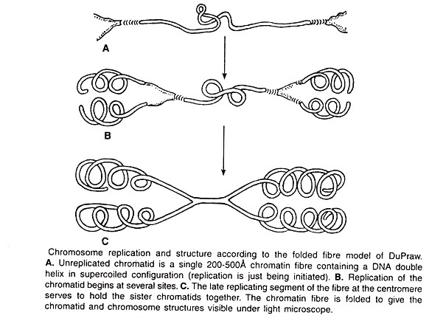

Slide 37
Karyotype and ideogram;
Number and appearance of chromosomes in nucleus.
Complete set of chromosomes in a specie.
Length, position of centromere, banding pattern etc.
Preparation and study in cytogenetics.
Giemsa dye.

Slide 38
Karyology; Study of whole sets of chromosomes.
Karyogram or ideogram; diagrammatic representation of karyotype.
No of chromosomes in somatic cells of individual .i.e. somatic no. 2n.
In germ-line (sex cells) chromosome no; n.
humans; 2n = 46.

Slide 39
Uses of karyotype;
Information about evolutionary events.
Taxonomic relationships.
Cellular functions.
Chromosomal aberrations.

