Slide 1
Stem Cells Culture
Cell and Tissue Culture

Slide 2
History
 In the 19th century, scientists from all over the world have studied stem cells, from plants, to mice, to patients in search of a cure for their diseases.
 Two scientists ;Martin Evans and Gail Martin discovered ways to derive embryonic stem cells from early mouse embryos more than 39 years ago, in 1981. The detailed study of the biology of mouse stem cells led to the discovery of stem cells.
 In 1998 stem cells were produced from human embryos and
cells were grown in the laboratory

Slide 3
Definition
One of the human body's master cells, with the ability to grow into any one of the body's more than 200 cell types
Stem cells are defined as a class of undifferentiated cells that are able to differentiate into specialized cell types

Slide 4
Commonly, stem cells come from two main sources:
Embryos formed during the blastocyst phase of embryological development (embryonic stem
cells)
Adult tissue (adult stem cells).

Slide 5
Why are they important?
Self-renewal: stem cells can renew themselves almost indefinitely. This is also known as proliferation.
Differentiation: stem cells have the special ability to differentiate into cells with specialized characteristics and functions.
Unspecialized cells capable of renewing themselves through cell division, sometimes after long periods of inactivity
Stem cell research is also useful for learning
about human development

Slide 6
Stem cell cultures
Stem cells are either extracted from adult tissue or from a dividing zygote in a culture dish and then allowed to divide and replicate.
Stem cell lines
Once stem cells have been allowed to divide and propagate in a controlled culture, the collection of healthy, dividing, and undifferentiated cells is called a stem cell line. These stem cell lines are subsequently managed and shared among researchers.

Slide 7
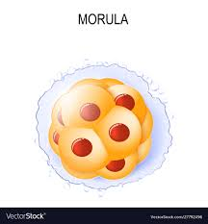
Potency
Stem cells are categorized by their potential to differentiate into other types of cells.
Totipotent - the ability to differentiate into all possible cell types. Examples are the zygote formed at egg fertilization and the first few
cells that result from the division of the zygote.

Slide 8
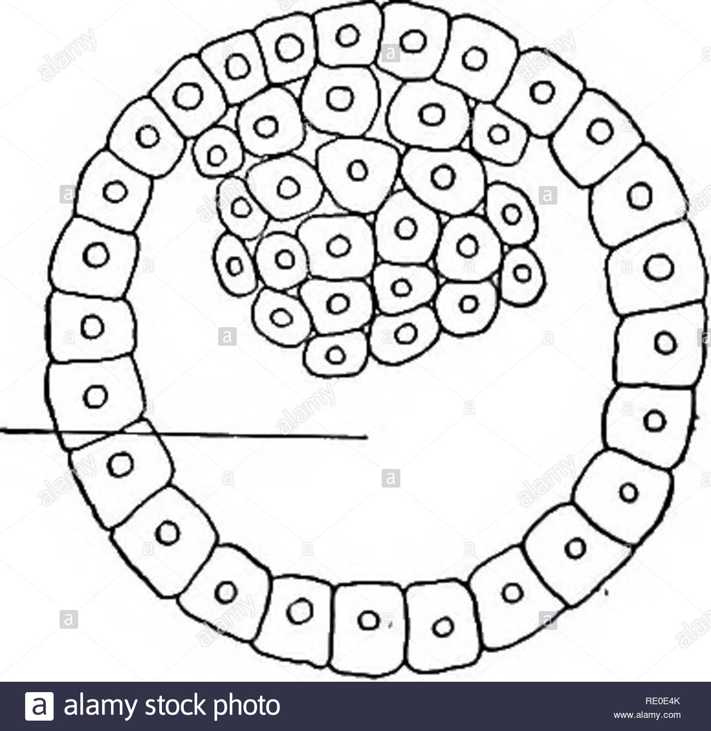
Pluripotent - the ability to differentiate into
almost all cell types. Examples include embryonic
stem cells and cells that are derived from the mesoderm,
endoderm, and ectoderm germ layers that are formed in the beginning stages of embryonic stem cell differentiation
Multipotent - the ability to differentiate into a closely related family of cells. Examples include adult stem
cells that can become red and white blood cells or platelets.

Slide 9
Oligopotent - the ability to differentiate into a few cells. Examples include (adult) lymphoid or myeloid stem cells.
Unipotent - the ability to only produce cells of their own type, but have the property of self-renewal required to be labeled a stem cell. Examples include (adult) muscle stem cell

Slide 10
TYPES
Embryonic stem cells
Adult stem cells
Induced pluripotent stem cells

Slide 11
EMBRYONIC STEM CELLS
OBTAIN
 These are derived from embryos which are fertilized in vitro
GROWTH
 generated by transferring cells from a preimplantation-stage embryo into a plastic laboratory culture dish that contains a nutrient broth known as culture medium
.

Slide 12
The inner surface of the culture dish was coated with mouse embryonic skin cells called a feeder layer.
 The mouse cells in the bottom of the culture dish provide the cells a sticky surface to which they can attach. Also, the feeder cells release nutrients into the culture medium

Slide 13
DIFFERENTIATION
Embryonic stem cells that have proliferated in cell culture for six or more months without differentiating, are pluripotent, and appear genetically normal are referred to as an embryonic stem cell line
IDENTIFICATION
This process is called characterization
Growing and subculturing the stem cells for many months to see that the cells look healthy and remain undifferentiated.
Transcription factors help turn genes on and off at the right time, which is an important part of the processes of cell undifferentiation and embryonic development e.g Nanong & Oct 4

Slide 14
Testing whether the human embryonic stem cells are pluripotent by
allowing the cells to differentiate spontaneously in cell culture
manipulating the cells so they will differentiate to form cells characteristic of the three germ layers
injecting the cells into a mouse with a suppressed immune system to test for the formation of a benign tumor called a teratoma

Slide 15
Advantages
Make all the different types of cells in our body.
Can self-renew forever so large supplies can be made.

Slide 16
ADULT STEM CELLS
Also called somatic stem cells
OBTAIN
 Found among differentiated cells in a tissue including brain, bone marrow, peripheral blood, blood vessels, skeletal muscle, skin, teeth, heart, gut, liver, ovarian epithelium, and testis
GROWTH
 Once removed from the body, their capacity to divide is limited, making generation of large quantities of stem cells difficult.

Slide 17
DIFFERENTIATION
Hematopoietic stem cells give rise to all the types of blood cells: red blood cells, lymphocytes, natural killer cells,monocytes, and macrophages.
Mesenchymal stem cells have been reported to be present in many tissues.
Those from bone marrow (bone marrow stromal stem cells, skeletal stem cells) give rise to a variety of cell types

Slide 18
Neural stem cells in the brain give rise to its three major cell types: nerve cells and non-neuronal cells—astrocytes and oligodendrocytes.
Epithelial stem cells in the lining of the digestive tract give rise to several cell types: absorptive cells, goblet cells, and enteroendocrine cells.
The epidermal stem cells give rise to keratinocytes
The follicular stem cells can give rise to both the hair follicle and to the epidermis.

Slide 19
IDENTIFICATION
label the cells in a living tissue with molecular markers and then determine the specialized cell types they generate
remove the cells from a living animal, label them in cell culture, and transplant them back into another animal to determine whether the cells replace their tissue of origin.

Slide 20
ADVANTAGE
 Make only the types of cells that belong in their own tissue, e.g skin stem cells make only types of skin cells ,they do not make brain cells
 Already partly specialised, which can make it more straightforward to obtain the particular specialised cell type required

Slide 21
INDUCED PLURIPOTENT STEM CELLS
OBTAIN
 derived from adult cells in 2006 - very recent discovery!
GROWTH
 can be grown indefinitely in culture in an undifferentiated state

Slide 22
DIFFERENTIATION
 similar properties to embryonic stem cells as can differentiate into many different tissue types –
Pluripotent
ADVANTAGE
 can create stem cells directly from a patient for research

Slide 24
Signals to Stem Cells
 Cells respond to molecules in their extracellular environment. They also respond to chemicals or molecules floating around in the liquid surrounding them
 Cells can feel and communicate with each other, and an embryonic stem cell may respond very differently to contact with a bunch of muscle cells than to a bunch of neurons
 Stem cell can make a decision to self-renew or differentiate based on the individual components

Slide 25
Embryonic stem cells in the dish: How do we culture ES cells?
 There are THOUSANDS of HUMAN embryonic stem cells growing in this circular colony.
The HUMAN embryonic stem cells are grown on top of MOUSE fibroblast cells—the elongated cells—which provide essential nutrients.
 When we culture embryonic stem cells, we are trying to stop the majority of the colony from differentiating so that we can maintain a pure population of proliferating embryonic stem cells. This is so we have a continuing supply for research purposes.

Slide 27
Culture methods
 Cells are cultured in plastic petri dishes or plates
 Everything is kept sterile, or closed off to the air, to prevent contamination by bacteria, fungi, and viruses.

Slide 28
First, you coat a plate with a thin layer of gelatin, and let it set. Then, you pipette Mouse Embryonic Feeder cells onto the gelatin, and let them grow. Next, you thaw a tube of human embryonic stem cells, and take the tube of cells underneath a fume hood. The air in here is constantly filtered so it’s for the most part sterile
 Then TO the plate you add a specific culture media, the liquid solution that the cells need and take nutrients.
To make this media, you add a culture solution at the correct pH for cells that also contains a color-changing pH indicator. Then you add a serum replacer
Next you add essential and non-essential amino acids AND a growth factor that promotes proliferation.

Slide 29
Last, you drip the embryonic stem cells onto the plate with media, and put it into an incubator
The incubator is kept at around body temperature and with 5% Carbon dioxide in the air, same as in your body. This helps them grow and keep the correct pH
When you check up on the cells the next day, the color-changing pH indicator will tell you the approximate pH of the cell media. If it is yellow to light orange, it has a lower pH (or is slightly acidic). If it is red, then it has a higher pH (or is slightly basic)
Human embryonic stem cells like to grow in a yellow to light orange media since they thrive in the lower pH

Slide 30
7.0 - Neutral
pH
6.8 – slightly acidic
8.4 – slightly basic

Slide 31
Fluorescent imaging of embryonic stem cell colonies.
 Scientists can label embryonic stem cells using antibodies attached to fluorescent molecules.
 The smaller blue dots in the green area label the nuclei of the embryonic stem cells, and the blue dots outside the colony label fibroblast feeder cells. This is how scientists can keep track of which cells are stem cells and which are not.
 Embryonic stem cells like to grow in little colonies spaced out over the dish instead of in one big layer.

Slide 32
Applications
Tissue repair
nerve, heart, muscle, organ, skin
Cancer
Autoimmune diseases
diabetes, rheumatoid arthritis, MS

Slide 33
Tissue repair
 Regenerate spinal cord, heart tissue and or any other major tissue in the body.

Slide 34
Heart tissue
 Adult born marrow stem cells injected into the hearts are believed to improve cardiac function in victims of heart failure or heart attack

Slide 35
Leukemia and cancer
 Studies shows that leukemia patients treated with stem cell emerge free of disease
 Injection of stem cells have also reduces pancreatic
cancers in some patients

Slide 36
Rheumatoid arthritis
 Adult stem cells may be help full in jump starting repair of some eroded cartilage

Slide 37
Type 1 diabetes
 Pancreatic cell do not secret insulin
 Embryonic stem cell might be trained to become
pancreatic islets cells needed to secrete insulin.

Slide 38
Stem cells in adult brains:

Slide 39
STEM CELL THERAPY
 Researchers have been studying the biology of stem cells to find new ways of treating health problems.
 As stem cells can give rise to any tissue found in the body, they provide nearly limitless potential for medical applications.
 Stem cell procedures currently provide life-saving treatments for patients

Slide 40
Currently using technologies
Adult stem cell transplant: Bone marrow stem cells
 Stem cell technology has been used for more than 20 years in bone marrow transplants
 If the transplant is successful, the stem cells will migrate into the patient's bone marrow and begin producing

Slide 41
Adult stem cell transplant: Peripheral blood stem cells (PBSCs)
Most blood stem cells reside in the bone marrow, a small number are present in the blood stream
 PBSCs can be obtained from drawn blood, making them easier to collect

Slide 42
Umbilical cord blood stem cell transplant
 In recent years, the stem-cell-rich blood found in the umbilical cord has also proven useful in treating some of health problems.
 The UCS cells appear to have a developmental plasticity equal.
 Drs. Juliet Barker and John Wagner, have successfully treated leukemias in children using UCS cell therapy.

Slide 43
Potential treatable aspects
There are certain perspectives in which stem cell therapy has a chance of being effective in one way or another
where clinical trials have already demonstrated the effectiveness

Slide 44
CONCLUSION
 Stem cell technology is progressing as the result of multidisciplinary efforts combining developments
 The versatility of stem cells and the promise they hold is without question, but……

