Slide 1
DAS
Department of Animal Sciences, UOS
Broiler and Layer Management
Introduction to Animal Husbandry
2020
Notes:
Experimental—deceleration, disability, supine, mice
Theory—mites, honeybees, identity, probit
Lifespan—primates, etc
Human—self reinforcing, wasp, NBA
Thank
Background
Invasive/Greece/Hawaii
CDFA Medfly panel
Aging research
LBAM
Workshop
Zalom et al
Retreat/Workshop
LMAM see that little changes
New day in science/policy

Slide 2
Broiler Management

Slide 3
Introduction
Broilers are those birds raised for meat production
Scarcity of the animal protein
Have inherited ability to grow rapidly
Attain 1.5-2 kg or more live body weight by consuming 3-4 kg or more feed within 5-6 weeks
Many typical broilers have white feathers and yellowish skin
Growing phases
Notes:
Experimental—deceleration, disability, supine, mice
Theory—mites, honeybees, identity, probit
Lifespan—primates, etc
Human—self reinforcing, wasp, NBA
Thank
Background
Invasive/Greece/Hawaii
CDFA Medfly panel
Aging research
LBAM
Workshop
Zalom et al
Retreat/Workshop
LMAM see that little changes
New day in science/policy

Slide 4
Commercial Broiler Strains
Hybro
Hubbard
Ross
Arbor Acres
Indian River
Avian-34
Starbra

Slide 5
Broiler Management
Following are the key points to which attention should be made;
Nutritional Management
Ventilation
Lighting
Vaccination and disease control
Catching guidelines
Record Keeping
Notes:
Experimental—deceleration, disability, supine, mice
Theory—mites, honeybees, identity, probit
Lifespan—primates, etc
Human—self reinforcing, wasp, NBA
Thank
Background
Invasive/Greece/Hawaii
CDFA Medfly panel
Aging research
LBAM
Workshop
Zalom et al
Retreat/Workshop
LMAM see that little changes
New day in science/policy

Slide 6
Nutritional Management
Broilers become ready to be marketed in just 5 weeks
This is due to their better feed consumption and conversion
Broiler starter
Age | Protein Energy
1-3 week | 23-24 % 3000 k cal.kg
Broiler finisher
4-5 weeks | 20-21% 3100 kcal/kg
Notes:
Experimental—deceleration, disability, supine, mice
Theory—mites, honeybees, identity, probit
Lifespan—primates, etc
Human—self reinforcing, wasp, NBA
Thank
Background
Invasive/Greece/Hawaii
CDFA Medfly panel
Aging research
LBAM
Workshop
Zalom et al
Retreat/Workshop
LMAM see that little changes
New day in science/policy

Slide 7
Withdrawal Diet
It will result in lower live weight growth and higher feed conversion
During this period, special attention should be directed towards medication and vaccine withdrawal dates
It ensure there is no residue retained in the carcass at processing

Slide 8
Sampling of feed
Sampling of feeds should be done and each sample should be recorded with the date, feed type and delivery ticket number
If Problems arise during production and feed is suspected, samples should be analyzed
Lab Reports should be compared with nutrient specifications for the respective diets

Slide 9
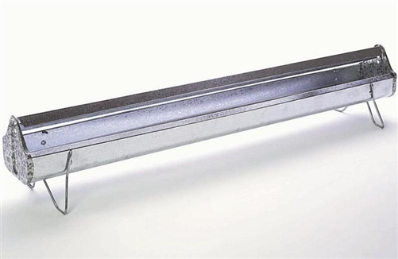
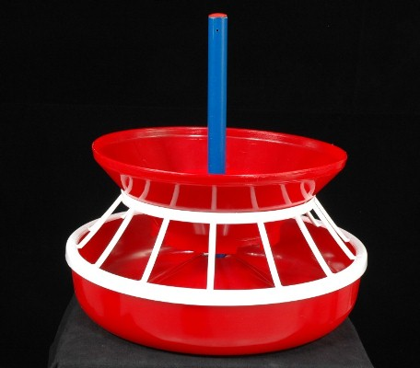
Feed Space
Provide 2ʺ trough space up-to 3 weeks and 3ʺ until market time
For circular pans, Provide 20 % less space/bird from above
One pan for 33 chicks should be provided
Notes:
Experimental—deceleration, disability, supine, mice
Theory—mites, honeybees, identity, probit
Lifespan—primates, etc
Human—self reinforcing, wasp, NBA
Thank
Background
Invasive/Greece/Hawaii
CDFA Medfly panel
Aging research
LBAM
Workshop
Zalom et al
Retreat/Workshop
LMAM see that little changes
New day in science/policy

Slide 10
Water
Broiler body contains about 70% water
Water should be free from any kind of contaminations
It should not be salty because salty water may cause salt poisoning
Provide two chick founts for every 100 chicks at the start of the brooding period
Later each broiler should have 0.75 inch (2 cm) of drinker space when troughs are used
Provide 20% less drinking space/bird when circular pans are used
Provide 1 gallon water for 25-30 broilers
Notes:
Experimental—deceleration, disability, supine, mice
Theory—mites, honeybees, identity, probit
Lifespan—primates, etc
Human—self reinforcing, wasp, NBA
Thank
Background
Invasive/Greece/Hawaii
CDFA Medfly panel
Aging research
LBAM
Workshop
Zalom et al
Retreat/Workshop
LMAM see that little changes
New day in science/policy

Slide 11
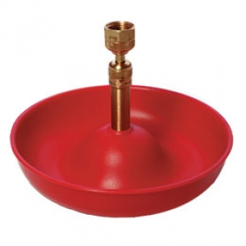
Chick Fount
Notes:
Experimental—deceleration, disability, supine, mice
Theory—mites, honeybees, identity, probit
Lifespan—primates, etc
Human—self reinforcing, wasp, NBA
Thank
Background
Invasive/Greece/Hawaii
CDFA Medfly panel
Aging research
LBAM
Workshop
Zalom et al
Retreat/Workshop
LMAM see that little changes
New day in science/policy

Slide 12
Ventilation
Objectives of Ventilation
• The provision of oxygen to meet the birds metabolic demand.
• The control of relative humidity.
• The maintenance of good litter conditions.
This system should be independent of any temperature control system
Notes:
Experimental—deceleration, disability, supine, mice
Theory—mites, honeybees, identity, probit
Lifespan—primates, etc
Human—self reinforcing, wasp, NBA
Thank
Background
Invasive/Greece/Hawaii
CDFA Medfly panel
Aging research
LBAM
Workshop
Zalom et al
Retreat/Workshop
LMAM see that little changes
New day in science/policy

Slide 13
Light Management
24 hours light should be provided for first two days
Only day light for the rest of their production period
Benefits of light
A period of darkness is a natural requirement for all animals
Energy is conserved during resting, leading to an improvement in feed conversion
Mortality is reduced, and skeletal defects are reduced
Bird uniformity is improved.
Growth rate can be equal to or better than that of birds reared on continuous light
Notes:
Experimental—deceleration, disability, supine, mice
Theory—mites, honeybees, identity, probit
Lifespan—primates, etc
Human—self reinforcing, wasp, NBA
Thank
Background
Invasive/Greece/Hawaii
CDFA Medfly panel
Aging research
LBAM
Workshop
Zalom et al
Retreat/Workshop
LMAM see that little changes
New day in science/policy

Slide 14
Diseases
Omphalitis
Pullorum
New castle disease
Hyderopericardium
Gumboro
Coccidiosis are the major diseases of broiler
Notes:
Experimental—deceleration, disability, supine, mice
Theory—mites, honeybees, identity, probit
Lifespan—primates, etc
Human—self reinforcing, wasp, NBA
Thank
Background
Invasive/Greece/Hawaii
CDFA Medfly panel
Aging research
LBAM
Workshop
Zalom et al
Retreat/Workshop
LMAM see that little changes
New day in science/policy

Slide 15
Vaccination and Disease Control
Vaccinate the birds according to the vaccination schedule against the prevailing disease in the area
Schedule
Age Vaccination Method
7 days New Castle Disease Eye Drops
10-14 Gumboro Eye Drops
16-17 Hydroparicardium 1/2 CC I/M
22-25 New Castle Disease Drinking water
30-32 Gumboro Drinking water
Notes:
Experimental—deceleration, disability, supine, mice
Theory—mites, honeybees, identity, probit
Lifespan—primates, etc
Human—self reinforcing, wasp, NBA
Thank
Background
Invasive/Greece/Hawaii
CDFA Medfly panel
Aging research
LBAM
Workshop
Zalom et al
Retreat/Workshop
LMAM see that little changes
New day in science/policy

Slide 16
Catching Guidelines
Feed withdrawal should take place 8-12 hours before catching
Water must be available until the start of catching
Lighting should be dimmed at the time of catching
Remove or raise all equipment that may interfere with the catch crew
When processing schedules allow, catching birds at night is recommended
Careful management of the ventilation system
If there is time between loads, turn up the lights, replace the water
Notes:
Experimental—deceleration, disability, supine, mice
Theory—mites, honeybees, identity, probit
Lifespan—primates, etc
Human—self reinforcing, wasp, NBA
Thank
Background
Invasive/Greece/Hawaii
CDFA Medfly panel
Aging research
LBAM
Workshop
Zalom et al
Retreat/Workshop
LMAM see that little changes
New day in science/policy

Slide 17
Record Keeping
During rearing following records should be kept
Line and source of chicken
Vaccination, medication and supplementation
Feeding program
Feed consumption by days, weeks and during whole rearing period
Body weight by weeks
Mortality by days and weeks
Culls (Harvesting of birds to market)
Notes:
Experimental—deceleration, disability, supine, mice
Theory—mites, honeybees, identity, probit
Lifespan—primates, etc
Human—self reinforcing, wasp, NBA
Thank
Background
Invasive/Greece/Hawaii
CDFA Medfly panel
Aging research
LBAM
Workshop
Zalom et al
Retreat/Workshop
LMAM see that little changes
New day in science/policy

Slide 18
Layer Management

Slide 19
Introduction
Birds that are raised for table eggs are known as layers
There are three phases of layers
Brooding
Rearing / Growing
Laying
Commercial White Leghorn-type hybrids produce white shelled eggs
Production of Rhode Island Red or Sex-linked hybrids will produce large brown shelled eggs
They also produce sufficient quantity of meat
Notes:
Experimental—deceleration, disability, supine, mice
Theory—mites, honeybees, identity, probit
Lifespan—primates, etc
Human—self reinforcing, wasp, NBA
Thank
Background
Invasive/Greece/Hawaii
CDFA Medfly panel
Aging research
LBAM
Workshop
Zalom et al
Retreat/Workshop
LMAM see that little changes
New day in science/policy

Slide 20
Commercial Layers Strains
White Leghorn
Lohmann Selected Leghorn (LSL)
Bowans
Babcock
Hyline
Nick chick
Dekalb
Hy-line W-36
Hy-line W-98

Slide 21
Conti…
The growing or rearing period is about 8-20 weeks of age in case of laying strain
Laying cycle is about 52 weeks
Poor quality pullets at maturity will always perform below breed’s standard of egg production, egg quality, feed conversion and size of egg
Notes:
Experimental—deceleration, disability, supine, mice
Theory—mites, honeybees, identity, probit
Lifespan—primates, etc
Human—self reinforcing, wasp, NBA
Thank
Background
Invasive/Greece/Hawaii
CDFA Medfly panel
Aging research
LBAM
Workshop
Zalom et al
Retreat/Workshop
LMAM see that little changes
New day in science/policy

Slide 22
Housing Management
The birds are left in the brooding until they are 10 weeks of age
Then they are moved to growing house till the completion of laying period this reduce the stress on the birds and reduce the chances of disease out break
There is three type of housing
(Brooding) + (Rearing) + (Laying)
(Brooding) + (Rearing and Laying)
(Brooding and Rearing) + (laying house)
Notes:
Experimental—deceleration, disability, supine, mice
Theory—mites, honeybees, identity, probit
Lifespan—primates, etc
Human—self reinforcing, wasp, NBA
Thank
Background
Invasive/Greece/Hawaii
CDFA Medfly panel
Aging research
LBAM
Workshop
Zalom et al
Retreat/Workshop
LMAM see that little changes
New day in science/policy

Slide 23
Litter
Add about 3 inches in summer and 5 inches in winter months
Remove wet litter
During laying phase, old litter should be covered with a thin layer of new litter after each 3rd months
Notes:
Experimental—deceleration, disability, supine, mice
Theory—mites, honeybees, identity, probit
Lifespan—primates, etc
Human—self reinforcing, wasp, NBA
Thank
Background
Invasive/Greece/Hawaii
CDFA Medfly panel
Aging research
LBAM
Workshop
Zalom et al
Retreat/Workshop
LMAM see that little changes
New day in science/policy

Slide 24
Nutrition Requirement
Protein requirement of brooding, growing and laying phases are 18, 16 and 17%, respectively
Energy should be 2970 Kcal/Kg in growing ration from 6-14 weeks but it should be reduced after 14 weeks to 2750 Kcal/Kg of ration to control or regulate body fat deposit
Exceeding fat, pullets usually suffer from an increased rate of prolapse
Insufficient energy consumption will result in poor laying house performance
Notes:
Experimental—deceleration, disability, supine, mice
Theory—mites, honeybees, identity, probit
Lifespan—primates, etc
Human—self reinforcing, wasp, NBA
Thank
Background
Invasive/Greece/Hawaii
CDFA Medfly panel
Aging research
LBAM
Workshop
Zalom et al
Retreat/Workshop
LMAM see that little changes
New day in science/policy

Slide 25
Feeder Space (8-20 wks)
Only fill trough feeder 1/3 to 1/2 full in order to minimize feed wastage
Strains | Space requirement inch/bird
Mini leghorn egg type pullets | 2
Leghorn egg type pullets | 2.5
Medium size egg type pullets | 3
Notes:
Experimental—deceleration, disability, supine, mice
Theory—mites, honeybees, identity, probit
Lifespan—primates, etc
Human—self reinforcing, wasp, NBA
Thank
Background
Invasive/Greece/Hawaii
CDFA Medfly panel
Aging research
LBAM
Workshop
Zalom et al
Retreat/Workshop
LMAM see that little changes
New day in science/policy

Slide 26
Drinking Space for Growing Pullets (8-20 Weeks)
Strains | Automatic in/bird | Nipple/ 100 birds
Mini leghorn pullets | 0.6 | 9
Leghorn pullets | 0.75 | 10
Medium size pullets | 0.85 | 11
Notes:
Experimental—deceleration, disability, supine, mice
Theory—mites, honeybees, identity, probit
Lifespan—primates, etc
Human—self reinforcing, wasp, NBA
Thank
Background
Invasive/Greece/Hawaii
CDFA Medfly panel
Aging research
LBAM
Workshop
Zalom et al
Retreat/Workshop
LMAM see that little changes
New day in science/policy

Slide 27
Space Requirements for Layers
Feeders
Provide 3.5 cm feeder space provided by a round
Drinkers
Watering space of 1.25 inches per birds should be provided
Notes:
Experimental—deceleration, disability, supine, mice
Theory—mites, honeybees, identity, probit
Lifespan—primates, etc
Human—self reinforcing, wasp, NBA
Thank
Background
Invasive/Greece/Hawaii
CDFA Medfly panel
Aging research
LBAM
Workshop
Zalom et al
Retreat/Workshop
LMAM see that little changes
New day in science/policy

Slide 28
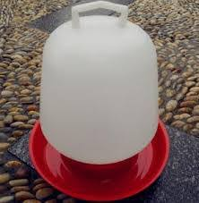
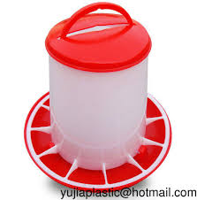
Manual Drinkers

Slide 29
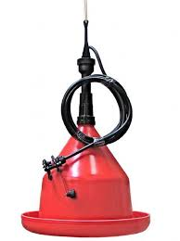
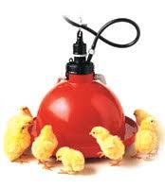
Automatic drinkers

Slide 30
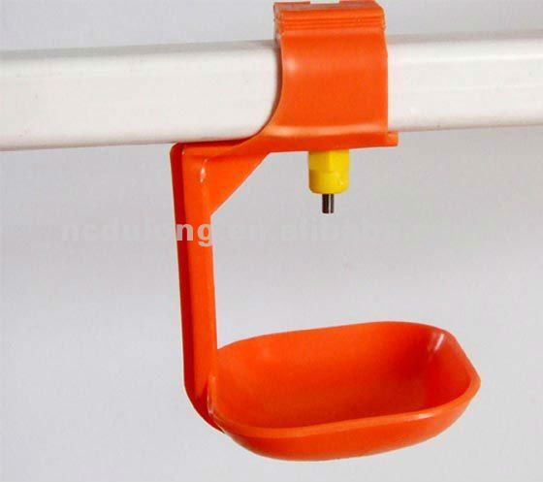
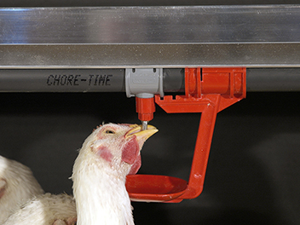
Nipple Drinkers

Slide 31
Lighting
Light intensity as well as duration affects the age at sexual maturity
If the duration of light period is less it causes late maturity and vice versa
Due to early maturity egg size remain small for several months and chances of prolapse also increases
Light threshold during rearing is 10-11 hours, which give the satisfactory results
Notes:
Experimental—deceleration, disability, supine, mice
Theory—mites, honeybees, identity, probit
Lifespan—primates, etc
Human—self reinforcing, wasp, NBA
Thank
Background
Invasive/Greece/Hawaii
CDFA Medfly panel
Aging research
LBAM
Workshop
Zalom et al
Retreat/Workshop
LMAM see that little changes
New day in science/policy

Slide 32
Duration of Light for Pullets
There are two lighting schedules;
In-season
Out-season
In-season
Chicks hatched between 1st March to 31st August
Provide 24 hrs light for first 3 days
Then provide natural light up to 19 weeks
Then provide 10 and 11 hrs of light during 20th and 21st weeks of age
Then increase 30-min light time per week until 16-17 hrs are maintained
Notes:
Experimental—deceleration, disability, supine, mice
Theory—mites, honeybees, identity, probit
Lifespan—primates, etc
Human—self reinforcing, wasp, NBA
Thank
Background
Invasive/Greece/Hawaii
CDFA Medfly panel
Aging research
LBAM
Workshop
Zalom et al
Retreat/Workshop
LMAM see that little changes
New day in science/policy

Slide 33
Duration of Light for Pullets
Out season
Chicks hatched between 1st September 28 February
Then provide 24 hrs light for 1st 3 days
Then determine day length at the age of 20 weeks
Add 7 hrs in it for 1st week
Decrease the light by 20 min/week until 19 weeks of age
At 20 weeks supply at least 10 hrs light and during 21 week provide 12 hrs light
After 21 weeks of age increase 30 min time/week until 16-17 hrs. of light is achieved
This target will continue till the end of productive life birds
Notes:
Experimental—deceleration, disability, supine, mice
Theory—mites, honeybees, identity, probit
Lifespan—primates, etc
Human—self reinforcing, wasp, NBA
Thank
Background
Invasive/Greece/Hawaii
CDFA Medfly panel
Aging research
LBAM
Workshop
Zalom et al
Retreat/Workshop
LMAM see that little changes
New day in science/policy

Slide 34
Age and Body Weight
The body weight of birds at first egg should be about 1250 g
Age at first egg vary with the strain it should be about 20 weeks
Roosts
Space for bird on the roost should be of six (6) inches
Place roosts 24" above the floor
Yards
Not necessary, but if desired, confine the birds to an exercise area which provides 5 to 10 sq. ft. per bird.
Notes:
Experimental—deceleration, disability, supine, mice
Theory—mites, honeybees, identity, probit
Lifespan—primates, etc
Human—self reinforcing, wasp, NBA
Thank
Background
Invasive/Greece/Hawaii
CDFA Medfly panel
Aging research
LBAM
Workshop
Zalom et al
Retreat/Workshop
LMAM see that little changes
New day in science/policy

Slide 35
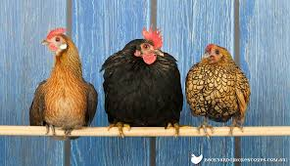
Roosts
Notes:
Experimental—deceleration, disability, supine, mice
Theory—mites, honeybees, identity, probit
Lifespan—primates, etc
Human—self reinforcing, wasp, NBA
Thank
Background
Invasive/Greece/Hawaii
CDFA Medfly panel
Aging research
LBAM
Workshop
Zalom et al
Retreat/Workshop
LMAM see that little changes
New day in science/policy

Slide 36
Ventilation
Growing birds must have an ample supply of fresh air (O₂)
Removal of CO₂ and NH₃ from growing house is important to reduce respiratory problems and stress during this critical period
The ammonia concentration in growing house should not be more than 25 ppm
Ventilation requirement is about 0.5 cubic feet/ lb body weight
Notes:
Experimental—deceleration, disability, supine, mice
Theory—mites, honeybees, identity, probit
Lifespan—primates, etc
Human—self reinforcing, wasp, NBA
Thank
Background
Invasive/Greece/Hawaii
CDFA Medfly panel
Aging research
LBAM
Workshop
Zalom et al
Retreat/Workshop
LMAM see that little changes
New day in science/policy

Slide 37
Nest Installation
A good, dry, dust free nesting material should be used to avoid egg breakage
Nesting material should be cheap, water absorbent and possess cushioning ability
Keep nest at dark place
Bottom should be 24 inches above the floor
Collect the eggs often (2-3 times daily)
Notes:
Experimental—deceleration, disability, supine, mice
Theory—mites, honeybees, identity, probit
Lifespan—primates, etc
Human—self reinforcing, wasp, NBA
Thank
Background
Invasive/Greece/Hawaii
CDFA Medfly panel
Aging research
LBAM
Workshop
Zalom et al
Retreat/Workshop
LMAM see that little changes
New day in science/policy

Slide 38
Types of Nests
1) Single compartment nests
Provide one nest hole for five hens
Nests should placed crosswise of the house
For laying birds, nest should be 12” wide and 14” deep
2) Community nests
They are occasionally used as 1 for 35 hens
A compartment of 2’ x 8’ feet in size has a hole at each end for the birds to leave and enter
3) Roll away nests
In these nests the wire bottom is sloped so that eggs roll to a compartment in the back
Notes:
Experimental—deceleration, disability, supine, mice
Theory—mites, honeybees, identity, probit
Lifespan—primates, etc
Human—self reinforcing, wasp, NBA
Thank
Background
Invasive/Greece/Hawaii
CDFA Medfly panel
Aging research
LBAM
Workshop
Zalom et al
Retreat/Workshop
LMAM see that little changes
New day in science/policy

Slide 39
Summer Management
Chickens prefer a laying house temperature of about 23.8 ºC and are comfortable up to 29.4 ºC
When the laying house temperature is above 32.3oC, birds are uncomfortable and the feed consumption and egg production is greatly reduced
Over 37.8oC, the mortality rate is rather high
Notes:
Experimental—deceleration, disability, supine, mice
Theory—mites, honeybees, identity, probit
Lifespan—primates, etc
Human—self reinforcing, wasp, NBA
Thank
Background
Invasive/Greece/Hawaii
CDFA Medfly panel
Aging research
LBAM
Workshop
Zalom et al
Retreat/Workshop
LMAM see that little changes
New day in science/policy

Slide 40
Guidelines for Heat Stress
Provide plenty of clean, cool drinking water at all times
Crushed ice may be provided in waters if possible
Plant shade trees around the poultry house
Use a hosepipe sprinkler on the roof
Feed the birds during cool hours of the day
Addition of electrolytes and Vitamin C in drinking water helps to alleviate heat stress
Provide fan ventilation during summer
Hang wet gunny bags on the sides
Notes:
Experimental—deceleration, disability, supine, mice
Theory—mites, honeybees, identity, probit
Lifespan—primates, etc
Human—self reinforcing, wasp, NBA
Thank
Background
Invasive/Greece/Hawaii
CDFA Medfly panel
Aging research
LBAM
Workshop
Zalom et al
Retreat/Workshop
LMAM see that little changes
New day in science/policy

Slide 41
Culling
This refers to the removal of sick, injured, unproductive and poor producing birds from the flock
The advantages derivable from culling of birds are:
Prevention of spread of diseases
Increase in the quality of the stock
More space is allowed for the remaining birds
Increase in profits principally by reducing feed required to produce a dozen eggs
Notes:
Experimental—deceleration, disability, supine, mice
Theory—mites, honeybees, identity, probit
Lifespan—primates, etc
Human—self reinforcing, wasp, NBA
Thank
Background
Invasive/Greece/Hawaii
CDFA Medfly panel
Aging research
LBAM
Workshop
Zalom et al
Retreat/Workshop
LMAM see that little changes
New day in science/policy

Slide 42
Layer Vaccination Schedule
Age | Vaccine | Dose/bird (ml) | Route
1st day | Marek’s | 0.3 cc | Sub-cut
5-7 days | ND+IB | One drop | E/D
9 days | HPS | 0.25 cc | I/M
8-12 days | IBD | One drop | E/D
18-20 days | IBD | - | D/W
21-22 days | ND (Lasota) | - | D/W
28-30 days | IBD | - | D/W
32-34 days | ND (Lasota) | - | D/W
Notes:
Experimental—deceleration, disability, supine, mice
Theory—mites, honeybees, identity, probit
Lifespan—primates, etc
Human—self reinforcing, wasp, NBA
Thank
Background
Invasive/Greece/Hawaii
CDFA Medfly panel
Aging research
LBAM
Workshop
Zalom et al
Retreat/Workshop
LMAM see that little changes
New day in science/policy

Slide 43
Layer Vaccination Schedule
Age | Vaccine | Dose/bird (ml) | Route
6th week | Fowl Pox | One dip of prong | W/W
8th week | Coryza | 0.25 cc | S/C OR I/M
10th week | ND+IB | - | D/W
14th week | Coryza | 0.25 cc | S/C OR I/M
16th week | ND+IB+EDS | 0.25 cc | S/C OR I/M
After every two month | ND (Lasota) | - | D/W
Notes:
Experimental—deceleration, disability, supine, mice
Theory—mites, honeybees, identity, probit
Lifespan—primates, etc
Human—self reinforcing, wasp, NBA
Thank
Background
Invasive/Greece/Hawaii
CDFA Medfly panel
Aging research
LBAM
Workshop
Zalom et al
Retreat/Workshop
LMAM see that little changes
New day in science/policy

Slide 44
Record Keeping
Records during rearing phase are just like of broilers;
Line and source of chicken
Vaccination, medication and supplementation
Feeding program
Feed consumption by days, weeks and during whole rearing period
Body weight by weeks
Mortality by days and weeks
Culls
Eggs production (%)
Whole eggs
Broken eggs
Notes:
Experimental—deceleration, disability, supine, mice
Theory—mites, honeybees, identity, probit
Lifespan—primates, etc
Human—self reinforcing, wasp, NBA
Thank
Background
Invasive/Greece/Hawaii
CDFA Medfly panel
Aging research
LBAM
Workshop
Zalom et al
Retreat/Workshop
LMAM see that little changes
New day in science/policy

Slide 45
THE END

