Slide 1
AGRICULTURAL EXTENSION PROGRAMMES IN PAKISTAN

Slide 2
Village Cooperative movement (During early 50s)
Village-AID (1952-1961)
Basic democracies (1959-1971)
Rural works progarmme (1962-72)
Farm Guide movement (1967)
Peoples’ works programme (1972)
IRDP (1972-1980)
Training and Visit programme (1978-2001)
Peoples’ works programme (1988-1990)

Slide 3
Tameer-a-Watan programme (1990-1993)
Social Action programme (SAP) (1992-2000)
People’s works programme (1993-1997)
Tameer-a-Watan programme (1997-1999)
Khushhal Pakistan programme (2000-2001)
Khushhal Pakistan programme under Devolution of Power Plan (2001-to date)

Slide 4
Village Agricultural and Industrial Development Programme (V-AID)
Started in 1952 after the recommendations of Sufi Committee
Committee stressed the need for bridging the gulf between Govt. and rural people

Slide 5
V-AID
Funding agencies
1. United States responsible for
i. Technical advices
ii. Training for Pakistani officials
iii. Equipment and commodities
2. Ford Foundation responsible for
i. Funds for salaries

Slide 6
V-AID
Democratic approach
People participate on self help basis
OBJECTIVES
To raise productivity of rural people by modern techniques
To multiply existing community services

Slide 7
V-AID
3. To create spirit of self help among villagers
4. To develop coordination among other developmental agencies
5. To improve the condition through social mobilization both to men and women

Slide 8
V-AID
Causes of failure
Termination of US mission aid
Departmental revelry
Frequent transfer of officers
Lack of experienced worker, supervisors and instructors
Terminated on 1961

Slide 9
Basic Democracies
Launched 1959
Terminated 1971
Objectives
To upgrade the living standard of rural people
To decentralize the Govt. administration
To develop a programme which met with the need of people

Slide 10
BDS
Four tiers of BDS
Divisional Council
District Council
Tehsil Council
Union Council

Slide 11
BDS
Training Institutes
At lala Musa and Tundo Jam
PARD, Peshawer
Drawbacks
Bureautic approach
Most of the Basic democrats were illiterate

Slide 12
BDS
Revelry between different groups
Condition of poor remain miserable
Rural Works Programme (RWP)
On experimental basis started at Comilla East Pakistan from 1961-1962
Launched 1963
Terminated 1972

Slide 13
RWP
Main objectives
To provide employments to surplus agricultural labour
To create infrastructure like roads, bridges etc.
To raise additional financial resources through taxation
Training to local councilors in planning

Slide 14
RWP
Causes of failure
Vanishing the concept of participatory management
Lack of technical skills
No due importance given to Agricultural Development
No procedure for accounting, reporting and evaluation

Slide 15
Farm Guide Movement
West Pakistan Agricultural University, Lyallpur started FGM in 1967
Basic Objectives
To organize the farm and city youth
To disseminate achievements of Science and Technology to the farmer in the filed of Agriculture and industrial development

Slide 16
Peoples’ work programme (PWP)
Launched 1972
Terminated 1977
By the recommendation of planning commission of Pakistan
Joint enterprise of Govt. and people
Govt.= Technical, administrative and some financial support

Slide 17
PWP
People= Contribute larger share in form of cash and identify projects
Basic objectives
Reduced polarization of rural society by agrarian reforms
Establishment of effective and viable rural institutions
Maximization of agricultural productivity

Slide 18
PWP
Causes of failure
Lack of inter and intra agency coordination
Ineffective involvement of people
Absence of rational planning at local level

Slide 19
IRDP
Launched 1971
Terminated 1978
Objectives
Bring necessary institutional, structural and attitudinal changes
Packages of economic, industrial and social infrastructure
Improving the quality of life of rural poor and rural weak

Slide 20
IRDP
Causes of Failure
Poor implementation of the district organization
Poor technical scrutiny and control
Influence of bureaucracy and feudal lords

Slide 21
Training and Visit programme
Launched 1978
Terminated 2001
Main objectives
Exclusive focus on extension
Single and direct line of organizational administration
Transfer of technology through training and visit programme

Slide 22
T&V
Causes of failure
Top down oriented
Rigid in terms of fortnightly schedule of visit
Very expensive
No effective use of mass media for communication

Slide 23
Tameer-a-Watan Programme
Launched 1990
Terminated 1993
Basic Approach
Participation of elected representatives of public in planning and execution of developmental programmes on the basis of needs of people

Slide 24
Tameer-a-Watan Programme
Basic objectives
Provision of basic amenities such as drinking water, Health, sanitation, construction of rural roads, Village electrification, education, supply of natural gas and establishment of public call offices

Slide 25
Tameer-a-Watan Programme
Coverage= Both rural and urban areas
Terminated due to the change of Govt. in the country and again launch in 1997-1999
Administrative set up
By the federal ministery of local Govt. and RD in collaboration with Provincial Govt.

Slide 26
Social Action Programme (SAP)
Initially launched for three years
Phase I 1993-96
Key Elements
Primary education
Primary healthcare
Family planning
Rural water supply and sanitation

Slide 27
SAP
Achievement
All the targets of various components have been achieved fully
Govt. initiated a four year SAP Phase-II
1996-2000

Slide 28
Khushhal Pakistan Programme
Launched 2000-2001
Development schemes approved= 9,899
Completed= 4,746
Objective
To create employment opportunities as well as to improve the living conditions of poor people

Slide 29
Khushhal Pakistan Programme
Coverage
Covers small public works both in urban and rural areas
The programme include
Farm to market roads
Water supply schemes
Lining of water channels and delisting of canals

Slide 30
Khushhal Pakistan Programme
Repairing of rural roads
Pavements of streets and drains
Improvement of schools
Equipment/machinery for vocational centers
Village electrification
Provision and renovation of civic amenities

Slide 31
Khushhal Pakistan Programme
Weaknesses
Irregularities and mismanagement of allocated funds
Not met with the needs of people
(Staff Report)

Slide 32
Decentralization Process
On 14th August 2001 Govt. started the process of Decentralization and Devolution of power under Devolution Plan. This process is based on 5 key principles represented by 5Ds.
Devolution of political power
Decentralization of administrative authority
De-concentration of management functions
Diffusion of power-authority nexus
Distribution of resources to the district level

Slide 33
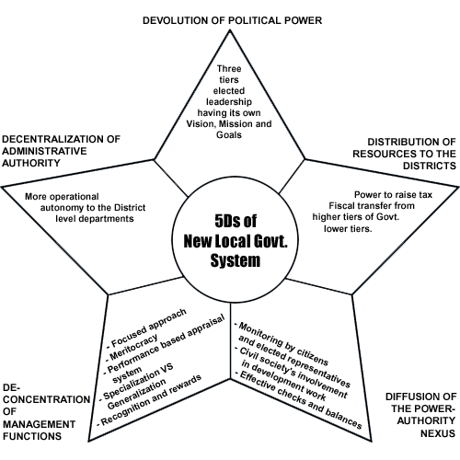
5Ds of Devolution Plan 2000

Slide 34
Basic Structure of Devolution Plan

Slide 35
CRITICAL ANALYSIS
Top down oriented
Corruption and misuse of funds
Political instability
Lack of technical skills and knowledge
Not in accordance with the needs of people

