Slide 1
Lecture-1
Applied Physics
Recommended Book
Basic Electronics Solid State by B.L Theraja

Slide 2
PHYS-101 Applied Physics
Credit Hours: 03
Course Content:
Zero Reference Level, Chassis Ground, Ohm‘s Law, Formula Variations of Ohm‘s Law, Graphical Representation of Ohm‘s Law, Linear Resistor, Non Linear Resistor, Cells in Series and Parallel.[Ch 1]
Resistive Circuits. [Ch 2]
Resistors (5.1-15), Inductors (5.19-21) Capacitors (5.35-48) .[Ch 5]
Energy Sources. [Ch 6]
Magnetism and electromagnetism [Ch 7].
Solid State. Atomic structure, Electron distribution of different atoms, Energy bands in solids, Bonds in solids, Conduction in solids, Conductors, Semiconductors and types of semiconductors, Insulators, Majority and Minority charge carriers, Mobile charge carriers and immobile ions, Drift current in good conductors. [Ch 12]
P-N Junction. Formation of depletion layer, Junction or barrier voltage, Forward biased P-N Junction, Forward V/I Characteristics, Reverse biased P-N Junction, Re-verse Saturation Current, Reverse V/I Characteristics, Junction breakdown, Junction Capacitance. [Ch 13]
Optoelectronics Devices. Spectral response of human eye, Light Emitting Diode (LED), Photo-emissive Devices, Photomultiplier Tube, Photovoltaic Devices, Bulk type Photoconductive cells, Photodiodes, P-N junction Photodiode, PIN Photodiode, and Avalanche Photodiode. [Ch 16]
DC Power Supplies. Unregulated and Regulated Power Supply, Steady and Pulsating DC Voltages, Rectifiers (17.5-17.8), Filters (17.9-17.2), Voltage Multipliers (17.24-17.30), Silicon Controlled Rectifier SCR (17.33-17.37) [Ch 17]
The Basic Transistor. Transistor Biasing, Transistor Circuit Configuration. [Ch 18]
Modulation and Demodulation. Carrier Waves, Modulation, Demodulation or Detection, Comparison between Amplitude Modulation (AM) and Frequency Modulation (FM). [Ch 30]
Integrated Circuits. Advantages of ICs and Drawbacks of ICs, Scale of Integration, Classification of ICs by function, Linear and Digital Integrated Circuits, IC Terminology, Fabrication of IC Components, Popular Application of ICs, Operational Amplifier. [Ch 31]
Fiber Optics. Structure of Optical Fibers, Classification of Optical Fibers, Fiber Characteristics, Choice of Wavelength, Optical Fiber cable, Application of Fiber Optic Communication. [Ch 38]

Slide 4
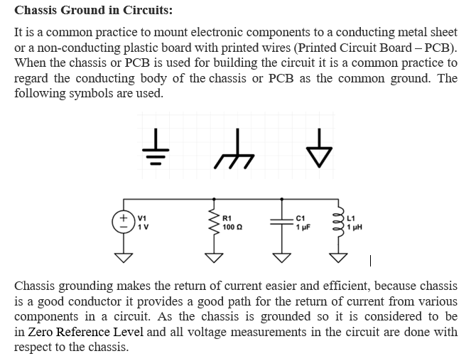

Slide 5
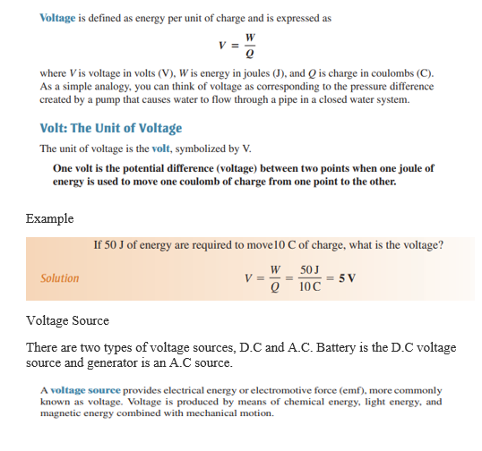

Slide 7
Problems
How long does it take 10 C to flow past a point if the current is 5 A?
2. How many coulombs pass a point in 0.1 s when the current is

Slide 8
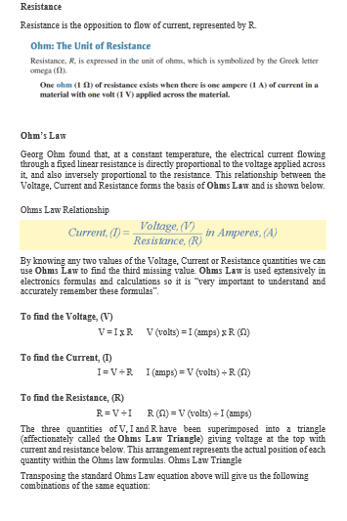

Slide 9
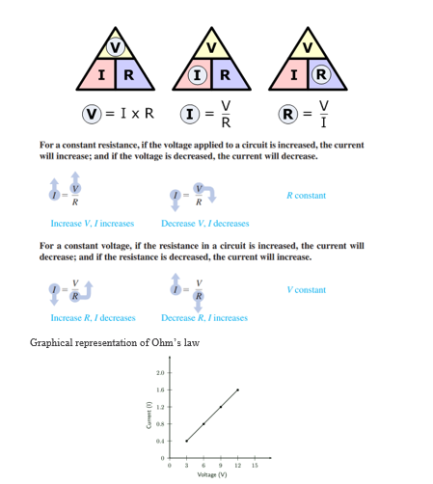

Slide 11
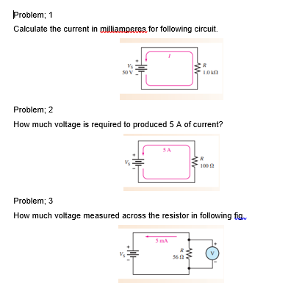

Slide 12
