Slide 1
An Overview of Animal Models Related to Psychosis
Muhammad Faseeh Haider
Roll# PPMS0E008
Adv. Applied Pharmacology
Dr. Abdul Malik

Slide 2
Overview
Definition
Key Features
Spectrum
Symptoms
Etiology
Patho-physiology
Dopaminergic pathways
Animal Models
Key features of Animal Model
Amphetamine Models
Phencyclidine Models
Behavioural Tests
Bibliography

Slide 3
Definition
Psychosis is a heterogeneous condition depicting impaired mental status and disassociation with the reality.
Psychosis is described in the American Psychiatric Association's Diagnostic and Statistical Manual of Mental Disorders (DSM - 5) as cluster of one or more these symptoms:
Delusions
Hallucinations
Disorganized thinking
Disorganized motor behavior
Negative symptoms
(American Psychiatric Association, 2013).

Slide 4
Key Features of Psychosis

Slide 5
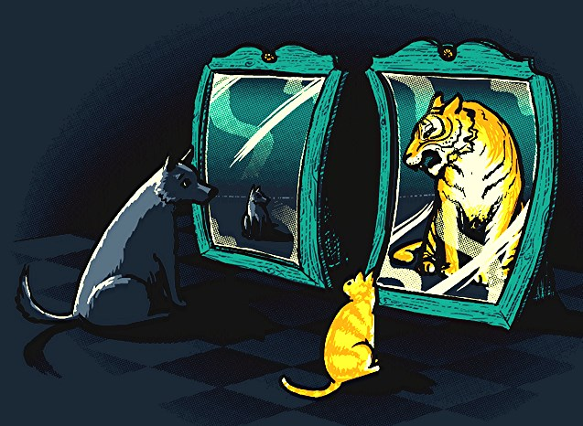
Delusions
Delusions are fixed beliefs that contradicts with the reality
DELUSIONS OF PARANOIA The belief that someone is after them. E.g. trying to kill them or listening to their thoughts
DELUSIONS OF REFERENCE The belief that an event or item holds special meaning for them
DELUSIONS OF GRANDEUR The belief that they are an important figure
DELUSIONS OF CONTROL The belief that their mind is being controlled by outside forces
(American Pychiatric Association, 2013)

Slide 6
Hallucinations
Hallucinations are perception-like experiences that occur without an external stimulus
Hearing voices
Seeing bright, colorful lights or flashes, or people who are not there
Tasting something that is not there. Often unpleasant
Smelling something that has no external cause. Usually unpleasant. Often the person is concerned that the bad smell is coming from them
Feeling as if someone is touching you or that there are bugs under your skin
(American Pychiatric Association, 2013)

Slide 7
Hallucinations
They are vivid and clear, with the full force and impact of normal perceptions, and not under voluntary control.
May occur in any sensory modality, but auditory hallucinations are the most common.
Must occur in the context of a clear sensorium; those that occur while falling asleep (hypnagogic) or waking up (s) are considered to be within the range of normal experience.
(American Pychiatric Association, 2013)

Slide 8
Disorganized Thinking
Disorganized thinking (formal thought disorder) is typically inferred from the individual's speech.
The individual may switch from one topic to another (derailment or loose associations).
Answers to questions may be obliquely related or completely unrelated (tangentiality).
Rarely, speech may be so severely disorganized that it is nearly incomprehensible and resembles receptive aphasia in its linguistic disorganization (incoherence or "word salad").
Because mildly disorganized speech is common and nonspecific, the symptom must be severe enough to substantially impair effective communication.
The severity of the impairment may be difficult to evaluate if the person making the diagnosis comes from a different linguistic background than that of the person being examined.
Less severe disorganized thinking or speech may occur during the prodromal and residual periods of schizophrenia.
(American Pychiatric Association, 2013)
Notes:
Receptive aphasia is a language disorder that makes it hard for a person to understand spoken or written language.

Slide 9
Disorganized Motor Behavior
Grossly disorganized or abnormal motor behavior may manifest itself in a variety of ways, ranging from childlike "silliness" to unpredictable agitation.
Problems may be noted in any form of goal-directed behavior, leading to difficulties in performing activities of daily living.
Catatonic behavior is a marked decrease in reactivity to the environment.
This ranges from resistance to instructions (negativism); to maintaining a rigid, inappropriate or bizarre posture; to a complete lack of verbal and motor responses (mutism and stupor).
It can also include purposeless and excessive motor activity without obvious cause (catatonic excitement).
Other features are repeated stereotyped movements, staring, grimacing, mutism, and the echoing of speech.
(American Pychiatric Association, 2013)

Slide 10
Negative Symptoms
Negative symptoms account for a substantial portion of the morbidity associated with schizophrenia, but are less prominent in other psychotic disorders.
Two negative symptoms are particularly prominent in psychosis: diminished emotional expression and avolition.
Diminished emotional expression includes reductions in the expression of emotions in the face, eye contact, intonation of speech (prosody), and movements of the hand, head, and face that normally give an emotional emphasis in speech.
Avolition is a decrease in motivated self-initiated purposeful activities. The individual may sit for long periods of time and show little interest in participating in work or social activities.
Other negative symptoms include alogia, anhedonia, and asociality.
Alogia is manifested by diminished speech output.
Anhedonia is the decreased ability to experience pleasure.
Asociality refers to the apparent lack of interest in social interactions.
(American Pychiatric Association, 2013)

Slide 11
Spectrum of Psychosis
Psychosis involves multiple psychiatric disorders with heterogeneous clinical presentations.
The spectrum of these disorders described by the World Health Organization in The ICD-10 Classification of Mental and Behavioural Disorders are
Schizophrenia
Schizotypal disorder
Persistent delusional disorder
Acute and transient psychotic disorders
Induced delusional disorder
Schizoaffective disorders
As well as other nonorganic psychotic disorders
(World Health Organization, 1993).

Slide 12
Clinical Symptoms of Psychosis
Positive symptoms
Delusions, Hallucinations, Hyper locomotion, Paranoia Agitation, Ataxia
Negative symptoms
Poor motivation, Hopelessness, Lack of interest, Social withdrawal, Thought disorders
Cognitive symptoms
Lack of perception of time and space, impairment in memory, learning, attention
These symptoms are most recognizable during periods of acute psychosis.
(Edwards, Garety, & Hardy, 2019; Fénelon, 2008)

Slide 13
Etiology
Factors | Causes
General risk factors | Childhood mishap, Childhood migration, Urbanization
Genetic factors | NRG1, DISC1, Dysbindin, DARPP-32, ART 1, DRD 2, PRODh, DAQA
Family History | Individual with First-degree relative with schizophrenia, bipolar disorder, or schizoaffective disorder
Underlying medical condition | Lung Neoplasm, Head trauma, cerebrovascular disease
Substance related | Alcohol, cannabis, Amphetamines, phencyclidine, cocaine
Obstetric Complications | Stress, infection, malnutrition, maternal diabetes, hypoxia and greater paternal age are a higher risk for the developing fetus.
Gender | Men were at higher risk of all psychotic disorders and non-affective disorders
(Georgopoulos et al., 2019; Tyrone D. Cannon et al., 2016; Keshavan et al., 2014; American Psychiatric Association, 2013).

Slide 14
Etiology
Etiology of psychosis:
complex interaction of genetic and environmental factors
(Tost, Alam, & Meyer-Lindenberg, 2010)

Slide 15
Pathophysiology of Psychosis
Dopamine Theory
Glutamate Theory
Serotonin Theory
Dopamine Hyperactivity in Mesolimbic pathways (Positive Symptoms)
Hypofunction in Mesocortical pathways (Negative & Cognitive Symptoms)
NMDA Hypofunction (positive, negative, and cognitive-like symptoms)
5-HT_{2A} receptor hyperfunction in the cortex (the motor and cognitive defects)
Blockade of dopamine D₂ receptors in the Nigrostriatal Pathway (Extrapyramidal Symptoms)
Blockade of dopamine D₂ receotors in the Tuberoinfundibular (TI) Pathway (hyperprolactinemia)
(Tost, Alam, & Meyer-Lindenberg, 2010)

Slide 16
DOPAMINE PATHWAYS IN THE BRAIN
(Stephen M Stahl & Stephen M Stahl, 2013)

Slide 17
The Mesolimbic Pathway
Anatomy
Physiology
Implications
Projects from the ventral tegmental area (VTA) to the nucleus accumbens in the limbic system.
Hyperactivity of dopamine in mediates positive psychotic symptoms, pleasure and reward.
Antagonism of D₂ receptors in this pathway treats positive psychotic symptoms.
(Stephen M Stahl & Stephen M Stahl, 2013)

Slide 18
The Mesocortical Pathway
Anatomy
Physiology
Implications
Projects from the VTA to the prefrontal cortex (PFC).
Projections to the dorsolateral prefrontal cortex (DLPFC) regulate cognition and executive functioning.
Decreased dopamine in this pathway is responsible for negative and cognitive symptoms.
Projections into the ventromedial prefrontal cortex (VMPFC) regulate emotions and affect.
(Stephen M Stahl & Stephen M Stahl, 2013)
Notes:
Nicotine releases dopamine in the mesocortical pathways alleviating negative symptoms (self-medication hypothesis).

Slide 19
The Nigrostriatal Pathway
Anatomy
Physiology
Implications
Projects from the substantia nigra to the basal ganglia or striatum.
Mediates motor movements.
Blockade of dopamine D₂ receptors in this pathway can lead to Extrapyramidal symptoms (EPS)
(Stephen M Stahl & Stephen M Stahl, 2013)

Slide 20
The Tuberoinfundibular (TI) Pathway
Anatomy
Physiology
Implications
Projects from the hypothalamus to the anterior pituitary.
The TI pathway inhibits prolactin release.
Blockade of dopamine D₂ increases prolactin levels which leads to amenorrhoea, galactorrhoea and sexual dysfunction.
Long-term hyperprolactinemia can be associated with osteoporosis.
(Stephen M Stahl & Stephen M Stahl, 2013)

Slide 21
Conceptualisation of Psychosis
(Stephen M Stahl & Stephen M Stahl, 2013)

Slide 22
Animal Models of Psychosis

Slide 23
Behavioural Animal Models of Psychosis
Measure | Description
Locomotor activity (positive symptoms) | Vigor of movement in response to a novel environment, stress, or pharmacological challenge (dopamine enhancers, NMDA receptor antagonists) is quantified.
Sucrose preference (negative symptoms) | Preference for sweetened water over unsweetened water is measured.
Social interaction (negative and cognitive symptoms) | Time spent in close proximity or direct contact with an unfamiliar or less familiar animal.
Latent inhibition (attentional processes, cognitive symptoms) | A classical conditioning procedure whereby previously unreinforced stimuli are slower (less efficient) in generating a conditioned response than novel stimuli.
(Ian R. Winship et al., 2019)

Slide 24
Behavioural Animal Models of Psychosis
Measure | Description
Memory (cognitive symptoms) | Many tests have been validated to measure various aspects of working memory, declarative memory, recognition memory (visual, spatial, and olfactory domains), and conditioning.
Reasoning and problem solving (cognitive symptoms) | Tests of behavioural flexibility in response to dynamic environments include set shifting and reversal learning.
Prepulse inhibition (sensorimotor deficits) | A reduction in the acoustic startle response is typically observed if the startling stimulus is preceded close in time by a low-intensity prepulse.
Anxiety-like behavior | Patterns of exploration in environments such as the elevated plus maze, open field, or light-dark box.
(Ian R. Winship et al., 2019)

Slide 25
Key features of Animal model
(C. A. Jones, D. J. G. Watson, & K. C. F. Fone, 2011)

Slide 26
Amphetamine Induced Model of Psychosis

Slide 27
Amphetamine Model of Psychosis
As dopamine dysregulation with hyperfunction of the mesolimbic dopamine system was the original tenet theory underlying the basis of psychosis, the first animal models were developed on the basis of pharmacological manipulation to attempt to mimic this feature.
Early efforts at modeling Psychosis in animals relied on the acute administration of indirect dopamine agonists such as “amphetamine” or direct dopamine receptor agonists such as “apomorphine” to induce a transient central hyperdopaminergia.
Typically, a single administration of 0.5-1.0 mg/kg of amphetamine is used to produce hyperlocomotion in rats, where higher doses (2.0-5.0 mg/kg) induce stereotypy and deficits in latent inhibition and pre-pulse inhibition (PPI).
However, acute administration of amphetamine in animals does not consistently produce impairments in their performance on cognitive tasks that are considered analogs of those that people with Psychosis perform poorly on.
Similarly, impairments in social interaction or other behaviors relevant to negative symptoms are not induced by acute administration of pro-dopamine drugs.
(C. A. Jones, D. J. G. Watson, & K. C. F. Fone, 2011)

Slide 28
Amphetamine Model of Psychosis
Because a single administration of amphetamine produces only a short-lived hyperdopaminergia and related behavioral effects, many investigators have attempted to model psychosis in animals using chronic administration of amphetamine, which induces a persistent sensitization and more robustly models symptoms than a single injection.
Sensitized animals display persistent deficits in some cognitive tasks relevant to Psychosis, whereas others are not affected such as deficits in social interaction and behaviors that are reminiscent of the negative symptoms of Psychosis.
Biochemical and structural changes are induced in the brain by chronic administration of amphetamine in animals, which may account for the persistent changes observed in behavioral and cognitive measures.
(C. A. Jones, D. J. G. Watson, & K. C. F. Fone, 2011)

Slide 29
Amphetamine Model of Psychosis
FEATURES OF AMPHETAMINE MODEL OF PSYCHOSIS
The similarities of this model with human psychosis: disrupted PPI is a well-established feature of psychosis (particularly schizophrenia) and the evidence for a latent inhibition deficit in schizophrenia is also strong but there is no strong evidence supporting increased locomotion in people with schizophrenia, and stereotypy is exhibited by only a small percentage of them.
Pharmacological induction of hyperdopaminergia by acute or chronic administration of amphetamine in animals seems to have reasonable validity and utility as models to study “positive symptoms of psychosis”.
(C. A. Jones, D. J. G. Watson, & K. C. F. Fone, 2011)

Slide 30
Phencyclidine (PCP) Model of Psychosis

Slide 31
Phencyclidine (PCP) Model of Psychosis
Converging evidence supports the notion that dysfunction of the glutamatergic system is a primary pathophysiological change see in psychosis.
Pharmacological evidence for the role of glutamate in psychosis centers on findings that blockade of the NMDA receptor by non-competitive antagonists, such as “ketamine” or “PCP”, produce a transient psychosis similar to that experienced by people with psychosis.
In response to this discovery, NMDA antagonists such as PCP, ketamine, and dizocilpine have been used to create pharmacological animal models of psychosis in an attempt to better understand the role of glutamate hypofunction and to screen for new treatments.
A single administration of PCP (0.1-10 mg/kg) produces a wide assay of Psychosis-relevant behaviors in rodents, such as hyperlocomotion, deficits in PPI and latent inhibition, social withdrawal, and impairment in performance on several animal cognition tasks, including set shifting, novel object recognition, spatial learning, and so on.
(Daniel Javitt, 2007; C. A. Jones, D. J. G. Watson, & K. C. F. Fone, 2011)

Slide 32
Phencyclidine (PCP) Model of Psychosis
Chronic administration of PCP produces more enduring social withdrawal and impairments in cognitive performance, but the duration of PPI deficits induced by acute and chronic PCP treatment seems to be comparable.
FEATURES OF PHENCYCLIDINE (PCP) MODEL OF PSYCHOSIS
One of the key features of PCP model of Psychosis is that they induce features that are similar to both negative and positive symptoms, as well as the cognitive deficits of psychosis.
Acute and chronic PCP administration model a wider spectrum of the clinical features of psychosis compared to models used by amphetamine.
NMDA antagonist-induced hypoglutamatergic models do not seem to be sensitive to drugs with no antipsychotic efficacy, and, therefore, they seem to have greater specificity for drugs with antipsychotic efficacy than the animal models that utilize pro-dopamine (e.g., amphetamine) drug administration.
(C. A. Jones, D. J. G. Watson, & K. C. F. Fone, 2011)

Slide 33
Behavioural Tests
Behavioural tests of motor function
Behavioural tests of cognitive function
Social Behaviour tests

Slide 34
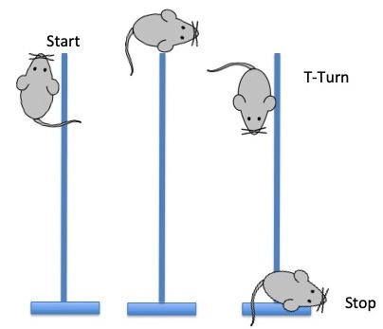
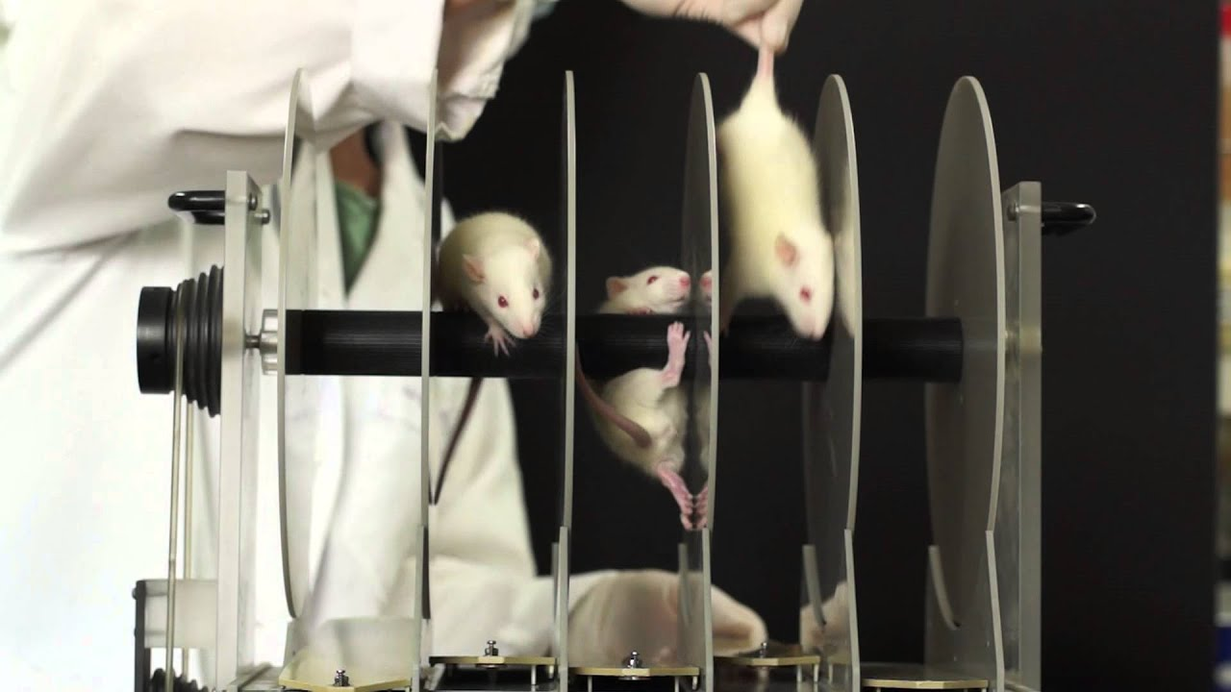
Behavioral Tests of Motor Function
MOTOR COORDINATION AND BALANCE
Rotarod Test: The rotarod test is a performance-based test on a long cylindrical rotating rod with forced motor activity being applied, usually by rodents. This test can be used to evaluate balance, grip strength, and motor coordination of the rodents.
Pole Test: The pole test evaluates the ability of the mouse to grasp and maneuver on a pole in order to descend to its home cage.

Slide 35
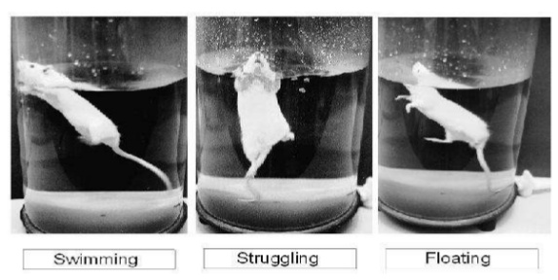
Behavioral Tests of Motor Function
Beam Walking Test: The beam walking test is used to analyze rodent gait in a testing environment that challenges their ability to maintain balance given that the animals have to cross an elevated beam with a narrow diameter.
Forced Swim Test: The enhancement of immobility in the forced swimming test brought about by repeated PCP treatment could be used as a model of the negative symptoms of psychosis.

Slide 36
Behavioral Tests of Motor Function
LOCOMOTOR ACTIVITY
Open Field Test:
The open field test provides a useful method to simultaneously measure the exploratory behavior, total locomotor activity levels in rodents.
The test is based on the tendency of the animal to explore novel areas and avoid bright light.
Locomotor hyperactivity may have some face validity for certain components of the positive symptoms of Psychosis, such as psychotic agitation.

Slide 37
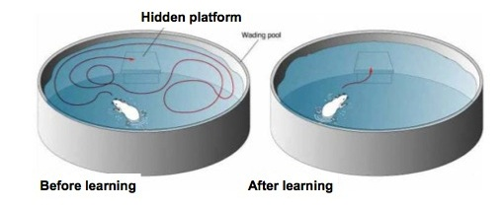
Behavioral Tests of Cognitive Function
Morris Water Task
Morris water task is a test widely used and established by behavioral physiologist and pharmacologist to evaluate and compare learning and memory in rodents. It is based on the rodent's (rats or mice) aversion to the water environment.
The apparatus consists of a water-filled pool with a hidden escape platform beneath the surface of the water. When the animal is released into the water, it will swim around the pool to look for the platform to escape from the water.

Slide 38
Behavioral Tests of Cognitive Function
Y Maze
The Y maze is widely used to assess behavioral task in preclinical research for studying congnition (spatial memory). The spontaneous alteration test is used to quantify the cognitive deficits, and evaluate the effects of drugs on cognition.
Each mice will be placed in the center of Y-maze field and freely allowed to explore all arms for 5 minutes. Ethanol is used to clean the apparatus for no olfactory clues by mice.

Slide 39
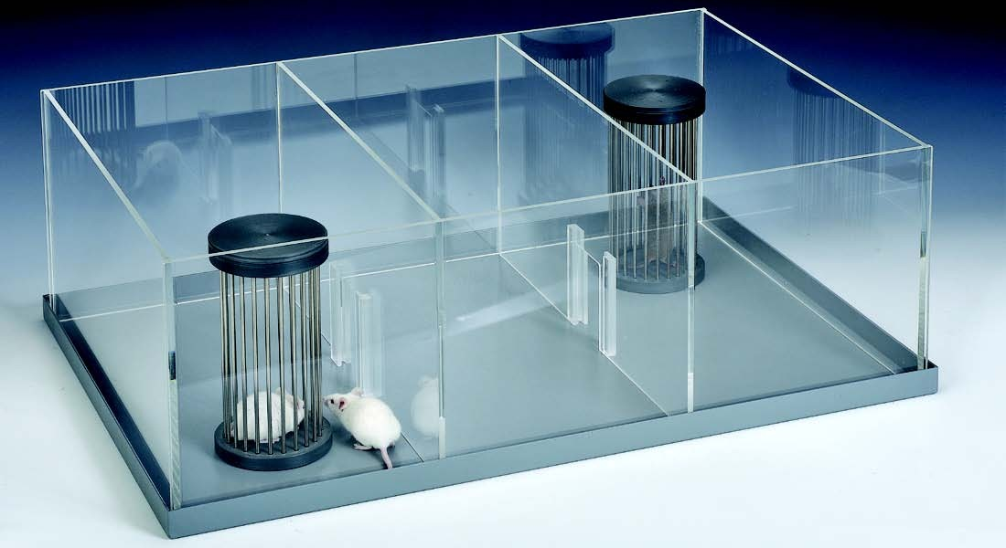
Social Behavior tests
Three Chamber Social Test
This test measures the "sociability", the preference to spend time with another mouse, as compared to time spent alone in an identical but empty chamber, and "social novelty", the preference to spend time with a previously never-before-met mouse rather than with a familiar mouse.

Slide 40
Bibliography
American Psychiatric Association. (2013). Diagnostic and statistical manual of mental disorders (DSM-5®): American Psychiatric Pub.
Clementine Jane Edwards, Garety, Philippa, & Hardy, Amy. (2019). The relationship between depressive symptoms and negative symptoms in people with non-affective psychosis: a meta-analysis. Psychological medicine, 49(15), 2486-2498.
Gilles Fénelon. (2008). Psychosis in Parkinson's disease: phenomenology, frequency, risk factors, and current understanding of pathophysiologic mechanisms. CNS spectrums, 13(S4), 18-25.
Daniel Javitt. (2007). Glutamate and Schizophrenia: Phencyclidine, N-Methyl-d-Aspartate Receptors, and Dopamine-Glutamate Interactions. International review of neurobiology, 78, 69-108. doi:10.1016/S0074-7742(06)78003-5
C. A. Jones, Watson, D. J. G., & Fone, K. C. F. (2011). Animal models of schizophrenia. British journal of pharmacology, 164(4), 1162-1194. doi:10.1111/j.1476-5381.2011.01386.x
Matcheri S Keshavan, Giedd, Jay, Lau, Jennifer YF, Lewis, David A, & Paus, Tomáš. (2014). Changes in the adolescent brain and the pathophysiology of psychotic disorders. The Lancet Psychiatry, 1(7), 549-558.
Stephen M Stahl, & Stahl, Stephen M. (2013). Stahl's essential psychopharmacology: neuroscientific basis and practical applications: Cambridge university press.
Heike Tost, Alam, Tajvar, & Meyer-Lindenberg, Andreas. (2010). Dopamine and psychosis: theory, pathomechanisms and intermediate phenotypes. Neuroscience & Biobehavioral Reviews, 34(5), 689-700.
Ian R. Winship, Dursun, Serdar M., Baker, Glen B., Balista, Priscila A., Kandratavicius, Ludmyla, Maia-de-Oliveira, Joao Paulo, Hallak, Jaime, & Howland, John G. (2019). An Overview of Animal Models Related to Schizophrenia. Canadian journal of psychiatry. Revue canadienne de psychiatrie, 64(1), 5-17. doi:10.1177/0706743718773728

Slide 41
Thank You

