Slide 3
IMMUNITY
Dr. Ambreen Malik Uttra
Pharm-D (Gold Medal), M.Phil. Pharmacology (Gold Medal),
Ph.D. Pharmacology
Lecturer (Pharmacology)
College of Pharmacy
University of Sargodha

Slide 4
Antibodies or Immunoglobulins
An antibody is defined as a protein that is produced by B lymphocytes in response to the presence of an antigen.
Antibody is gamma globulin in nature and it is also called immunoglobulin (Ig).
Immunoglobulins form 20% of total plasma proteins.
Types of Antibodies Five types of antibodies are identified 1. IgA (Ig alpha) 2. IgD (Ig delta) 3. IgE (Ig epsilon) 4. IgG (Ig gamma) 5. IgM (Ig mu). Among these antibodies, IgG forms 75% of antibodies in the body.

Slide 5
Each chain of the antibody includes two regions: 1. Constant region 2. Variable region.
Functions of Different Antibodies 1. IgA plays a role in localized defense mechanism in external secretions like tear. 2. IgD is involved in recognition of the antigen by B lymphocytes. 3. IgE is involved in allergic reactions. 4. IgG is responsible for complement fixation. 5. IgM is also responsible for complement fixation. Mechanism of Actions of Antibodies They protect the body from invading organisms in two ways: 1. By direct actions 2. Through complement system.

Slide 6
1. Direct Actions of Antibodies These directly inactivate the invading organism by any one of the following methods: i. Agglutination: In this, the foreign bodies like RBCs or bacteria with antigens on their surfaces are held together in a clump by the antibodies. ii. Precipitation: In this, the soluble antigens like tetanus toxin are converted into insoluble forms and then precipitated. iii. Neutralization: During this, the antibodies cover the toxic sites of antigenic products. iv. Lysis: It is done by the most potent antibodies. These antibodies rupture the cell membrane of the organisms and then destroy them.

Slide 7
2. Actions of Antibodies through Complement System
The indirect actions of antibodies are stronger than direct actions and play more important role in defense mechanism of body than direct actions.
Complement system enhances/accelerates various activities during fight against invading organisms.
“Complement” is a collective term that describes a system of about 20-30 proteins (many of which are enzyme precursors) produced by the liver and found circulating in blood plasma and within tissues through out the body.
Principal actors in this system are 11 proteins designated C1 (C1q C1r C1s), through C9, B, and D.
Normally, these enzymes are in inactive form and are activated in three ways: a. Classical pathway b. Lectin pathway c. Alternate pathway.

Slide 8
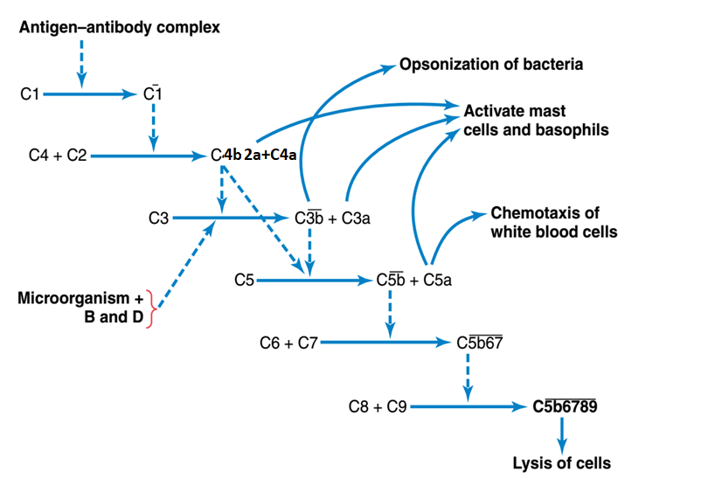
Cascade of Reactions During Activation of Classic Pathway of Complement
C3b binds to the surface of a microbe and receptors on phagocytes attach to C3b.
Thus C3b enhances phagocytosis by coating a microbe, a process called opsonization.
Opsonization promotes attachment of a phagocyte to a microbe.
C3a and C5a bind to mast cells and cause them to release histamine that increases blood vessel permeability during inflammation.
C5a also attracts phagocytes to the site of inflammation (chemotaxis).

Slide 9
a. Classic Pathway:
Initiation
The classical complement pathway can be initiated by binding of antigen-antibody complexes to C1q protein. The globular regions of C1q recognize and bind to Fc region of antibody isotypes IgG or IgM.
Formation of C3 convertase
The binding of C1q leads to conformational changes and activation of serine protease C1r.
The activated C1r then cleaves and activates the serine protease C1s.
The activated C1s cleaves C4 into C4a and C4b, and C2 into C2a and C2b. The larger and active fragments, C4b and C2a form C4bC2a, a C3 convertase.
C3 convertase then cleaves C3 into C3a and C3b. While C3a interacts with its C3a receptor (C3aR) to recruit leukocytes, C3b contributes to further downstream complement activation.

Slide 10
Formation of C5 convertase and MAC
C3b binds to C3 convertase (C4bC2a), to form C5 convertase (C4bC2aC3b).
C5 convertase then cleaves C5 into C5a and C5b.
Like C3a, C5a interacts with its cognate C5a receptor (C5aR) to attract leukocytes.
Subsequent interactions between C5b and other terminal components C6, C7, C8, and C9 form the membrane attack complex or the C5b-9 complex which forms channels in the plasma membrane that result in cytolysis (bursting of the microbial cells due to inflow of extracellular fluid through the channels).

Slide 11
Effects of Complement System 1. Opsonization and phagocytosis
One of the products of complement cascade, C3b, strongly activates phagocytosis by both neutrophils and macrophages, causing these cells to engulf the bacteria to which the antigen-antibody complexes are attached. This process is called opsonization.
2. Lysis
One of the most important of all products of complement cascade is the lytic complex, which is a combination of multiple complement factors and designated C5b6789.
This has a direct effect of rupturing the cell membranes of bacteria or other invading organisms. 3. Agglutination
The complement products also change the surfaces of invading organisms, causing them to adhere to one another, thus promoting agglutination.

Slide 12
4. Neutralization of viruses
The complement enzymes and other complement products can attack the structures of some viruses and thereby render them nonvirulent.
5. Chemotaxis
Fragment C5a initiates chemotaxis of neutrophils and macrophages, thus causing large numbers of these phagocytes to migrate into the tissue area adjacent to the antigenic agent.

Slide 13
6. Activation of mast cells and basophils
Fragments C3a, C4a, and C5a activate mast cells and basophils, causing them to release histamine, heparin, and several other substances into local fluids.
These substances cause increased local blood flow, increased leakage of fluid and plasma protein into the tissue, and other local tissue reactions that help inactivate or immobilize the antigenic agent.
The same factors play a major role in inflammation and allergy.
7. Inflammatory effects
In addition to inflammatory effects caused by activation of mast cells and basophils, several other complement products contribute to local inflammation.
These products cause
the already increased blood flow to increase still further,
the capillary leakage of proteins to be increased, and
the interstitial fluid proteins to coagulate in the tissue spaces, thus preventing movement of invading organism through the tissues.

Slide 14
b. Lectin pathway
In lectin pathway, macrophages that digest microbes release chemicals that cause the liver to produce proteins called lectins.
Lectins bind to the carbohydrates on the surface of microbes, ultimately causing the activation of C3.
c. Alternate pathway
The alternative pathway does not involve antibodies.
It is initiated by an interaction between lipid–carbohydrate complexes on the surface of microbes and complement protein factors B, D, and P.
This interaction activates C3.

Slide 16
Natural Killer Cell
It is a large granular cell that plays an important role in defense mechanism of the body.
Is the third type of lymphocyte.
It is often called the non-T, non-B cell. It is derived from bone marrow.
NK cell is said to be the first line of defense in specific immunity, particularly against viruses.
NK cell kills the invading organisms or cells of body without prior sensitization.
It is not a phagocytic cell but its granules contain hydrolytic enzymes such as perforins and granzymes.
These hydrolytic enzymes play an important role in the lysis of cells of invading organisms.

Slide 17
Functions of Natural Killer (NK) Cell 1. Destroys the viruses 2. Destroys the viral infected or damaged cells, which might form tumors 3. Destroys the malignant cells and prevents development of cancerous tumors 4. Secretes cytokines such as IL-2, interferons, colony stimulating factor (GM-CSF) and TNF-α.

Slide 18
Cytokines
Cytokines are hormone-like small proteins acting as intercellular messengers (cell signaling molecules) by binding to specific receptors of target cells.
These non-antibody proteins are secreted by WBCs and some other types of cells.
Their major function is activation and regulation of general immune system of body.
Cytokines are distinct from other cell-signaling molecules such as growth factors and hormones.

Slide 20
Immunization
Immunization is defined as the procedure by which body is prepared to fight against a specific disease.
It is used to induce the immune resistance of body to a specific disease.
Immunization is of two types:
1. Passive immunization
2. Active immunization.
Passive immunization
Passive immunization or immunity is produced without challenging the immune system of body.
It is done by administration of serum or gamma globulins from a person who is already immunized (affected by the disease) to a non-immune person.
Passive immunization is acquired either naturally or artificially
Active immunization
Active immunization or immunity is acquired by activating immune system of the body.
Body develops resistance against disease by producing antibodies following exposure to antigens.
Active immunity is acquired either naturally or artificially.

Slide 22
Immune Deficiency Diseases 1. Acquired Immune Deficiency Syndrome (AIDS) 2. Autoimmune disease Common autoimmune diseases are: a. Insulin-dependent diabetes mellitus b. Myasthenia gravis c. Graves disease d. Rheumatoid arthritis

Slide 23
ALLERGY AND IMMUNOLOGICAL HYPERSENSITIVITY REACTIONS

Slide 24
The term allergy means hypersensitivity.
It is defined as abnormal immune response to a chemical or physical agent (allergen).
During the first exposure to an allergen, the immune response does not normally produce any reaction in the body.
Sensitization or an initial exposure to allergen is required for the reaction.
So, the subsequent exposure to the allergen causes variety of inflammatory responses. These responses are called allergic reactions or immunological hypersensitivity reactions.
Immunological hypersensitivity reactions may be innate or acquired.
These reactions are mediated mostly by antibodies and in some conditions, T cells are involved.
Common symptoms include sneezing, itching and skin rashes.
Common allergic conditions are: 1. Food allergy 2. Allergic rhinitis 3. Bronchial asthma 4. Urticaria.

Slide 25
Allergens
Any substance that produces the manifestations of allergy is called an allergen.
It may be an antigen or a protein or any other type of substance.
Even physical agents (Cold, heat, light, pressure and radiation) can develop allergy.
Allergens are introduced by: 1. Contact (Chemical substances, metals, animals, plants) 2. Inhalation (Pollen grains, fungi, dust, smoke, perfumes, disagreeable odor) 3. Ingestion (food e.g., wheat, egg, milk, chocolate) 4. Injection (drugs e.g., aspirin, antibiotics)
5. Infections (Parasites, bacteria, viruses and fungi)

Slide 26
Immunological Hypersensitive Reactions
Immunological hypersensitive reactions to an agent give rise to several allergic conditions and autoimmune diseases.
Hypersensitive reactions are classified into five types: Type I or anaphylactic reactions. Type II or cytotoxic reactions. Type III or antibody-mediated reactions. Type IV or cell-mediated reactions. Type V or stimulatory/blocking reactions.

Slide 28
INFLAMMATION

Slide 29
Inflammation is a nonspecific, defensive response of body to tissue damage.
Inflammation is an attempt to dispose of microbes, toxins, or foreign material at the site of injury, to prevent their spread to other tissues and to prepare the site for tissue repair in an attempt to restore tissue homeostasis.
Among the conditions that may produce inflammation are pathogens, abrasions, chemical irritations, disturbances of cells and extreme temperatures.
The four characteristic signs and symptoms of inflammation are
Redness (Rubor)
Pain (Dolor)
Heat (Calor)
Swelling (Tumor).
Inflammation can also cause loss of function in the injured area, depending on the site and extent of injury.
Inflammatory response has three basic stages:
(1) Vasodilation and increased permeability of blood vessels
(2) Emigration (movement) of phagocytes from blood into interstitial fluid
(3) Tissue repair.

Slide 30
1. Vasodilation and Increased Permeability of Blood Vessels
Vasodilation allows more blood to flow through the damaged area, and increased permeability permits defensive proteins such as antibodies and clotting factors to enter the injured area from the blood.
The increased blood flow also helps remove microbial toxins and dead cells.
Among the substances that contribute to vasodilation, increased permeability and other aspects of inflammatory response are the following:
Histamine
In response to injury, mast cells in connective tissue and basophils and platelets in blood release histamine.
Neutrophils and macrophages attracted to the site of injury also stimulate the release of histamine, which causes vasodilation and increased permeability of blood vessels.

Slide 31
Kinins
These polypeptides formed in blood from inactive precursors called kininogens induce vasodilation and increased permeability and serve as chemotactic agents for phagocytes e.g., bradykinin.
Prostaglandins (PGs)
These lipids, especially those of E series, are released by damaged cells and intensify the effects of histamine and kinins.
PGs also may stimulate the emigration of phagocytes through capillary walls.
Leukotrienes (LTs)
Produced by basophils and mast cells, LTs cause increased permeability.
They also function in adherence of phagocytes to pathogens and as chemotactic agents that attract phagocytes.
Complement
Different components of complement system stimulate histamine release, attract neutrophils by chemotaxis, and promote phagocytosis; some components can also destroy bacteria.

Slide 32
Heat and redness result from large amount of blood that accumulates in damaged area.
Edema results from increased permeability of blood vessels, which permits more fluid to move from blood plasma into tissue spaces.
Pain is a prime symptom of inflammation, which results from injury to neurons and from toxic chemicals released by microbes.
Kinins affect some nerve endings, causing much of the pain associated with inflammation.
Prostaglandins intensify and prolong the pain associated with inflammation.
Pain may also be due to increased pressure from edema.

Slide 33
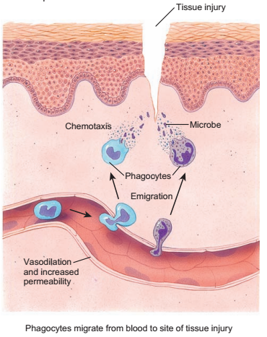
Emigration of Phagocytes

Slide 34
Fever
It is an abnormally high body temperature that occurs because the hypothalamic thermostat is reset.
It commonly occurs during infection and inflammation.
Many bacterial toxins elevate body temperature, sometimes by triggering release of fever-causing cytokines such as IL-1 from macrophages.
Elevated body temperature intensifies the effects of interferons, inhibits the growth of some microbes and speeds up body reactions that aid repair.

