Slide 1
DAS
Basic Concepts
Introduction to Animal Husbandry
2019
Notes:
Experimental—deceleration, disability, supine, mice
Theory—mites, honeybees, identity, probit
Lifespan—primates, etc
Human—self reinforcing, wasp, NBA
Thank
Background
Invasive/Greece/Hawaii
CDFA Medfly panel
Aging research
LBAM
Workshop
Zalom et al
Retreat/Workshop
LMAM see that little changes
New day in science/policy

Slide 2
Mechanism of inheritance
Each human is made up of several hundred microscopic cells
Variety of shapes (round, flat, angular)
Nucleus is important component in each cell which is spherical in shape
All cells are descended from a single fertilized egg by successive cell divisions
From the tip of your nose to the top of your toes, your DNA is similar and does not change throughout your life
Notes:
Experimental—deceleration, disability, supine, mice
Theory—mites, honeybees, identity, probit
Lifespan—primates, etc
Human—self reinforcing, wasp, NBA
Thank
Background
Invasive/Greece/Hawaii
CDFA Medfly panel
Aging research
LBAM
Workshop
Zalom et al
Retreat/Workshop
LMAM see that little changes
New day in science/policy

Slide 3
Nucleus
It is a membrane-enclosed organelle found in eukaryotic cells
Eukaryotes usually have a single nucleus, but a few cell types, such as mammalian red blood cells, have no nuclei, and a few others have many like liver cells, muscle fiber etc.
Eukaryotic cells contain membrane-bound organelles, including a nucleus. Eukaryotes can be single-celled or multi-celled, such as you, me, plants, fungi, and insects
Bacteria are an example of prokaryotes
Prokaryotic cells do not contain a nucleus or any other membrane-bound organelle.
Notes:
Experimental—deceleration, disability, supine, mice
Theory—mites, honeybees, identity, probit
Lifespan—primates, etc
Human—self reinforcing, wasp, NBA
Thank
Background
Invasive/Greece/Hawaii
CDFA Medfly panel
Aging research
LBAM
Workshop
Zalom et al
Retreat/Workshop
LMAM see that little changes
New day in science/policy

Slide 4
Chromosome
The nucleus contains thread like microscopic structures called chromosomes
Every species has a characteristic number of chromosomes like 46, 60 and 78 in human, cattle and chicken
They occur in pairs
Meiosis ensures half number of chromosomes in gametes
Twenty three chromosomes in case of human
Chromosomes of Sperm & Egg contain 3 billion base pairs, hence Somatic cell has 6 billion
Notes:
Experimental—deceleration, disability, supine, mice
Theory—mites, honeybees, identity, probit
Lifespan—primates, etc
Human—self reinforcing, wasp, NBA
Thank
Background
Invasive/Greece/Hawaii
CDFA Medfly panel
Aging research
LBAM
Workshop
Zalom et al
Retreat/Workshop
LMAM see that little changes
New day in science/policy

Slide 5
Conti…
Members of chromosome pair are identical in shape and size
Except sex chromosome
In human Y chromosome is much smaller than X
Auto-somes ?
Male has 22 Autosomes and XY chromosome
Female has 22 Autosome and XX chromosome
In chickens, ZW system is used male & female???
ZZ (Cock), ZW (Hen)
Notes:
Experimental—deceleration, disability, supine, mice
Theory—mites, honeybees, identity, probit
Lifespan—primates, etc
Human—self reinforcing, wasp, NBA
Thank
Background
Invasive/Greece/Hawaii
CDFA Medfly panel
Aging research
LBAM
Workshop
Zalom et al
Retreat/Workshop
LMAM see that little changes
New day in science/policy

Slide 6
Genome
The whole set of base pairs in a gamete or the entire sequence of DNA in an organism is called the genome
Any two human genome are alike for the overwhelming majority of their bases; 1 base pair/1000. (1/1000 of 6 billion is 6 million)
6 million base differences are sufficient to produce all the genetic differences between two persons
Great diversity of shape, size, color, behavior, disease resistance and so on…
No two are genetically alike, unless they are identical twins
Notes:
Experimental—deceleration, disability, supine, mice
Theory—mites, honeybees, identity, probit
Lifespan—primates, etc
Human—self reinforcing, wasp, NBA
Thank
Background
Invasive/Greece/Hawaii
CDFA Medfly panel
Aging research
LBAM
Workshop
Zalom et al
Retreat/Workshop
LMAM see that little changes
New day in science/policy

Slide 7
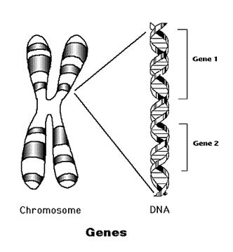
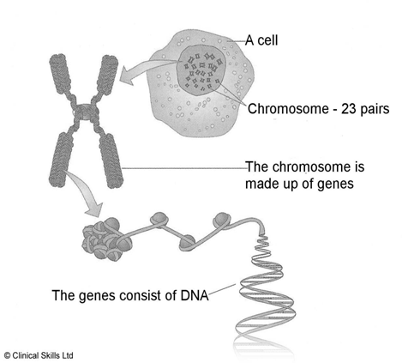
Gene
A gene is a stretch of DNA from 1,000 to 100,000 or more base pairs in length that has a specific function
A gene is responsible for a particular protein
Alternative forms of the gene are called alleles
Notes:
Experimental—deceleration, disability, supine, mice
Theory—mites, honeybees, identity, probit
Lifespan—primates, etc
Human—self reinforcing, wasp, NBA
Thank
Background
Invasive/Greece/Hawaii
CDFA Medfly panel
Aging research
LBAM
Workshop
Zalom et al
Retreat/Workshop
LMAM see that little changes
New day in science/policy

Slide 8
Linkage
The tendency for two different genes on the same chromosomes to be inherited together is called Linkage
The closer together two genes on the same chromosome, the less probable it is that a break will occur between them
The more probable that they are to be inherited together
To map the position of the genes on the chromosome, the Linkage phenomena is useful
Notes:
Experimental—deceleration, disability, supine, mice
Theory—mites, honeybees, identity, probit
Lifespan—primates, etc
Human—self reinforcing, wasp, NBA
Thank
Background
Invasive/Greece/Hawaii
CDFA Medfly panel
Aging research
LBAM
Workshop
Zalom et al
Retreat/Workshop
LMAM see that little changes
New day in science/policy

Slide 9
Mutation
Genes are ordinarily transmitted from generation to generation unchanged
Sometimes, the gene is changed, a rare process called Mutation
Mutant gene is as stable and as regularly transmitted as the original gene
Mutation may be;
A substitution of one base for another
One or more bases may be gained or lost
Order of a group of the bases may be changed
Notes:
Experimental—deceleration, disability, supine, mice
Theory—mites, honeybees, identity, probit
Lifespan—primates, etc
Human—self reinforcing, wasp, NBA
Thank
Background
Invasive/Greece/Hawaii
CDFA Medfly panel
Aging research
LBAM
Workshop
Zalom et al
Retreat/Workshop
LMAM see that little changes
New day in science/policy

Slide 10
Junk DNA
Non-coding regions in the DNA
The genes make up only a tiny fraction of the DNA, the rest- about 97% has no known function
Regions of DNA useful for forensic analysis are usually not genes, but are located in those parts of chromosomes with Junk DNA
Notes:
Experimental—deceleration, disability, supine, mice
Theory—mites, honeybees, identity, probit
Lifespan—primates, etc
Human—self reinforcing, wasp, NBA
Thank
Background
Invasive/Greece/Hawaii
CDFA Medfly panel
Aging research
LBAM
Workshop
Zalom et al
Retreat/Workshop
LMAM see that little changes
New day in science/policy

Slide 11
Genetic blueprints
DNA contains an entire library of informations
Information on how to make, maintain and reproduce an organism
It also keeps a record of clues to the organism's evolutionary history
Genome size may be as small as 9,750 bases (HIV) to as large as the +3 billion bases in mouse, human and cattle
Notes:
Experimental—deceleration, disability, supine, mice
Theory—mites, honeybees, identity, probit
Lifespan—primates, etc
Human—self reinforcing, wasp, NBA
Thank
Background
Invasive/Greece/Hawaii
CDFA Medfly panel
Aging research
LBAM
Workshop
Zalom et al
Retreat/Workshop
LMAM see that little changes
New day in science/policy

Slide 12
Conti…
The genetic blueprint is carefully preserved in a genome, stored in the linear sequence of the molecules, referred to as nucleotides
In DNA, 4 bases:
Adenine (A),
Guanine (G),
Cytosine (C)
Thymine (T)
Notes:
Experimental—deceleration, disability, supine, mice
Theory—mites, honeybees, identity, probit
Lifespan—primates, etc
Human—self reinforcing, wasp, NBA
Thank
Background
Invasive/Greece/Hawaii
CDFA Medfly panel
Aging research
LBAM
Workshop
Zalom et al
Retreat/Workshop
LMAM see that little changes
New day in science/policy

Slide 13
Conti…
DNA consists two strands of nucleotides laid side by side and connected by chemical pairing complementary (matching) bases: A pairs with T and G pairs with C
Bonds between these molecules impose a twisting force on the structure and cause it to wind slightly
Ribonucleic acid (RNA) is a single-starnded copy of DNA, in which thymine is replaced by uracil
Notes:
Experimental—deceleration, disability, supine, mice
Theory—mites, honeybees, identity, probit
Lifespan—primates, etc
Human—self reinforcing, wasp, NBA
Thank
Background
Invasive/Greece/Hawaii
CDFA Medfly panel
Aging research
LBAM
Workshop
Zalom et al
Retreat/Workshop
LMAM see that little changes
New day in science/policy

Slide 14
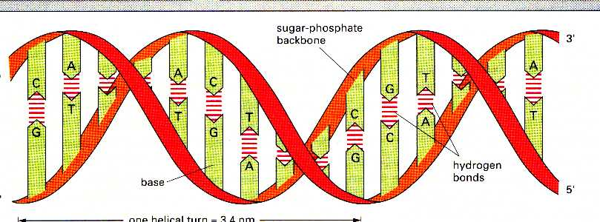
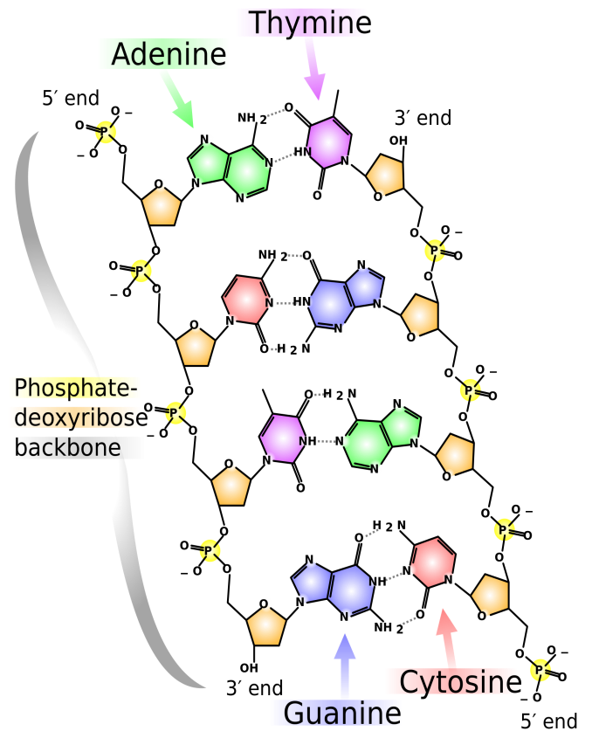
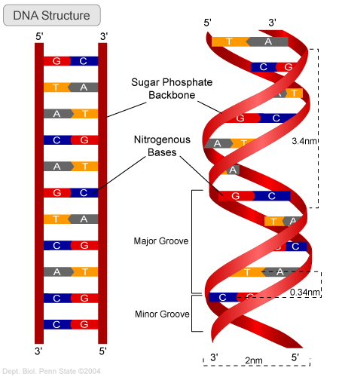
Notes:
Experimental—deceleration, disability, supine, mice
Theory—mites, honeybees, identity, probit
Lifespan—primates, etc
Human—self reinforcing, wasp, NBA
Thank
Background
Invasive/Greece/Hawaii
CDFA Medfly panel
Aging research
LBAM
Workshop
Zalom et al
Retreat/Workshop
LMAM see that little changes
New day in science/policy

Slide 15
Conti…
DNA sequence is translated into the protein sequence by a code, with a triplet of bases (a codon) specifies a single amino acid
Proteins are made up from a linear sequence of amino acids, and the exact sequence of amino acids determines the function of the protein
Notes:
Experimental—deceleration, disability, supine, mice
Theory—mites, honeybees, identity, probit
Lifespan—primates, etc
Human—self reinforcing, wasp, NBA
Thank
Background
Invasive/Greece/Hawaii
CDFA Medfly panel
Aging research
LBAM
Workshop
Zalom et al
Retreat/Workshop
LMAM see that little changes
New day in science/policy

Slide 16
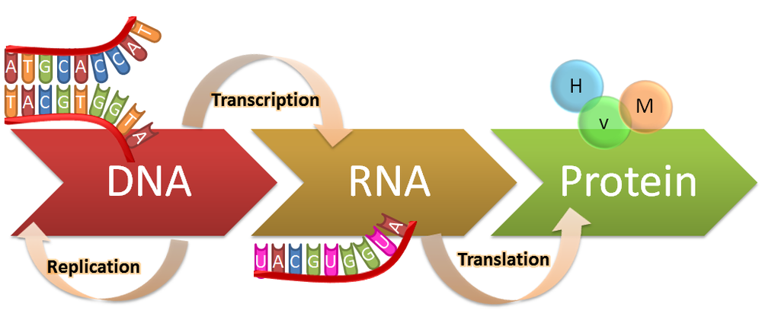
Conti…
As a cell reads the DNA instructions, it builds a protein by adding successive amino acid
Notes:
Experimental—deceleration, disability, supine, mice
Theory—mites, honeybees, identity, probit
Lifespan—primates, etc
Human—self reinforcing, wasp, NBA
Thank
Background
Invasive/Greece/Hawaii
CDFA Medfly panel
Aging research
LBAM
Workshop
Zalom et al
Retreat/Workshop
LMAM see that little changes
New day in science/policy

Slide 17
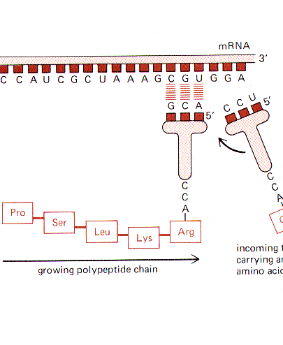
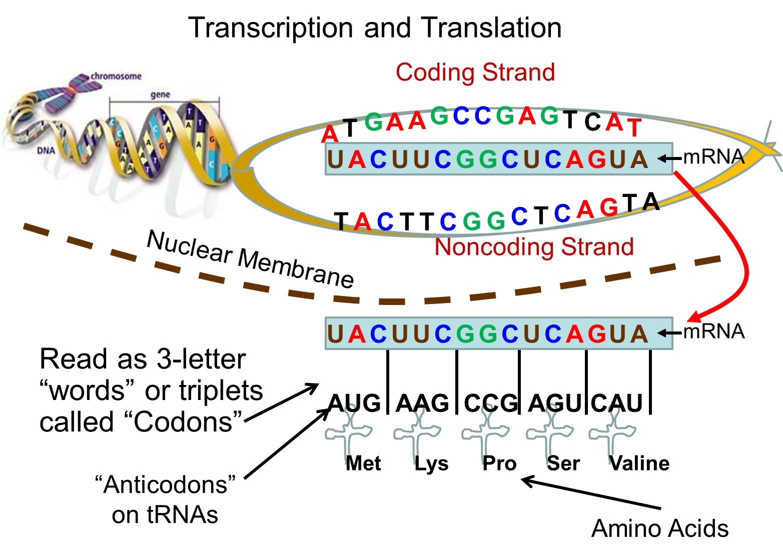
Notes:
Experimental—deceleration, disability, supine, mice
Theory—mites, honeybees, identity, probit
Lifespan—primates, etc
Human—self reinforcing, wasp, NBA
Thank
Background
Invasive/Greece/Hawaii
CDFA Medfly panel
Aging research
LBAM
Workshop
Zalom et al
Retreat/Workshop
LMAM see that little changes
New day in science/policy

