Slide 2
FATS AND OILS
FST-403
B. Sc. (Hons). Food and Science and technology
INSTITUTE OF FOOD SCIENCE AND NUTRITION
UNIVERSITY OF SARGODHA, SARGODHA

Slide 3
LECTURE OUTLINE
Rendering of fats
Introduction
Types
Process
Advantages

Slide 4
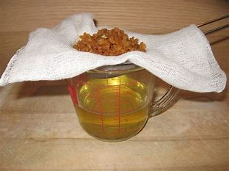
RENDERING OF FATS
Rendering is a process that converts waste animal tissue into stable, usable materials.
Rendering can be carried out on an
Industrial
Farm
kitchen scale
Rendering is carried out to covert whole animal fatty tissue into purified fats like lard or tallow

Slide 5
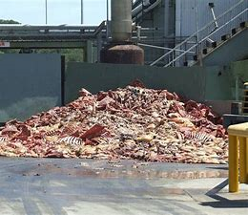
RENDERING
In animal products the majority of tissue processed comes from slaughterhouses and butcher shop trimmings and expired meat from grocery stores.
The most common animal sources are beef, mutton and poultry
Rendering plants often also handle other
materials, such as slaughterhouse blood, feathers and hair

Slide 6
RENDERING
The rendering process varies in a number of ways:
Whether the end products are used as human or animal food depends on the quality of input material and the processing methods and equipment
The material may be processed by wet or dry means. In wet processing, either boiling water or steam is added to the material, separating fat into a floating phase. In dry processing, fat is released by dehydrating the raw material
The temperature range used may be high or low
Rendering may be done either in discrete batches or in a continuous process
The processing plant may be operated by an independent company that buys input material from suppliers, or by a packing plant that produces the material in-house

Slide 7
RENDERING
Rendering
Dry rendering
Soaps
Candles
Wet rendering
Tallow

Slide 8
WET RENDERING/EDIBLE RENDERING
Edible rendering processes are basically meat processing operations and produce lard or edible tallow for use in food products.
In this process, a vessel is filled with fatty material with small amount of water and steam is injected to boil the water and displace the air
Vessel is then closed, except for a small vent and steam operation is continued
Agitator/centrifugal force is provided during cooking operation
During this process, fats separates from solid and rises to top
Fat is drawn off and purified

Slide 9
DRY RENDERING/INEDIBLE RENDERING
Dry rendering involves cooking of material at 115C to 120C in agitated, steam jacketed vessels until the moisture is evaporated usually 1.5 hours to 4 hours
No water/steam is injected inside
The cooked material is then screened to drain off free fat either through centrifugation or filtration

Slide 10
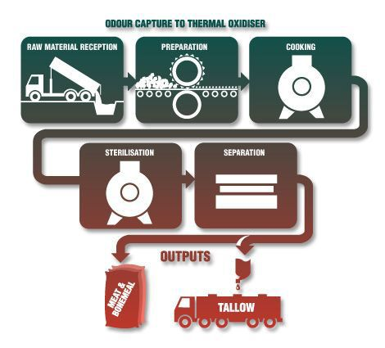
RENDERING

Slide 11
ADVANTAGES RENDERING
Sterilization of animal by-products
The sterilization process kills all forms of microbial life, including transmissible agents. The cooking system sterilizes the animal by-products for it to be save to handle
Production of useful edible and inedible products
The fat can be used in animal feed, pet feed in soap-making, in candles, as a raw material for biodiesel production, and as a feed-stock for the chemical industry
In the steel rolling industry, providing lubrication when compressing steel sheets.

Slide 12
Thank You ☺

